Slide 1
PHP ＆ AJAX

Slide 2
AJAX (XMLHttpRequest)注意事項
AJAX(使用XMLHttpRequest)網頁程式必須經由瀏覽器連線至網站伺服器才能正常執行。
AJAX(使用XMLHttpRequest)網頁程式必須遵守同源政策 (Same origin policy)。
同源是指兩份網頁具備相同協定、埠號以及主機位置。

Slide 3
Same Origin Policy
Client
Server
http://server/path/ajax.html
or
XMLHttpRequest
JSON
or

Slide 4
以政府Open Data應用為例
口罩數量 查詢網頁
口罩數量 查詢網頁
ycchen.im.ncnu.edu.tw
https://data.nhi.gov.tw/resource/mask/maskdata.csv
maskdata.csv
data.nhi.gov.tw

Slide 5
http://ycchen.im.ncnu.edu.tw/www2011/lab/getMask.html
ycchen.im.ncnu.edu.tw
口罩數量 查詢網頁
data.nhi.gov.tw
口罩數量 查詢網頁
XMLHttpRequest
getPuliMask.php
maskdata.csv
https://data.nhi.gov.tw/resource/mask/maskdata.csv

Slide 6
cURL - Client URL Library
https://www.php.net/manual/en/book.curl.php
<?php
$url="https://data.nhi.gov.tw/resource/mask/maskdata.csv";
$ch = curl_init();
curl_setopt($ch, CURLOPT_URL, $url);
// Set so curl_exec returns the result instead of outputting it.
curl_setopt($ch, CURLOPT_RETURNTRANSFER, true);
curl_setopt($ch, CURLOPT_SSL_VERIFYPEER, false);
// Get the response and close the channel.
$maskCsv=curl_exec($ch);
echo $maskCsv;
curl_close($ch);
?>

Slide 7
使用file()讀取外部網站資料
allow_url_fopen = On (in php.ini)
<?php
$url="https://data.nhi.gov.tw/resource/mask/maskdata.csv";
$arr = file($url, FILE_IGNORE_NEW_LINES | FILE_SKIP_EMPTY_LINES);
for ($i=1; $i<count($arr)-1; $i++) {
$maskArr[$i-1]=explode(",", $arr[$i]);
}
…
?>

Slide 8
使用file_get_contents()讀取外部網站資料
Reads entire file into a string
<?php $memo = file_get_contents('memo.txt'); echo $memo; ?>
<?php $homepage = file_get_contents('http://www.example.com/'); echo $homepage; ?>

Slide 9
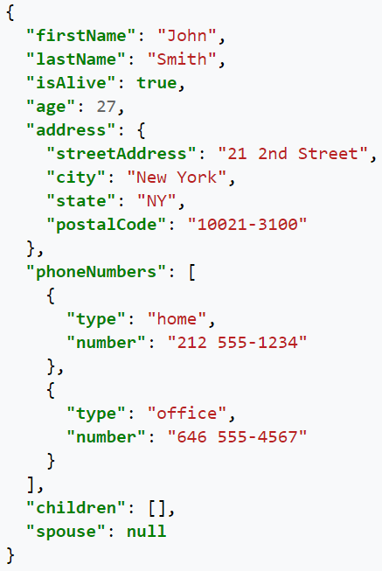
JSON (JavaScript Object Notation)
{ "title":"The Little Prince",
"author":" Antoine de Saint-Exupéry",
"price": 360 }
[
{
"orgId": 5938020079,
"orgName": "仁和藥局",
"address": "南投縣埔里鎮薰化里中山路三段９７號",
"TEL": "(049)2985470",
"maskNumAdult": 2514,
"maskNumChild": 486,
"time": "2020/05/15 12:11:32"
},
{
"orgId": 5938020088,
"orgName": "佳民藥局",
"address": "南投縣埔里鎮薰化里南昌街２８７號",
"TEL": "(049)2987151",
"maskNumAdult": 5328,
"maskNumChild": 935,
"time": "2020/05/15 12:11:32"
},
…
]

Slide 10
json_encode()
https://www.w3schools.com/php/func_json_encode.asp
encode a value to JSON format
json_encode(value, options, depth)
$ageArr = array("Peter"=>35, "Ben"=>37, "Joe"=>43); echo json_encode($ageArr);
{"Peter":35,"Ben":37,"Joe":43}

Slide 11
json_decode()
https://www.w3schools.com/php/func_json_decode.asp
Store JSON data in a PHP variable, and then decode it into a PHP object.
json_decode(string, assoc, depth, options)
assoc:
When set to true, the returned object will be converted into an associative array. When set to false, it returns an object.

Slide 12
[
{Zip5: "10068", City: "臺北市", Area: "中正區", Road: "西藏路", Scope: "雙 140號以下"},
{Zip5: "24147", City: "新北市", Area: "三重區", Road: "自強路１段", Scope: "雙 34號以上"},
…
]
<?php
$url="https://quality.data.gov.tw/dq_download_json.php?nid=5948&md5_url=b7ce2082883f6b680810828799d4c32e";
$json=file_get_contents($url);
$zip5=json_decode($json, true);
$citys=array_column($zip5, "City");
$cityArr=array_values(array_unique($citys));
print_r($cityArr);
?>

