Slide 1
XAMPP設定 - Apache

Slide 2
XAMPP目錄
C:\xampp
網站主目錄
C:\xampp\htdocs
Apache組態檔
C:\xampp\apache\conf\httpd.conf
php組態檔
C:\xampp\php\php.ini
phpMyAdmin
C:\xampp\phpMyAdmin\config.inc.php
MySQL
C:\xampp\mysql

Slide 3
httpd.conf
檔案位置: C:\xampp\apache\conf
# This is the main Apache HTTP …
ServerRoot "C:/xampp/apache"
Listen 80
DocumentRoot "C:/xampp/htdocs"
LoadModule alias_module modules/mod_alias.so
<IfModule alias_module>
…
</IfModule>

Slide 4
Directory
預設目錄設定
<Directory />
AllowOverride none
Require all denied
</Directory>
有存取控制時使用*
Access is denied unconditionally.
AllowOverride 設定為 None:
.htaccess 檔案將被完全略過
需於httpd.conf中使用<Directory>進行設定
AllowOverride 設定為 All:
允許於.htaccess 檔案做各式設定。
* http://httpd.apache.org/docs/2.4/mod/mod_authz_core.html#require

Slide 5
網站主目錄設定
Server Side Includes
<Directory "C:/xampp/htdocs">
Options Indexes FollowSymLinks Includes ExecCGI
AllowOverride All
Require all granted
</Directory>
Execution of CGI scripts
Options:
http://httpd.apache.org/docs/2.4/mod/core.html#options

Slide 6
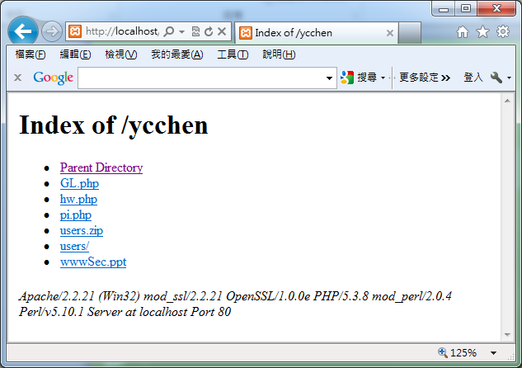
Directory Browsing
Options Indexes

Slide 7
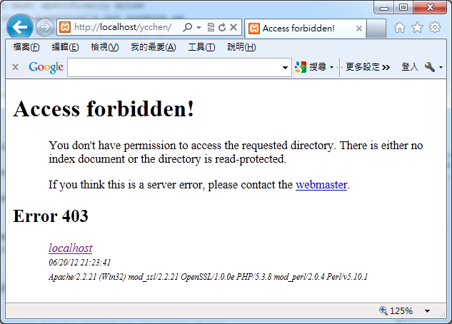
Disable Directory Browsing
從Options中移除’Indexes’

Slide 8
修改httpd.conf
Directory Browsing有安全疑慮！
➔ 建議刪除Indexes
<Directory "C:/xampp/htdocs">
Options Indexes FollowSymLinks Includes ExecCGI
AllowOverride All
</Directory>

Slide 9
AllowOverride
除了httpd.conf組態設定，也可於每個資料夾下的.htaccess檔案設定
AllowOverride 用來指名哪些組態允許於.htaccess檔設定
Example:
AllowOverride All
AllowOverride None
AllowOverride Indexes AuthConfig

Slide 10
.htaccess Example
Options Indexes
AuthType Basic
AuthName "YCChen's Restricted Files"
AuthUserFile C:/xampp/.htpasswd
Require user ycchen
http://httpd.apache.org/docs/2.4/en/howto/auth.html

Slide 11
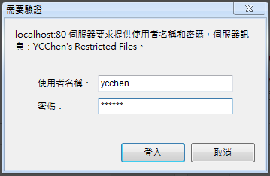
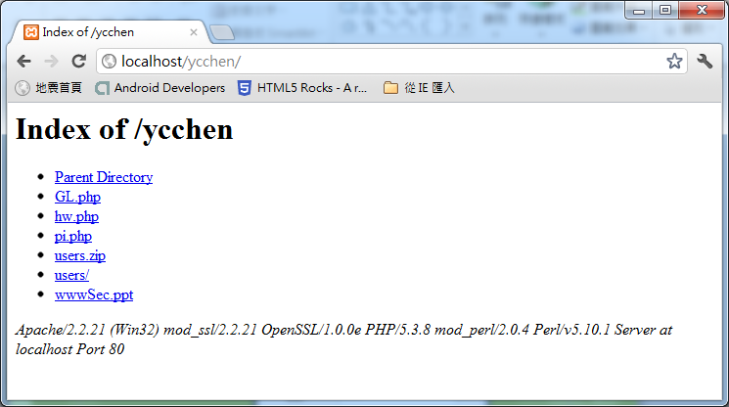

Slide 12
使用htpasswd產生密碼檔
C:\xampp\apache\bin
htpasswd –c 路徑/密碼檔名 使用者名稱
htpasswd –c C:\xampp\.htpasswd ycchen

Slide 13
Alias (別名)
<IfModule alias_module>
# 設定資料夾別名
Alias /php "D:/course/www/php"
#設定網址別名
Alias /class "D:/course/www/php/class/data.php"
</IfModule>
http://localhost/php/hw.php
http://localhost/php/ex1/
http://localhost/class

Slide 14
為有設別名之資料夾設定組態
Alias /php "D:/course/www/php"
<Directory "D:/course/www/php">
AllowOverride None
Options FollowSymLinks
Order allow,deny
Allow from all
#AuthType Basic
#AuthName "Admin Only"
#AuthUserFile C:/xampp/.htpasswd
#Require user ycchen admin
</Directory>

Slide 15
其他設定
<IfModule dir_module>
DirectoryIndex index.php index.pl index.html …
</IfModule>
Include "conf/extra/httpd-xampp.conf"
# 注意一些組態設定在C:\xampp\apache\conf\extra
<Files private.html>
Order allow,deny
Deny from all
</Files>

Slide 16
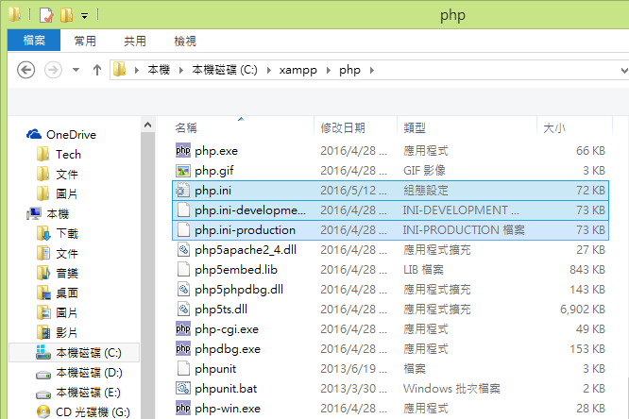
php.ini
C:\xampp\php\

Slide 17
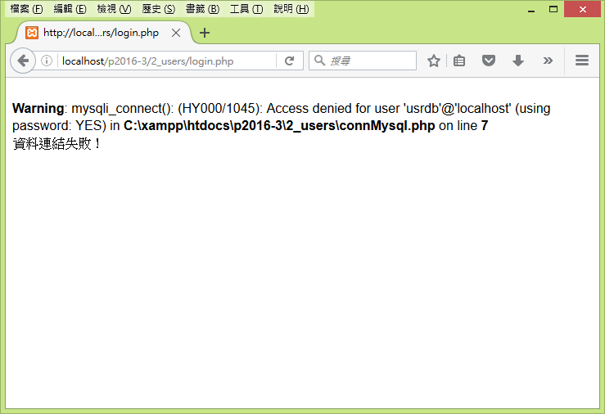
正式上線後，不應再顯示錯誤訊息

Slide 18
改使用php.ini-production
將php.ini-production改名為php.ini 取代原php.ini
error_reporting = E_ALL & ~E_DEPRECATED & ~E_STRICT
display_errors = Off
display_startup_errors = Off
log_errors = On
# 或設定:
error_log="\xampp\php\logs\php_error_log"
# errors 存於 C:\xampp\apache\logs\error.log

