Slide 1
網站開發技術簡介
國立暨南國際大學
資訊管理學系
陳彥錚

Slide 2
大綱
WWW簡介
JavaScript
CSS
其他用戶端Web技術
Server端Web技術
企業網站建置

Slide 3
1. WWW簡介
(1945)Vannevar Bush發表 “As We May Think” (Atlantic Monthly)
  超連結(Hyperlink)
(Mar. 1989)服務於CERN之Tim Berners-Lee發表 “Information Management: A Proposal”
  A client/server model for a distributed hypertext system
CERN: European Organization for Nuclear Research

Slide 4


WWW技術發展
(1990) Tim BL撰寫第一個Web 瀏覽器:
  WorldWideWeb
(Sep. 1993) NCSA發表Mosaic browser.
(Mar. 1994) Marc Andreessen & Jim Clark 開設 Mosaic Communications Corp. (後改名Netscape)
(Dec. 1994) Netscape發表Netscape Navigator
  只支援HTML
NCSA: National Center for Supercomputing Applications

Slide 5
Browser
  Google Chrome
  Firefox
  Safari
  IE/Edge
  Opera, …
Web Server
  Apache
  Nginx
  Microsoft-IIS
  LiteSpeed
  Google Servers, …
Web Browser Statistics:
See Next slide
Web Server Statistics:
https://w3techs.com/technologies/overview/web_server/all
Web Technology Survey:
https://w3techs.com/technologies

Slide 6
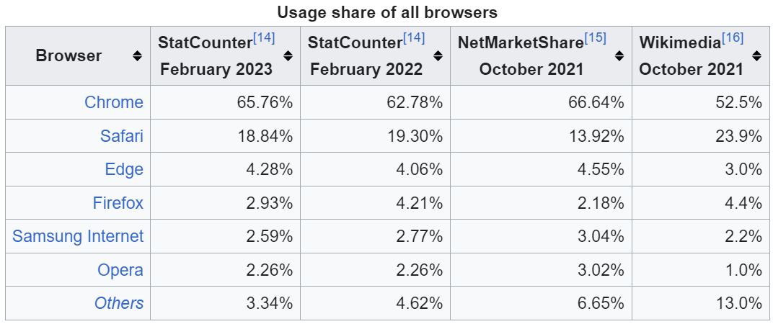
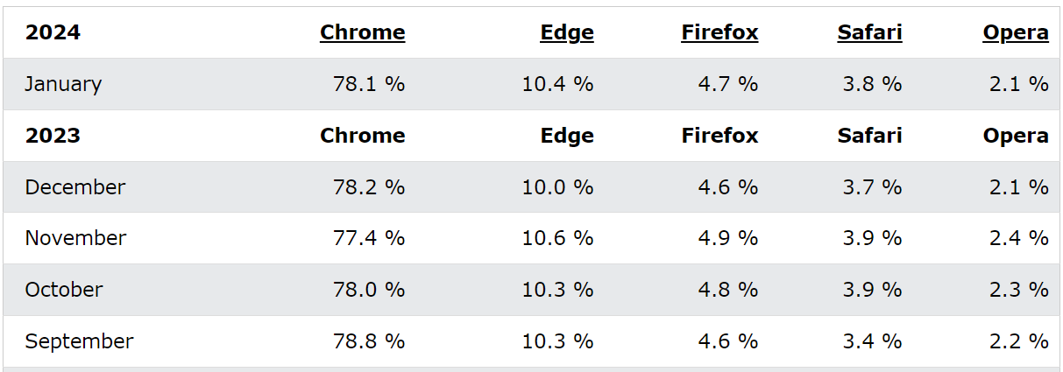
http://en.wikipedia.org/wiki/Usage_share_of_web_browsers
http://www.w3schools.com/browsers/browsers_stats.asp
http://gs.statcounter.com/

Slide 7
HTML and HTTP
Web Server
Application
Browser
1.
HTTP Request
2.
HTTP Response
Web Server
Client PC
HTML Document
Notes:
In HTTP, the browser sends an HTTP request.
The webserver application program sends back an HTTP response message.

Slide 8


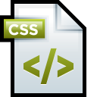










Client
Web Server
Database
Server
Brower
Apache Web Server
phpMyAdmin
php Apps
MySQL

Slide 9
2. JavaScript
(Dec. 1995) Netscape Navigator 2.0支援JavaScript
  可於Brower中解譯執行的程式語言
<script>
for (i=0;i<10;i++) {
document.write("<hr size="+2*i+" width=" + 40*i+" color='red'>");
}
alert("Welcome to JavaScript Test!\nSee you!");
</script>

Slide 10
Advantages of Using JavaScript
Validate user's input.
Perform aggregrate calculations.
Easily prompt a user for confirmation, alert, pop-up information.
Control of Web browser's behaviors and HTML page component's properties.
Conditionalize HTML.
Perform operations independent of server information.
Control of Dynamic HTML.
http://ycchen.im.ncnu.edu.tw/moth/
http://www.w3schools.com/js/js_examples.asp

Slide 11
3. Cascading Style Sheets (CSS)
樣式表 (Stylesheet) 語言
提供網頁設定樣式功能，讓網頁能以更精確與結構化方式顯示網頁版面
Dynamic HTML: JavaScript + CSS
<style>
a {text-decoration:none;}
td {background-color:Ivory;}
ul {list-style-image:url(gball.gif);}
h2 {color:white; background-color:black; font-size:1in}
…
</style>
http://www.w3schools.com/css/default.asp
http://ycchen.im.ncnu.edu.tw/www2011/lab/bf.html

Slide 12
網頁設計應注意事項
兼顧美工與內容
避免使用橫向捲軸
考慮瀏覽器的差異性 (JavaScript, ActiveX, CSS, …)
超連結之正確性
  file:///C:/www/radio.html
  http://192.168.0.1/xx.html

Slide 13
5. Server端Web技術
Common Gateway Interface (CGI)
  Web Server 與 Server端應用程式之介面
Server端Web程式語言
  ASP, JSP, Perl, PHP
Database
  MS SQL Server, MySQL, mSQL, Oracle

Slide 14
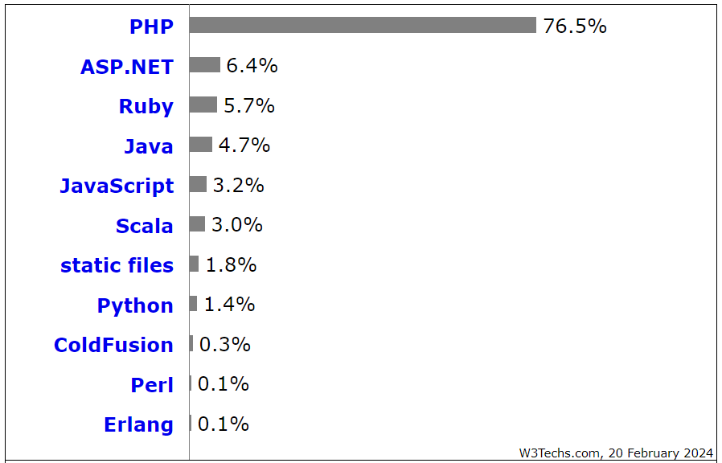
Usage of server-side programming languages for websites
https://w3techs.com/technologies/overview/programming_language/all

