Slide 1
Advanced Computer Networks
Packet Switching vs. Circuit Switching

Slide 2
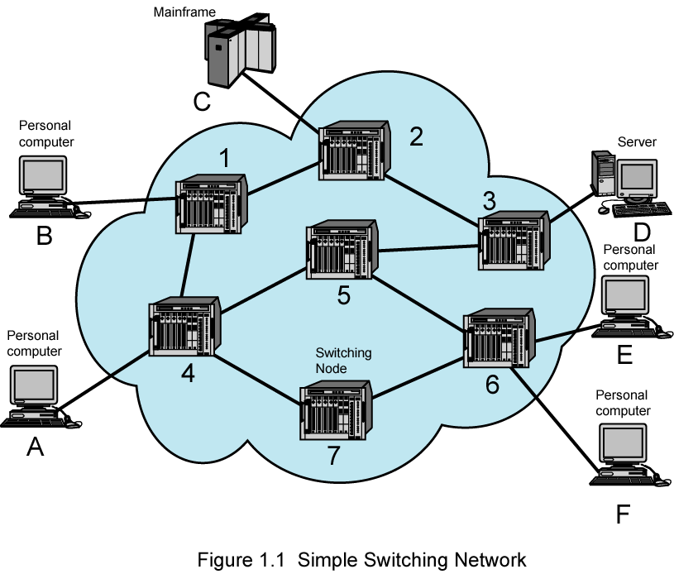
A Simple Switching Network
Node
Station

Slide 3
Data Networks
Communication by transmitting data through a network of intermediate switching nodes
Switching nodes not concerned with content
End devices referred to as stations
Computers, terminals, telephones, etc.
Nodes connected by transmission links (trunks), in some topology.
Station attaches to node (by access links)
Collection of nodes is a communications network

Slide 4
Circuit Switching
Dedicated path between two stations
Connected sequence of links between nodes
E.g telephone network
Communication involves three phases
Circuit establishment
Data transfer
Circuit disconnect

Slide 5
Circuit Establishment
Station A to node 4 requesting connection to station E
Circuit from A to 4 usually dedicated line
Node 4 finds next leg to node 6
Based on routing information, availability, cost, node 4 selects circuit to node 5
Allocates a free channel
TDM [time-division multiplexing]
FDM [frequency-division multiplexing]
Node 4 requests connection to E
And so on
What is Multiplexing ?

Slide 6
Data Transfer
Data may be digital (e.g., terminal to host) or analog (e.g., voice)
Signaling and transmission may each be digital or analog
Path is A-4 circuit, internal switching through 4, 4-5 channel, internal switching through 5, 5-6 channel, internal switching through 6, 6-E circuit
Generally, full duplex (data in both directions)
Data , Signaling, Transmission

Slide 7
Circuit Disconnect
Connection terminated
Usually by one of the stations
Signals to 4, 5, and 6 to de-allocate resources

Slide 8
Circuit Switching - Notes
Connection established before data transmission begins
Channel capacity must be available and reserved.
Nodes must have capacity to handle connection
Switches must have intelligence to make allocations and devise route

Slide 9
Circuit Switching - Notes
Can be inefficient
Capacity dedicated for duration of connection
Even if no data are being transferred
For voice, utilization high, but still doesn’t approach 100%
For terminal connection, may be idle most of the time
Delay prior to data transfer for call establishment
Once circuit established, network transparent to users
Data transmitted at fixed rate
No delay other than propagation
Delay at node negligible

Slide 10
Packet Switching – Circuit Switching Issues
Designed for voice
Resources dedicated to particular call
For voice, high utilization
Most of the time, someone is talking
For data
Line idle much of the time
Constant data rate
Limits interconnection of variety of host computers and terminals

Slide 11
Packet Switching – Basic Operation
Data are transmitted in short blocks, called packets, typical upper bound 1000 octets (bytes)
Longer messages broken up into series of packets
Transmitting computer sends message as sequence of packets.
Packet includes control information including destination station.
Packets sent to node to which sending station attaches
Node stores packet briefly, determines next leg of route, and queues packet to go out on that link
When link is available, packet is transmitted to next node
All packets eventually work their way through network

Slide 12
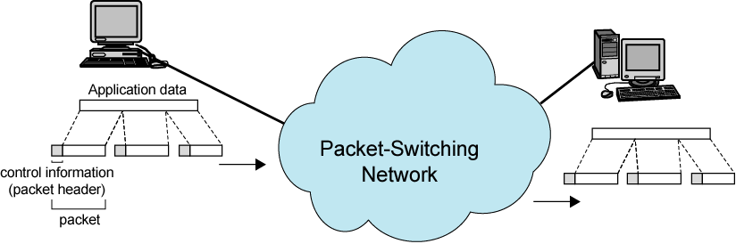
The Use of Packets

Slide 13
Packet Switching – Advantages
Line efficiency greater
Node-to-node link dynamically shared by many packets
Data-rate conversion
Each station connects to its node at its proper data rate
Nodes act as buffers
Packets accepted, even under heavy traffic, but delivery delay increases
Circuit switching networks would block new connections
Priorities can be used

Slide 14
Packet Switching – Disadvantages
Delay
Transmission delay equal to length of packet divided by incoming channel rate
Variable delay due to processing and queuing
Packets may vary in length, take different routes, …
May be subject to varying delays
Overall packet delay can vary substantially (jitter)
Not good for real-time applications like voice and real-time video
Overheads including address of destination, sequencing information added to packet
Reduces capacity available for user data
More processing required at node

Slide 15
Packet Switching Techniques
Datagram
Each packet is treated independently.
Virtual Circuit
Sending packets via a preplanned route, similar to circuit switching.

Slide 16
Switching Technique - Datagram
Datagram: each packet treated independently
No reference to packets that have gone before
Each node chooses next node on path
Packets with same destination address do not follow same route
May arrive out of sequence
Exit node or destination restores packets to original order
Packet may be destroyed in transit
Either exit node or destination detects loss and recovers
Call setup avoided
For an exchange of a few packets, datagram quicker
More flexible.
E.g. Routing away from the congestion
Delivery is inherently more reliable
If a node fails, subsequent packets may be re-routed

Slide 17
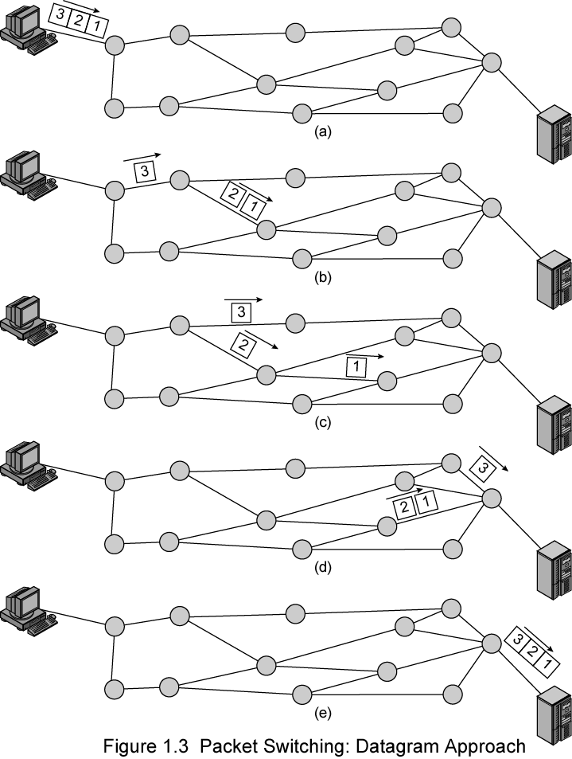
Packet Switching: Datagram Approach

Slide 18
Packet Switching Technique – Virtual Circuit
Preplanned route established before packets sent
All packets follow same route
Similar to circuit in circuit-switching network
Hence virtual circuit
Each packet has virtual circuit identifier
Nodes on route know where to direct packets
No routing decisions
Not dedicated path, as in circuit switching
Packet still buffered at node and queued for output
Routing decision made once for that virtual circuit
Network may provide services related to virtual circuit
Sequencing and error control
Packets should transit more rapidly
If node fails, all virtual circuits through node lost

Slide 19
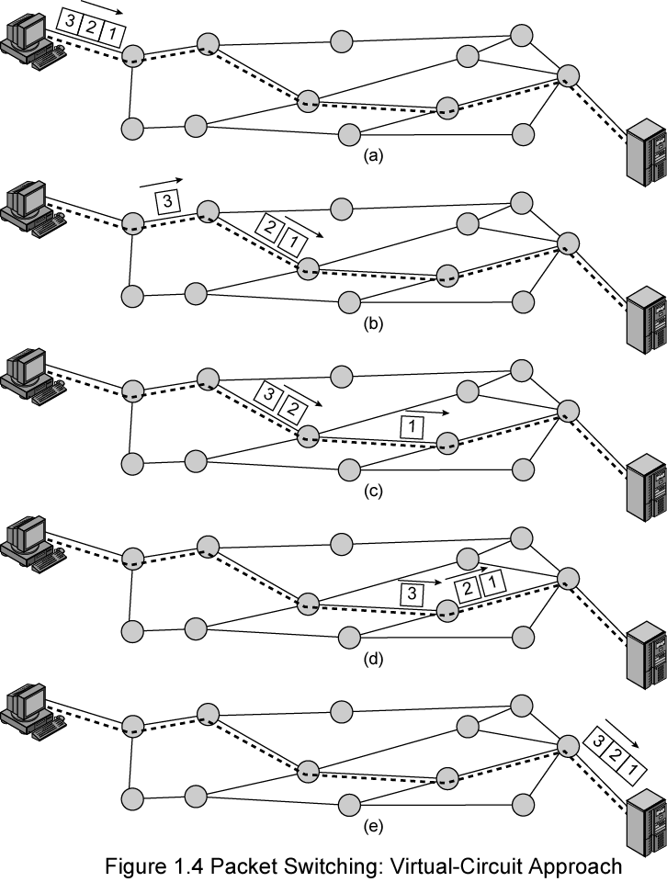
Packet Switching: Virtual-Circuit Approach

Slide 20
Discussion
Data comm. Vs. Voice comm.
What if the Internet is circuit-switching?
What if the telephone network is packet-switching?
The failure of WAP (Wireless Application Protocol)
Internet Telephony vs. PSTN
PSTN: Public Switching Telephone Network

