Slide 1
OSI vs. TCP/IP
想像一下，你是彗星撞地球後的倖存者，
這個世界正待你來重建，你是網路專家，
如果要重新打造一個Internet…

Slide 2
開啟電腦(筆電)，自動連上(無線)網路後，開啟Web Browser， 輸入https://www.im.ncnu.edu.tw/
Which protocols are used?
2. Which network devices/servers are required?

Slide 3
ChatGPT

Slide 4
ChatGPT

Slide 5
Need For Protocol Architecture
File transfer as an example
Source must activate communication path or inform network of destination
Source must check destination is prepared to receive
File transfer application on source must check destination file management system will accept and store file for his user
May need file format translation
Task broken into subtasks
Implemented separately in layers in stack
Functions needed in both systems
Peer layers communicate

Slide 6
Key Elements of a Protocol
The peer layers communicates by means of formatted blocks of data that obey a set of rules and conventions known as a protocol.
Key elements:
Syntax
Format of the data blocks
Signal levels
Semantics
Control information for coordination and error handling
Timing
Speed matching
Sequencing

Slide 7
Protocol Architecture
Task of communication broken up into modules
For example, file transfer could use three modules:
File transfer application
Communication service module
Network access module

Slide 8
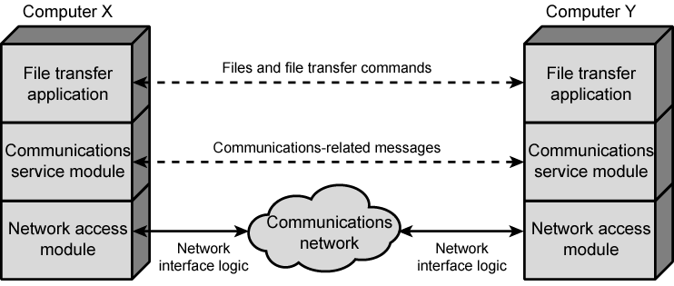
Simplified Architecture for File Transfer

Slide 9
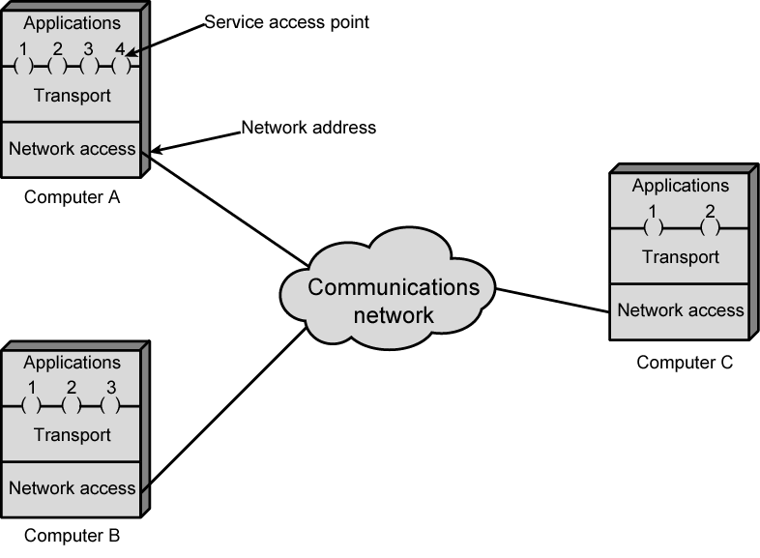
Protocol Architectures and Networks

Slide 10
Addressing Requirements
Two levels of addressing required
Each computer needs unique network address
Each application on a (multi-tasking) computer needs a unique address within the computer
The service access point or SAP
The port on TCP/IP stacks

Slide 11
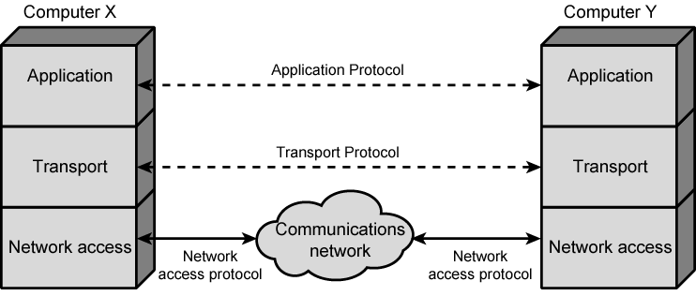
Protocols in Simplified Architecture

Slide 12
Protocol Data Units (PDU)
At each layer, protocols are used to communicate
Control information is added to user data at each layer (PDU = Control + Data)
Transport layer may fragment user data
Each fragment has a transport header added
Destination SAP (port)
Sequence number
Error detection code
This gives a transport protocol data unit

Slide 13
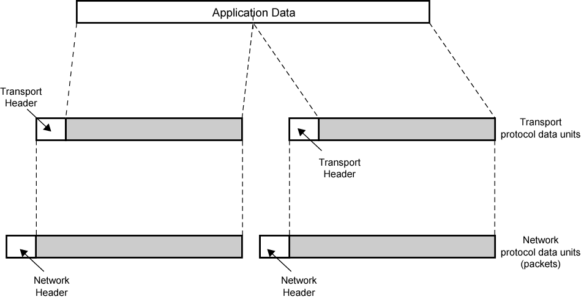
Protocol Data Units, PDUs

Slide 14
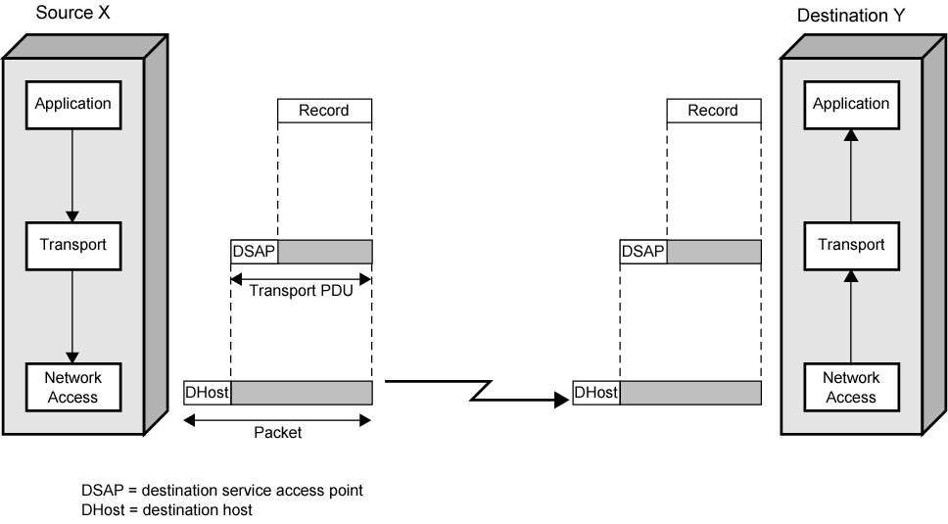
Operation of a Protocol Architecture

Slide 15
Standardized Protocol Architectures
Required for devices to communicate
Vendors have more marketable products
Customers can insist on standards based equipment
Two standards:
OSI Reference model
Never lived up to early promises
TCP/IP protocol suite
Most widely used

Slide 16
OSI
Open Systems Interconnection
Developed by the International Organization for Standardization (ISO)
Seven layers
A theoretical system delivered too late!
TCP/IP is the de facto standard

Slide 17
OSI - The Model
A layer model
Each layer performs a subset of the required communication functions
Each layer relies on the next lower layer to perform more primitive functions
Each layer provides services to the next higher layer
Changes in one layer should not require changes in other layers

Slide 18
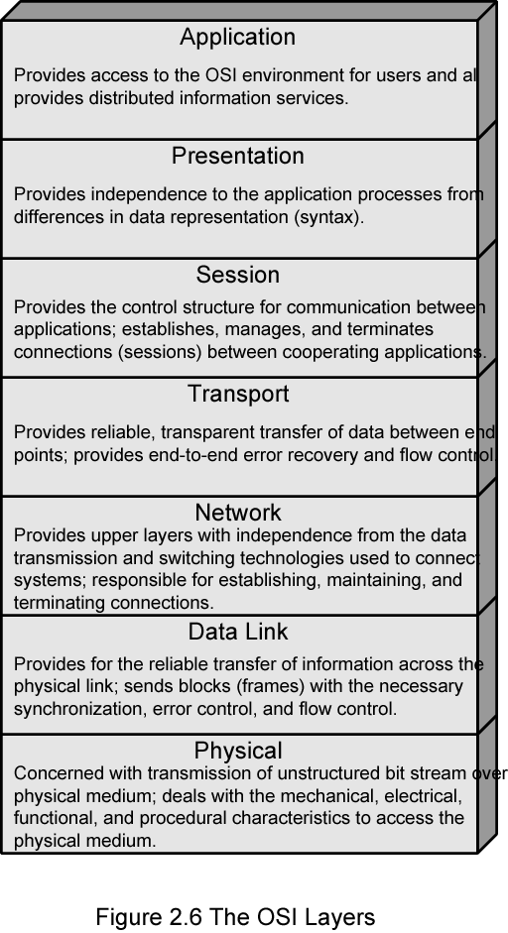
OSI Seven Layers

Slide 19
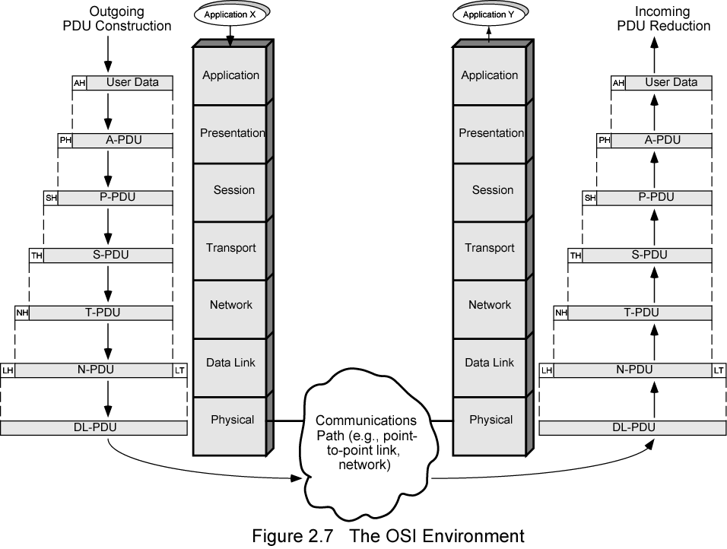
The OSI Environment

Slide 20
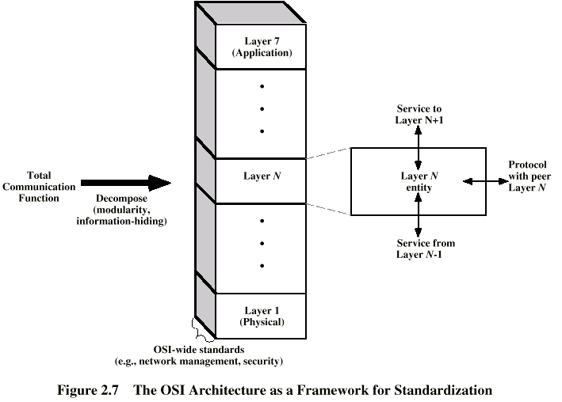
OSI as Framework for Standardization
Service
Protocol

Slide 21
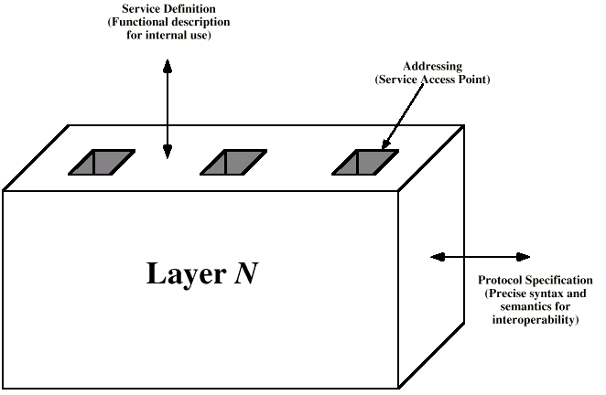
Layer Specific Standards
2
3
1

Slide 22
Elements of Standardization
Protocol specification
Operates between the same layer on two systems
May involve different operating system
Protocol specification must be precise
Format of data units
Semantics of all fields
allowable sequence of PDUs
Service definition
Functional description of what is provided
Addressing
Referenced by SAPs

Slide 23
Service Primitives and Parameters
Services between adjacent layers expressed in terms of primitives and parameters
Primitives specify function to be performed
Parameters pass data and control info

Slide 24
Primitive Types
REQUEST | A primitive issued by a service user to invoke some service and to pass the parameters needed to specify fully the requested service
INDICATION | A primitive issued by a service provider either to: indicate that a procedure has been invoked by the peer service user on the connection and to provide the associated parameters, or notify the service user of a provider-initiated action
RESPONSE | A primitive issued by a service user to acknowledge or complete some procedure previously invoked by an indication to that user
CONFIRM | A primitive issued by a service provider to acknowledge or complete some procedure previously invoked by a request by the service user

Slide 25
Service Primitive Types
Request
Confirm
Indication
Response
Layer N
Layer N

Slide 26
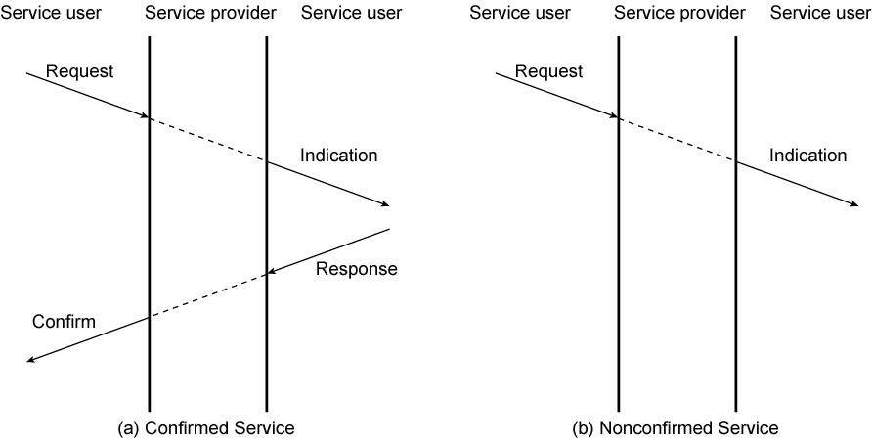
Timing Sequence for Service Primitives

Slide 27
TCP/IP Protocol Architecture
Developed by the US Defense Advanced Research Project Agency (DARPA) for its packet switched network (ARPANET)
Used by the global Internet
No official model but a working one.
Application layer
Transport layer
Internet layer
Data Link layer
Physical layer
(host-to-host)
(Network Access Layer)

Slide 28
Physical Layer
Physical interface between data transmission device (e.g. computer) and transmission medium or network
Characteristics of transmission medium
Signal levels
Data rates
etc.

Slide 29
Network Access Layer
Exchange of data between end system and network
Destination address provision
Invoking services like priority
Internet Layer (IP)
Systems may be attached to different networks
Routing functions across multiple networks
Implemented in end systems and routers

Slide 30
Transport Layer (TCP)
Reliable delivery of data
Ordering of delivery
Application Layer
Support for user applications
e.g. HTTP, SMTP

Slide 31
OSI v TCP/IP
Internet
Standards
IEEE
ISO
ITU-T

Slide 32
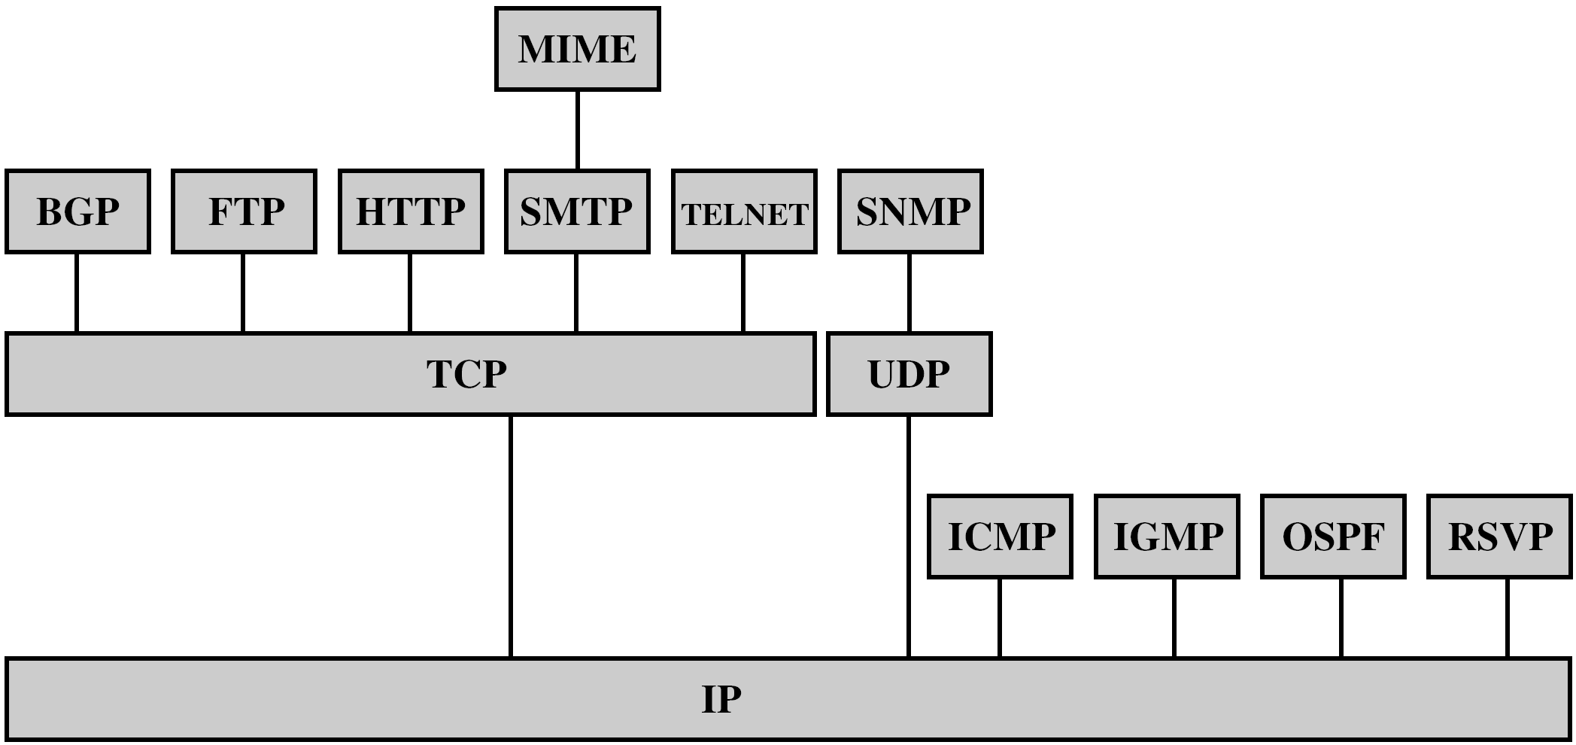
Some Protocols in TCP/IP Suite

Slide 33
TCP
Usual transport layer is Transmission Control Protocol
Reliable connection
Connection
Temporary logical association between entities in different systems
TCP PDU
Called TCP segment
Includes source and destination port (c.f. SAP)
Identify respective users (applications)
Connection refers to pair of ports
TCP tracks segments between entities on each connection

Slide 34
UDP
Alternative to TCP is User Datagram Protocol
Not guaranteed delivery
No preservation of sequence
No protection against duplication
Minimum overhead
Adds port addressing to IP

Slide 35
IP and IPv6
IP (v4) header
minimum 20 octets (160 bits)
32-bit source and destination addresses
Checksum applies to header to avoid incorrect delivery
Protocol field shows if TCP, UDP etc. carried
Flags and fragmentation offset used in fragmentation
IPv6
1995 IPng became standard IPv6 in 1996
Enhancements for modern high speed networks
Carry multimedia data streams
Increase address space (128 bits)

Slide 36
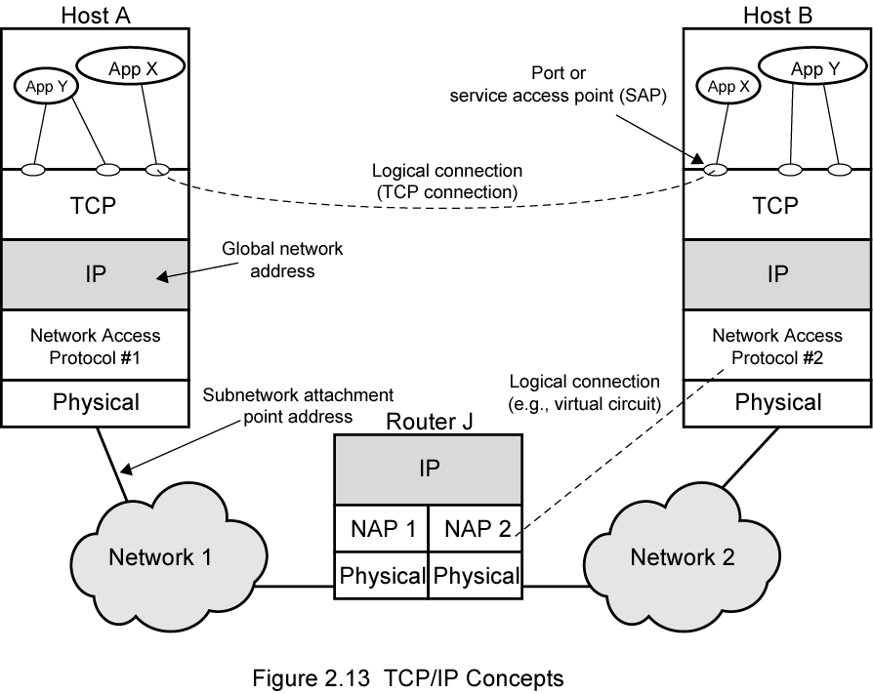
TCP/IP Concepts

Slide 37
Addressing level
Level in architecture at which entity is named
Unique address for each end system (computer) and router
Network level address
IP or internet address (TCP/IP)
Network service access point or NSAP (OSI)
Process within the system
Port number (TCP/IP)
Service access point or SAP (OSI)

Slide 38
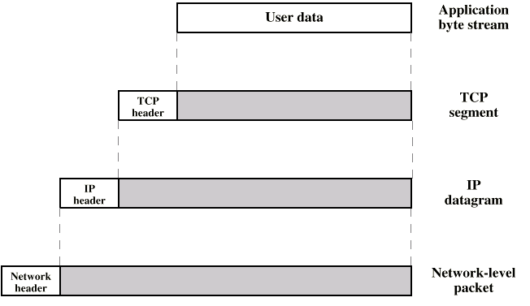
PDUs in TCP/IP

Slide 39
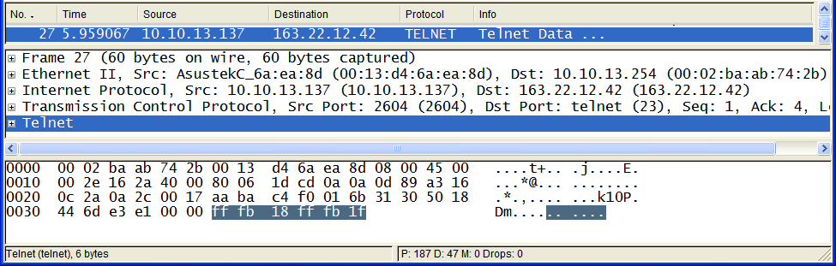
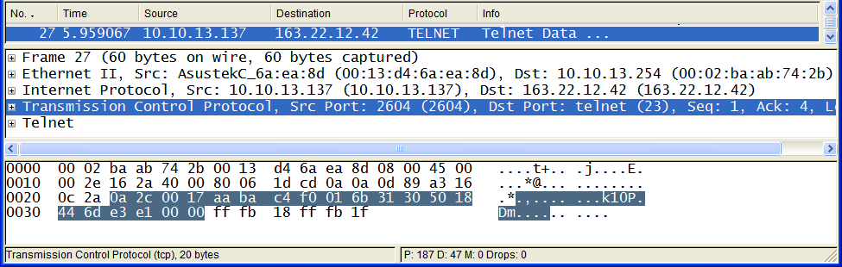
Telnet Data
TCP Header + Telnet Data

Slide 40
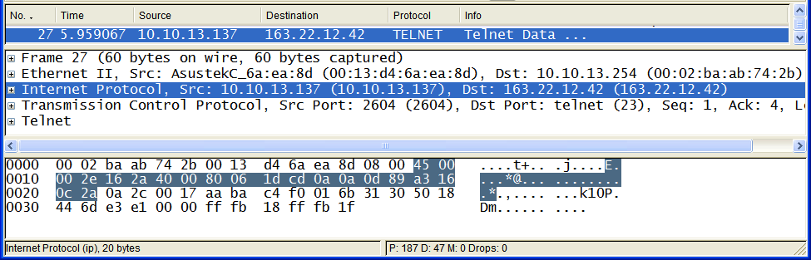
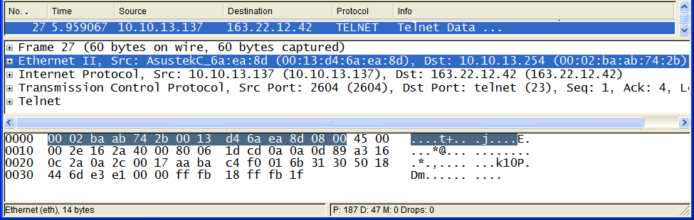
IP Header + TCP Header + Telnet Data
Ethernet Frame Header + IP Header + TCP Header + Telnet Data

Slide 41
Example Header Information
Destination port
Sequence number
Checksum

Slide 42
Internetworking
Most networks not isolated
Different types of LAN
Multiple similar LANs
Multiple sites connected by WAN(s)
May appear as large network
Entire configuration referred to as an internet
Each constituent network is a subnetwork

Slide 43
Internetworking Devices
Each subnetwork supports communication among devices attached to that subnetwork
End systems (ESs)
Subnetworks connected by intermediate systems (ISs)
Provide communications path and relay and routing functions
Bridges and routers
Different types of protocols used
Bridge operates at layer 2
Relay between like networks
Router operates at layer 3
Routes packets between potentially different networks

Slide 44
Routers
Interconnect dissimilar subnetworks
Provide a link between networks
Provide for routing and delivery of data between processes on end systems attached to different networks
Do not require modifications of architecture of subnetworks
Must accommodate differences among networks
Addressing schemes
Maximum packet sizes
Interfaces
Reliability
Satisfied by internetworking protocol implemented in all end systems and routers
IP

Slide 45
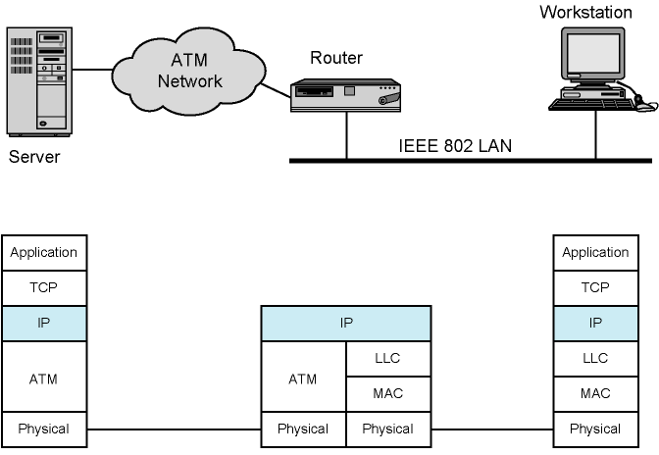
Configuration for TCP/IP Example
ATM: Asynchronous Transfer Mode

Slide 46
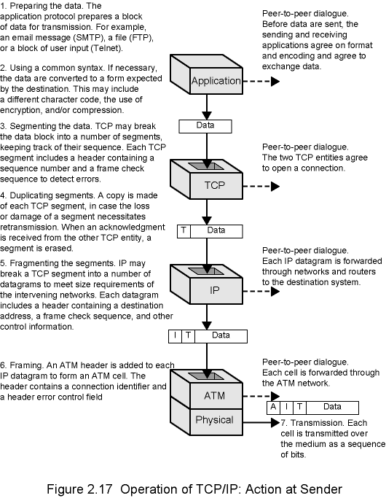
Action of Sender

Slide 49
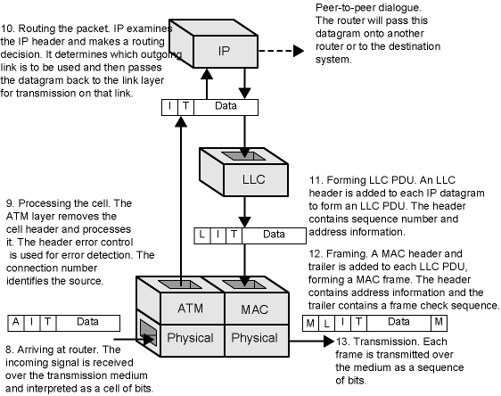
Action of Router

Slide 50
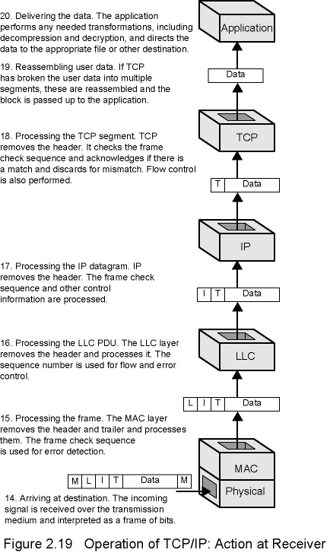
Action of Receiver

Slide 53
Internetworking Terminology
End System (ES)
Device attached to one of the networks of an internet
Supports end-user applications or services
Intermediate System (IS)
Device used to connect two networks
Permits communication between ES attached to different networks
Bridge
IS used to connect two LANs that use similar protocols
Address filter
Does not modify packets
Layer 2 of the OSI model
Router
IS used to connect two networks that may or may not be similar
Uses an internet protocol present in each router and each end system of the network
Layer 3 of the OSI model
"Switch" can be regarded as a multiport bridge.

