Slide 1
Chapter 03
Traditional Applications

Slide 2
Traditional Applications
Terminal Access – Telnet
File Transfer – FTP
Electronic Mail
  SMTP
  MIME
  POP3

Slide 3
File Transfer - FTP
File Transfer Protocol, RFC 959
TCP Ports: 20: Data, 21: Control
Objectives:
  Promote sharing of files
  Encourage indirect or implicit use of remote computers
  Shield user from variations in file storage systems
  Transfer data reliably and efficiently
Anonymous FTP
  User: anonymous
  Password: guest or your e-mail address

Slide 4
FTP Model

Slide 5
FTP User Commands
! delete literal prompt send
? debug ls put status
append dir mdelete pwd trace
ascii disconnect mdir quit type
bell get mget quote user
binary glob mkdir recv verbose
bye hash mls remotehelp
cd help mput rename
close lcd open rmdir

Slide 6
C:\>ftp ftp.ncnu.edu.tw
Connected to ftp4.ncnu.edu.tw.
220 Welcome to NCNU FTP service.
User (ftp4.ncnu.edu.tw:(none)): anonymous
331 Please specify the password.
Password:
230 Login successful.
ftp> dir
200 PORT command successful. Consider using PASV.
150 Here comes the directory listing.
drwxr-xr-x 2 503 503 4096 Feb 03 2006 Application
drwxr-xr-x 8 503 503 4096 Apr 05 2006 Documentation
drwxr-xr-x 17 503 503 4096 Oct 04 05:20 FreeBSD
drwxr-xr-x 19 503 503 4096 Feb 05 2006 JavaDownload
-rw-r--r-- 1 503 503 5327 Apr 22 04:04 index.html
226 Directory send OK.
ftp: 684 bytes received in 0.00Seconds 684000.00Kbytes/sec.
ftp> ascii
200 Switching to ASCII mode.
ftp> get index.html
200 PORT command successful. Consider using PASV.
150 Opening BINARY mode data connection for index.html (5327 bytes).
226 File send OK.
ftp: 5327 bytes received in 0.01Seconds 355.13Kbytes/sec.
ftp> bye
221 Goodbye.

Slide 7
Electronic Mail
Most heavily used application on any network
Simple Mail Transfer Protocol (SMTP)
  TCP/IP
  Delivery of simple text messages
Multi-purpose Internet Mail Extension (MIME)
  Delivery of other types of data
  Voice, images, video clips

Slide 8
SMTP
RFC 821
Not concerned with format of messages or data
  Covered in RFC 822 (see later)
SMTP uses info written on envelope of mail
  Message header
Does not look at contents
  Message body
Except:
  Standardize message character set to 7 bit ASCII
  Add log info to start of message
    Shows path taken

Slide 9
Basic Operation
Mail created by user agent program (mail client)
  Message consists of:
    Header containing recipient’s address and other info
    Body containing user data
Messages queued and sent as input to SMTP sender program
  Typically a server process (daemon on UNIX)

Slide 10
Mail Message Contents
Each queued message has:
  Message text
    RFC 822 header with message envelope and list of recipients
    Message body, composed by user
  A list of mail destinations
    Derived by user agent from header
    May be listed in header
    May require expansion of mailing lists
    May need replacement of mnemonic names with mailbox names
If BCCs (Blind Carbon Copies) indicated, user agent needs to prepare correct message format

Slide 11
SMTP Sender
Takes message from queue
Transmits to proper destination host
  Via SMTP transaction
  Over one or more TCP connections to port 25
Host may have multiple senders active
Host should be able to create receivers on demand
When delivery complete, sender deletes destination from list for that message
When all destinations processed, message is deleted

Slide 12
Optimization
If message destined for multiple users on a given host, it is sent only once
  Delivery to users handled at destination host
If multiple messages ready for given host, a single TCP connection can be used
  Saves overhead of setting up and dropping connection

Slide 13
Possible Errors
Host unreachable
Host out of operation
TCP connection fail during transfer
Sender can re-queue mail
  Give up after a period
Faulty destination address
  User error
  Target user changed address
  Redirect if possible
  Inform user if not

Slide 14
SMTP Protocol - Reliability
Used to transfer messages from sender to receiver over TCP connection
Attempts to provide reliable service
No guarantee to recover lost messages
No end to end acknowledgement to originator
Error indication delivery not guaranteed
Generally considered reliable

Slide 15
SMTP Receiver
Accepts arriving message
Places in user mailbox or copies to outgoing queue for forwarding
Receiver must:
  Verify local mail destinations
  Deal with errors
    Transmission
    Lack of disk space
Sender responsible for message until receiver confirm complete transfer
  Indicates mail has arrived at host, not user

Slide 16
SMTP Forwarding
Mostly direct transfer from sender host to receiver host
May go through intermediate machine via forwarding capability
  Sender can specify route
  Target user may have moved

Slide 17
Conversation
SMTP limited to conversation between sender and receiver
Main function is to transfer messages
Rest of mail handling beyond scope of SMTP
  May differ between systems

Slide 18
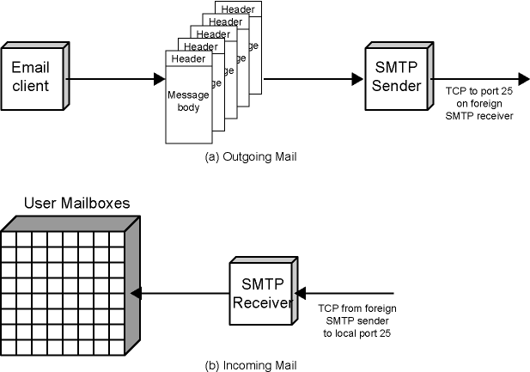
Figure 3.9 SMTP Mail Flow

Slide 19
SMTP System Overview
Commands and responses between sender and receiver
Initiative with sender
  Establishes TCP connection
Sender sends commands to receiver
e.g. HELO<SP><domain><CRLF>
Each command generates exactly one reply
e.g. 250 requested mail action ok; completed

Slide 20
SMTP Replies
Leading digit indicates category
  Positive completion reply (2xx)
  Positive intermediate reply (3xx)
  Transient negative completion reply (4xx)
  Permanent negative completion reply (5xx)

Slide 21
Operation Phases
Connection setup
Exchange of command-response pairs
Connection termination

Slide 22
Connection Setup
Sender opens TCP connection with receiver
Once connected, receiver identifies itself
  220 <domain> service ready
Sender identifies itself
  HELO
Receiver accepts sender’s identification
  250 OK
If mail service not available, step 2 above becomes:
  421 service not available

Slide 23
Mail Transfer
Sender may send one or more messages to receiver
MAIL command identifies originator
  Gives reverse path to used for error reporting
  Receiver returns 250 OK or appropriate fail/error message
One or more RCPT commands identifies recipients for the message
  Separate reply for each recipient
DATA command transfers message text
  End of message indicated by line containing just period (.)

Slide 24
Closing Connection
Two steps
Sender sends QUIT and waits for reply
Then initiate TCP close operation
Receiver initiates TCP close after sending reply to QUIT

Slide 25
SMTP Commands
<SP> = space
<CRLF> = carriage return, Line feed
ASCII codes: 13 (0D), 10 (0A)

Slide 26
Sample SMTP Exchange
S: HELO pc-ycc
R: 250 euler.im.ncnu.edu.tw Hello …, pleased
to meet you
S: MAIL FROM: Smith@Alpha.ARPA
R: 250 OK
S: RCPT TO: Jones@Beta.ARPA
R: 250 OK
S: RCPT TO: Green@Beta.ARPA
R: 550 No such user here
S: DATA
R: 354 Start mail input; end with <CRLF>.<CRLF>
S: Blah blah blah…
S: etc. etc. etc.
S: <CRLF>.<CRLF>
R: 250 OK
S: QUIT

Slide 27
使用 Telnet 測試 SMTP 通訊
如何使用 Telnet 來測試 SMTP 通訊
手動 telnet SMTP 寄信、手動telnet POP3 收信

Slide 28
Format for Text Messages
RFC 822
Message viewed as having envelope and contents
Envelope contains information required to transmit and deliver message
Message is sequence of lines of text
  Uses general memo framework
  Header usually keyword followed by colon followed by arguments

Slide 29
Internet Message Format
RFC 5322
Messages are made up of characters in the US-ASCII range of 1 through 127.
Messages are divided into lines of characters, delimited with CRLF.
Each line of characters MUST be no more than 998 characters, and SHOULD be no more than 78 characters, excluding the CRLF.
A message consists of header fields (header) followed, optionally, by a body.
Body is separated from the header section by an empty line.
Header fields are lines beginning with a field name, followed by a colon (":"), followed by a field body, and terminated by CRLF.
https://datatracker.ietf.org/doc/html/rfc5322

Slide 30
Header
Received: By OpenMail Mailer;Mon, 16 Oct 2006 09:32:54 +0800 (CST)
From: "Yen-Cheng Chen" <ycchen@ncnu.edu.tw>
Reply-To: ycchen@ncnu.edu.tw
Subject: RFC 822 Header Example
Message-ID: <1160962374.7261.ycchen@ncnu.edu.tw>
To: ycchen@im.ncnu.edu.tw,"Yen-Cheng Chen" <ycchen@ncnu.edu.tw>
Date: Mon, 16 Oct 2006 09:32:54 +0800 (CST)
MIME-Version: 1.0
Return-Path: ycchen@ncnu.edu.tw
Disposition-Notification-To: "Yen-Cheng Chen" <ycchen@ncnu.edu.tw>
X-Priority: 1
X-MSMail-Priority: High
Content-Type: text/plain; charset=big5
Content-Transfer-Encoding: quoted-printable
Dear Professor Chen:
…

Slide 31
smtpClient.java
http://ycchen.im.ncnu.edu.tw/net2011/smtpClient.java
import java.io.*;
import java.net.*;
public class smtpClient {
public static void main(String[] args) {
Socket smtpSocket = null;
DataOutputStream os = null;
DataInputStream is = null;
BufferedReader br = null;
String responseLine;
try {
smtpSocket = new Socket("smtp.ncnu.edu.tw", 25);
os = new DataOutputStream(smtpSocket.getOutputStream());
is = new DataInputStream(smtpSocket.getInputStream());
br = new BufferedReader(new InputStreamReader(is));
} catch (UnknownHostException e) {
System.err.println("Don't know about host: hostname");
} catch (IOException e) {
System.err.println("Couldn't get I/O for the connection to: smtp.ncnu.edu.tw");
}

Slide 32
if (smtpSocket != null && os != null && is != null) {
try {
os.writeBytes("HELO\n");
os.writeBytes("MAIL FROM: sender@ncnu.edu.tw\n");
os.writeBytes("RCPT TO: receiver@ncnu.edu.tw\n");
os.writeBytes("DATA\n");
os.writeBytes("From: sender@ncnu.edu.tw\n");
os.writeBytes("To: receiver@ncnu.edu.tw\n");
os.writeBytes("Subject: A test mail\n\n");
os.writeBytes("Dear Professor Chen,\n\n"); // message body
os.writeBytes("How are you?\n"); // message body
os.writeBytes("Best regards,\n\nFred\n"); // message body
os.writeBytes("\r\n.\r\n");
os.writeBytes("quit\n");
while ((responseLine = br.readLine()) != null) {
System.out.println("Server: " + responseLine);
}
os.close();
br.close();
is.close();
smtpSocket.close();
} catch (UnknownHostException e) {
System.err.println("Trying to connect to unknown host: " + e);
} catch (IOException e) {
System.err.println("IOException: " + e);
}
}
}
}

Slide 33
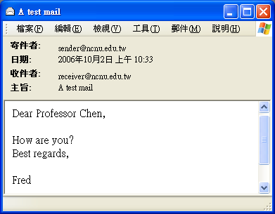
C:\Java>javac smtpClient.java
C:\Java>java smtpClient
Server: 220 sunday.ncnu.edu.tw ESMTP Service(NCNU EMail Ver. 0.3) ready Mon, 02 Oct 2006 10:32:32 +0800 (CST)
Server: 250 sunday.ncnu.edu.tw
Server: 250 Sender <sender@ncnu.edu.tw> OK
Server: 250 Recipient <receiver@ncnu.edu.tw> OK
Server: 354 Please start mail input.
Server: 250 Mail queued for delivery.
Server: 221 Closing connection. Good bye.

Slide 34
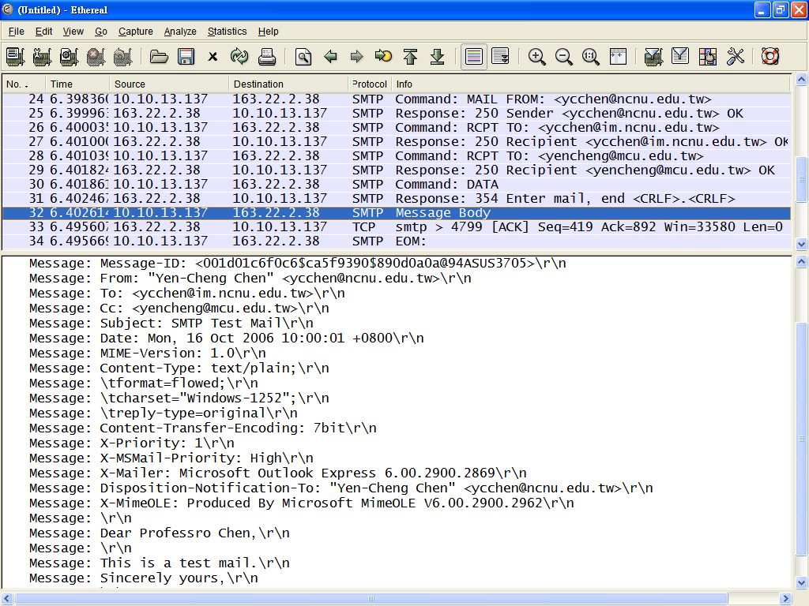

Slide 35
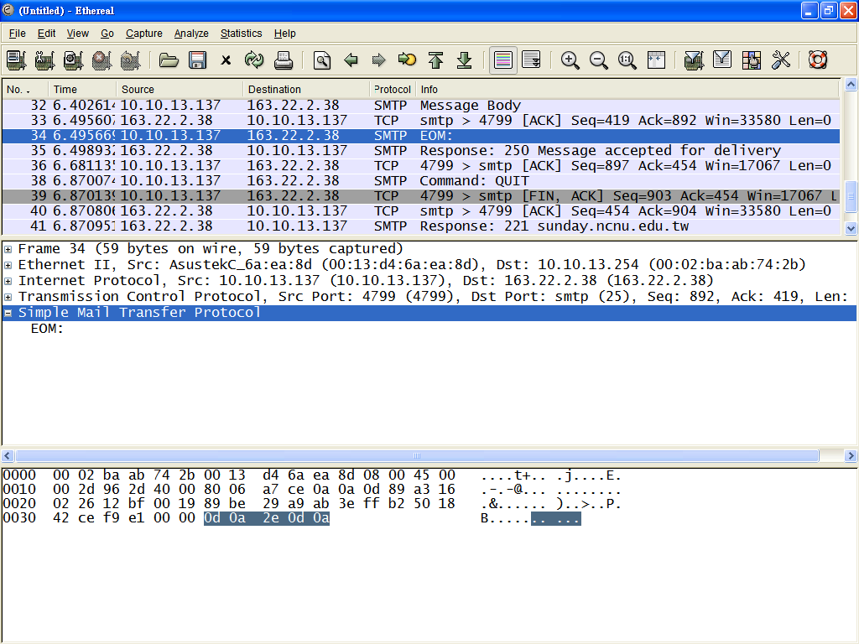

Slide 36
Multipurpose Internet Mail Extension (MIME)
Extension to RFC822
SMTP can not transmit executables
  Uuencode and other schemes are available
    Not standardized
Can not transmit text including international characters (e.g. â, å, ä, è, é, ê, ë)
  Need 8 bit ASCII
Servers may reject mail over certain size
Translation between ASCII and EBCDIC not standard
SMTP gateways to X.400 can not handle none text data in X.400 messages
Some SMTP implementations do not adhere to standard
  CRLF, truncate or wrap long lines, removal of white space, etc.

Slide 37
Overview of MIME
Five new message header fields
  MIME version
  Content type
  Content transfer encoding
  Content Id
  Content Description
Number of content formats defines
Transfer encoding defined

Slide 38
Content Types
Text
  Plain
Multipart
  Mixed, Parallel, Alternative, Digest
Message
  RFC 822, Partial, External-body
Image
  jpeg, gif
Video
  mpeg
Audio
  Basic
Application
  Postscript
  octet stream

Slide 39
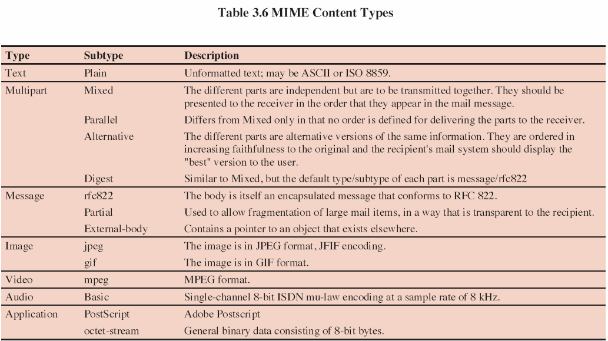

Slide 40
multipart/mixed
https://ycchen.im.ncnu.edu.tw/AdvNet/TestMIME.eml
...
From: "Yen-Cheng Chen" <ycchen@ncnu.edu.tw>
To: <ycchen@im.ncnu.edu.tw>
Subject: test mail!
Date: Wed, 22 May 2002 14:27:07 +0800
MIME-Version: 1.0
Content-Type: multipart/mixed;
boundary="----=_NextPart_000_0047_01C2019E.69F32C40"
Status:
This is a multi-part message in MIME format.
------=_NextPart_000_0047_01C2019E.69F32C40
Content-Type: text/plain; charset="big5"
Content-Transfer-Encoding: 7bit
Start of Body!
Yen-Cheng
------=_NextPart_000_0047_01C2019E.69F32C40
Content-Type: text/plain; name="a.txt"
Content-Transfer-Encoding: 7bit
Content-Disposition: attachment;
filename="a.txt“
This is the first and only one line of the file.
------=_NextPart_000_0047_01C2019E.69F32C40--

Slide 41
Content-Transfer-Encoding
Reliable delivery across wide range of environments
Content transfer encoding field
  Six values
  Three (7bit, 8bit, binary) no encoding done
    Provide info about nature of data
Quoted-printable
  Data largely printable ASCII characters
  Non-printing characters represented by hex code
Base64
  Maps arbitrary binary input onto printable output
X-token
  Named nonstandard encoding

Slide 42
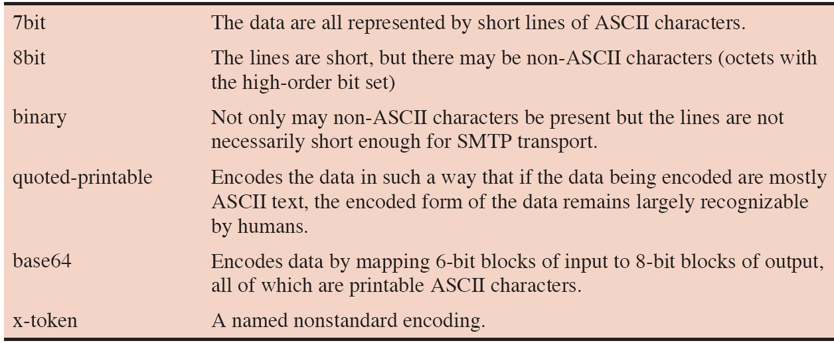

Slide 43
Content-Transfer-Encoding
Content-Transfer-Encoding: base64
24 bits
0
0
0
0
0
0
0
0
Radix-64
0~63 ➔ A~Za~z0~9+/
32 bits

Slide 45
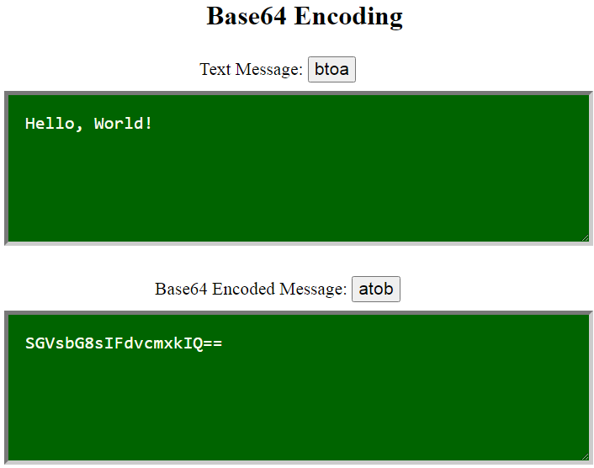
Base64 Encoding/Decoding
JavaScript btoa( ) and atob( ) functions
http://ycchen.im.ncnu.edu.tw/AdvNet/base64.html

Slide 46
Quoted-printable
Content-Type: text/plain; charset="big5"
Content-Transfer-Encoding: quoted-printable
一年=365天
=A4@=A6~=3D365=A4=D1
暨南大學
=BA[=ABn=A4j=BE=C7
X=Y
X=3DY

Slide 47
Quoted-Printable encoder/decoder
https://mothereff.in/quoted-printable
PHP
quoted_printable_encode( )
  https://www.php.net/manual/en/function.quoted-printable-encode.php
quoted_printable_decode( )
  https://www.php.net/manual/en/function.quoted-printable-decode.php

Slide 48
Discussion
Open Mail Relay
Junk mail
Virus Spreading via mails
Mail Security: authentication, privacy, integrity,…
MIME applications
  .mht (mht file format for Web pages)
  MMS, WAP Push Messages, …
Developing mail applications

Slide 49
POP3
Post Office Protocol - Version 3
RFC 1939 / Std 53
To retrieve emails from server (POP3 server)
Three states
  Authorization State
  Transaction State
  Update State

Slide 50
POP3 Commands
Authorization State
  USER username
  PASS password
  APOP name digest
Transaction State
  STAT
  LIST [msgNo]
  RETR msgNo
  DELE msgNo
  NOOP
  RSET
  TOP msgNo line
  UIDL [msgNo]
Update State
  QUIT

Slide 51
S: +OK POP3 server ready <1896.697170952@dbc.mtview.ca.us>
C: USER mrose
S: +OK User name accepted, password please
C: PASS pwd999
S: +OK Mailbox open, 2 messages (320 octets)
C: STAT
S: +OK 2 320
C: LIST
S: +OK 2 messages (320 octets)
S: 1 120
S: 2 200
S: .
C: RETR 1
S: +OK 120 octets
S: <the POP3 server sends message 1>
S: .
C: DELE 1
S: +OK message 1 deleted
C: QUIT
S: +OK dewey POP3 server signing off (maildrop empty)

Slide 52
delSpam.java (1/4)
https://ycchen.im.ncnu.edu.tw/AdvNet/delSpam.java
C:\java>javac delSpam.java
C:\java>java delSpam password
import java.io.*;
import java.net.*;
public class delSpam {
public static void main(String[] args) {
Socket popSocket = null;
DataOutputStream os = null;
DataInputStream is = null;
BufferedReader br = null;
String responseLine;
try {
popSocket = new Socket(“pop3.ncnu.edu.tw", 110);
os = new DataOutputStream(popSocket.getOutputStream());
is = new DataInputStream(popSocket.getInputStream());
br = new BufferedReader(new InputStreamReader(is));
} catch (UnknownHostException e) {
System.err.println("Don't know about host: hostname");
} catch (IOException e) {
System.err.println("Couldn't get I/O for the connection to: pop.ncnu.edu.tw");
}

Slide 53
delSpam.java (2/4)
yourUserName@ncnu.edu.tw
if (popSocket != null && os != null && is != null) {
try {
System.out.println("Server: "+ br.readLine());
os.writeBytes("user yourUserName\n");
System.out.println("Server: "+ br.readLine());
os.writeBytes("pass "+ args[0]+"\n");
System.out.println("Server: "+ br.readLine());
os.writeBytes("stat\n");
String num[] = new String[3];
num = (br.readLine()).split("\\s");
System.out.println("Number of mails: " + num[1]);
int No = Integer.parseInt(num[1]);

Slide 54
delSpam.java (3/4)
for (int i=1;i<=No;i++) {
os.writeBytes("top " + i+ " 0\n");
responseLine = br.readLine();
boolean isDel = false;
while (!responseLine.equals(".")) {
if (responseLine.startsWith("Subject: [SPAM ")) {
isDel= true;
}
if (responseLine.startsWith("Subject")) {
System.out.println(i+": " + responseLine.substring(9,
Math.min(38, responseLine.length())));
}
if (responseLine.startsWith("To")) {
System.out.println(i+": " + responseLine);
}
responseLine = br.readLine();
}
if (isDel) {
os.writeBytes("dele " + i+ "\n");
System.out.println("Server: "+ br.readLine());
}
}
垃圾信件(unsolicited email)

Slide 55
delSpam.java (4/4)
os.writeBytes("quit\n");
System.out.println("\nServer: " + br.readLine());
os.close();
br.close();
is.close();
popSocket.close();
} catch (UnknownHostException e) {
System.err.println("Trying to connect to unknown host: " + e);
} catch (IOException e) {
System.err.println("IOException: " + e);
}
}
}
}

Slide 56
C:\Java>java delSpam mypassword
Server: +OK POP3 mcu.edu.tw 2004.89 server ready
Server: +OK User name accepted, password please
Server: +OK Mailbox open, 6 messages
Number of mails: 6
1: To: slchang@mcu.edu.tw
1: [SPAM MAIL]
Server: +OK Message deleted
2: [SPAM MAIL] =?Big5?B?pnCqR7F6
2: To: yencheng@mcu.edu.tw
Server: +OK Message deleted
3: [SPAM MAIL] =?iso-2022-jp?B?G
3: To: <yencheng@mcu.edu.tw>
Server: +OK Message deleted
4: To: cyfan@mcu.edu.tw
4: [SPAM MAIL] LV
Server: +OK Message deleted
5: To: yencheng@mcu.edu.tw
5: [SPAM MAIL] fancy
Server: +OK Message deleted
6: [SPAM MAIL]
6: To: hjchen@mcu.edu.tw
Server: +OK Message deleted
Server: +OK Sayonara

Slide 57
IMAP (Internet Message Access Protocol )
An Internet standard for retrieving emails from a server.
IMAP uses TCP port 143 (clear text) or TCP port 993 (SSL)
IMAP Authentication
  login
  SASL AUTH LOGIN
  SASL AUTH PLAIN
IMAP4rev2 (RFC 9051)
https://datatracker.ietf.org/doc/html/rfc9051
login ycchen@ncnu.edu.tw My_P@ssword1
base64 encoded
a single base64 encoded string

