Slide 1
1. Web Access – HTTP
2. Voice Over IP – SIP

Slide 2
Hypertext Transfer Protocol
HTTP
Underlying protocol of the World Wide Web
Not a protocol for transferring hypertext
  For transmitting information with efficiency necessary for hypertext jumps
Can transfer plain text, hypertext, audio, images, and Internet accessible information
HTTP 1.1, RFC 2616

Slide 3
HTTP Overview
Transaction oriented client/server protocol
Usually between Web browser (client) and Web server
Uses TCP connections
Stateless
  Each transaction treated independently
  Each new TCP connection for each transaction
  Terminate connection when transaction complete

Slide 4
HTTP/2.0
Current HTTP version is 1.1
  get /menu.html http/1.1
HTTP/2 specification was published as RFC 7540 in May 2015.
HTTP/2 allows the server to "push" content, that is, to respond with data for more queries than the client requested.
Multiplexing of requests, header compression, and prioritization of request.
https://en.wikipedia.org/wiki/HTTP/2

Slide 5
Key Terms
Client
User agent
Gateway
Proxy
Tunnel
Origin server
Server
Entity
Message
Cache
Connection
Resource

Slide 6
HyperText Transfer Protocol (HTTP)
  http://www.im.ncnu.edu.tw:80/~ycchen/
  http://www.im.ncnu.edu.tw/~ycchen/www/test.cgi?var1=123&var2=value2
Electronic Mail (Mailto)
  mailto:username@ncnu.edu.tw
  mailto:username@ncnu.edu.tw?subject=Hello!
Telnet to Remote Host (Telent)
  telnet://bbs.ee.cycu.edu.tw/
  telnet://guest@bbs.ncnu.edu.tw/
File Transfer Protocol (FTP)
  ftp://ftp.ncnu.edu.tw/
  ftp://ftp.ncnu.edu.tw/JavaDownload/Docs/
  ftp://anonymous:guest@ftp.ncnu.edu.tw/
  ftp://ycchen@www.im.ncnu.edu.tw/
Host-Specific File Names (File)
  file:///C|/My Documents/
Gopher Protocol (Gopher)
  gopher://gopher.nsysu.edu.tw/11/traveler/train
Usenet News (News)
  news:tw.bbs.rec.travel
  news:*
URL Examples
URL: Uniform Resource Locator

Slide 7
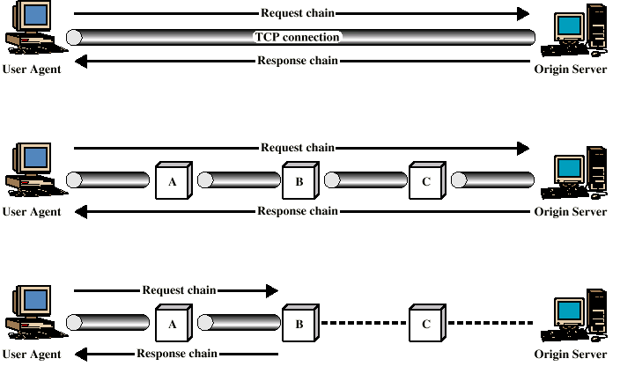
Examples of HTTP Operation
Cache

Slide 8
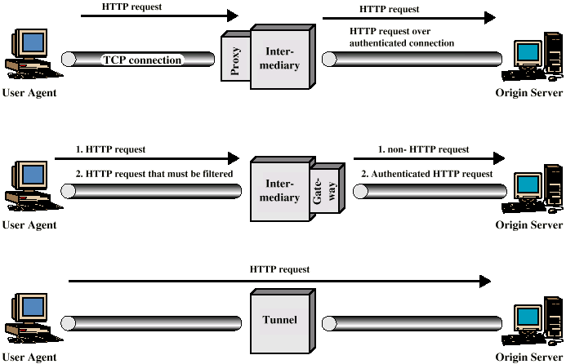
Intermediate HTTP Systems

Slide 9
HTTP Messages
Requests
  Client to server
Responses
  Server to client
Request line
Response line
General header
Request header
Response header
Entity header
Entity body

Slide 10
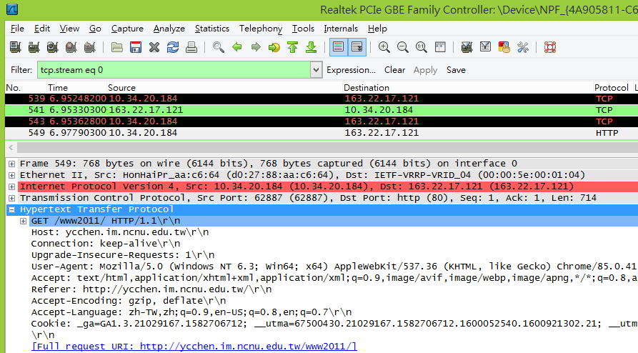
http://ycchen.im.ncnu.edu.tw/www2011/
GET /www2011/ HTTP/1.1
Host: ycchen.im.ncnu.edu.tw
Connection: keep-alive
User-Agent: Mozilla/5.0 …
Cookie: _ga=GA1.3.21029167…

Slide 11
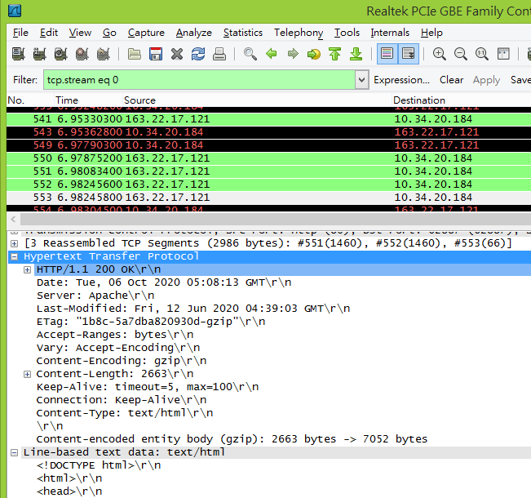
HTTP/1.1 200 OK
Server: Apache
Keep-Alive: timeout=5, max=100
Connection: Keep-Alive

Slide 12
GET /ycchen/ HTTP/1.1
Host: www.im.ncnu.edu.tw
User-Agent: Mozilla/5.0 (Windows; U; Windows NT 6.0; zh-TW; rv:1.9.2.10) Gecko/20100914 Firefox/3.6.10 GTB7.1 ( .NET CLR 3.5.30729; .NET4.0E)
Accept: text/html,application/xhtml+xml,application/xml;q=0.9,*/*;q=0.8
Accept-Language: zh-tw,en-us;q=0.7,en;q=0.3
Accept-Encoding: gzip,deflate
Accept-Charset: UTF-8,*
Keep-Alive: 115
Connection: keep-alive
Cookie: ja_helio_tpl=ja_helio; __utma=67500430.1193889225.1287195599.1287195599.1287239452.2;jfcookie[lang]=zh
If-Modified-Since: Wed, 15 Sep 2010 08:24:53 GMT
If-None-Match: "db1f3-ec8-4904810569f40"
HTTP/1.1 304 Not Modified
Date: Tue, 19 Oct 2010 12:45:32 GMT
Server: Apache/2.2.16 (FreeBSD) DAV/2 PHP/5.2.14 with Suhosin-Patch mod_ssl/2.2.16 OpenSSL/0.9.8k
Connection: Keep-Alive
Keep-Alive: timeout=5, max=100
ETag: "db1f3-ec8-4904810569f40"

Slide 13
Virtual Hosting
https://www.im.ncnu.edu.tw/
https://ssyu.im.ncnu.edu.tw/
https://hychien.im.ncnu.edu.tw/
Virtual hosting is a method for hosting multiple domain names (with separate handling of each name) on a single server (or pool of servers).
Name-based Virtual Hosting
  Name-based virtual hosts use multiple host names for the same IP address.
IP-based Virtual Hosting
  Each site points to a unique IP address.
  The webserver is configured with multiple IP addresses.
https://en.wikipedia.org/wiki/Virtual_hosting

Slide 14
##NameVirtualHost *:80
#
# VirtualHost example:
# Almost any Apache directive may go into a VirtualHost container.
# The first VirtualHost section is used for all requests that do not
# match a ##ServerName or ##ServerAlias in any <VirtualHost> block.
#
##<VirtualHost *:80>
##ServerAdmin webmaster@dummy-host.example.com
##DocumentRoot "C:/xampp/htdocs/dummy-host.example.com"
##ServerName dummy-host.example.com
##ServerAlias www.dummy-host.example.com
##ErrorLog "logs/dummy-host.example.com-error.log"
##CustomLog "logs/dummy-host.example.com-access.log" common
##</VirtualHost>
##<VirtualHost *:80>
##ServerAdmin webmaster@dummy-host2.example.com
##DocumentRoot "C:/xampp/htdocs/dummy-host2.example.com"
##ServerName dummy-host2.example.com
##ErrorLog "logs/dummy-host2.example.com-error.log"
##CustomLog "logs/dummy-host2.example.com-access.log" common
##</VirtualHost>
Apache httpd.conf

Slide 15
General Header Fields
Cache-control
Connection
Data
Forwarded
Keep-Alive
MIME version
Pragma
Upgrade

Slide 16
Request Methods
Request-Line = Method <SP> Request_URL <SP> HTTP-Version <CRLF>
Methods:
  Options
  Get
  Head
  Post
  Put
  Patch
  Copy
  Move
  Delete
  Link
  Unlink
  Trace
  Wrapped
  Extension-method
GET / HTTP/1.1
GET /ycchen/ HTTP/1.1
GET /ycchen/pub.html HTTP/1.1
POST /7net/join.php HTTP/1.1

Slide 17
Request Header Field
Accept
Accept charset
Accept encoding
Accept language
Authorization
From
Host
If modified since
Proxy authentication
Range
Referrer
Unless
User agent

Slide 18
Response Messages
Status line followed by one or more general, response and entity headers, followed by optional entity body
Status-Line = HTTP-Version <SP> Status-Code <SP> Reason-Phrase <CRLF>
HTTP/1.1 200 OK
HTTP/1.1 304 Not Modified

Slide 19
Status Codes
Informational
Successful
Redirection
Client error
Server error

Slide 20
Response Header Fields
Location
Proxy authentication
Public
Retry after
Server
WWW-Authenticate

Slide 21
Entity Header Fields
Allow
Content encoding
Content language
Content length
Content MD5
Content range
Content type
Content version
Derived from
Expires
Last modified
Link
Title
Transfer encoding
URL header
Extension header

Slide 22
Entity Body
Arbitrary sequence of octets
HTTP transfers any type of data including:
  text
  binary data
  audio
  images
  video
Interpretation of data determined by header fields
  Content encoding, content type, transfer encoding

Slide 23
import java.io.*;
import java.net.*;
public class httpClient {
public static void main(String[] args) {
Socket httpSocket = null;
DataOutputStream os = null;
DataInputStream is = null;
BufferedReader br = null;
String responseLine;
try {
httpSocket = new Socket("www.im.ncnu.edu.tw", 80);
os = new DataOutputStream(httpSocket.getOutputStream());
is = new DataInputStream(httpSocket.getInputStream());
br = new BufferedReader(new InputStreamReader(is));
} catch (UnknownHostException e) {
System.err.println("Don't know about host: hostname");
} catch (IOException e) {
System.err.println("Couldn't get I/O for the connection to: www.im.ncnu.edu.tw");
}
if (httpSocket != null && os != null && is != null) {
try {
os.writeBytes("GET / HTTP/1.1\n");
os.writeBytes("Host: ycchen.im.ncnu.edu.tw\n\n");
responseLine = br.readLine();
while (responseLine != null) {
System.out.println("Server: " + responseLine);
responseLine = br.readLine();
}
System.out.println("Server: " + responseLine);
os.close();
br.close();
is.close();
httpSocket.close();
} catch (UnknownHostException e) {
System.err.println("Trying to connect to unknown host: " + e);
} catch (IOException e) {
System.err.println("IOException: " + e);
}
}// if
} // main
} // httpClient

Slide 24
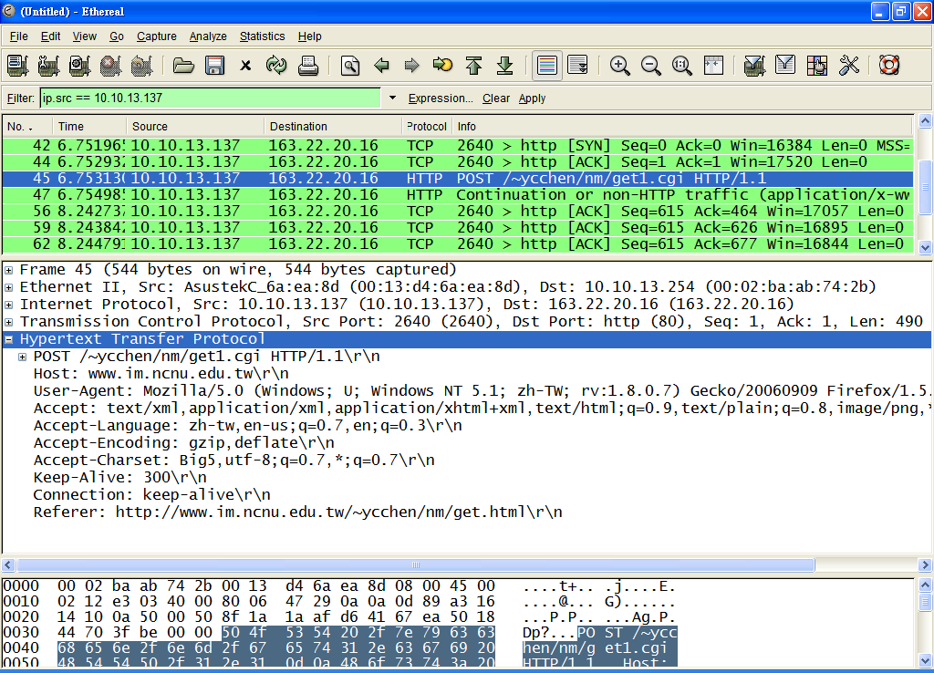
POST

Slide 25
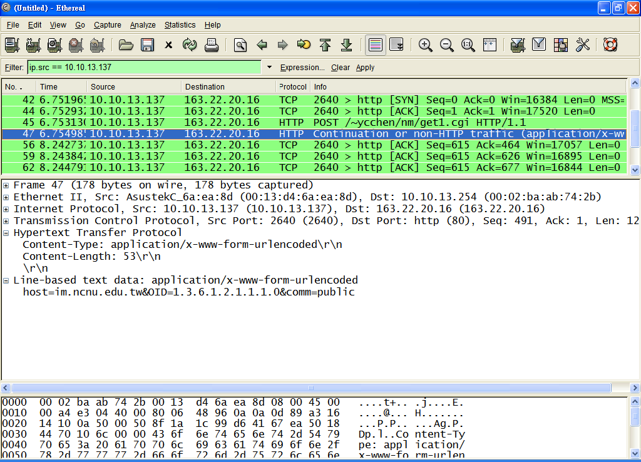
POST

Slide 26
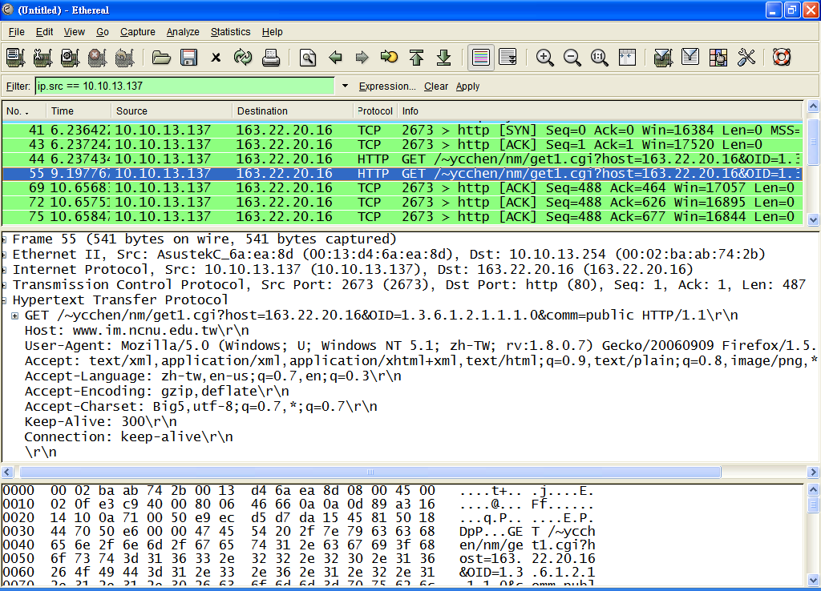
GET

Slide 27
Session Initiation Protocol
Overview
RFC 3261
Application-level control protocol
  Setting up, modifying, and terminating real-time sessions
  Enable Internet telephony, (voice over IP, VoIP)
  Supports single or multimedia session, including teleconferencing
Facets of SIP
  User location: Users can access application features from remote locations
  User availability: Willingness of called party to communicate
  User capabilities: Media and parameters to be used
  Session setup: Point-to-point and multiparty calls
  Session management: Transfer and termination, modifying session parameters, and invoking services

Slide 28
Session Initiation Protocol
Features
Based on HTTP-like request/response transaction model
Client request invokes function on server
  At least one response
Uses most HTTP header fields, encoding rules, and status codes
  Readable format for displaying information
Uses concepts similar to recursive and iterative searches of DNS
Incorporates Session Description Protocol (SDP)
  Defines session content using types similar to MIME

Slide 29
Components and Protocols (1)
Client
  Sends requests and receives responses
  User agent clients and proxies are clients
Server
  Receives requests and sends back responses
  Proxies, user agent servers, redirect servers, and registrars
User Agent
  In every SIP end station
    User agent client (UAC): Issues requests
    User agent server (UAS): Receives requests and reponds
Redirect Server
  Determines address of called device
  Like iterative searches in DNS

Slide 30
Components and Protocols (2)
Proxy Server
  Server and client
  Makes requests for other clients
    Routing
    Enforcing policy
    Like recursive searches in DNS
Registrar
  Server that accepts REGISTER requests
  Places information it receives in requests into location service for its domain
    SIP address, associated IP address of device
Location Service
  Used by redirect or proxy server to obtain information about a callee's possible location(s)
  Maintains database of SIP-address/IP-address mappings

Slide 31
Components and Protocols (3)
Servers defined (RFC 3261) as logical devices
Implemented as separate servers or combined into single application
Proxy servers may act as redirect servers
  Need to consult location service database
    May be on proxy server or not
    Communication between proxy server and location service beyond scope of SIP standard
    Proxy consults DNS server to find target domain proxy
SIP typically runs on UDP for performance
  Own reliability mechanisms
  May also use TCP
  May use Transport Layer Security (TLS) protocol for secure connection

Slide 32
Session Description Protocol
SDP
RFC 2327
SIP invites participants to session
SDP-encoded body of SIP message contains information about what media encodings (e.g., voice, video) parties can and will use
Then data transmission begins, using appropriate transport protocol
  Real-Time Transport Protocol (RTP)
Participants can make changes to session parameters using SIP

Slide 33
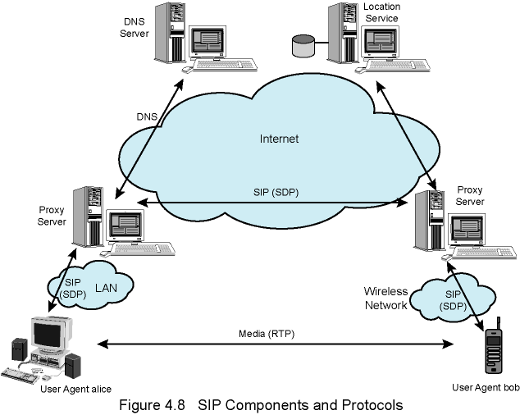
SIP Components and Protocols

Slide 34
Uniform Resource Identifier URI
Identifies SIP resource
  User of online service
  Appearance on multiline phone
  Mailbox on messaging system
  Telephone number at gateway service
  Group (such as "sales" or "helpdesk") in an organization
Format based on email address formats
  user@domain
  sip:bob@biloxi.com
May also include password, port number, & related parameters
If secure transmission required, use "sips:“
  SIP messages are transported over TLS
URI is generic identifier for resource on Internet
  URL, for Web addresses is type of URI

Slide 35
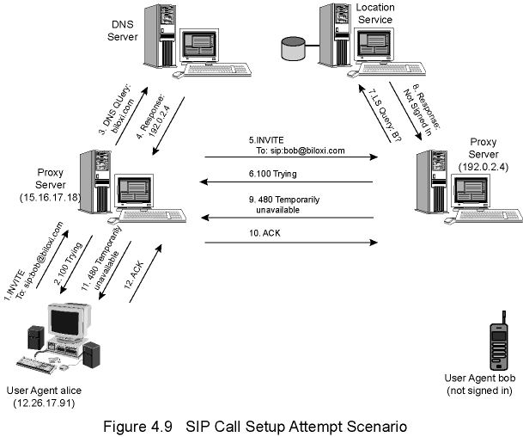
SIP
Call Setup Attempt Scenario
(Unsuccessful Attempt)

Slide 36
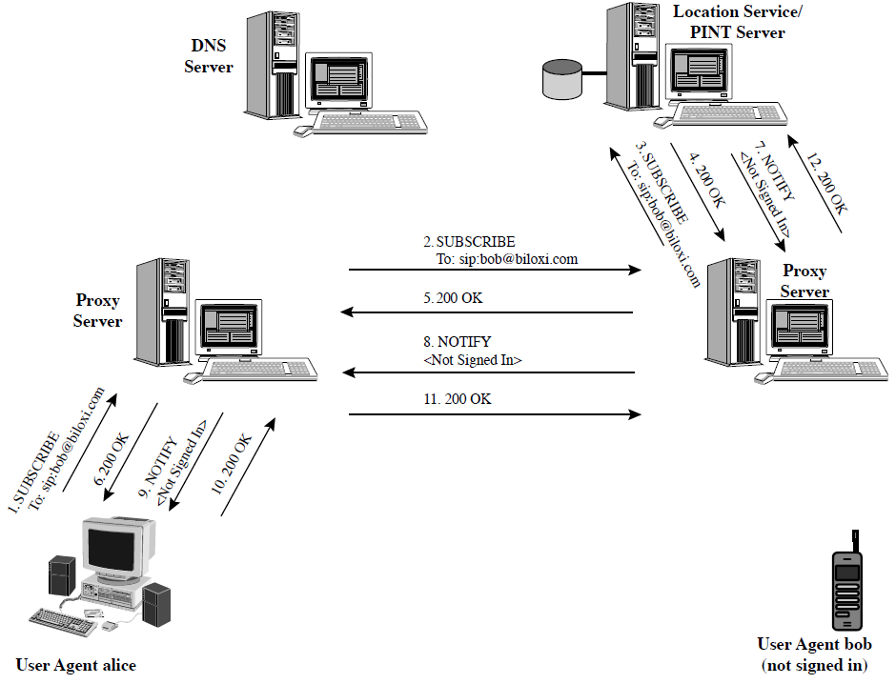
SIP Presence Example
RFC 3265
SIP-Specific Event Notification
(PSTN-Internet Networking)

Slide 37
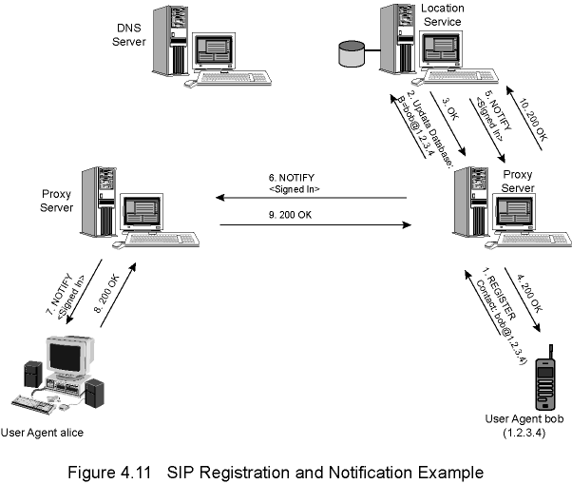
SIP Registration and Notification Example

Slide 38
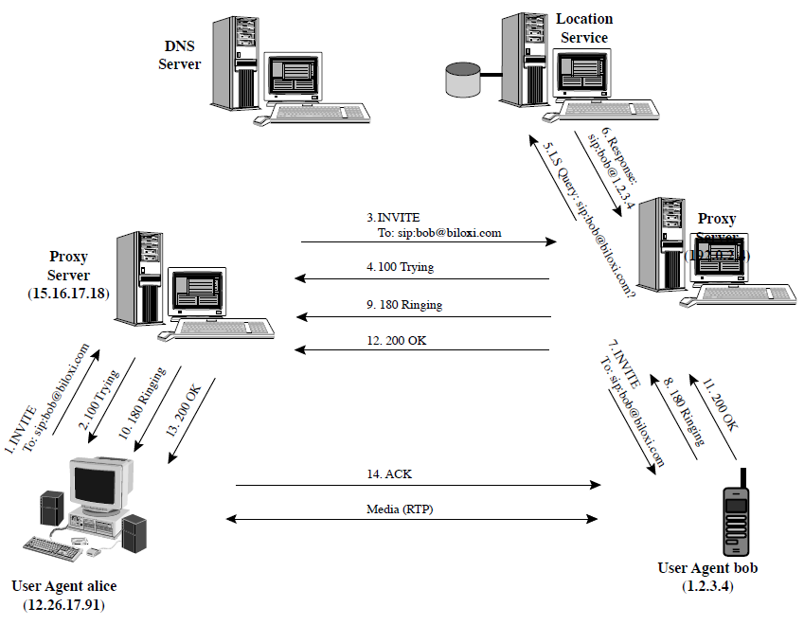
SIP Successful Call Setup

Slide 39
SIP Messages
Requests and responses
Difference between types in first line
Request
  Method: nature of request
  Request-URI: where request should be sent
Response has response code
All messages include header
  a number of lines, beginning with header label
Message can also contain body e.g. SDP media description

Slide 40
SIP Messages - Requests
Methods
  REGISTER: notify SIP network of IP address and URLs for which it would like to receive calls
  INVITE: establish session between user agents
  ACK: Confirms reliable message exchanges
  CANCEL: Terminates pending request, but does not undo completed call
  BYE: Terminates session between two users in conference
  OPTIONS: Solicits information about callee capabilities
  SUBSCRIBE: Subscribes for an Event of Notification from the Notifier.

Slide 41
SIP Message Request Example
INVITE sip:bob@biloxi.com SIP/2.0
Via: SIP/2.0/UDP 12.26.17.91:5060
Max-Forwards: 70
To: Bob <sip:bob@biloxi.com>
From: Alice <sip:alice@atlanta.com>;tag=1928301774
Call-ID: a84b4c76e66710@12.26.17.91
CSeq: 314159 INVITE
Contact: <sip:alice@atlanta.com>
Content-Type: application/sdp
Content-Length: 142
70 hops (proxies)

Slide 42
SIP Messages - Response
Provisional (1xx): Request received and being processed
Success (2xx): Action successfully received, understood, and accepted
Redirection (3xx): Further action needed
Client Error (4xx): Request contains bad syntax or cannot be fulfilled at this server
Server Error (5xx): Server failed to fulfill apparently valid request
Global Failure (6xx): Request cannot be fulfilled at any server

Slide 43
SIP Response Example
SIP/2.0 200 OK
Via: SIP/2.0/UDP server10.biloxi.com
Via: SIP/2.0/UDP bigbox3.site3.atlanta.com
Via: SIP/2.0/UDP 12.26.17.91:5060
To: Bob <sip:bob@biloxi.com>;tag=a6c85cf
From: Alice <sip:alice@atlanta.com>;tag=1928301774
Call-ID: a84b4c76e66710@12.26.17.91
CSeq: 314159 INVITE
Contact: <sip:bob@biloxi.com>
Content-Type: application/sdp
Content-Length: 131

Slide 44
SDP Information
Media streams
  Session can include multiple streams of differing content
  Currently defines audio, video, data, control, and application
Addresses
  Destination addresses,
  May be multicast
Ports
  For each stream
Payload types
  For each media stream type
Start and stop times
  For broadcast sessions e.g. television or radio program
Originator
  For broadcast sessions

