Slide 1
Transport Protocols
- TCP and UDP
https://en.wikipedia.org/wiki/Best-effort_delivery
The Internet is a best-effort packet switching network,
which doesn't guarantee that data is delivered or that
delivery meets any quality of service.

Slide 2
Transport Protocols
The transport protocol provides an end-to-end data transfer service that shields upper-layer protocols from the details of the intervening network.
Two types of transport service
  connection oriented, e.g. TCP
  connectionless (datagram), e.g. UDP

Slide 3
Connection Oriented Transport Protocol Mechanisms
Logical connection
  Establishment
  Maintenance
  Termination
Reliable
e.g. TCP

Slide 4
(1). Reliable Sequencing Network Service
Assume the network service accepts messages of arbitrary length.
Assume virtually 100% reliable delivery by network service
  e.g. reliable packet switched network using X.25
  e.g. frame relay using LAPF control protocol
  e.g. IEEE 802.3 using connection oriented LLC service
As if the transport protocol is used as an end-to-end protocol between two systems on same network.

Slide 5
Issues in a Simple Transport Protocol
Addressing
Multiplexing
Flow Control
Connection establishment and termination

Slide 6
Addressing
Target user specified by:
  User identification
    Usually host, port
      Called a socket in TCP
    Port represents a particular transport service (TS) user
  Transport entity identification
    Generally only one per host
    If more than one, then usually one of each type
      Specify transport protocol (TCP, UDP)
  Host address
    An attached network device
    In an internet, a global internet address
  Network number
Service User

Slide 7
Finding Addresses
Four methods
  Know address ahead of time
    e.g. collection of network device stats
  Well known addresses
  Name server
  Sending process request to
  well known address

Slide 8
Multiplexing
Multiplexing/Demultiplexing
Multiple users employ same transport protocol
User identified by port number or service access point (SAP)

Slide 9
Flow Control
Flow control is a protocol mechanism that enables a destination entity to regulate the flow of packets sent by a source entity.
Limits amount or rate of data sent
Reasons:
  Source may send PDUs faster than destination can process headers
  Higher-level protocol user at destination may be slow in retrieving data
  Destination may need to limit incoming flow to match outgoing flow for retransmission

Slide 10
Flow Control
Flow control at the transport layer is rather complicated.
  Longer transmission delay between transport entities
    Delay in communication of flow control info
  Variable transmission delay
    Difficult to use timeouts
Flow may be controlled because:
  The receiving user can not keep up
  The receiving transport entity can not keep up
Results in buffer filling up

Slide 11
Coping with Flow Control Requirements
Do nothing
  Segments that overflow are discarded
  Sending transport entity will fail to get ACK and will retransmit (Shame!)
    Thus further adding to incoming data
Backpressure
  Refuse further segments
  If multiple connections are multiplexed, flow control is excised only on the aggregate of all connections.
Use credit scheme

Slide 12
Credit Scheme (Used in TCP)
To overcome the inefficiencies of the stop-and-wait scheme, in which only one PDU at a time can be in transit.
Decouples flow control from ACK
  May ACK without granting credit and vice versa
Each octet has sequence number
Each transport segment has the following fields in header
  sequence number (seq.)
  acknowledgement number (ack.)
  window size

Slide 13
Allowing multiple PDUs in transit
How to do it?
  Receiver allocates a buffer space to hold PDUs
  Sender is allowed to send a number of PDUs without waiting for an ack.
  To keep track of which PDUs have been acknowledged, sequence numbers are used.

Slide 14
Use of Header Fields
When sending, seq number is that of first octet in segment
ACK includes AN=i, W=j
AN=i ➔ All octets through SN=i -1 acknowledged
  Next expected octet is i
W=j ➔ Permission to send additional window of j octets
  i.e. Octets through i+j-1
SN: Sequence number
AN: Acknowledgement number
W: Window Size

Slide 15
1460
1460
1200
Sender
SN=91612
SN=93072
SN=94532
SN=?
91612 + 1460
93072 + 1460
1460
Receiver receives
AN = ?
SN=91612

Slide 16
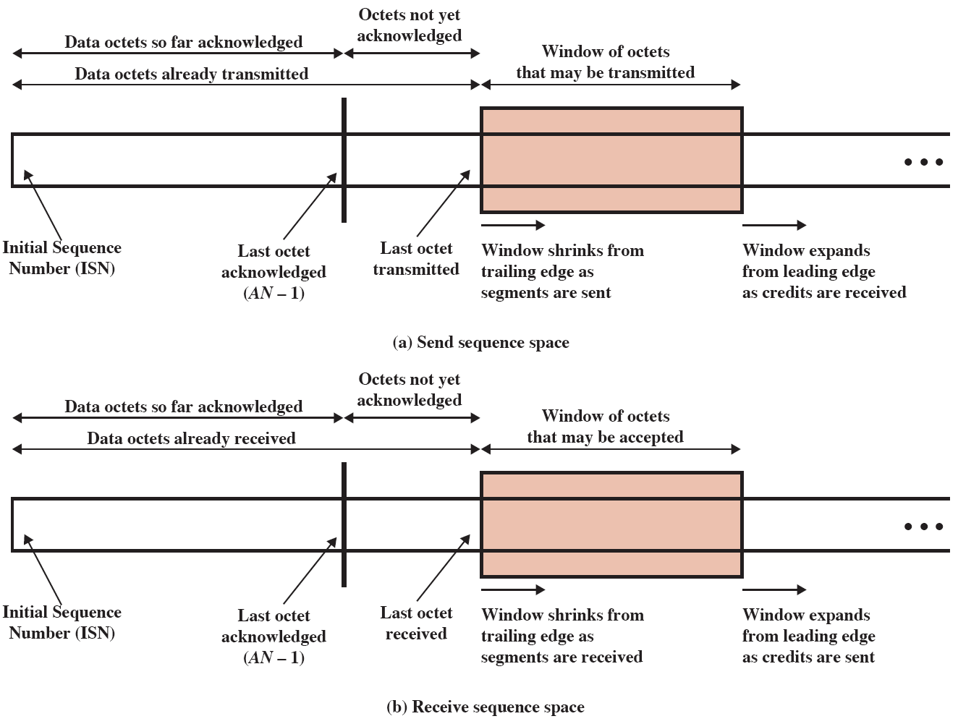
Sending and Receiving Flow Control Perspectives

Slide 17
Example of TCP Credit Allocation Mechanism

Slide 18
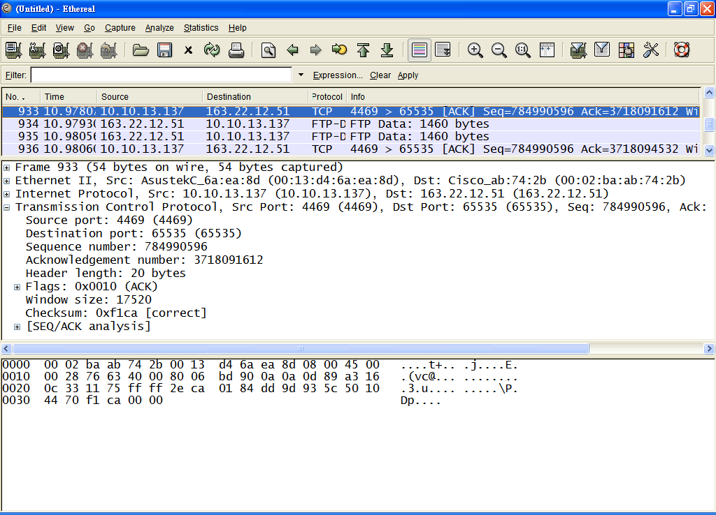
17520 (3718091612 ~ 3718091612+17519)
My PC
10.10.13.137
AN = 3718091612
W = 17520
FTP Server
163.22.12.51

Slide 19
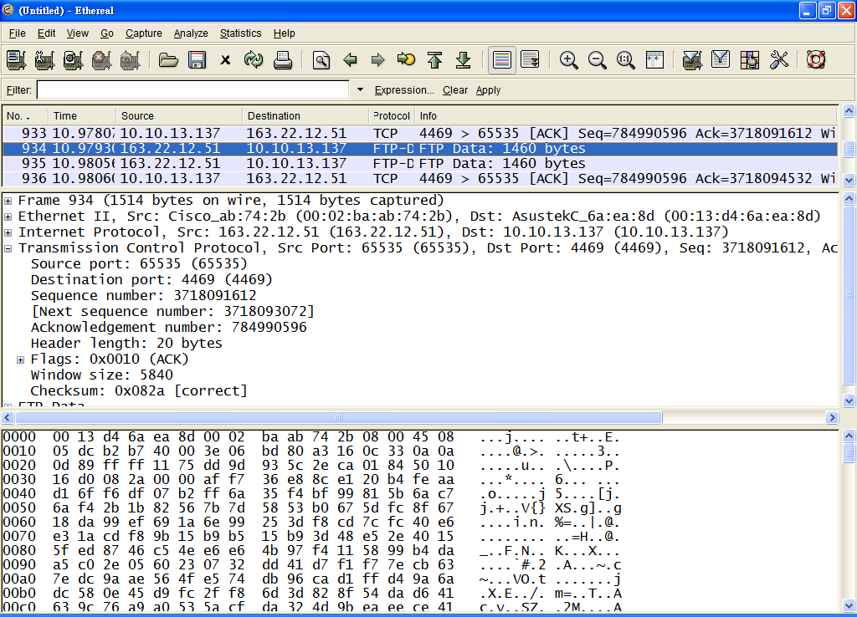
3718091612 + 1460 = 3718093072
16060 (3718093072 ~ 3718091612+17519)
My PC
10.10.13.137
SN = 3718091612
Data: 1460 octets
FTP Server
163.22.12.51

Slide 20
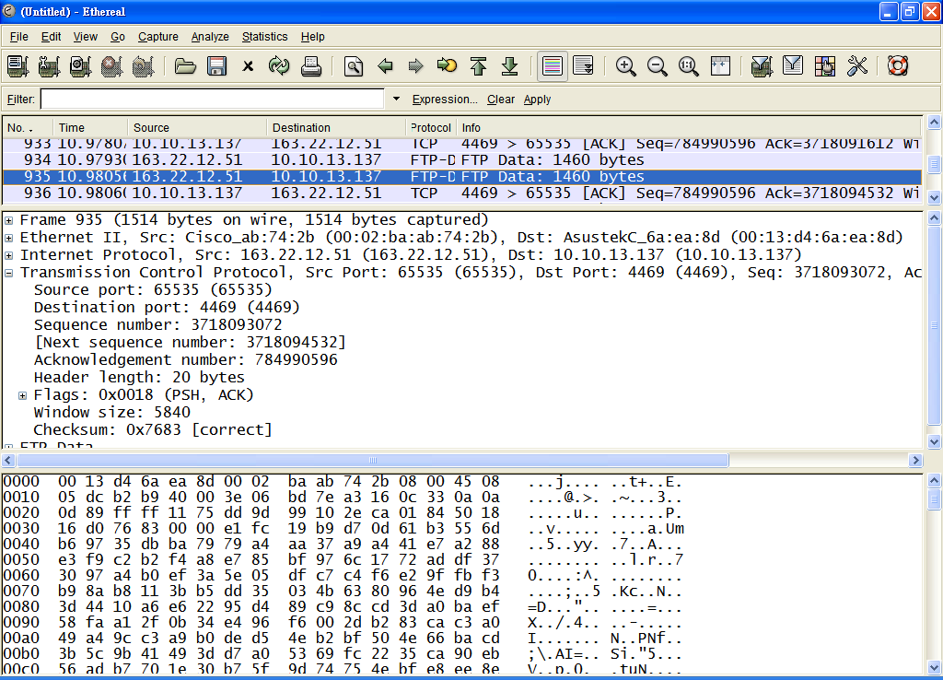
= 3718091612 + 1460
3718093072 + 1460 = 3718094532
13600 (3718094532 ~ 3718091612+17519)
My PC
10.10.13.137
SN = 3718093072
Data: 1460 octets
FTP Server
163.22.12.51

Slide 21
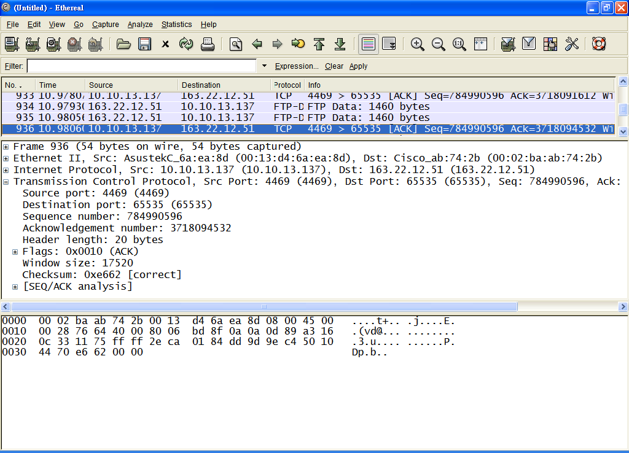
= 3718093072 + 1460
17520 (3718094532 ~ 3718094532+17519)
My PC
10.10.13.137
AN = 3718094532
W = 17520
FTP Server
163.22.12.51

Slide 22
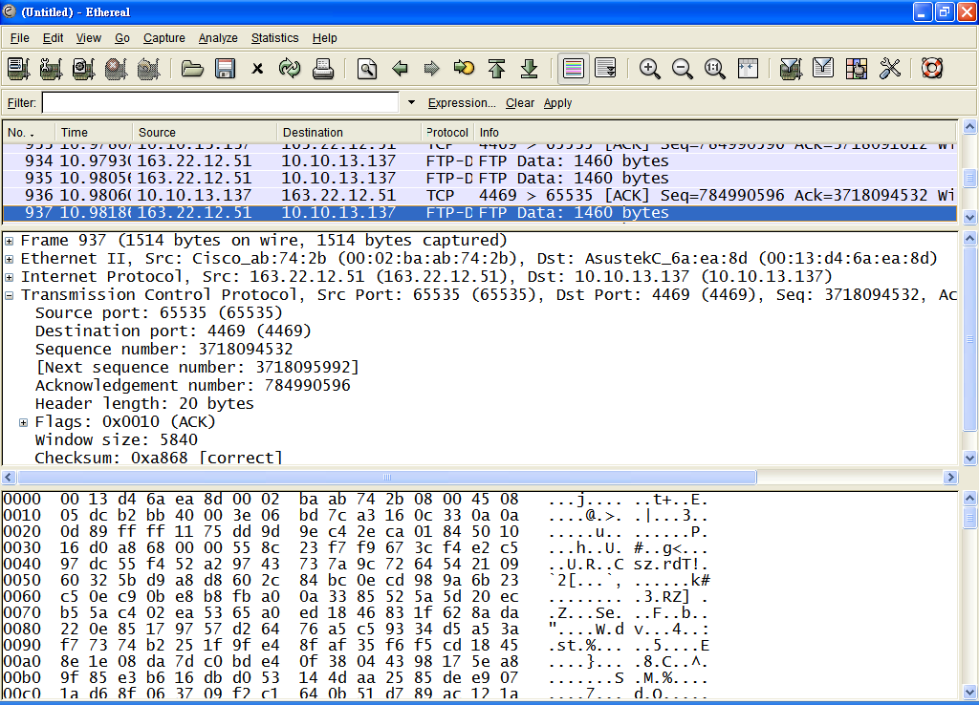

Slide 23
Establishment and Termination
Connection establishment
  Allow each end to know the other exists
  Negotiation of optional parameters
  Triggers allocation of transport entity resources
By mutual agreement

Slide 24
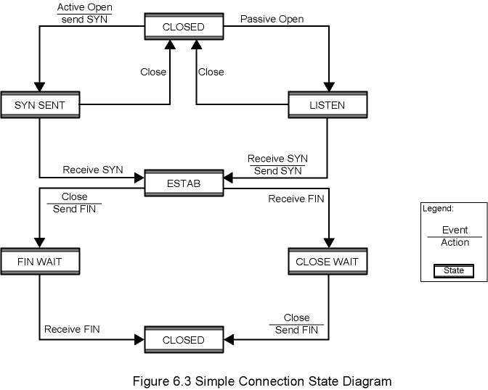
Figure 6.3 Simple Connection State Diagram

Slide 25
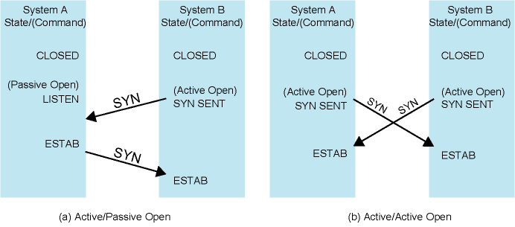
Figure 6.4 Connection Establishment Scenarios

Slide 26
Not Listening
A SYN comes in while the requested TS user is idle (not listening).
  Reject with RST (Reset)
  Queue request until matching open issued
  Signal TS user to notify of pending request

Slide 27
Termination
Either or both sides
By mutual agreement
Abrupt termination
Or graceful termination
  Close wait state must accept incoming data until FIN received

Slide 28
Side Initiating Termination
TS user Close request
Transport entity sends FIN, requesting termination
Connection placed in FIN WAIT state
  Continue to accept data and deliver data to user
  Not send any more data
When FIN received, inform user and close connection

Slide 29
Side Not Initiating Termination
FIN received
Inform TS user and place connection in CLOSE WAIT state
  Continue to accept data from TS user and transmit it
TS user issues CLOSE primitive
Transport entity sends FIN
Connection closed
All outstanding data is transmitted from both sides
Both sides agree to terminate

Slide 30
(2). Unreliable Network Service
E.g.
  internet using IP,
  frame relay using LAPF
  IEEE 802.3 using unacknowledged connectionless LLC
Segments may get lost
Segments may arrive out of order

Slide 31
Problems
Ordered Delivery
Retransmission strategy
Duplication detection
Flow control
Connection establishment
Connection termination
Failure recovery

Slide 32
Ordered Delivery
Segments may arrive out of order
Number segments sequentially
TCP numbers each octet sequentially
Segments are numbered by the first octet number in the segment

Slide 33
Retransmission Strategy
Segment damaged in transit
Segment fails to arrive
Transmitter does not know of failure
Receiver must acknowledge successful receipt
  Doesn’t require one ACK per segment
  Use cumulative acknowledgement
Time out waiting for ACK triggers re-transmission
  Retransmission timer

Slide 34
Transport Protocol Timers

Slide 35
Duplication Detection
If ACK lost, segment is re-transmitted
Receiver must recognize duplicates
Duplicate received prior to closing connection
  Receiver assumes ACK lost. → ACKs the duplicate
  Sender must not get confused with multiple ACKs
  Sequence number space large enough to not cycle within maximum life of segment
Duplicate received after closing connection
  See “Connection Establishment”

Slide 36
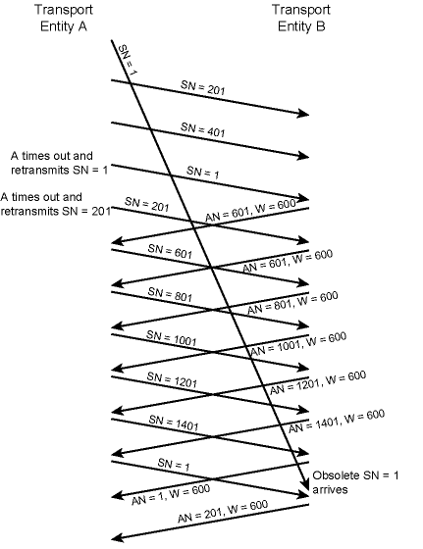
Example of
Incorrect
Duplicate
Detection
Sequence space: 1600
Segment:
SN = 1
is considered as a duplicate.
➔
Sequence number space should be
long enough.

Slide 37
Flow Control
Credit allocation
Problem if AN=i, W=0 closing window
Send AN=i, W=j to reopen, but this is lost
Sender thinks window is closed, receiver thinks it is open
Use window timer
If timer expires, send something
  Could be re-transmission of previous segment

Slide 38
Connection Establishment
Two way handshake
  A send SYN, B replies with SYN
  Lost SYN handled by re-transmission
    Can lead to duplicate SYNs
  Ignore duplicate SYNs once connected
Lost or delayed data segments can cause connection problems
  Segment from old connections
  Start segment numbers far removed from previous connection
    Use SYN i
    Need ACK to include i
Solved using Three Way Handshake

Slide 39
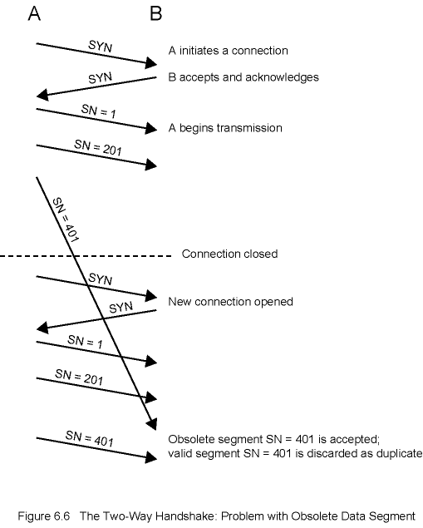
Two-Way
Handshake
Problem with
Obsolete
Data
Segment
➔
Start each new connection
with a different SN far from
the most recent connection.

Slide 40
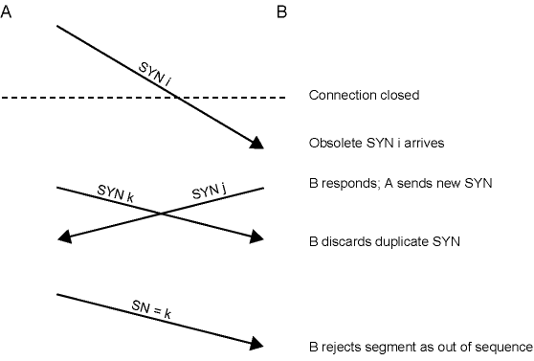
Two-Way Handshake Problem with Obsolete SYN Segments
A does not know
that SYN k was discarded.
SYN should be acknowledged.

Slide 41
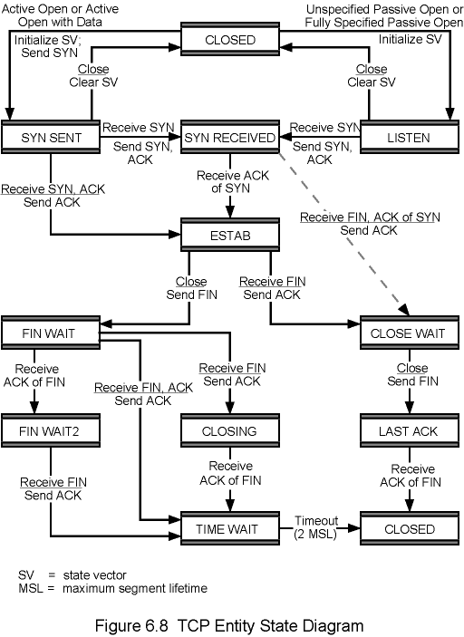
TCP Entity
State Diagram
SV: state vector
MSL: maximum segment lifetime

Slide 42
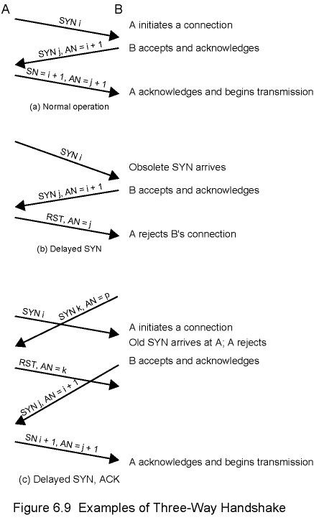
Examples of
Three-Way
Handshake

Slide 43
Connection Termination
Entity in CLOSE WAIT state sends last data segment, followed by FIN
FIN arrives before last data segment
Receiver accepts FIN
  Closes connection
  Loses last data segment
Associate sequence number with FIN
Receiver waits for all segments before FIN sequence number
Loss of segments and obsolete segments
  Must explicitly ACK FIN

Slide 44
Graceful Close
Send FIN i and receive AN i
Receive FIN j and send AN j
Wait twice maximum expected segment lifetime

Slide 45
Failure Recovery
After transport entity restarts, state info of all active connections is lost.
Connection is half open
  Side that did not crash still thinks it is connected
Close connection using persistence timer
  Wait for ACK for (time out) * (number of retries)
  When expired, close connection and inform user
When a transport entity fails and quickly restarts
  Send RST i in response to any i segment arriving
TS User must decide whether to reconnect
  Problems with lost or duplicate data

Slide 46
TCP Services
Transmission Control Protocol
  Connection oriented
  RFC 793
TCP service provides the reliable end-to-end transport of data between host processes.
Categories of TCP services:
  Multiplexing (via ports)
  Connection management
  Data transport
  Special capabilities (push, urgent)
  Error reporting

Slide 47
TCP Multiplexing & Connection Management
Multiplexing
  TCP can simultaneously provide service to multiple processes
  Process identified with port
Connection Management
  Establishment, Maintenance, and Termination
  Set up logical connection between sockets
  Connection between two sockets may be set up if:
    No connection between the sockets currently exists
    Internal TCP resources (e.g., buffer space) sufficient
    Both users agree
  Maintenance supports data transport and special capability services
  Termination either abrupt or graceful
    Abrupt termination may lose data
    Graceful termination prevents either side from shutting down until all outstanding data have been delivered

Slide 48
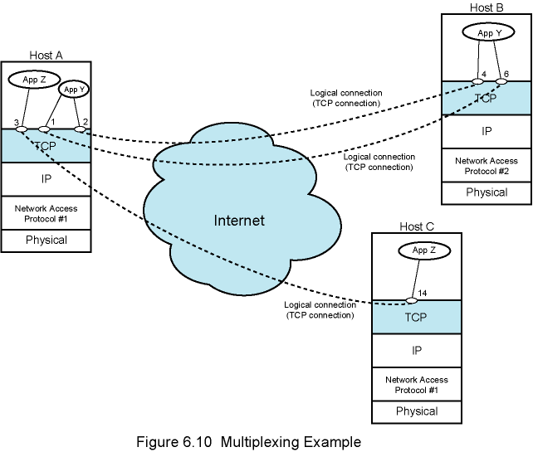
Multiplexing Example

Slide 49
Data Transport
Full duplex
Timely
  Associate timeout with data submitted for transmission
  If data not delivered within timeout, user notified of service failure and connection abruptly terminates
Ordered
Labelled
  Establish connection only if security designations match
  If precedence levels do not match, higher level used
Flow controlled
Error controlled
  Simple checksum
  Delivers data free of errors within probabilities supported by checksum
(IP Options)

Slide 50
Special Capabilities
Data stream push
  TCP decides when enough data available to form segment
  Push flag requires transmission of all outstanding data up to and including that labelled
  Receiver will deliver data in same way
Urgent data signalling
  Tells destination user that significant or "urgent" data is in stream
  Destination user determines appropriate action
Error Reporting
  TCP will report service failure due to internetwork conditions for which TCP cannot compensate

Slide 51
TCP Service Primitives
Services defined in terms of primitives and parameters
Primitive specifies function to be performed
Parameters pass data and control information

Slide 52
TCP Service
Request Primitives

Slide 53
TCP Service
Response Primitives

Slide 54
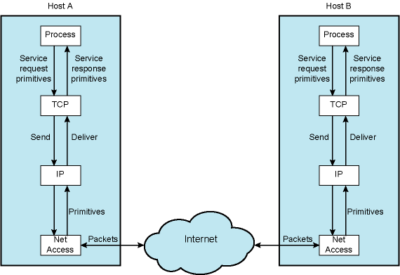
Use of TCP and IP Service Primitives

Slide 55
TCP Basic Operation
Data transmitted in segments
  TCP header and portion of user data
  Some segments carry no data
    For connection management
Data passed to TCP by user in sequence of Send primitives
Buffered in send buffer
TCP assembles data from buffer into segment and transmits
Segment transmitted by IP service
Delivered to destination TCP entity
Strips off header and places data in receive buffer
TCP notifies its user by Deliver primitive that data are available

Slide 56
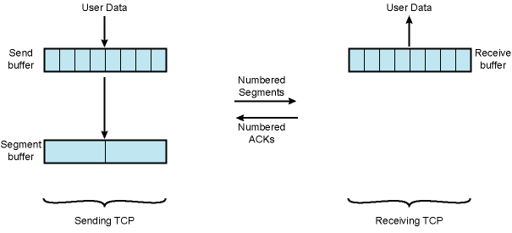
Basic TCP Operation

Slide 57
Difficulties
Segments may arrive out of order
  Sequence number in TCP header
Segments may be lost
  Sequence numbers and acknowledgments
  TCP retransmits lost segments
    Save copy in segment buffer until acknowledged

Slide 58
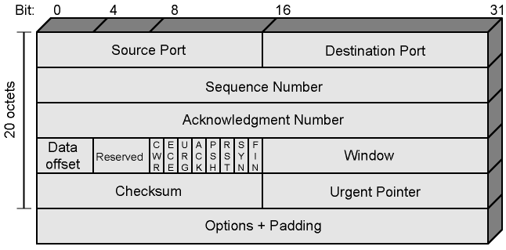
TCP Header

Slide 59
TCP Options
Maximum segment size
  Included in SYN segment
Window scale
  Included in SYN segment
  Window field gives credit allocation in octets
  With Window Scale value in Window field multiplied by 2^{F}
    F is the value of window scale option
Sack-permitted
  Selective acknowledgement allowed
Sack
  Receiver can inform sender of all segments received successfully
  Sender retransmit segments not received
Timestamps
  Send timestamp in data segment and return echo of that timestamp in ACK segment

Slide 60
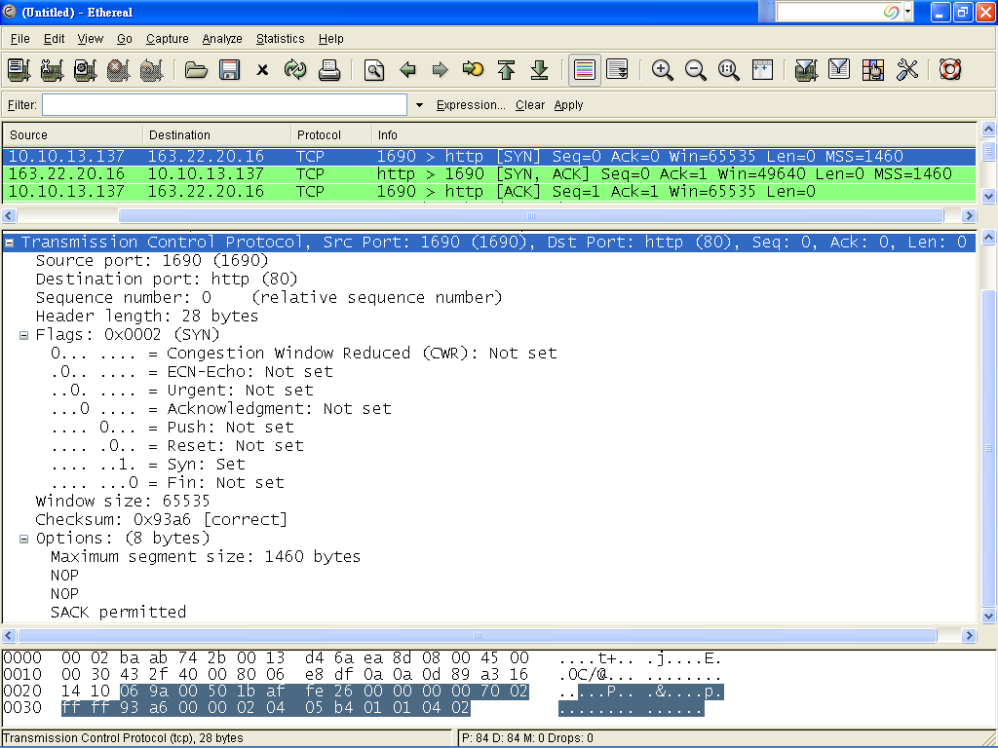

Slide 61
Items Passed to IP
TCP passes some parameters down to IP
  Precedence
  Normal delay/low delay
  Normal throughput/high throughput
  Normal reliability/high reliability
  Security

Slide 62
TCP Mechanisms (1)
Connection establishment
  Three way handshake
  Between pairs of ports
  One port can connect to multiple destinations

Slide 63
TCP Mechanisms (2)
Data transfer
  Logical stream of octets
  Octets numbered modulo 2³²
  Flow control by credit allocation of number of octets
  Data buffered at transmitter and receiver

Slide 64
TCP Mechanisms (3)
Connection termination
  Graceful close
  TCP users issues CLOSE primitive
  Transport entity sets FIN flag on last segment sent
  Abrupt termination by ABORT primitive
    Entity abandons all attempts to send or receive data
    RST segment transmitted

Slide 65
Implementation Policy Options
Send policy
Deliver policy
Accept policy
Retransmit policy
Acknowledge policy

Slide 66
Send Policy
If no push or close TCP entity transmits at its own convenience
Data buffered at transmit buffer
May construct segment per data batch
May wait for certain amount of data

Slide 67
Deliver Policy
In absence of push, deliver data at own convenience
May deliver as each in order segment received
May buffer data from more than one segment

Slide 68
Accept Policy
Segments may arrive out of order
In order
  Only accept segments in order
  Discard out of order segments
In windows
  Accept all segments within receive window

Slide 69
Retransmit Policy
TCP maintains queue of segments transmitted but not acknowledged
TCP will retransmit if not ACKed in given time
  First only: one retransmission timer for the queue / first
  Batch: one retransmission timer for the queue / all
  Individual: one retransmission timer per segment
Acknowledge Policy
Immediate: Immediately send ACK
Cumulative: piggyback the ACK

Slide 70
UDP
User Datagram Protocol (UDP)
  Connectionless
  RFC 768
Connectionless service for application level procedures
  Unreliable
  Delivery and duplication control not guaranteed
Reduced overhead
e.g. network management

Slide 71
UDP Uses
Inward data collection
Outward data dissemination
Request-Response
Real time application

Slide 72
Service Discovery by Multicast
Service discovery
  mDNS (Multicast DNS)
  DNS Service Discovery (DNS-SD)
  uPnP (Universal Plug and Play)
  SSDP (Simple Discovery Service Protocol)
239.255.255.250: UDP 1900

Slide 73
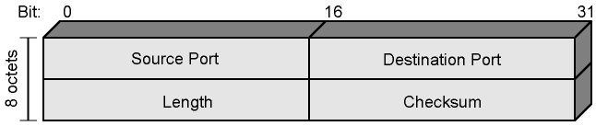
UDP Header

