Slide 1
Internet Protocols
IPv4 and IPv6

Slide 2
What is Internet Protocol (IP)?
Protocol for internetworking
IP provides a connectionless, or datagram, service between end systems.
Advantages from IP’s connectionless internet services:
Flexible: IP can deal with a variety of networks. IP requires little from the constituent networks.
Robust: IP uses datagram services.
Best for connectionless transport protocols: No unnecessary overhead

Slide 3
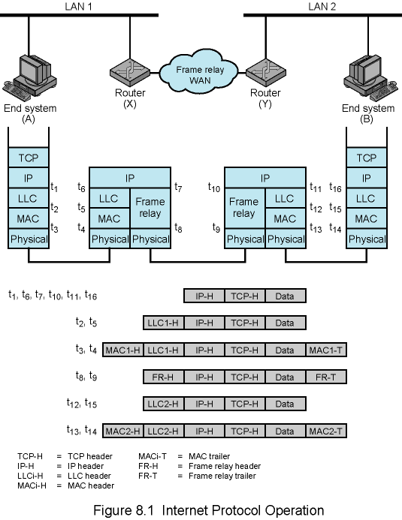
Internet Protocol Operation
* A ➔ B
Router X makes a decision:
B is in one of the networks to which X is attached. → send
B is in a remote network. Additional routers must be traversed. → routing
X does not know the destination address.
→ Error message

Slide 4
Connectionless Internetworking
Unreliable
Not guaranteed delivery
Not guaranteed order of delivery
Packets can take different routes
Reliability is responsibility of next layer up (e.g. TCP)

Slide 5
Design Issues
Routing
Datagram lifetime
Fragmentation and re-assembly
Error control
Flow control

Slide 6
Routing
End systems and routers maintain routing tables
Indicate next router to which datagram should be sent
Static
May contain alternative routes
Dynamic
Flexible response to congestion and errors
Source routing
Source specifies route as sequential list of routers to be followed
Security
Priority
Route recording

Slide 7
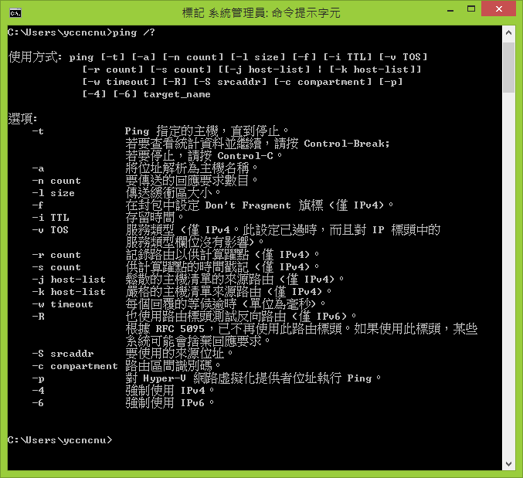

Slide 8
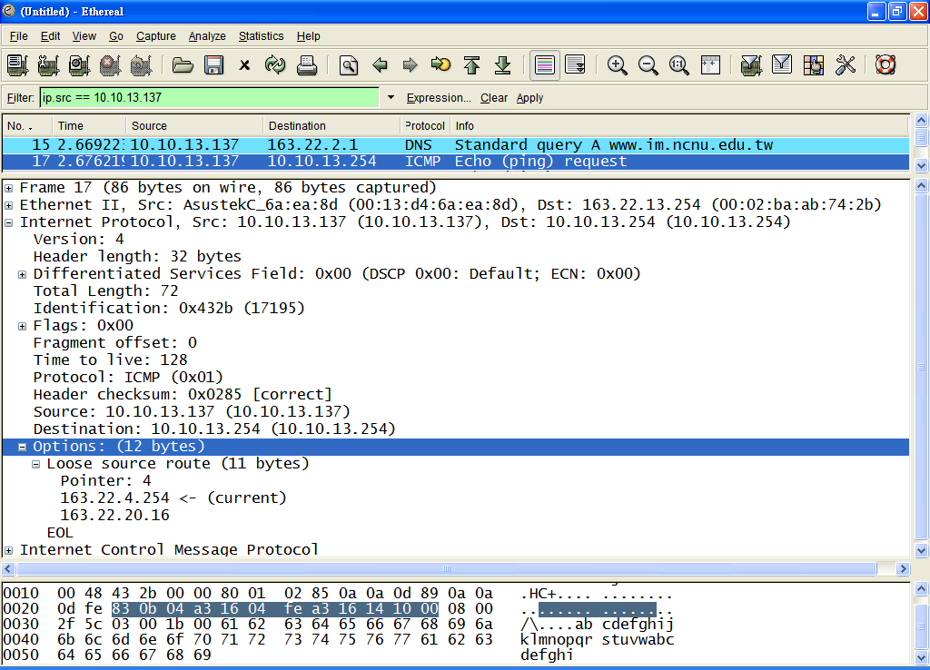

Slide 9
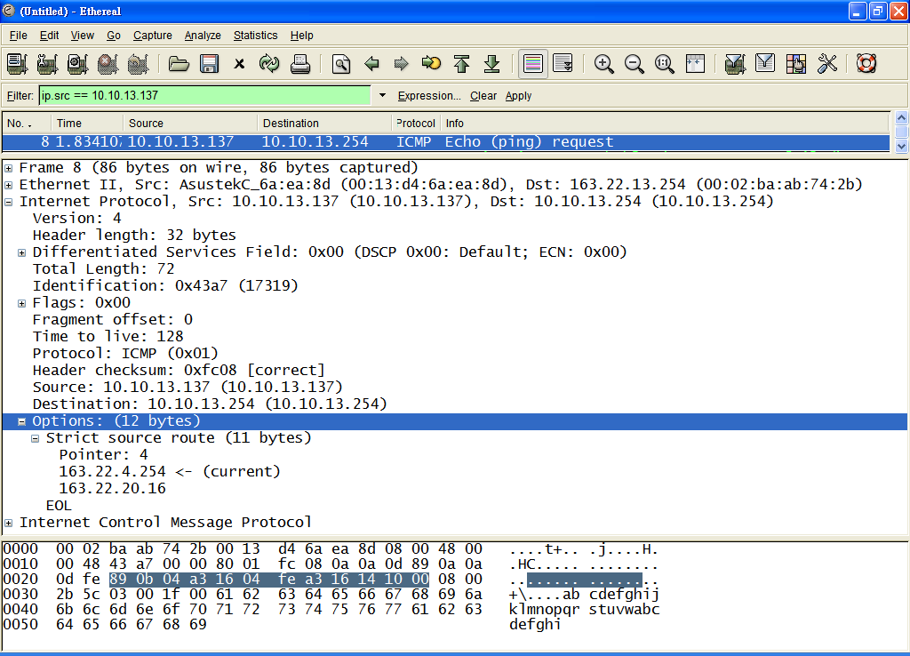

Slide 10
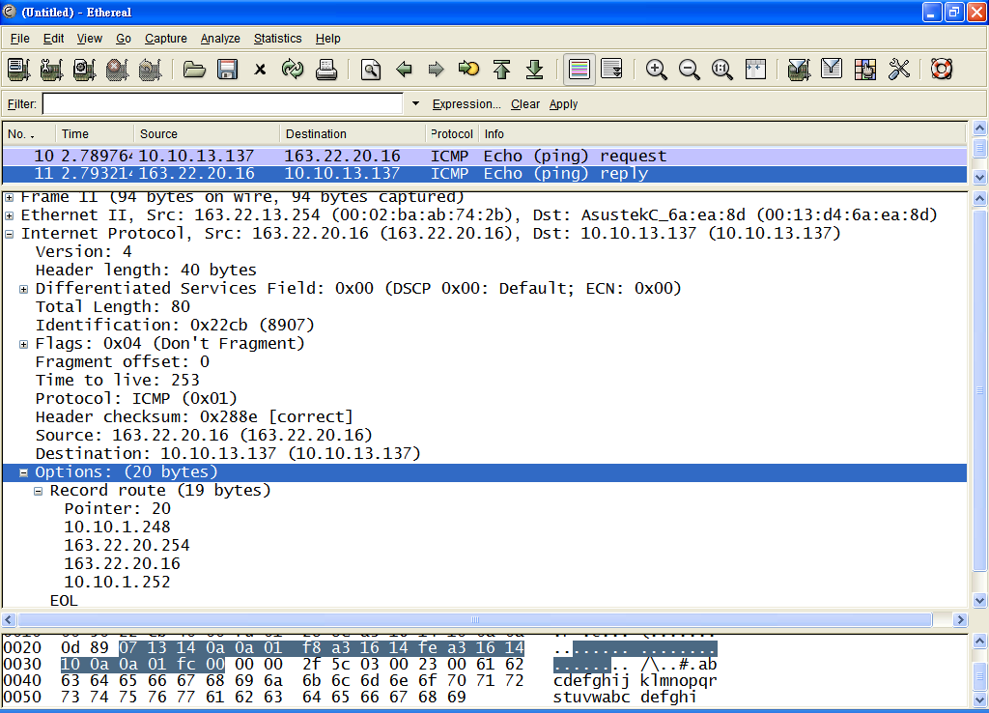

Slide 11
Datagram Lifetime
Datagrams could loop indefinitely
Consumes resources
Transport protocol may need upper bound on datagram life
Datagram marked with lifetime
Time To Live field in IP
Once lifetime expires, datagram discarded (not forwarded)
Hop count
Decrement time to live on passing through a each router
Time count
Need to know how long since last router

Slide 12
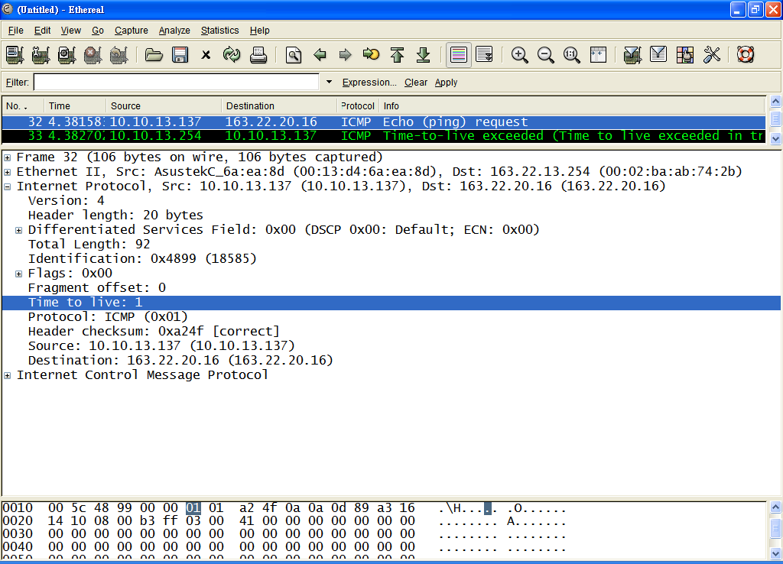

Slide 13
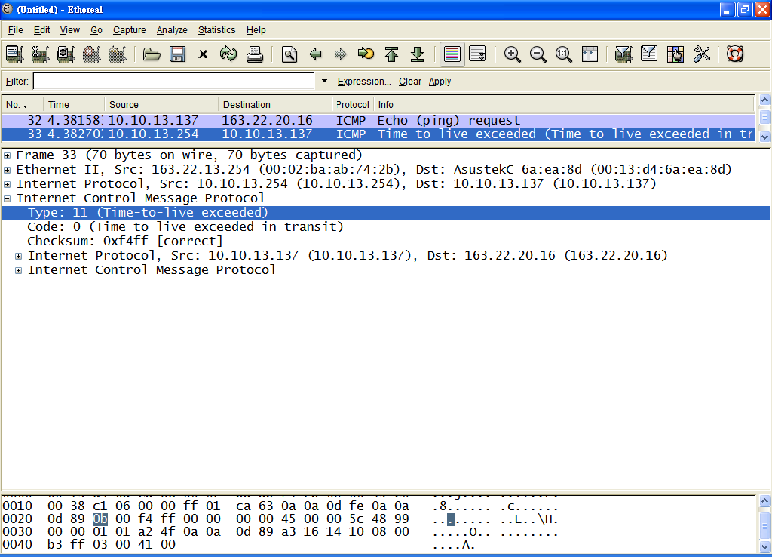

Slide 14
Fragmentation and Re-assembly
Different packet sizes
When to re-assemble
At destination
Results in packets getting smaller as data traverses internet
Intermediate re-assembly
Need large buffers at routers
Buffers may fill with fragments
All fragments must go through same router
Inhibits dynamic routing

Slide 15
IP Fragmentation
IP re-assembles at destination only
Uses fields in header
Data Unit Identifier (ID)
Identifies end system originated datagram
Source and destination address
Protocol layer generating data (e.g. TCP)
Identification supplied by that layer
Data length
Length of user data in octets
Offset
Position of fragment of user data in original datagram
In multiples of 64 bits (8 octets)
More flag
Indicates that this is not the last fragment

Slide 16
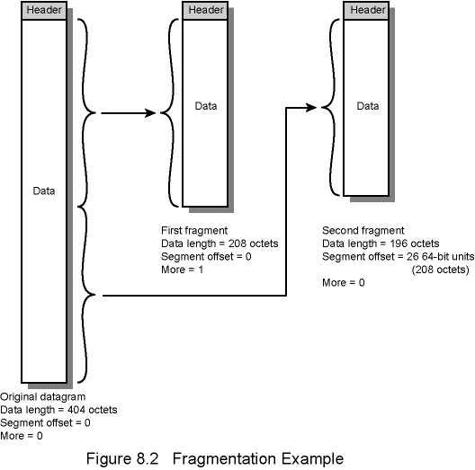
Fragmentation Example

Slide 17
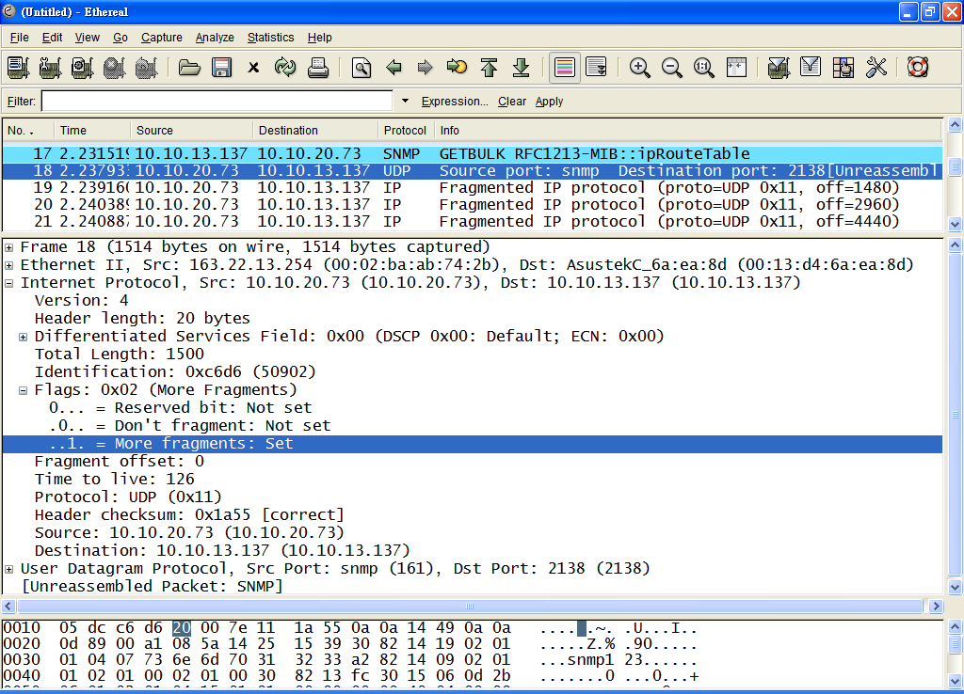

Slide 19
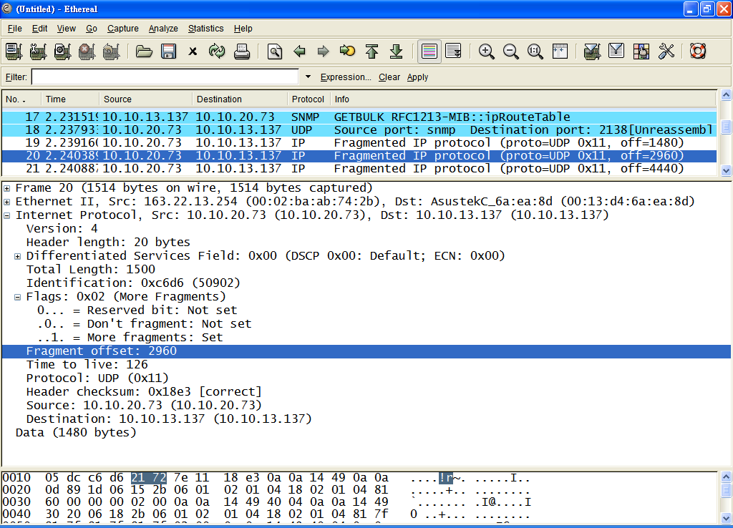

Slide 20
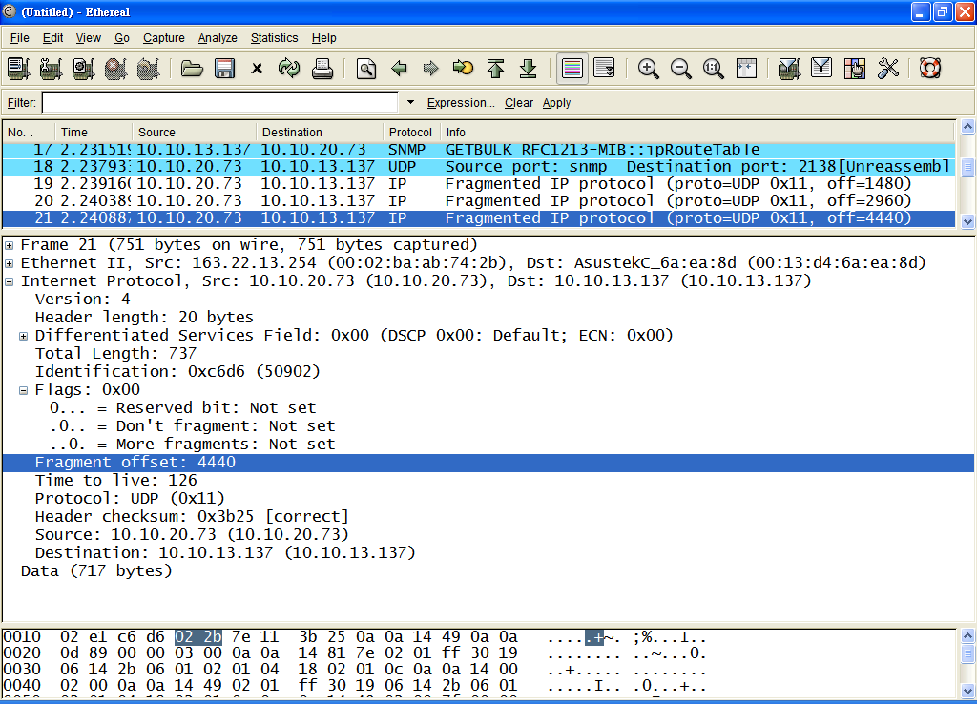

Slide 21
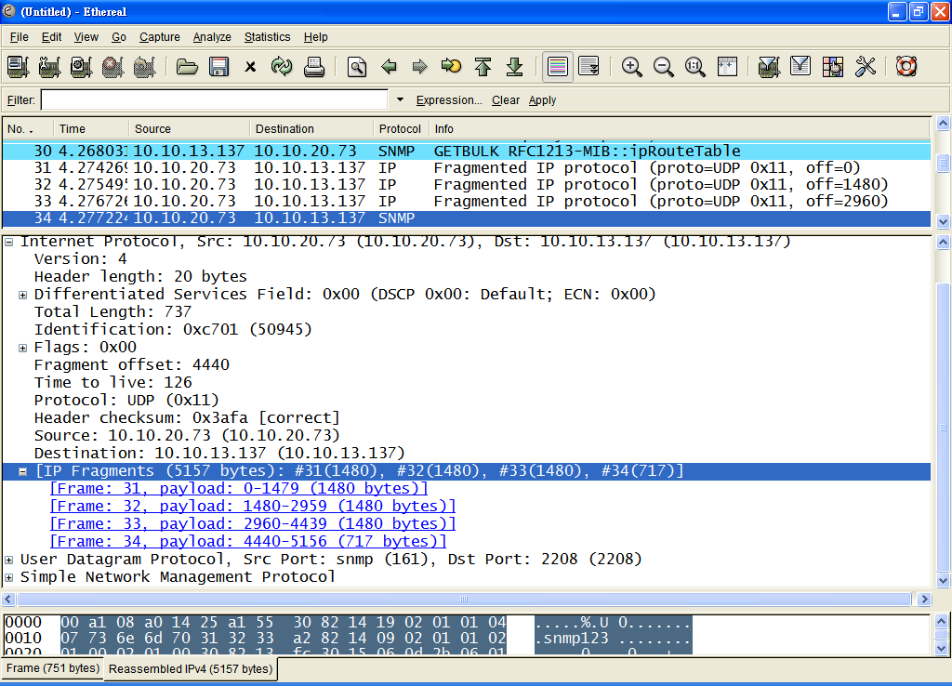

Slide 22
Addressing
Addressing level
Addressing scope
Connection identifiers
Addressing mode

Slide 23
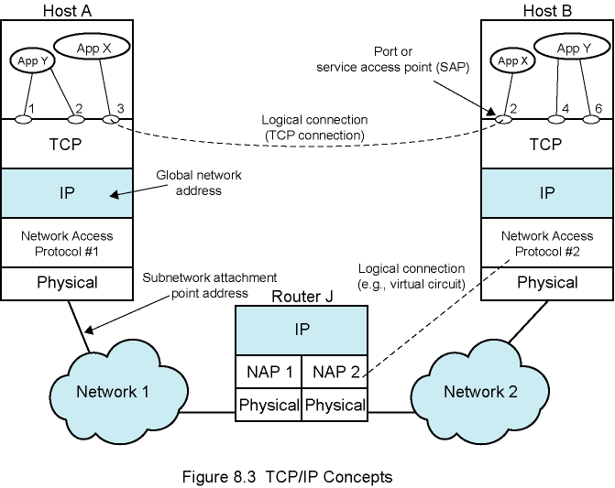
TCP/IP Concepts

Slide 24
Addressing Level
Level in comms architecture at which entity is named
Unique address for each end system
e.g. workstation or server
And each intermediate system
(e.g., router)
Network-level address
IP address or internet address
OSI - network service access point (NSAP)
Used to route PDU through network
At destination data must routed to some process
Each process assigned an identifier
TCP/IP port
Service access point (SAP) in OSI

Slide 25
Addressing Scope
Global address
Global nonambiguity
Global applicability: Any system identifies any other system by means of global address.
Enables internet to route data between any two systems
Need unique address for each device interface on network
MAC address on IEEE 802 network and ATM host address
Enables network to route data units through network and deliver to intended system
Network attachment point address

Slide 26
IPv4/v6 Addressing Modes
Unicast
Anycast (in IPv6)
Multicast
Broadcast
Note:
In practice, Multicast/Broadcast packets will not be forwarded by routers.
➔ Scope of Multicast/Broadcast is limited within a single network.

Slide 27
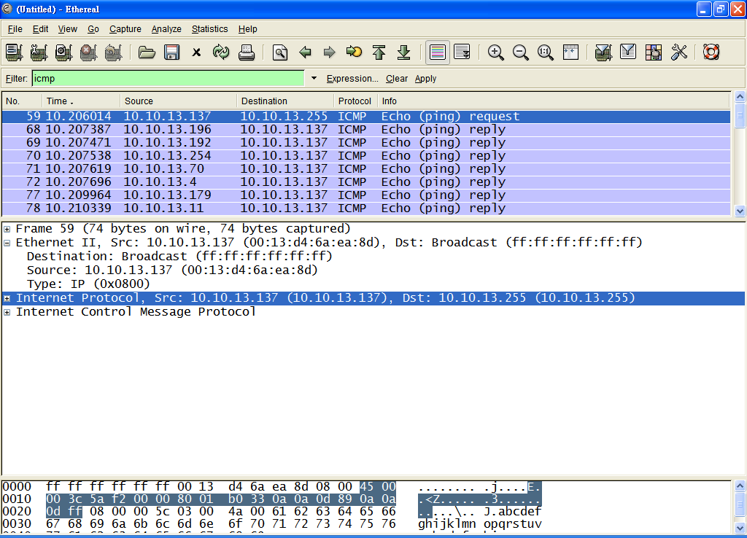
Broadcast

Slide 28
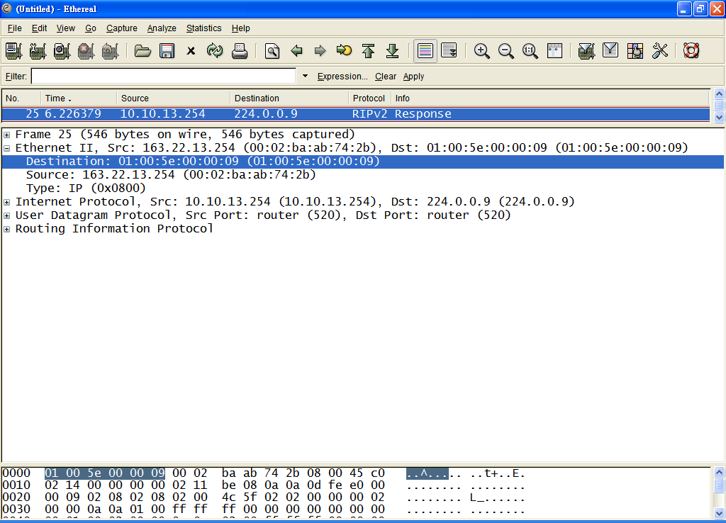
IP Multicast address: W.X.Y.Z
23 low order bits
Multicast
0xxxxxxx.xxxxxxxx.xxxxxxxx
X’ Y Z
01:00:5e:X’:Y:Z

Slide 29
Internet Protocol (IP) Version 4
Part of TCP/IP
Used by the Internet
Specifies interface with higher layer
e.g. TCP
Specifies protocol format and mechanisms
RFC 791
www.rfc-editor.org
Will (eventually) be replaced by IPv6 (see later)

Slide 30
IP Services
Primitives
Functions to be performed
Form of primitive implementation dependent
e.g. subroutine call
Send
Request transmission of data unit
Deliver
Notify user of arrival of data unit
Parameters
Used to pass data and control info

Slide 31
Parameters (1)
Source address
Destination address
Protocol
Recipient e.g. TCP
Type of Service
Specify treatment of data unit during transmission through networks
Identification
Source, destination address and user protocol
Uniquely identifies PDU
Needed for re-assembly and error reporting
Send only

Slide 32
Parameters (2)
Don’t fragment indicator
Can IP fragment data
If not, may not be possible to deliver
Send only
Time to live
Send only
Data length
Option data
User data

Slide 33
Options
Security
Source routing (Strict, Loose)
Route recording
Stream identification
Timestamp

Slide 34
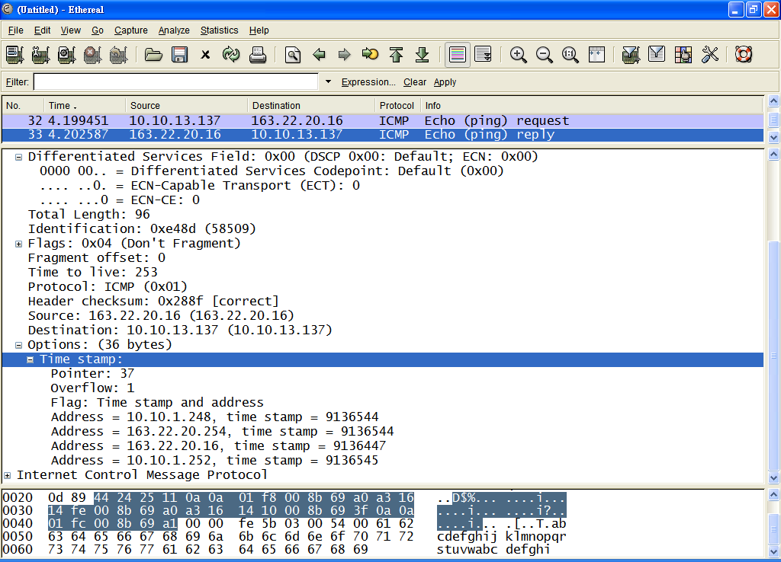
Timestamp
9136.544 sec
~ 152.28 min
~ 2.54 hr
Milliseconds since midnight UT

Slide 35
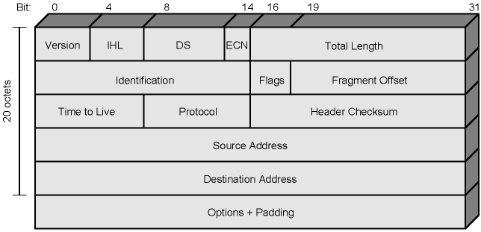
IPv4 Header

Slide 36
Header Fields (1)
Version
Currently 4
IP v6 - see later
Internet header length
In 32 bit words
Including options
Type of service (DS/ECN)
Total length
Of datagram, in octets
DS: Differentiated Service
ECN: Explicit Congestion Notification

Slide 37
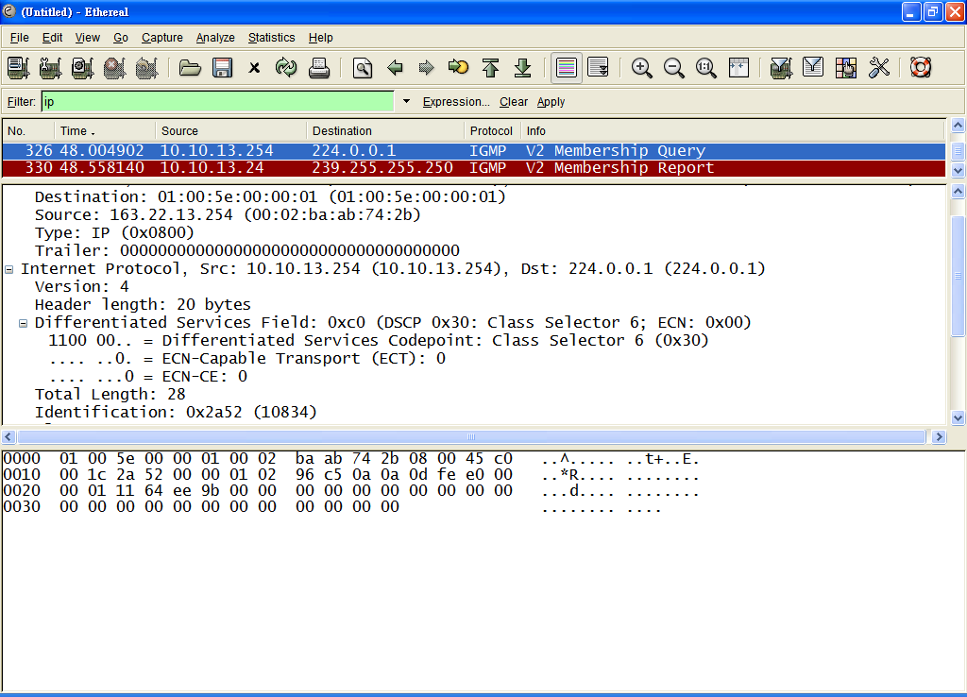
DS/ECN

Slide 38
Header Fields (2)
Identification
Sequence number
Used with addresses and user protocol to identify datagram uniquely
Flags
More bit
Don’t fragment
Fragmentation offset
Time to live
Protocol
Next higher layer to receive data field at destination
0
DF
MF

Slide 39
Protocol
Protocol: 8 bits
Identifies contents of data field
1 = ICMP
6 = TCP
17 =UDP
IP
Header
Data Field
ICMP, TCP, or UDP Message
http://www.iana.org/assignments/protocol-numbers

Slide 40
Header Fields (3)
Header checksum
Re-verified and recomputed at each router
16 bit ones complement sum of all 16 bit words in header
Set to zero during calculation
Source address
Destination address
Options
Padding
To fill to multiple of 32 bits long

Slide 41
Traceroute
RFC 1393
To provide a trace of the path the packet took to reach the destination.
Operates by first sending out a packet with a Time To Live (TTL) of 1. The first hop then sends back an ICMP error message indicating that the packet could not be forwarded because the TTL expired.
The packet is then resent with a TTL of 2, and the second hop returns the TTL expired. This process continues until the destination is reached.
Record the source of each ICMP TTL exceeded message

Slide 42
tracert
C:\>tracert –d 163.22.7.6
Tracing route to 163.22.7.6 over a maximum of 30 hops
1 2 ms 4 ms <1 ms 10.10.13.254
2 <1 ms <1 ms <1 ms 163.22.1.253
3 <1 ms <1 ms <1 ms 163.22.7.6
Trace complete.

Slide 43
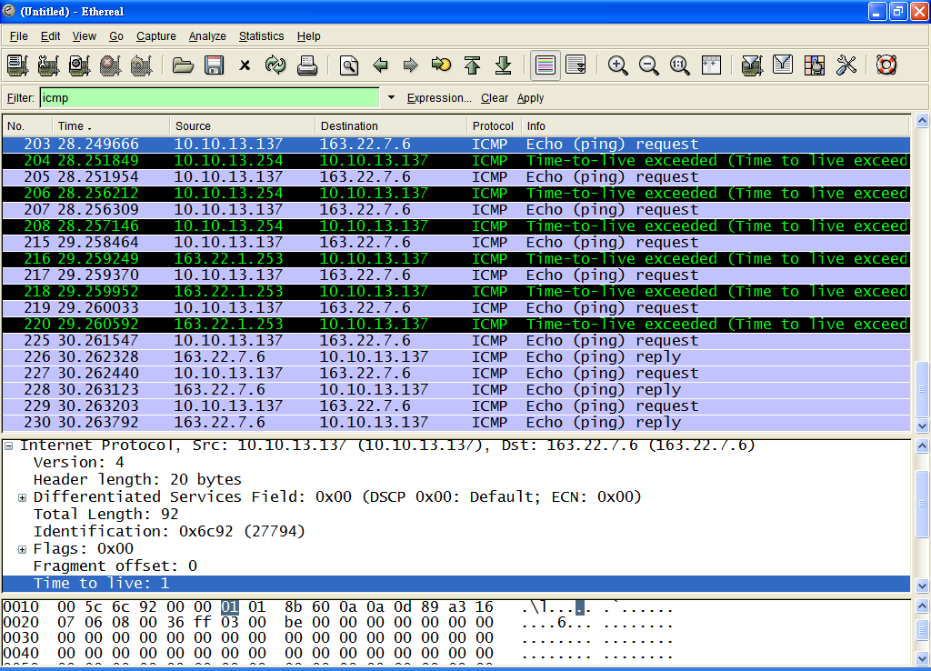

Slide 44
VisualRoute
http://www.visualroute.com/

Slide 45
Data Field
Carries user data from next layer up
Integer multiple of 8 bits long (octet)
Max length of datagram (header plus data) 65,535 octets

Slide 46
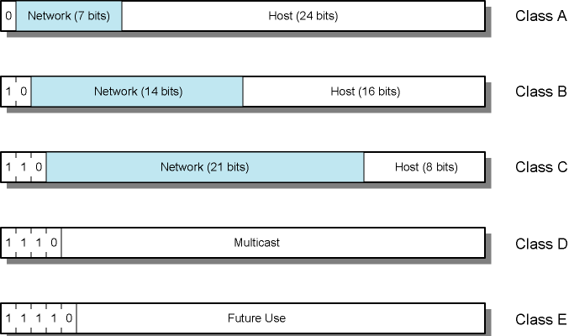
IPv4 Address Formats
0 ~ 127
128 ~ 191
192 ~ 223
224 ~ 239
240 ~

Slide 47
IP Addresses - Class A
32 bit global internet address
Network part and host part
Class A
Start with binary 0
All 0 reserved (0.0.0.0)
01111111 (127) reserved for loopback
Range 1.x.x.x to 126.x.x.x
All allocated
http://www.iana.org/assignments/ipv4-address-space

Slide 48
IP Addresses - Class B
Start 10
Range 128.x.x.x to 191.x.x.x
Second Octet also included in network address
2¹⁴ = 16,384 class B addresses
All allocated

Slide 49
IP Addresses - Class C
Start 110
Range 192.x.x.x to 223.x.x.x
Second and third octet also part of network address
2²¹ = 2,097,152 addresses
Nearly all allocated
See IPv6

Slide 50
Private IP Addresses
Any organization can use these inside their network
Can’t go on the internet. [RFC 1918]
10.0.0.0 - 10.255.255.255 (10/8 prefix)
172.16.0.0 - 172.31.255.255 (172.16/12 prefix)
192.168.0.0 - 192.168.255.255 (192.168/16 prefix)
1
16
256

Slide 51
Subnets and Subnet Masks
Allow arbitrary complexity of internetworked LANs within organization
Insulate overall internet from growth of network numbers and routing complexity
Site looks to rest of internet like single network
Each LAN assigned subnet number
Host portion of address partitioned into subnet number and host number
Local routers route within subnetted network
Subnet mask indicates which bits are subnet number and which are host number

Slide 52
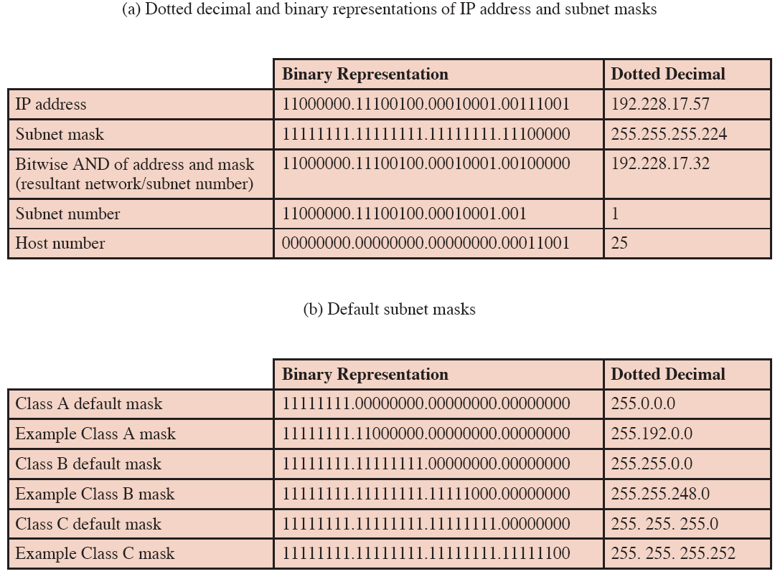

Slide 53
Special IP Addresses
All-0 host suffix ⇒ Network Address
163.22.20.16/24 → 163.22.20.0/24
163.22.20.137/26 → 163.22.20.?/26
163.22.20.137: 163.22.20.10001001 → 163.22.20.10000000 (163.22.20.128/26)
All-0s ⇒ This computer
0.0.0.0
All-0s network ⇒ This network.
163.22.20.7/24 → 0.0.0.7 (Host 7 on this network)
All-1 host suffix ⇒ All hosts on the destination net
(directed broadcast)
163.22.20.16/24 → 163.22.20.255
All-1s ⇒ All hosts on this net (limited broadcast)
255.255.255.255
Subnet number cannot be all 1
127.*.*.* ⇒ Loopback through IP layer
127.0.0.1

Slide 54
Question
一個原為Class C之IP網路，均分成多個子網路遮罩為255.255.255.224的子網路後，將減少____ 個可配置的主機位址。(96研)
Hints:
Class C: 255.255.255.0
224: 11100000
host all 0’s: Network ID
host all 1’s: Broadcast address

Slide 55
Host: 10.10.4.26
Subnet mask: 255.255.255.0
Default Gateway: 10.10.4.254
Send a packet destined to 10.10.4.35
10.10.4.35 AND 255.255.255.0 ?= 10.10.4.26 AND 255.255.255.0 → Yes, the same subnet
Send to 10.10.4.35 directly
Send a packet destined to 10.10.6.3
10.10.6.3 AND 255.255.255.0 ?= 10.10.4.26 AND 255.255.255.0 → No, the different subnets
Send to default gateway (10.10.4.254)

Slide 56
Routing Table
For each row [i]:
if ((Mask[i] & Destination Addr) = = Destination[i]) ➔ Match!
if row[i] is the best match
forward to NextHop[i]

Slide 57
C:\> route print
C:\>route print
===========================================================================
Interface List
0x1 ........................... MS TCP Loopback interface
0x10003 ...00 15 f2 ec 4a 50 ...... Intel(R) PRO/1000 PL Network Connection
===========================================================================
===========================================================================
Active Routes:
Network Destination Netmask Gateway Interface Metric
0.0.0.0 0.0.0.0 10.10.13.254 10.10.13.137 20
10.10.13.0 255.255.255.0 10.10.13.137 10.10.13.137 20
10.10.13.137 255.255.255.255 127.0.0.1 127.0.0.1 20
10.255.255.255 255.255.255.255 10.10.13.137 10.10.13.137 20
127.0.0.0 255.0.0.0 127.0.0.1 127.0.0.1 1
224.0.0.0 240.0.0.0 10.10.13.137 10.10.13.137 20
255.255.255.255 255.255.255.255 10.10.13.137 10.10.13.137 1
Default Gateway: 10.10.13.254
===========================================================================
Persistent Routes:
None
C:\>

Slide 58
Routing Table
Row
Destination
Network or
Subnet
Mask (/Prefix)*
Metric
(Cost)
Interface
Next-
Hop
Router
1
128.171.0.0
255.255.0.0 (/16)
47
2
G
2
172.30.33.0
255.255.255.0 (/24)
0
1
Local
3
192.168.6.0
255.255.255.0 (/24)
12
2
G
Routers Base Routing Decisions on Their Routing Tables.
Each Row Represents a Route to a Network or Subnet
For Each Arriving Packet, The Packet’s Destination IP Address Is Matched Against the Destination Network or Subnet Field in Every Row

Slide 59
Routing Table
Row
Destination
Network or
Subnet
Mask (/Prefix)*
Metric
(Cost)
Interface
Next-
Hop
Router
1
128.171.0.0
255.255.0.0 (/16)
47
2
G
2
172.30.33.0
255.255.255.0 (/24)
0
1
Local
3
192.168.6.0
255.255.255.0 (/24)
12
2
G
Each Row Represents a Route to a Network or Subnet.
All packets to that network or subnet are governed by that one row.
So there is one rule for a range of IP addresses. This reduces the number of rows that must be considered.

Slide 60
Routing Table
Row
Destination
Network or
Subnet
Mask (/Prefix)*
Metric
(Cost)
Interface
Next-
Hop
Router
1
128.171.0.0
255.255.0.0 (/16)
47
2
G
2
172.30.33.0
255.255.255.0 (/24)
0
1
Local
3
192.168.6.0
255.255.255.0 (/24)
12
2
G
Row 1
If Destination IP Address = 172. 30.33.6
Mask = 255.255. 0.0
Result = 172. 30. 0.0
Destination Network or Subnet = 128.171. 0.0
No match!

Slide 61
Routing Table
Row
Destination
Network or
Subnet
Mask (/Prefix)*
Metric
(Cost)
Interface
Next-
Hop
Router
1
128.171.0.0
255.255.0.0 (/16)
47
2
G
2
172.30.33.0
255.255.255.0 (/24)
0
1
Local
3
192.168.6.0
255.255.255.0 (/24)
12
2
G
Row 1
If Destination IP Address = 172. 30. 33.6
Mask = 255.255.255.0
Result = 172. 30. 33.0
Destination Network or Subnet = 172. 30. 33.0
This row is a match!

Slide 62
Routing Table
Row
Destination
Network or
Subnet
Mask (/Prefix)*
Metric
(Cost)
Interface
Next-
Hop
Router
1
128.171.0.0
255.255.0.0 (/16)
47
2
G
2
172.30.33.0
255.255.255.0 (/24)
0
1
Local
3
192.168.6.0
255.255.255.0 (/24)
12
2
G
Row 3
If Destination IP Address = 172. 30. 33.6
Mask =
Result =
Destination Network or Subnet =
Is this row is a match?

Slide 63
Routing
For Each Incoming IP Packet
Destination IP address is matched against every row in the routing table.
If the routing table has 10,000 rows, 10,000 comparisons will be made for each packet.
There can be multiple matching rows for a destination IP address, corresponding to multiple alternative routes.
After all matches are found, the best match must be selected.

Slide 64
only one row matches
Row
Destination
Network or
Subnet
Mask (/Prefix)*
Metric
(Cost)
Interface
Next-
Hop
Router
3
192.168.0.0
255.255.0.0 (/16)
12
2
G
If only one row matches, it will be selected as the best row match.
Destination IP address = 192.168.6.7

Slide 65
Default Route
Row
Destination
Network or
Subnet
Mask (/Prefix)*
Metric
(Cost)
Interface
Next-
Hop
Router
15
0.0.0.0
0.0.0.0 (/0)
5
3
H
The default row always matches
Mask 0.0.0.0 applied to anything results in 0.0.0.0.
This always matches the Network/Subnet value 0.0.0.0.
The router specified for this row (H) is the default router.

Slide 66
Multiple Matches - 1
Row
Destination
Network or
Subnet
Mask (/Prefix)*
Metric
(Cost)
Interface
Next-
Hop
Router
1
128.171.0.0
255.255.0.0 (/16)
47
2
G
7
127.171.17.0
255.255.255.0 (/24)
55
3
H
If there are multiple matches, the row with the longest length of match is selected
This is Row 7 for 128.171.17.56 (24 bit match)
Row 1’s length of match is only 16 bits
Longer matches often are routes to a particular subnet within a network

Slide 67
Multiple Matches - 2
Row
Destination
Network or
Subnet
Mask (/Prefix)*
Metric
(Cost)
Interface
Next-
Hop
Router
5
172.29.8.0
255.255.255.0 (/24)
34
1
F
8
172.29.8.0
255.255.255.0 (/24)
20
3
H
If there are multiple rows with the same lengths of match, the metric column compares alternative routes.
If the metric is cost, the smallest metric wins (20)
If the metric is speed, the largest metric wins (34)

Slide 68
IPv6 - Version Number
IP v 1-3 defined and replaced
IP v4 - current version
IP v5 - streams protocol
Connection oriented internet layer protocol
IP v6 - replacement for IP v4
During development it was called IPng
Next Generation

Slide 69
Why Change IP?
Address space exhaustion
Two level addressing (network and host) wastes space
Network addresses used even if not connected to Internet
Growth of networks and the Internet
Extended use of TCP/IP
Single address per host
Requirements for new types of service

Slide 70
IPv6 RFCs
1752 - Recommendations for the IP Next Generation Protocol
8200 - Overall specification
4291 - addressing structure
others (find them)
www.rfc-editor.org

Slide 71
IPv6 Enhancements (1)
Expanded address space
128 bit
Improved option mechanism
Separate optional headers between IPv6 header and transport layer header
Most are not examined by intermediate routes
Improved speed and simplified router processing
Easier to extend options
Address autoconfiguration
Dynamic assignment of addresses

Slide 72
IPv6 Enhancements (2)
Increased addressing flexibility
Anycast - delivered to one of a set of nodes
Improved scalability of multicast addresses (scope)
Support for resource allocation
Replaces type of service
Labeling of packets to particular traffic flow
Allows special handling
e.g. real time video

Slide 73
IPv6 Structure
40 octets
0 or more
IPv6 header | Extension Header |    | Extension Header | Transport-level PDU
Extension Headers:
Hop-by-Hop Options
Require processing at each router
Routing
Similar to v4 source routing
Fragment
Authentication
Encapsulating security payload
Destination options
For destination node

Slide 74
IPv6 Extension Headers
Without Extension Headers
IPv6 Header
Next Header=
TCP
Data
TCP Header
With Extension Headers
IPv6 Header
Next Header=
Routing
Data
Routing Header
Next Header=
TCP
TCP Header
IPv6 Header
Next Header=
Routing
Data
Routing Header
Next Header=
Fragment
Fragment Header
Next Header=
TCP
TCP Header

Slide 75
IPv6 Packet with Extension Headers
Next header

Slide 76
IPv6 Header
Traffic Class

Slide 77
IPv6 Header Fields (1)
Version
6
Traffic Class (DS/ECN)
Classes or priorities of packet
Still under development
See RFC 2460
Flow Label
Used by hosts requesting special handling
Payload length
Includes all extension headers plus user data

Slide 78
IPv6 Header Fields (2)
Next Header
Identifies type of header
Extension or next layer up
http://www.iana.org/assignments/protocol-numbers
Source Address
Destination address
0 = Hop-by-Hop Options
41 = ipv6
43 = Routing
44 = Fragment
51 = Authentication
60 = Destination Options
50 = Encapsulating Security Payload
58 = Internet Control Message Protocol (ICMP for IPv6)
59 = no next header

Slide 79
Flow Label
Flow
Sequence of packets from particular source to particular (unicast or multicast) destination
Source desires special handling by routers
Uniquely identified by source address, destination address, and 20-bit flow label
Router's view
Sequence of packets sharing attributes affecting how packets handled
Path, resource allocation, discard needs, accounting, security
Handling must be declared
Negotiate handling ahead of time using control protocol
At transmission time using extension headers
E.g. Hop-by-Hop Options header

Slide 80
Flow Label Rules
Flow Label set to zero if not supported by host or router when originating
Pass unchanged when forwarding
Ignore when receiving
Packets from given source with same nonzero Flow Label must have same Destination Address, Source Address, Hop-by-Hop Options header contents (if present), and Routing header contents (if present)
Router can make decisions by looking up flow label in table
Source assigns flow label
New flow labels be chosen (pseudo-) randomly and uniformly
Range 1 to 2²⁰ – 1
Not reuse label within lifetime of existing flow
Zero flow label indicates no flow label

Slide 81
IPv6 Addresses
128 bits long
Assigned to interface
Single interface may have multiple unicast addresses
Three types of address
unicast, anycast, multicast

Slide 82
Types of address
Unicast
Single interface
Anycast
Set of interfaces (typically different nodes)
Delivered to any one interface
the “nearest”
Multicast
Set of interfaces
Delivered to all interfaces identified

Slide 83
Text Representation of IPv6 Addresses
RFC 3513* / 4291
x:x:x:x:x:x:x:x
hexadecimal values of the eight 16-bit pieces of the address.
FEDC:BA98:7654:3210:FEDC:BA98:7654:3210
1080:0:0:0:8:800:200C:417A
It is not necessary to write the leading zeros in an individual field.
0008 ➔ 8, 0800 ➔ 800
* RFC 3513 has been obsoleted by RFC 4291.

Slide 84
IPv6 Address Representation (2)
The use of "::" indicates multiple groups of 16-bits of zeros.
Unicast address
1080:0:0:0:8:800:200C:417A
1080::8:800:200C:417A
Multicast address
FF01:0:0:0:0:0:0:101 ➔ FF01::101
Loopback address
0:0:0:0:0:0:0:1 ➔ ::1
unspecified addresses (Absence of address)
0:0:0:0:0:0:0:0 ➔ ::

Slide 85
IPv6 Address Representation (3)
IPv4 and IPv6 mixed address
x:x:x:x:x:x:d.d.d.d
x: IPv6, d: IPv4
Eg.
0:0:0:0:0:FFFF:129.144.52.38
::13.1.68.3
::FFFF:129.144.52.38

Slide 86
Address Type Identification
Address type Binary prefix IPv6 notation
Unspecified 00...0 (128 bits) ::/128
Loopback 00...1 (128 bits) ::1/128
Global Unicast 001 2000::/3
Unique Local Unicast 1111 110 FC00::/7
Link Local Unicast 1111 1110 10 FE80::/10
Site-local unicast* 1111 1110 11 FEC0::/10
Multicast 1111 1111 FF00::/8
http://www.iana.org/assignments/ipv6-address-space/ipv6-address-space.xml
* No longer supported in new implementations

Slide 87
Unicast Addresses
Global Unicast address
Unique Local Unicast address (RFC 4193)
globally unique for local communications, usually inside of a site.
Not expected to be routable on the global Internet.
Routable inside of a limited area such as a site.
Link Local address (RFC 4291)
for addressing on a single link for purposes such as automatic address configuration, neighbor discovery, or when no routers are present.
Routers must not forward any packets with Link-Local source or destination addresses to other links.
Site-local address
(Private IP addresses)

Slide 88
IPv6 Global Unicast Address Assignments
https://www.iana.org/assignments/ipv6-unicast-address-assignments/ipv6-unicast-address-assignments.xhtml
Prefix | Designation | Date | WHOIS | RDAP | Status
2001:0000::/23 | IANA | 1999/7/1 | whois.iana.org |  | ALLOCATED
2001:0200::/23 | APNIC | 1999/7/1 | whois.apnic.net | https://rdap.apnic.net/ | ALLOCATED
2001:0400::/23 | ARIN | 1999/7/1 | whois.arin.net | https://rdap.arin.net/registry | ALLOCATED
 |  |  |  | http://rdap.arin.net/registry
2001:0600::/23 | RIPE NCC | 1999/7/1 | whois.ripe.net | https://rdap.db.ripe.net/ | ALLOCATED
2001:0800::/22 | RIPE NCC | 2002/11/2 | whois.ripe.net | https://rdap.db.ripe.net/ | ALLOCATED
2001:0c00::/23 | APNIC | 2002/5/2 | whois.apnic.net | https://rdap.apnic.net/ | ALLOCATED
2001:0e00::/23 | APNIC | 2003/1/1 | whois.apnic.net | https://rdap.apnic.net/ | ALLOCATED
2001:1200::/23 | LACNIC | 2002/11/1 | whois.lacnic.net | https://rdap.lacnic.net/rdap/ | ALLOCATED
2001:1400::/22 | RIPE NCC | 2003/7/1 | whois.ripe.net | https://rdap.db.ripe.net/ | ALLOCATED
2001:1800::/23 | ARIN | 2003/4/1 | whois.arin.net | https://rdap.arin.net/registry | ALLOCATED
 |  |  |  | http://rdap.arin.net/registry
2001:1a00::/23 | RIPE NCC | 2004/1/1 | whois.ripe.net | https://rdap.db.ripe.net/ | ALLOCATED
2001:1c00::/22 | RIPE NCC | 2004/5/4 | whois.ripe.net | https://rdap.db.ripe.net/ | ALLOCATED
2001:2000::/19 | RIPE NCC | 2019/3/12 | whois.ripe.net | https://rdap.db.ripe.net/ | ALLOCATED
2001:4000::/23 | RIPE NCC | 2004/6/11 | whois.ripe.net | https://rdap.db.ripe.net/ | ALLOCATED
2001:4200::/23 | AFRINIC | 2004/6/1 | whois.afrinic.net | https://rdap.afrinic.net/rdap/ | ALLOCATED
 |  |  |  | http://rdap.afrinic.net/rdap/
2001:4400::/23 | APNIC | 2004/6/11 | whois.apnic.net | https://rdap.apnic.net/ | ALLOCATED

Slide 89
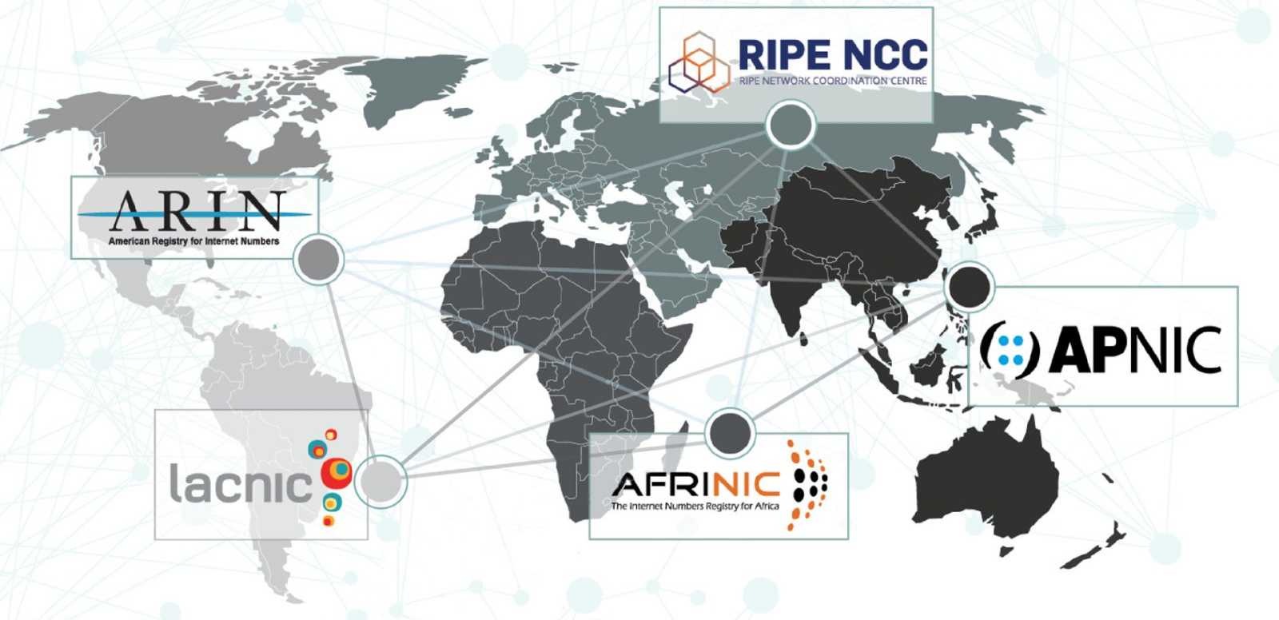
Number Resource Organization (NRO)
A coordinating body for the world’s Regional Internet Registries (RIRs)

Slide 90
IPv6 Unicast Addresses
128 bits
node address
n bits
128-n bits
subnet prefix
interface ID
n = 64 ➔ 8+8

Slide 91
Global Unicast Addresses
n bits
m bits
128-n-m bits
global routing prefix
subnet ID
interface ID
Site
Link

Slide 92
Local-Use IPv6 Unicast Addresses
fe80::98bc:4ce7:aae8:fed5
Link-Local Unicast Addresses
Site-Local Unicast Addresses
FE80::x:x:x:x
10 bits
54 bits
64 bits
1111111010
0
Interface ID
FEC0::s:x:x:x:x
10 bits
38 bits
16 bits
64 bits
1111111011
0
Subnet ID
Interface ID

Slide 93
Multicast Addresses
8 bits
4 bits
4 bits
112 bits
11111111
Flags
Scope
Group ID
0 reserved
1 Interface-Local scope
2 Link-Local scope
3 reserved
4 Admin-Local scope
5 Site-Local scope
6 (unassigned)
7 (unassigned)
8 Organization-Local scope
9 (unassigned)
A (unassigned)
B (unassigned)
C (unassigned)
D (unassigned)
E Global scope
F reserved
(loopback)
Flags:
Scope:
0000 : well known
0001 : transient
(multiple sites)

Slide 94
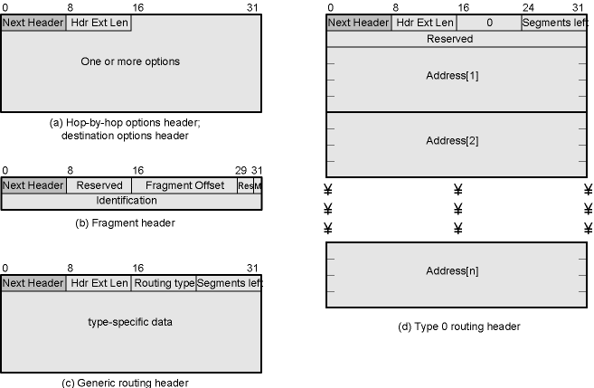
IPv6 Extension Headers
http://www.iana.org/assignments/ipv6-parameters

Slide 95
Hop-by-Hop Options
Next header
Header extension length
Options
Pad1
Insert one byte of padding into Options area of header
PadN
Insert N (≥2) bytes of padding into Options area of header
Ensure header is multiple of 8 bytes
Jumbo payload
Over 2¹⁶ = 65,535 octets
Router alert
Tells router that contents of packet is of interest to router
Provides support for RSPV

Slide 96
Fragmentation Header
Fragmentation only allowed at source
No fragmentation at intermediate routers
Node must perform path discovery to find smallest MTU of intermediate networks
Source fragments to match MTU
Otherwise limit to 1280 octets
RFC 1981: Path MTU Discovery for IP version 6

Slide 97
Fragmentation Header Fields
Next Header
Reserved
Fragmentation offset
Reserved
More flag
Identification

Slide 98
Routing Header
List of one or more intermediate nodes to be visited
Next Header
Header extension length
Routing type
Segments left
i.e. number of nodes still to be visited

Slide 99
Destination Options
Same format as Hop-by-Hop options header

