Slide 1
Network Security

Slide 2
Security Requirements
Confidentiality
Integrity
Authenticity
Availability
Non-repudiation

Slide 3
Passive Attacks
Eavesdropping on transmissions
To obtain information
Two types of passive attacks:
Release of message contents
  Outsider learns content of transmission
Traffic analysis
  By monitoring frequency and length of messages, even encrypted, nature of communication may be guessed
Difficult to detect
Can be prevented

Slide 4
Active Attacks
Four categories:
Masquerade
  Pretending to be a different entity
Replay
Modification of messages
  alter, delay, reorder
Denial of service
Easy to detect
  Detection may lead to deterrent(威懾)
Hard to prevent

Slide 5
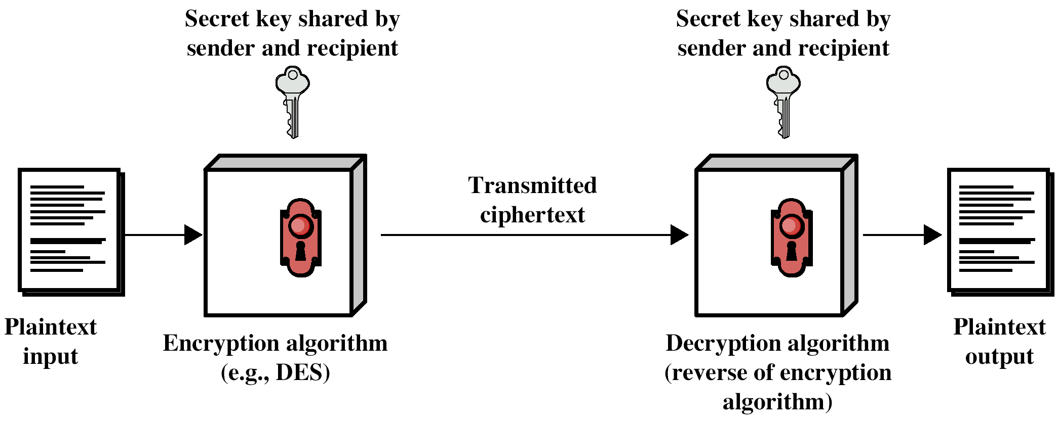
Confidentiality with Symmetric Encryption
Plain text
Encryption algorithm
Secret key
Cipher text
Decryption algorithm
Ingredients:

Slide 6
Requirements for Secure Use of Symmetric Encryption
Strong encryption algorithm
  Even if known, should not be able to decrypt or work out key
  Even if a number of cipher texts are available together with plain texts of them
Sender and receiver must obtain secret key securely
  Once key is known, all communication using this key is readable

Slide 7
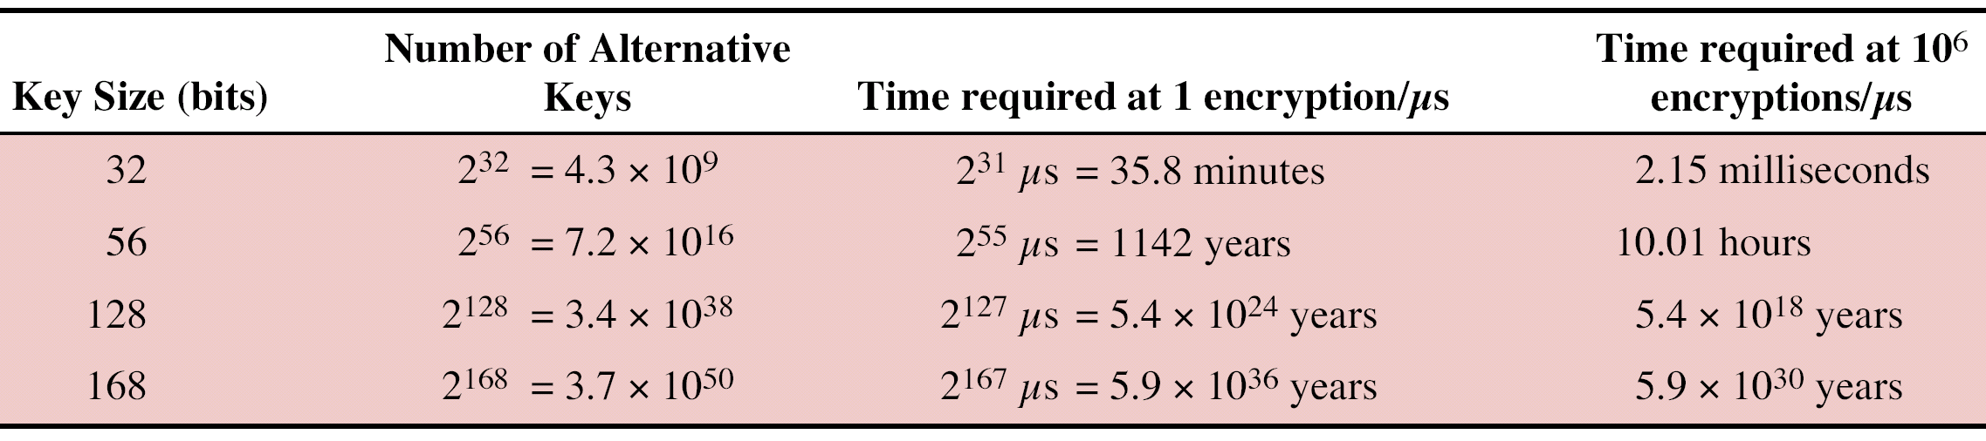
Attacking Encryption
Cryptanalysis
  Rely on nature of algorithm plus some knowledge of general characteristics of plain text
  Attempt to deduce plain text or key
Brute force
  Try every possible key until plain text is achieved

Slide 8
Encryption Algorithms
Block Cipher
  Process plain text in fixed block sizes producing block of cipher text of equal size
  Data encryption standard (DES)
  Triple DES (3DES, TDES)
  Advanced Encryption Standard (AES)

Slide 9
DES - Data Encryption Standard
US standard
64 bit plain text blocks
56 bit key
Broken in 1998 by Electronic Frontier Foundation
  Special purpose machine
  Less than three days
  DES now worthless

Slide 10
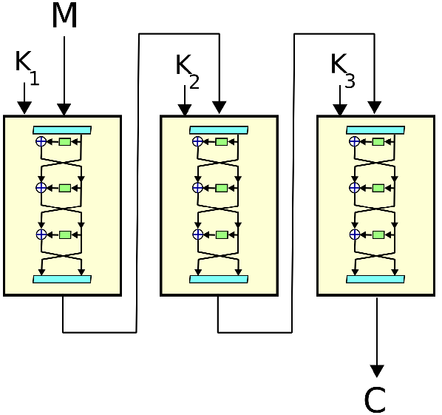
Triple DEA
ANSI X9.17 (1985)
Incorporated in DEA standard 1999
Uses 3 keys and 3 executions of DEA algorithm
key length 112 or 168 bit
Block size: 64 bit
Slow
Wiki

Slide 11
Advanced Encryption Standard
National Institute of Standards and Technology (NIST) in 1997 issued call for Advanced Encryption Standard (AES)
  Rijndael (Rijmen & Daemen)
  Security strength equal to or better than 3DES
  Improved efficiency
  Symmetric block cipher, Block length 128 bits
  Key lengths 128, 192, and 256 bits
  Evaluation include security, computational efficiency, memory requirements, hardware and software suitability, and flexibility
  2001, AES issued as federal information processing standard (FIPS 197)

Slide 12
AES Description
Assume key length 128 bits
Input is single 128-bit block
  Depicted as square matrix of bytes
  Block copied into State array
    Modified at each stage
  After final stage, State copied to output matrix
128-bit key depicted as square matrix of bytes
  Expanded into array of key schedule words
  Each four bytes (1 word = 4 bytes)
  Total key schedule 44 words (4 *11) for 128-bit key
Byte ordering by column
  First four bytes of 128-bit plaintext input occupy first column of in matrix
  First four bytes of expanded key occupy first column of w matrix
1
2
3
4
5
6
7
8
9
10
11
12
13
14
15
16

Slide 13
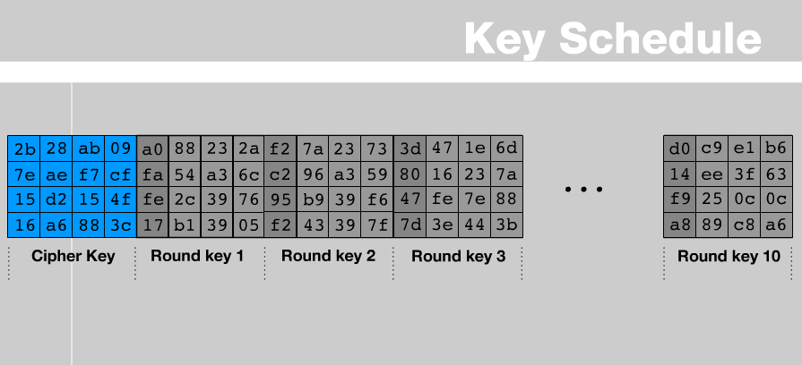
w[0, 3]
w[4, 7]

Slide 14
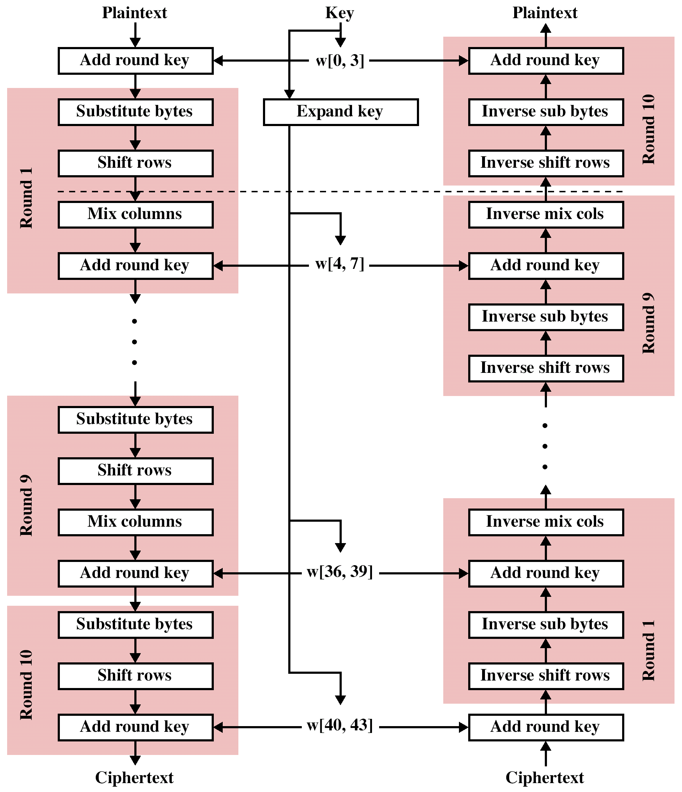
AES
Encryption /
Decryption

Slide 15
AES Comments (1)
Key expanded into array of forty-four 32-bit words, w[i]
  Four distinct words (128 bits) serve as round key for each round
Four different stages (One permutation and three substitution)
  Substitute bytes uses S-box table to perform byte-by-byte substitution of block
  Shift rows is permutation that performed row by row
  Mix columns is substitution that alters each byte in column as function of all of bytes in column
  Add round key is bitwise XOR of current block with portion of expanded key

Slide 16
AES Comments (2)
Simple structure
  For both encryption and decryption, cipher begins with Add Round Key stage
  Followed by nine rounds,
    Each includes all four stages
  Followed by tenth round of three stages
https://ycchen.im.ncnu.edu.tw/AdvNet/aes.swf
https://www.youtube.com/watch?v=gP4PqVGudtg

Slide 17
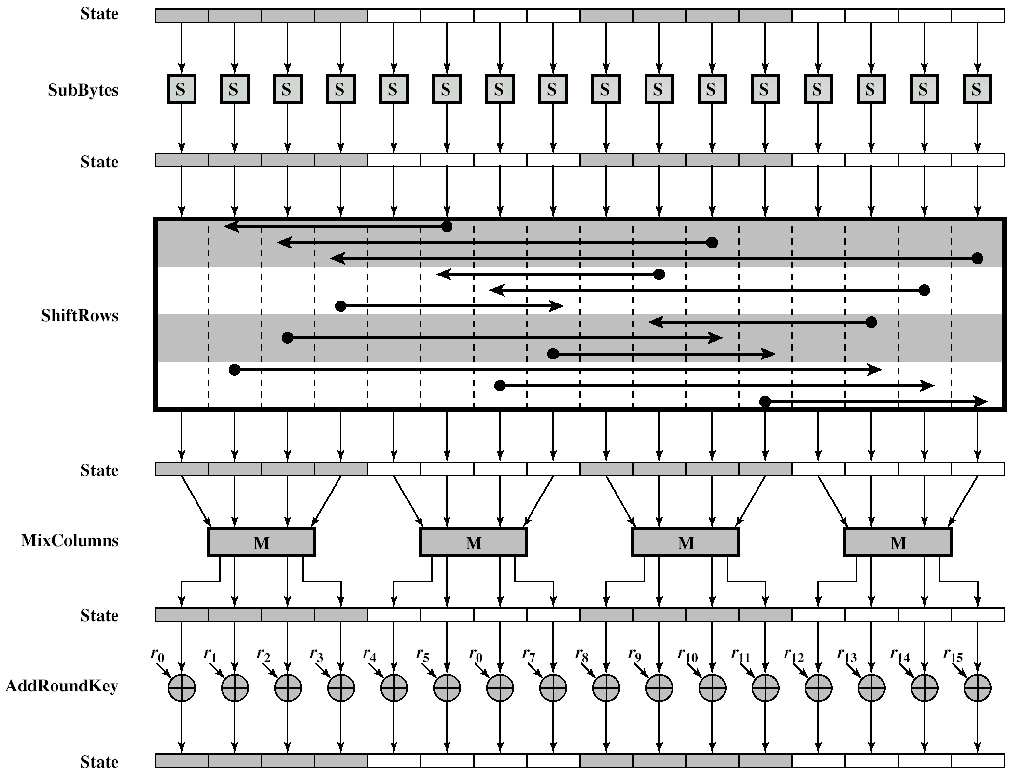
AES Encryption Round

Slide 18
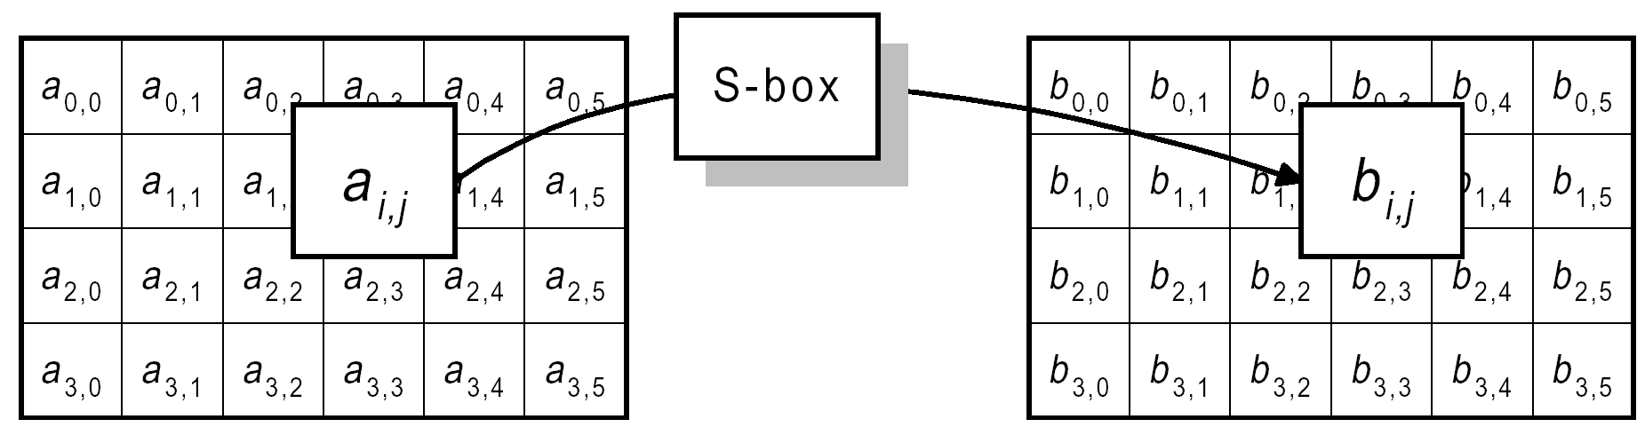
Byte Substitution

Slide 19
b6 ➔ 4e, 7b ➔ ?

Slide 20
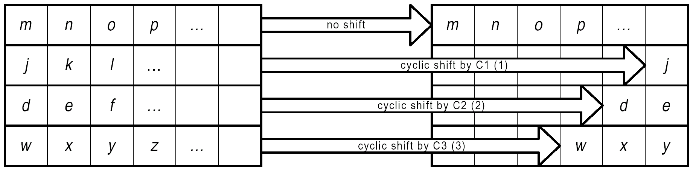
ShiftRows Operation

Slide 21
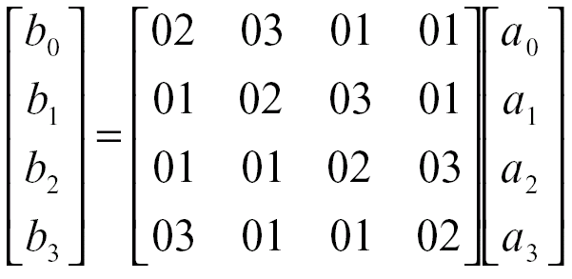
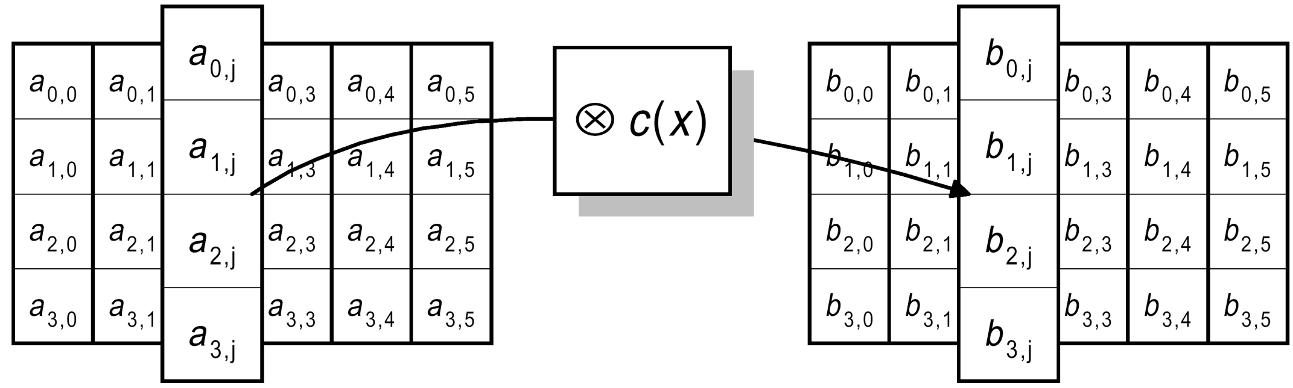
MixColumn Operation

Slide 22
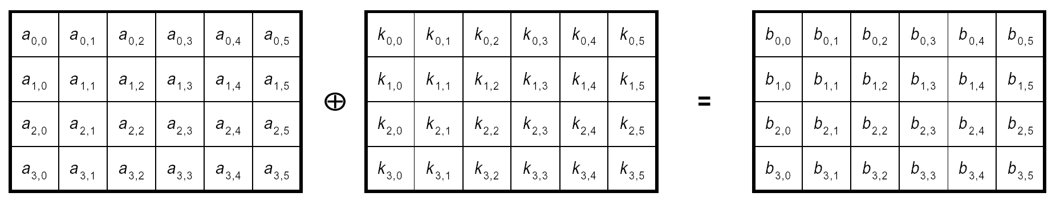
Add Round Key

Slide 23
AES Comments (3)
Only Add Round Key stage uses key
  Begin and ends with Add Round Key stage
  Any other stage at beginning or end, reversible without key
    Adds no security
Add Round Key stage by itself not formidable
  Other three stages scramble bits
  By themselves provide no security because no key
Each stage easily reversible
Decryption uses expanded key in reverse order
  Not identical to encryption algorithm
Easy to verify that decryption does recover plaintext
Final round of encryption and decryption consists of only three stages
  To make the cipher reversible

Slide 24
Key Distribution and Agreement
Key Distribution
  A manual or automated key-establishment procedure whereby one entity (the sender) selects and distributes the key to another entity (the receiver).
Key Agreement
  A key-establishment procedure where resultant key is a function of information contributed by two or more participants
  No party can predetermine the value of the key independently of the other party’s contribution.
  Key agreement refers to one form of key exchange in which two or more users execute a protocol to securely share a resultant key.

Slide 25
Session Key and Permanent Key
Two kinds of keys:
Session Key
  Used for duration of one logical connection
  Destroyed at end of session
  Used for user data
Permanent key
  Used for distribution of keys

Slide 26
Traffic Padding
To reduce the opportunity of traffic analysis
Produce cipher text continuously
If no plain text to encode, send random data
Make traffic analysis impossible

Slide 27
Message Authentication and Hash Functions
Protection against active attacks
  Falsification of data and transactions
Message is authentic if it is genuine and comes from the alleged source
Authentication allows receiver to verify that message is authentic
  Message has not altered
  Message is from authentic source
  Message timeline

Slide 28
Authentication Using Encryption
Assumes sender and receiver are only entities that know key
Message includes:
  error detection code
  sequence number
  time stamp

Slide 29
Authentication Without Encryption
Authentication tag generated and appended to each message
Message not encrypted
Useful for:
  Messages broadcast to multiple destinations
    Have one destination responsible for authentication
  One side heavily loaded
    Encryption adds to workload
    Can authenticate random messages
  Programs authenticated without encryption can be executed without decoding

Slide 30
Message Authentication Code
Generate authentication code based on shared key and message
Common key shared between A and B (K_{AB})
MAC_{M} = F(K_{AB}, M )
If only sender and receiver know key and code matches:
  Receiver assured message has not altered
  Receiver assured message is from alleged sender
  If message has sequence number, receiver assured of proper sequence

Slide 31
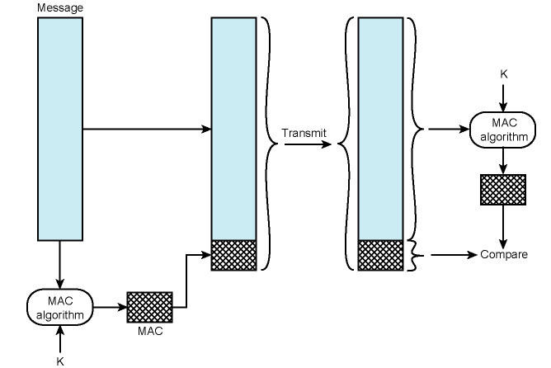
Message Authentication
Using a Message Authentication Code

Slide 32
One Way Hash Function
Accepts variable size message M and produces fixed size message digest H(M ).
Advantages of authentication without encryption
  Encryption is slow
  Encryption hardware expensive
  Encryption hardware optimized to large data
  Algorithms covered by patents
  Algorithms subject to export controls (from USA)

Slide 33
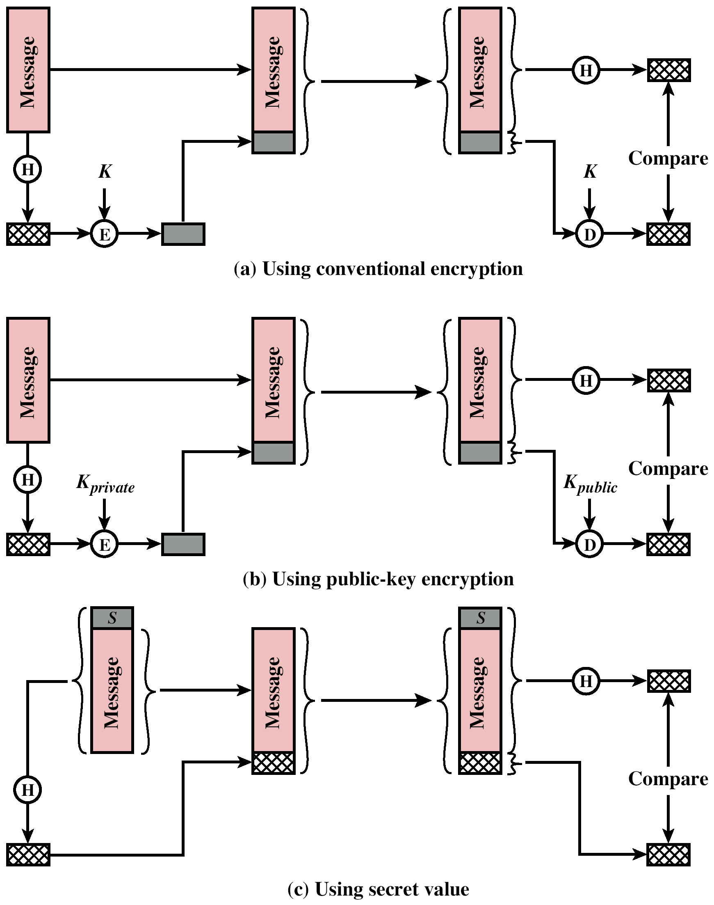
Message Authentication
Using a One-Way Hash Function

Slide 34
Message Authentication
Using a One-Way Hash Function

Slide 35
Secure Hash Functions
Hash function H must have following properties:
  1. H can be applied to a data block of any size.
  2. H produces fixed length output.
  3. H(x) is easy to compute for any given x.
  4. For any given y, it is infeasible to find x such that H(x) = y. (→ preimage attack/resistance)
  5. For any given x, it is infeasible to find y ≠ x with H(y) = H(x).
  6. It is infeasible to find any pair (x, y) such that H(y) = H(x). (→ collision attack, birthday attack)
1~5: Weak, 1~6: Strong

Slide 36
SHA-1
Secure Hash Algorithm 1
  SHA-0, SHA-1,
  SHA-2 (SHA2-224, SHA-256, SHA-384, SHA-512)
  SHA-3 (SHA3-224, SHA3-256, SHA3-384, SHA3-512), Oct. 2012
Input message less than 2⁶⁴ bits
  Processed in 512 bit blocks
Output 160 bit digest
The collisions of SHA-1 can be found with complexity less than 2⁶⁹ hash operations. (Xiaoyun Wang et al.)
➔ 2⁶³ (August 2005)
➔ 2⁵¹ (St´ephane Manuel, 2008)
New ➔

Slide 37
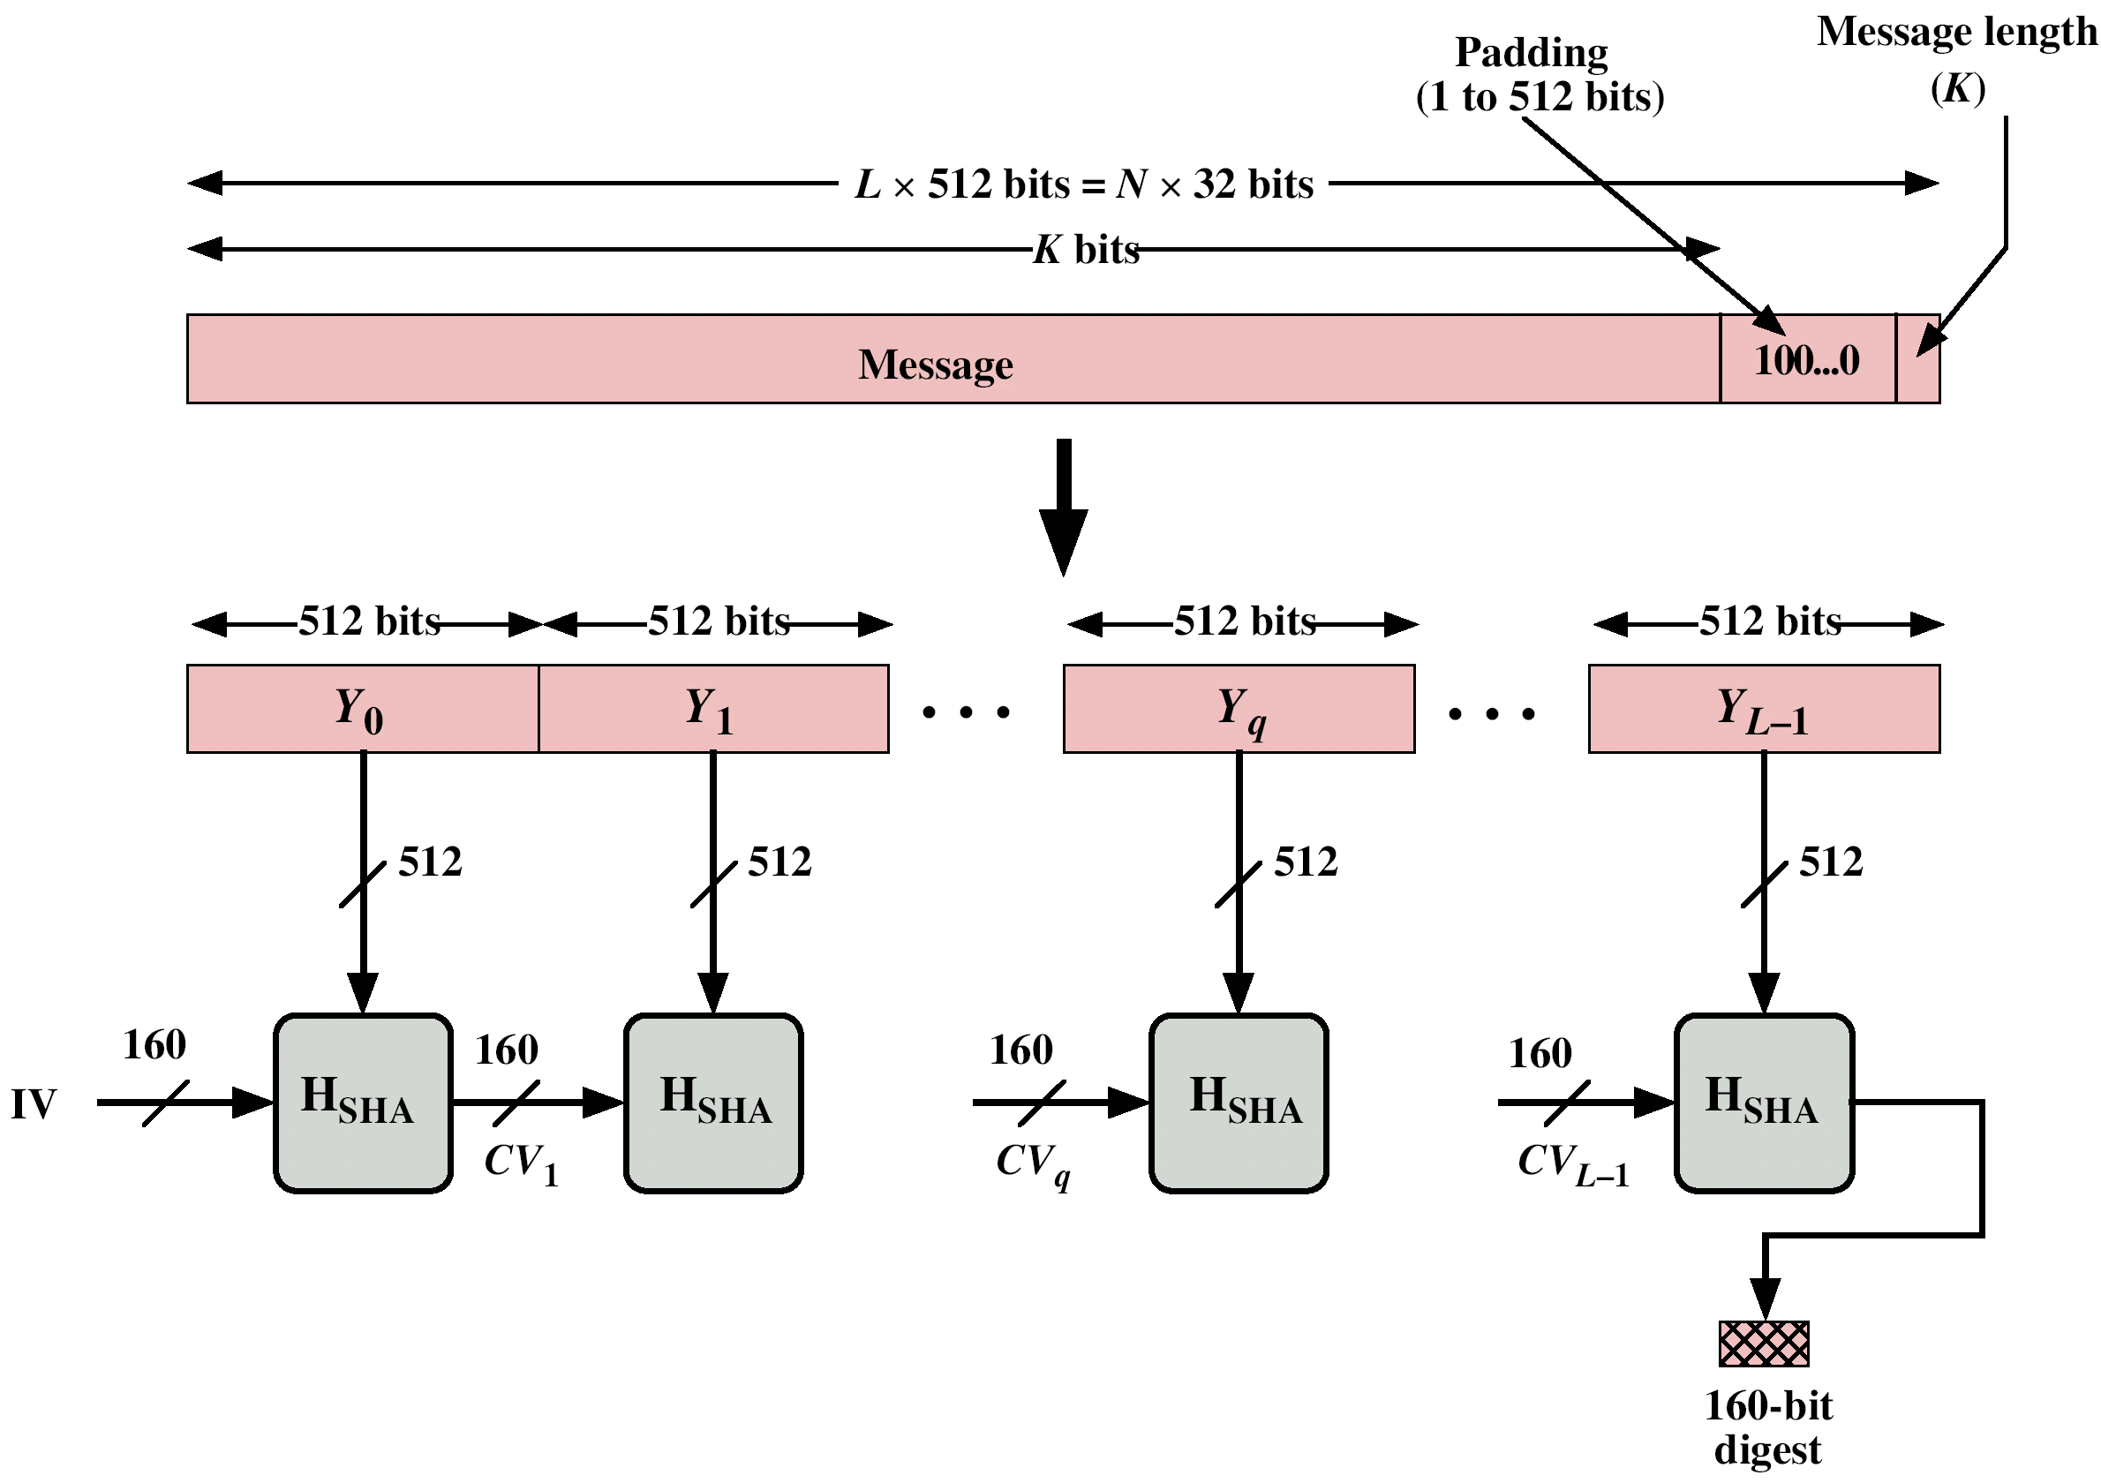
Message Digest Generation Using SHA-1
4 rounds
20 steps per round

Slide 38
SHA Overview
pad message so its length is 448 mod 512
append a 64-bit length value to message
initialise 5-word (160-bit) buffer (A,B,C,D,E) to
  (67452301,efcdab89,98badcfe,10325476,c3d2e1f0)
process message in 16-word (512-bit) chunks:
  expand 16 words into 80 words by mixing & shifting
  use 4 rounds of 20 bit operations on message block & buffer
  add output to input to form new buffer value
output hash value is the final buffer value
Notes:
Note that the SHA-1 Overview is very similar to that of MD5.

Slide 39
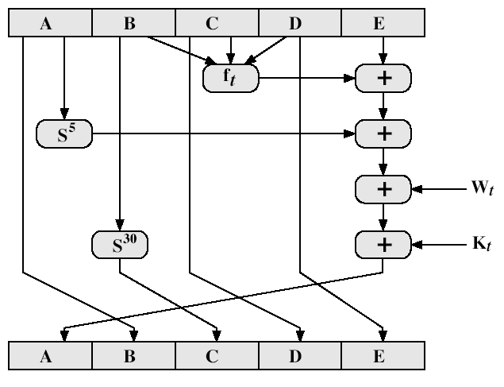
SHA-1 Compression Function
http://en.wikipedia.org/wiki/SHA-1
t = 0 .. 79
S^{n}: Left bit rotation by n places
t = 0..19
t = 20..39
t = 40..59
t = 70..79
f _{t}= (B and C) or ((not B) and D)
f _{t}= B xor C xor D
f _{t} = (B and C) or (B and D) or (C and D)
f _{t}= B xor C xor D
k_{t} = 0x5A827999
k_{t} = 0x6ED9EBA1
k_{t} = 0x8F1BBCDC
k_{t} = 0xCA62C1D6
Notes:
Stallings Fig 12-6.

Slide 40
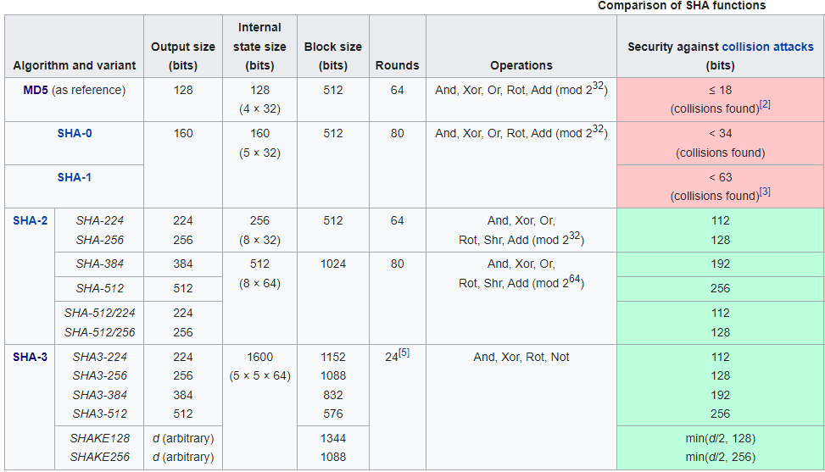
Comparison of SHA functions
https://en.wikipedia.org/wiki/Secure_Hash_Algorithms

Slide 41
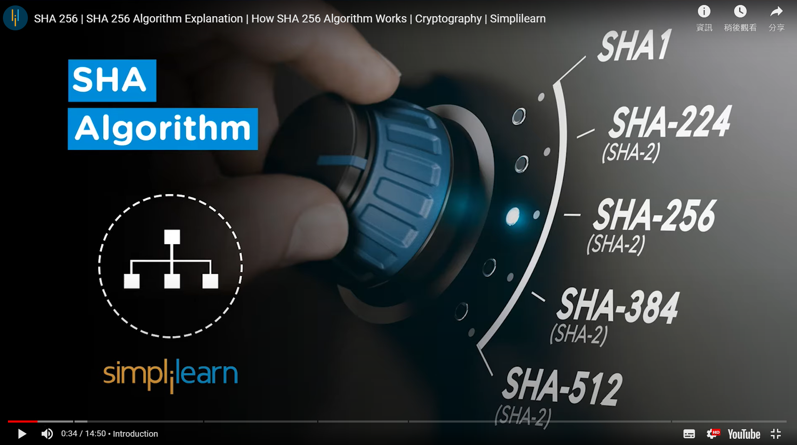
SHA-256 (Secure Hash Algorithms)
https://www.simplilearn.com/tutorials/cyber-security-tutorial/sha-256-algorithm
https://youtu.be/nduoUEHrK_4
https://youtu.be/orIgy2MjqrA?si=_K-GBZItta7fkHW6

Slide 42
SHA-3
In 2005, cryptanalysts found attacks on SHA-1.
In 2012, NIST selected an additional algorithm, Keccak, for standardization under SHA-3.
The SHA-3 standard was released by NIST on August 5, 2015.
https://en.wikipedia.org/wiki/SHA-3

Slide 43
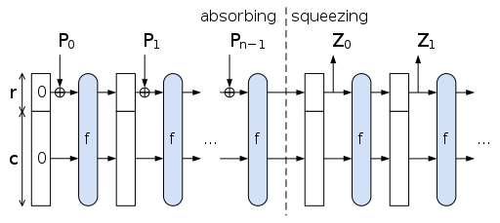
Sponge Construction
bitrate
State S
capacity
Pad the input N using the pad function, yielding a padded bit string P
Break P into n consecutive r-bit pieces P₀, ..., P_{n−1}
Initialize the state S to a string of b zero bits (b = r+c)
For each block Pi:
- Extend Pi with c zero bits, yielding one of length b, XOR that with S
- Apply the block permutation f, yielding a new state S
While the length of Z is less than d:
  - Append the first r bits of S to Z
  - If Z is still less than d bits long, apply f to S, yielding a new state S
  - Finally truncate Z to d bits
https://en.wikipedia.org/wiki/SHA-3

Slide 44
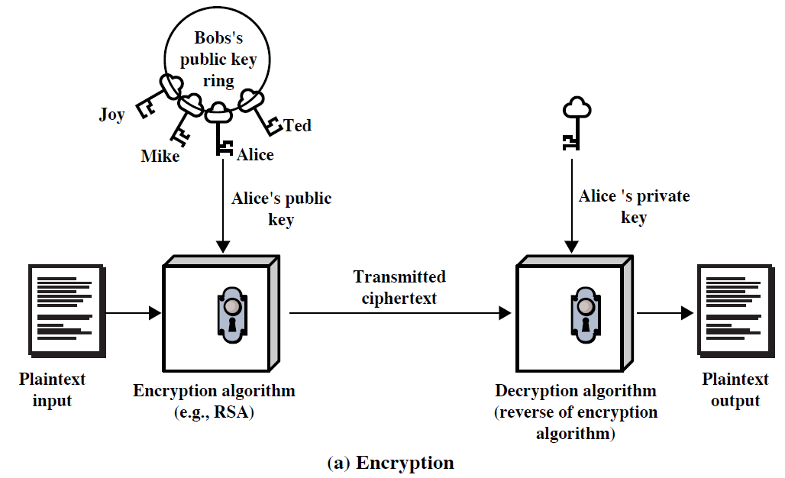
Public-Key Cryptography - Encryption

Slide 45
Public Key Encryption
Based on mathematical algorithms
Asymmetric
  Use two separate keys
Ingredients
  Plain text
  Encryption algorithm
  Public and private key
  Cipher text
  Decryption algorithm

Slide 46
Public Key Encryption - Operation
One key made public
  Used for encryption
Other kept private
  Used for decryption
Infeasible to determine decryption key given encryption key and algorithm
Either key can be used for encryption, the other for decryption

Slide 47
Steps
User generates pair of keys
User places one key in public domain
To send a message to user, encrypt using public key
User decrypts using private key

Slide 48
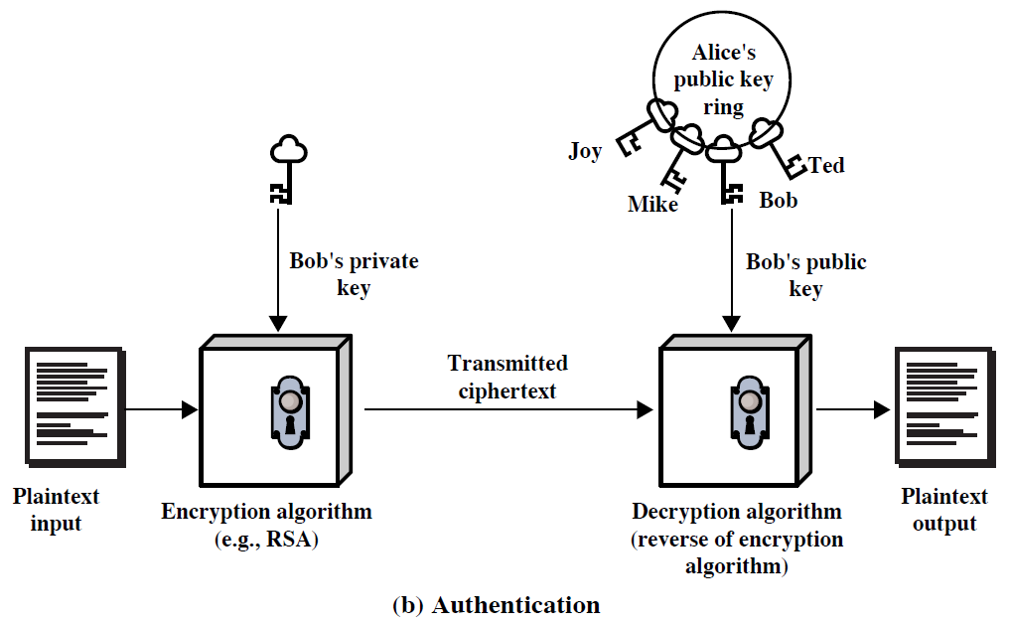
Public-Key Cryptography - Authentication

Slide 49
Digital Signature
Sender encrypts message with their private key
Receiver can decrypt using senders public key
This authenticates sender, who is only person who has the matching key
Does not give privacy of data
  Decrypt key is public

Slide 50
Digital Signature
Digital Signature

Slide 51
RSA (Rivest–Shamir–Adleman)
Proposed by Ron Rivest, Adi Shamir, and Leonard Adleman in 1977.
Plain text: M
Encryption: Ciphertext C=Me mod n
Decryption: M = C^{d} mod n
Knowing e and n, or even M, it can be extremely difficult to find d
(Me)^{d} mod n = M mod n
(M^{d})^{e} mod n = M mod n

Slide 52
RSA
C = Me mod n
M = C^{d} mod n = (Me)^{d} mod n = M^{ed} mod n
Public Key KU = {e, n}
Private Key KR = {d, n}
➔ Find e, d, n such that M = M^{ed} mod n

Slide 53

博士熱愛的算式/小川洋子
鞋子是24號：4是純潔的數字，是4的階乘。
電話號碼是5761455：一億以下的質數總數
生日是220，錶編號是284：220跟284是友誼數
28是個完全數。
孿生質數 ，兩個相鄰的質數中只隔著一個偶數。雖然靠得很近，卻永遠碰不到彼此

Slide 54
Mathematics for RSA
Fermat’s Little Theorem
  a ^{p-1} ≡ 1 (mod p) p: prime, p | a
  ex. p = 5 2⁴ = 16 ≡ 1 (mod 5)
Euler's totient function (φ (n))
  number of positive integers ≦ n and relatively prime to n
互質
p = 3, q = 5 (3-1)(5-1) = 8
3*5 = 15, 2⁸ ≡ 1 (mod 15)

Slide 55
http://www.cs.utsa.edu/~wagner/crypto/cs3235-3.pdf
a ^{p-1} mod p

Slide 56
Mathematics for RSA
https://en.wikipedia.org/wiki/RSA_(cryptosystem)
M, n relative prime
Find e, d satisfying ed = kφ(n)+1
or ed ≡ 1 (mod λ(pq)) , where λ(pq) = lcm(p-1,q-1)

Slide 57
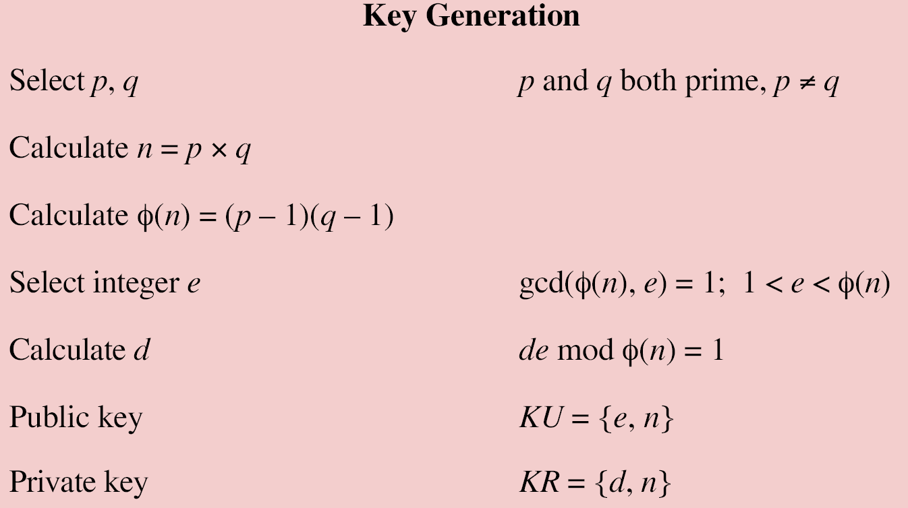
Encryption
Plaintext: M < n
Ciphertext: C = Me mod n
Decryption
Ciphertext: C
Plaintext: M = C^{d} mod n

Slide 58
Factoring Problem
The security of RSA relies on the difficulty of factoring the product of two large prime numbers, the "factoring problem".
When the numbers are sufficiently large, no efficient integer factorization algorithm is known.
https://en.wikipedia.org/wiki/Integer_factorization

Slide 59
RSA Example
M = 88
C = 88⁷ mod 187 = 11
C = 11
M = 11²³ mod 187 = 88

Slide 60
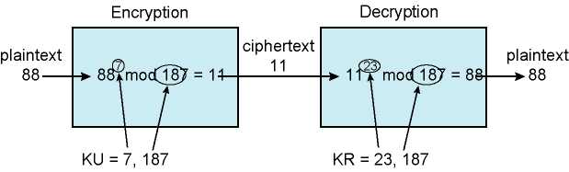
Example of RSA Algorithm

Slide 61
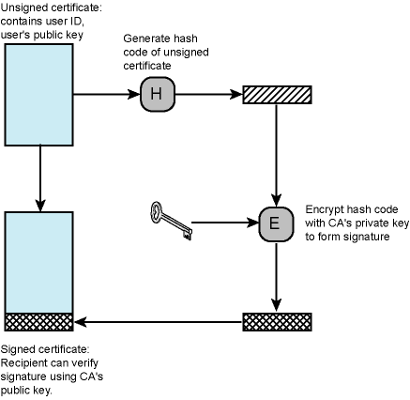
Public-Key Certificate
CA:
Certificate Authority

Slide 62

Digital Certificate vs. 印鑑證明

Slide 63
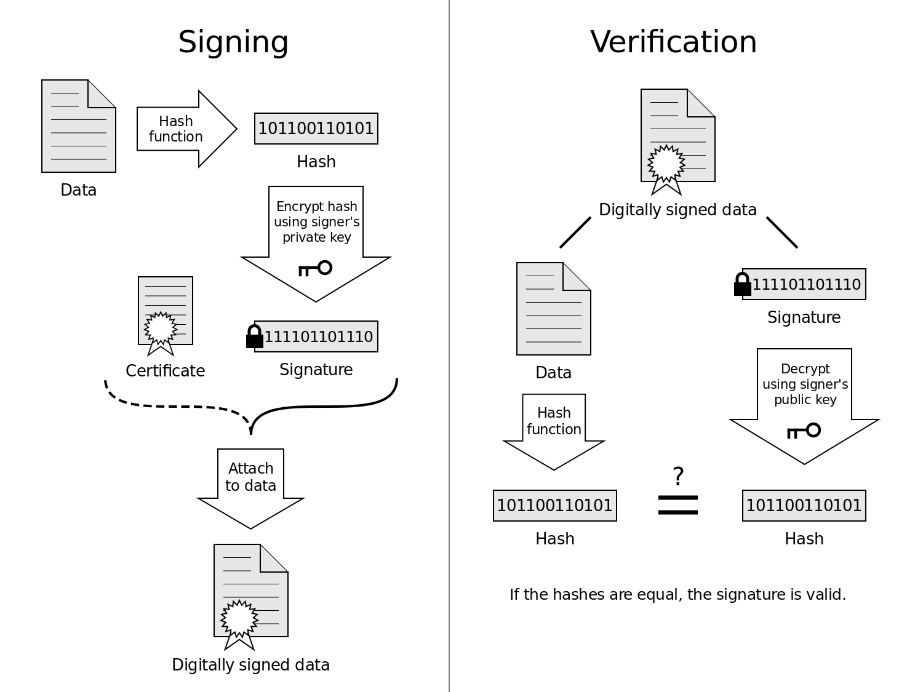
http://security.stackexchange.com/questions/81154/using-digital-certificates-in-digital-signatures

Slide 64
Discrete Logarithm Problem (DLP)
Given an element g in a finite group G and another element y, it is hard to find x such that
y = g^{x}
3⁴ = 243 = 5 (mod 7)
3^{x} = 5 (mod 7), find x
← easy
← hard

Slide 65
Diffie-Hellman Key Exchange
Two parties with no prior knowledge of each other can jointly establish a shared secret key over an insecure communications channel.
p: prime number, g: primitive root of p
Bob
Alice
Choose a
Choose b
A= gª (mod p)
A
B = g^{b} (mod p)
B
K = Bª (mod p)
= g^{ab} (mod p)
K = A^{b} (mod p)
= g^{ab} (mod p)

Slide 66
Secure Sockets Layer (SSL)
Transport Layer Security (TLS)
Security services
Transport Layer Security defined in RFC 2246
SSL general-purpose service
  Set of protocols that rely on TCP
Two implementation options
  Part of underlying protocol suite
    Transparent to applications
  Embedded in specific packages
    E.g. Netscape and Microsoft Explorer and most Web servers
Minor differences between SSLv3 and TLS

Slide 67
SSL Architecture
SSL uses TCP to provide reliable end-to-end secure service
SSL two layers of protocols
Record Protocol provides basic security services to various higher-layer protocols
  In particular, HTTP can operate on top of SSL
Three higher-layer protocols
  Handshake Protocol
  Change Cipher Spec Protocol
  Alert Protocol
  Used in management of SSL exchanges (see later)

Slide 68
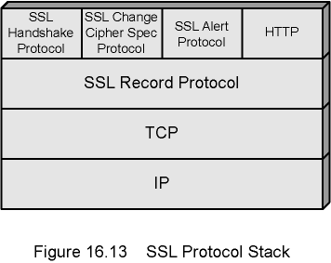
SSL Protocol Stack

Slide 69
SSL Connection and Session
Connection
  Transport that provides suitable type of service
  Peer-to-peer
  Transient
  Every connection associated with one session
Session
  Association between client and server
  Created by Handshake Protocol
  Define set of cryptographic security parameters
  Used to avoid negotiation of new security parameters for each connection
Maybe multiple secure connections between parties
May be multiple simultaneous sessions between parties
  Not used in practice

Slide 70
SSL Record Protocol
Confidentiality
  Handshake Protocol defines shared secret key
  Used for symmetric encryption
Message Integrity
  Handshake Protocol defines shared secret key
  Used to form message authentication code (MAC)
Each upper-layer message fragmented
  2¹⁴ bytes (16384 bytes) or less
Compression optionally applied
Compute message authentication code
Compressed message plus MAC encrypted using symmetric encryption
Prepend header: Content Type, Version, Compressed Length

Slide 71
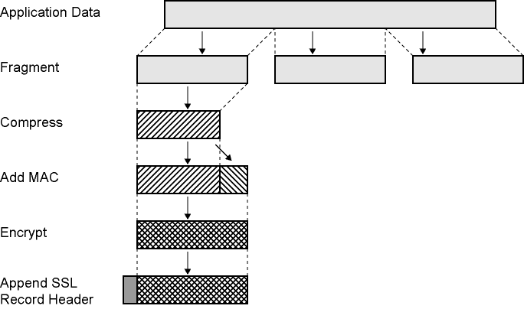
SSL Record Protocol Operation

Slide 72
Record Protocol Header
Content Type (8 bits)
  change_cipher_spec, alert, handshake, and application_data
  No distinction between applications (e.g., HTTP)
    Content of application data opaque to SSL
Major Version (8 bits) – SSL v3 is 3
Minor Version (8 bits) - SSLv3 value is 0
Compressed Length (16 bits)
  Maximum 2¹⁴ + 2048
Record Protocol then transmits unit in TCP segment
Received data are decrypted, verified, decompressed, and reassembled and then delivered

Slide 73
Change Cipher Spec Protocol
Uses Record Protocol
Single message
  Single byte value 1
Cause pending state to be copied into current state
  Updates cipher suite to be used on this connection
Simplest!

Slide 74
Alert Protocol
Convey SSL-related alerts to peer entity
Alert messages compressed and encrypted
Two bytes
  First byte warning(1) or fatal(2)
    If fatal, SSL immediately terminates connection
    Other connections on session may continue
    No new connections on session
  Second byte indicates specific alert
  E.g. fatal alert is an incorrect MAC
  E.g. nonfatal alert is close_notify message

Slide 75
Handshake Protocol
Authenticate
Negotiate encryption and MAC algorithm and cryptographic keys
Used before any application data sent
Four phases

Slide 76
Handshake Protocol –
Phase 1: Initiate Connection
Version
  Highest SSL version understood by client
Random
  Client-generated random structure
  32-bit timestamp and 28 bytes from secure random number generator
  Used during key exchange to prevent replay attacks
Session ID
  Variable-length
  Nonzero indicates client wishes to update existing connection or create new connection on session
  Zero indicates client wishes to establish new connection on new session
Cipher Suites
  List of cryptographic algorithms supported by client
  Each element defines key exchange algorithm and CipherSpec
Compression Method
  Compression methods client supports
client_hello
server_hello
Client
Server

Slide 77
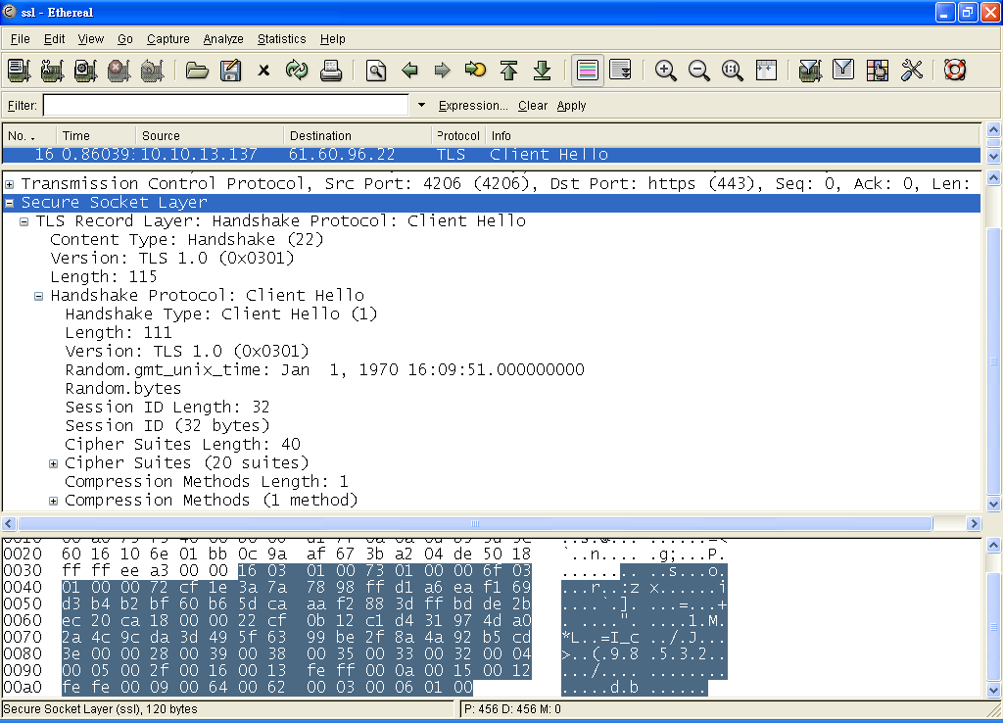
⬅ Record
⬅ Handshake: Client Hello

Slide 78
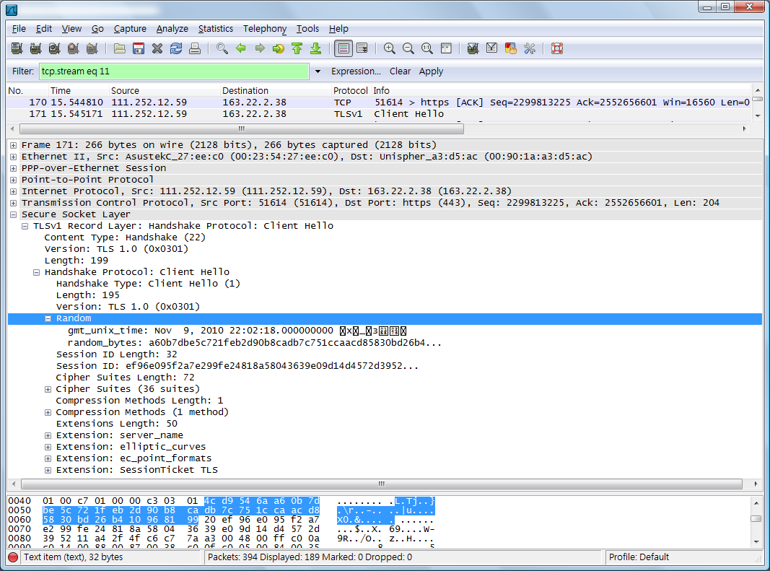
Random

Slide 79
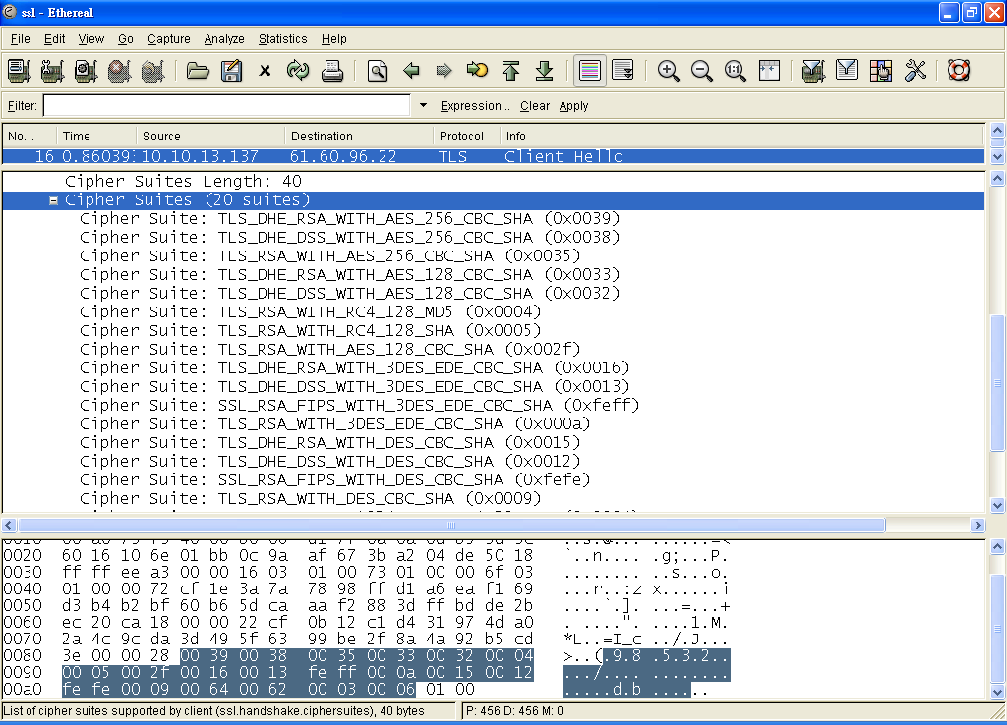
Cipher Suites

Slide 80
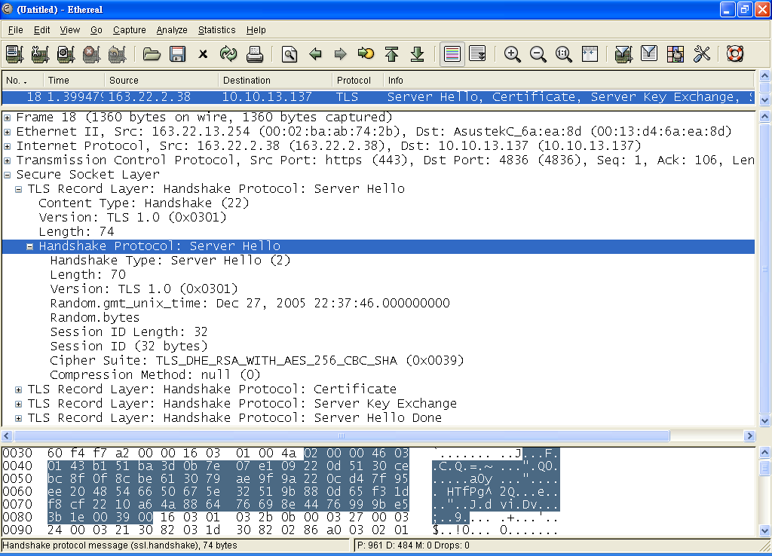
Server Hello

Slide 81
Handshake Protocol –
Phase 2, 3
Phase 2 depends on underlying encryption scheme
  Server sends certificate, key exchange, & a request for client certificate
Final message in Phase 2 is server_done
  Required
Phase 3
  Upon receipt of server_done, client verifies certificate if required and check server_hello parameters
  Client sends messages to server, depending on underlying public-key scheme
    Certificate, key exchange, certificate verification

Slide 82
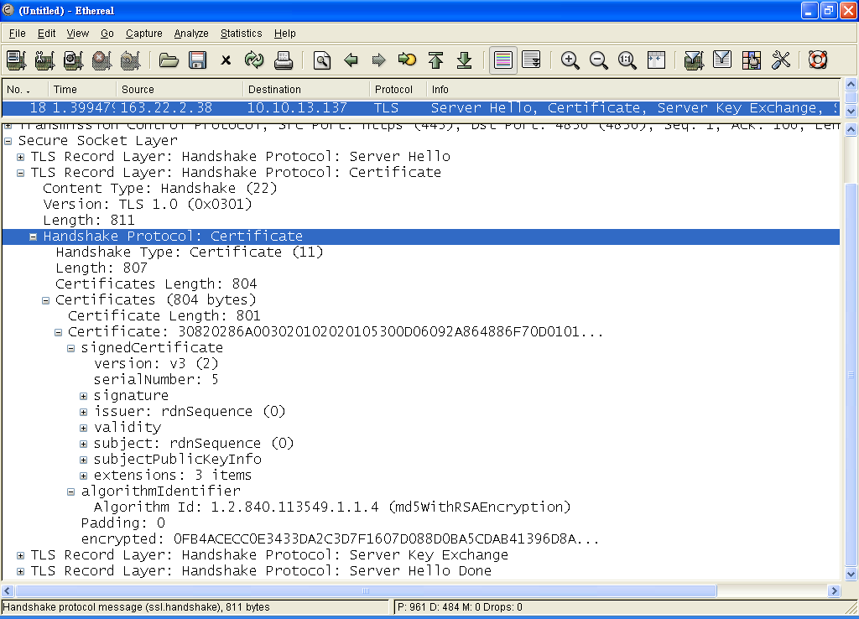
Certificate

Slide 83
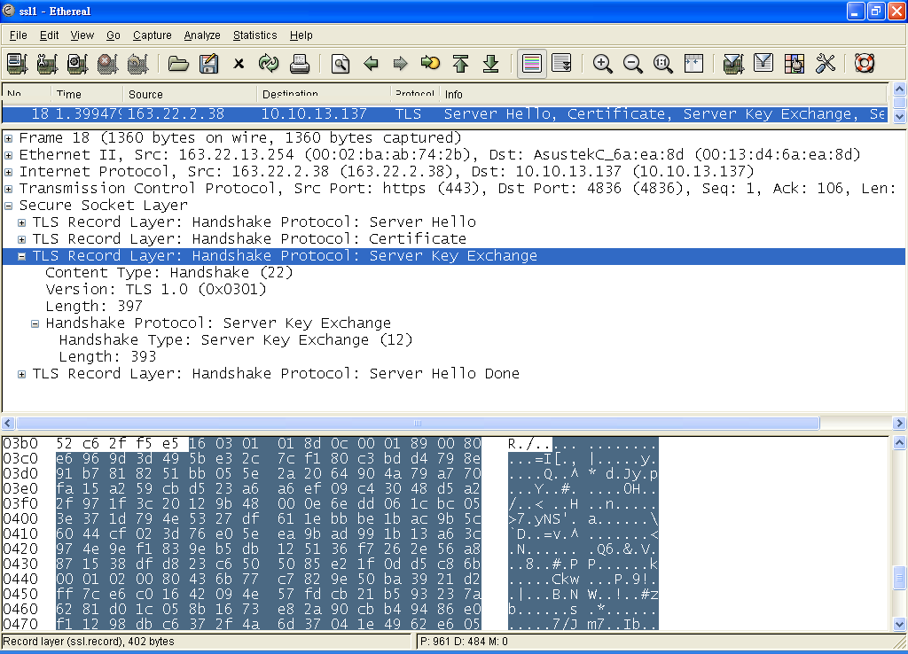

Slide 84
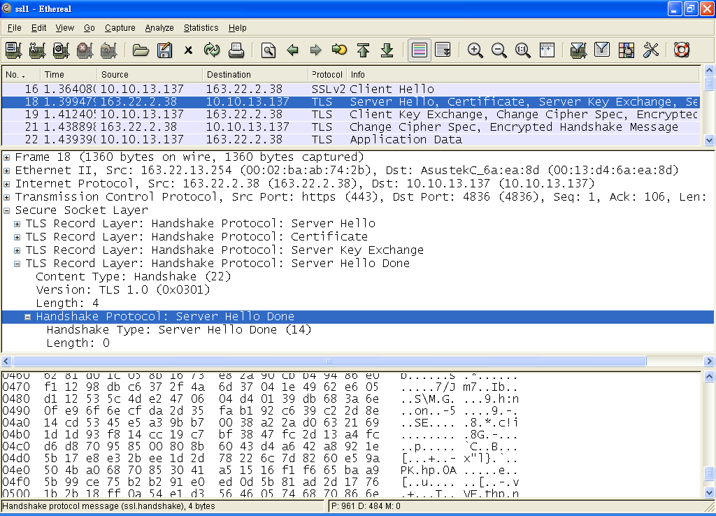

Slide 85
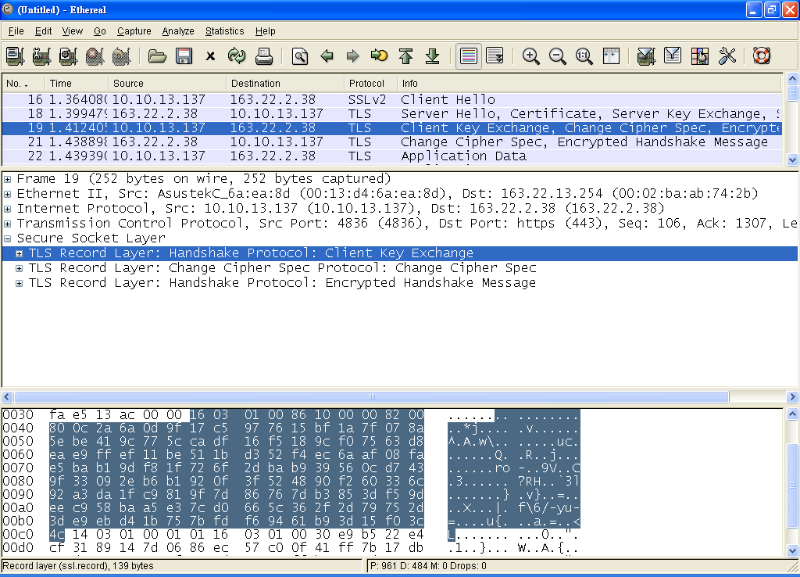

Slide 86
Handshake Protocol –
Phase 4
Completes setting up
Client sends change_cipher_spec
Copies pending CipherSpec into current CipherSpec
  Not considered part of Handshake Protocol
  Sent using Change Cipher Spec Protocol
Client sends finished message under new algorithms, keys, and secrets
Finished message verifies key exchange and authentication successful
Server sends own change_cipher_spec message
Transfers pending to current CipherSpec
Sends its finished message
Handshake complete

Slide 87
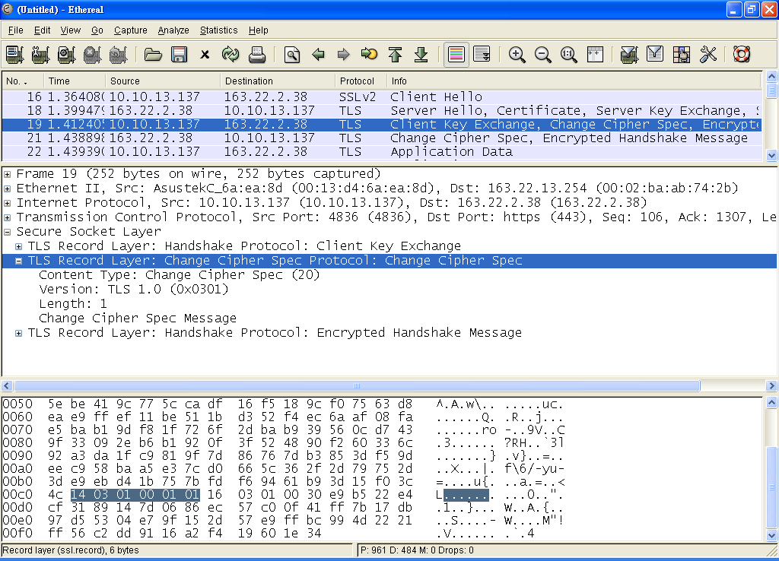
← finished

Slide 88
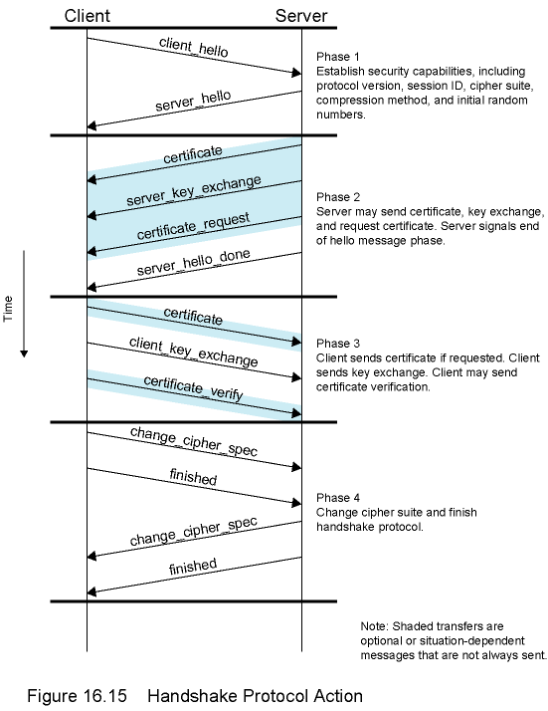
Handshake
Protocol
Action

