Slide 1
高等資訊網路
Advanced Computer Networking
Yen-Cheng Chen
http://ycchen.im.ncnu.edu.tw/

Slide 2
Textbook
自編教材
  http://ycchen.im.ncnu.edu.tw/AdvNet/
  寬頻匯流網管教材
參考書籍
  Computer Networking with Internet Protocols and Technology, William Stallings, Prentice Hall
  Essential SNMP
  Douglas Mauro, Kevin Schmidt, Kevin J. Schmidt, O'Reilly

Slide 3
SNMP Tools
ManageEngine MIB Browser: https://www.manageengine.com/products/mibbrowser-free-tool/
Net-SNMP: http://www.net-snmp.org/
MRTG: https://oss.oetiker.ch/mrtg/

Slide 4
Advanced Computer Networking
PowerPoint Slides:
  http://ycchen.im.ncnu.edu.tw/AdvNet/
Grading:
  Assignments 30%
  Mid-Term Exam. 35%
  Final Exam. 35%
Office Hours: 每週三 14:00~16:00

Slide 5
Course Outline (1/3)
Fundamentals
Applications
Transport Protocols
IP Networks
Network Security
Network Management Model
SNMP Communication Model
SNMP Information Model
SNMP Applications

Slide 6
Course Outline (2/3)
1. Overview
* Packet Switching vs. Circuit Switching
* OSI 7 Layer Model
* TCP/IP Protocol Architecture
2. Applications
* E-Mail: SMTP and MIME, and POP
* HTTP
* Voice Over IP (VoIP)
3. Transport Protocols
* TCP & UDP
4. Internet Procotols
* IP, IPv6, Routing, Multicasting
5. Network Security
* AES, SHA, RSA, SSL/TLS

Slide 7
Course Outline (3/3)
6. Network Management Model
* Network Management, ASN.1, BER
7. SNMP Communication Model
* SNMP Protocol
8. SNMP Information Model - SMI
* Structure of Management Information (SMI, SMIv2)
9. SNMP Information Model - MIB
* MIB Design, MIB II
9. SNMP Applications
* SNMP Tools: MIB Browser, MRTG
* SNMP Programming: Net-SNMP, PHP

Slide 8
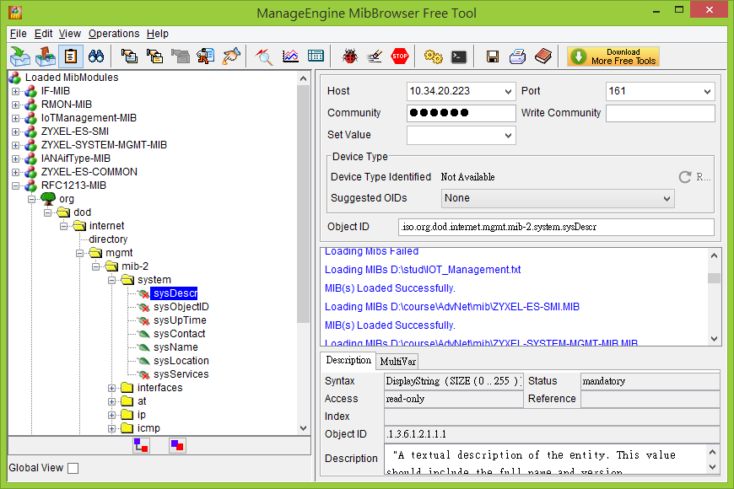
自主學習
MIB Browser

Slide 9
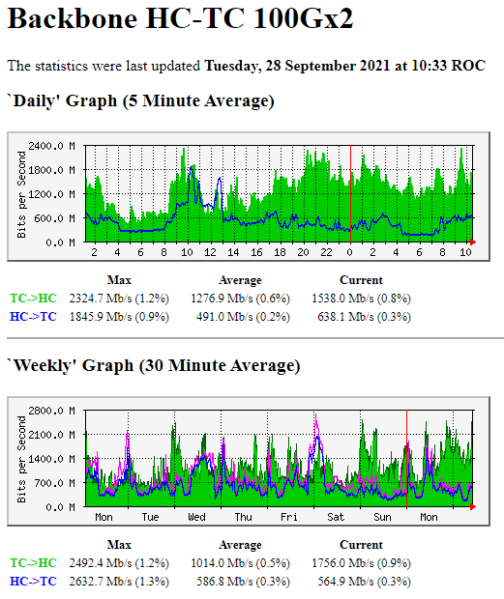
自主學習
MRTG
https://oss.oetiker.ch/mrtg/

