Slide 1
Wireless LANs I
Chapter 6
Panko and Panko
Business Data Networks and Security, 10th Edition, Global Edition
Copyright © 2015 Pearson Education, Ltd.

Slide 2
Introduction
Radio Signal Propagation
Radio Bands and Bandwidth
Spread Spectrum Transmission
802.11 WLAN Operation
802.11 Transmission Standards
Wireless Mesh Networking

Slide 3
6.1 802.11/Wi-Fi WLAN Technology
Ethernet 802.3 LANs
Require standards at Layer 1 (physical) and Layer 2 (data link)
Therefore, use OSI standards
The 802.3 Working Group of the IEEE 802 Committee creates standards

Slide 4
6.1 802.11/Wi-Fi WLAN Technology
Wireless LANs
Operate at Layers 1 and 2
OSI dominates at Layers 1 and 2
Therefore, they are OSI standards

Slide 5
6.1 802.11/Wi-Fi WLAN Technology
802.11 Wireless LAN Technology
The dominant WLAN technology today
Standardized by the 802.11 Working Group of the IEEE 802 Committee

Slide 6
6.1 802.11/Wi-Fi WLAN Technology
Wi-Fi Alliance
Industry association of 802.11 equipment manufacturers
802.11 standards have many options
Wi-Fi Alliance selects subsets of standards as profiles
Does interoperability testing on these profiles
Only products that pass can display the Wi-Fi logo

Slide 7
6.1 802.11/Wi-Fi WLAN Technology
Wi-Fi Alliance
However, sometimes develops new standards
Two have been security nightmares
WPA
WPS

Slide 8
6.2 Hybrid Switched/Wireless 802.11 Network
The wireless access point connects the wireless client to the wired Ethernet LAN.

Slide 9
6.2 Hybrid Switched/Wireless 802.11 Network
The LAN connection is needed to give clients access to servers and Internet access routers on the wired LAN.

Slide 10
Introduction
Radio Signal Propagation
Radio Bands and Bandwidth
Spread Spectrum Transmission
802.11 WLAN Operation
802.11 Transmission Standards
Wireless Mesh Networking

Slide 11
6.3 Electromagnetic Wave
Optical fiber transmission is measured in terms of wavelength.
Typical data LAN frequencies are 500 MHz to 10 GHz

Slide 12
6.4 Omnidirectional and Dish Antennas

Slide 13
6.4 Omnidirectional and Dish Antennas
Questions:
What type of antenna do mobile phones use?
Why?

Slide 14
6.5: Wireless Propagation Problems
The signal strength spreads out as the surface of a sphere.
This means that its strength falls as (1/r²), where r is the radius.
If you double the distance, you only get ¼ the signal strength

Slide 15
Inverse Square Law Attenuation
Radio signals spread out in a sphere.
S = signal power, r = range (distance) or radius
If the signal power at 10 meters is 9 milliwatts (mW), how strong is it at 30 meters?
S₂ = S₁ * (r₁/r₂)²
S₂ = 9 mW * (10/30)²
S₂ = 9 mW * (1/3)²
S₂ = 9 mW * (1/9)
S₂ = 1 mW

Slide 16
6.6: Inverse Square Law Attenuation
Your turn.
If the signal strength at 5 meters is 48 mW, how strong is it at 20 meters?

Slide 17
Absorptive Attenuation
Signal is absorbed by the air and water.
Note that there are two types of attenuation: Inverse square law and absorptive attenuation.
Note that this is different than shadow zones.

Slide 18
Dead Zones
Shadow zones are places the signal cannot penetrate because of obstacles in its path.
Shadow zones, also called dead spots, grow worse as frequency increases.

Slide 19
Multipath Interference
Direct and reflected signals may interfere.
Most serious propagation problem at WLAN frequencies.

Slide 20
Multipath Interference
If the two waves are out of phase, they will negate each other, giving no signal.

Slide 21
Electromagnetic Interference (EMI)
2.
Electromagnetic
Interference (EMI) is unwanted power at the same frequency from other devices.
1.
Wireless transmission has many propagation problems.

Slide 22
Frequency-Dependent Propogation Problems
Recap
Two forms of attenuation
Two grow worse at higher frequencies

Slide 23
Introduction
Radio Signal Propagation
Radio Bands and Bandwidth
Spread Spectrum Transmission
802.11 WLAN Operation
802.11 Transmission Standards
Wireless Mesh Networking

Slide 24
6.8 Frequency Spectrum, Service Band, Channels
0 Hz

Slide 25
6.8 Frequency Spectrum, Service Band, Channels

Slide 26
6.8 Frequency Spectrum, Service Band, Channels

Slide 27
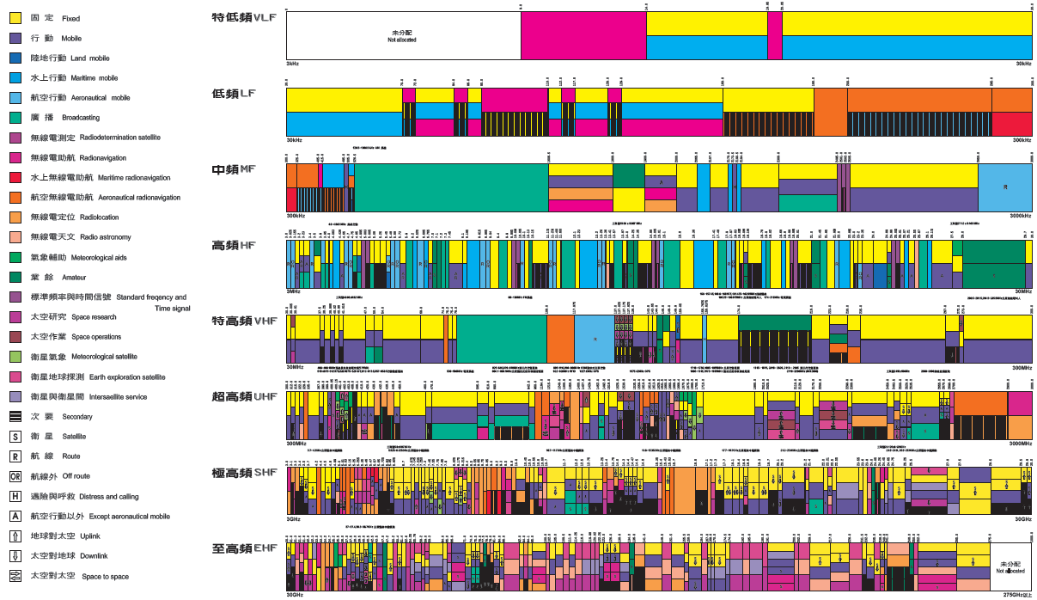
台灣的 無線電波波譜分配圖表

Slide 28
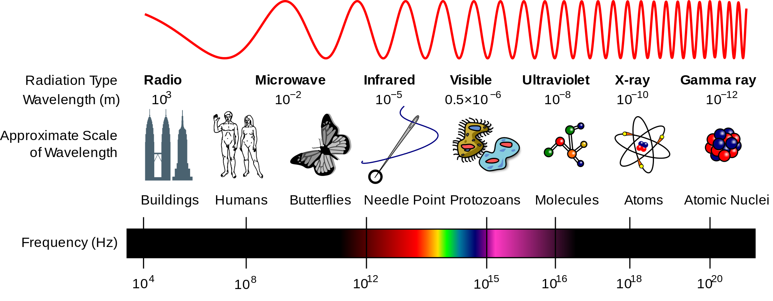

Slide 30
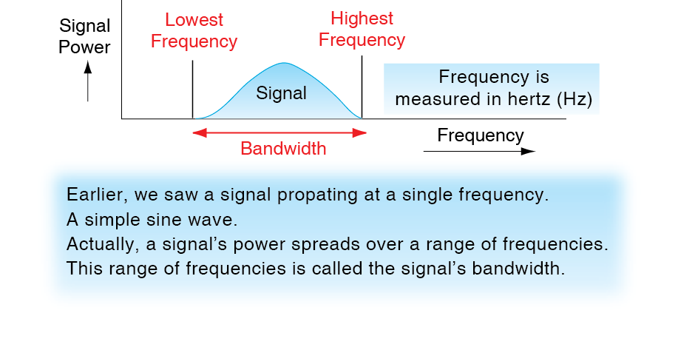
6.9 Signal Bandwidth

Slide 31
6.10: Channel Bandwidth and Transmission Speed
Channel Bandwidth
Channel bandwidth is the highest frequency in a channel minus the lowest frequency.
An 88.0 MHz to 88.2 MHz channel has a bandwidth of 0.2 MHz (200 kHz).
Higher-speed signals need wider channel bandwidths.

Slide 32
6.10 Channel Bandwidth and Transmission Speed
Transmission Speed and Channel Bandwidth
There is a direct relationship between required transmission speed and required channel bandwidth
Doubling bandwidth doubles the possible transmission speed
Multiplying bandwidth by N makes possible N times the transmission speed

Slide 33
6.10 Channel Bandwidth and Transmission Speed
Broadband Channels
Broadband means wide radio channel bandwidth and therefore high speed
Popularly, fast systems are called “broadband” even if they are not radio systems

Slide 34
6.11 2.4 GHz and 5 GHz Service Band
The 2.4 GHz Service Band
2.4 GHz to 2.485 GHz
Propagation characteristics are good
For 20 MHz 802.11 channels, only three nonoverlapping channels are possible
Channels 1, 6, and 11

Slide 35
http://en.wikipedia.org/wiki/IEEE_802.11

Slide 36
6.11 2.4 GHz and 5 GHz Service Band
The 2.4 GHz Service Band
Co-channel interference between nearby access points transmitting in the same channel degrades performance
Except in very small networks, difficult or impossible to put nearby access points on different channels (Figure 6-12)

Slide 37
6.11 2.4 GHz and 5 GHz Service Band
The 5 GHz Service Band
More bandwidth, so between 11 and 24 non-overlapping 20 MHz channels
Makes it easy to have nearby access points operate on non-overlapping channels
Increasing channel bandwidth in newer standards reduces the number of possible channels

Slide 38
6.11 2.4 GHz and 5 GHz Service Band
What is the main advantage of 2.4 GHz operation?
What is the main advantage of 5 GHz operation?

Slide 39
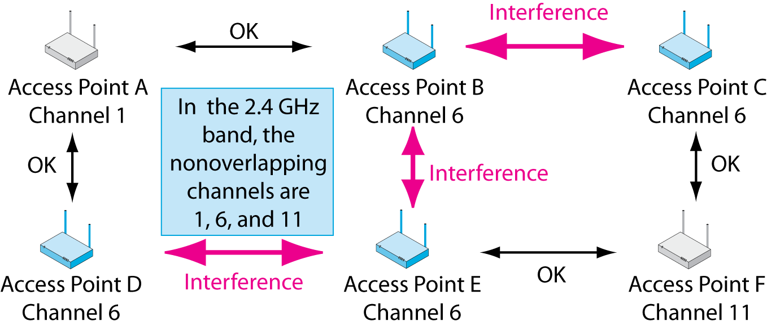
6.12 Co-Channel Interference, 2.4 GHz Band
The 2.4 GHz Unlicensed Band
Difficult or impossible to put nearby access points on different channels
Figure 6-12

Slide 40
6.13 Licensed & Unlicensed Service Bands
Licensed Radio Bands
If two nearby radio hosts transmit in the same channel, their signals will interfere
Most radio bands are licensed bands, in which hosts need a license to transmit: FM radio, etc.
The government limits licenses to control interference
In cellular telephone bands, only the central antennas are licensed, not the mobile phones

Slide 41
6.13 Licensed & Unlicensed Service Bands
Unlicensed Radio Bands
A few service bands are set aside as unlicensed bands
Hosts in these service bands do not need to be licensed to be turned on or moved
Anybody can operate anywhere

Slide 42
6.13 Licensed & Unlicensed Service Bands
Unlicensed Radio Bands
802.11 Wi-Fi operates in unlicensed radio bands
This allows access points and hosts to be moved freely

Slide 43
6.13 Licensed & Unlicensed Service Bands
Unlicensed Radio Bands
However, there is no legal recourse against interference from other nearby users
Your only recourse is to negotiate
At the same time, you may not cause unreasonable interference by transmitting at illegally high power

Slide 44
Introduction
Radio Signal Propagation
Radio Bands and Bandwidth
Spread Spectrum Transmission
802.11 WLAN Operation
802.11 Transmission Standards
Wireless Mesh Networking

Slide 45
Spread Spectrum Transmission
Spread Spectrum Transmission
You are required by law to use spread spectrum transmission in the 2.4 and 5 GHz bands.
Spread spectrum transmission reduces propagation problems.
Especially multipath interference
Spread spectrum transmission is NOT used for security in WLANs.

Slide 46
6.14: Normal vs Spread Spectrum Transmission
Why do you not want to make radio channel bandwidth greater than the signal requires?

Slide 47
6.14: Normal vs Spread Spectrum Transmission
Wasteful of bandwidth but necessary to avoid propagation problems.

Slide 48
6.15: Orthogonal Frequency Division Multiplexing

Slide 49
Introduction
Radio Signal Propagation
Radio Bands and Bandwidth
Spread Spectrum Transmission
802.11 WLAN Operation
802.11 Transmission Standards
Wireless Mesh Networking

Slide 50
6.16 Typical 802.11 Wi-Fi Operation
Sender puts a packet for the destination host into an 802.11 frame, then sends the
frame wirelessly to the access point.

Slide 51
6.16 Typical 802.11 Wi-Fi Operation
The 802.11 frame has the wrong frame format to travel over an 802.3 Ethernet network. The switches and destination host would not know what to do with it.
The access point removes the packet from the 802.11 frame and discards the frame.

Slide 52
6.16 Typical 802.11 Wi-Fi Operation
The access point encapsulates the packet in an 802.3 frame and sends this frame on to the destination host via Ethernet switches.

Slide 53
6.16 Typical 802.11 Wi-Fi Operation
The Wired Ethernet Network is called the Distribution System (DS)
The server removes the packet from the 802.3 frame.

Slide 54
6.16 Typical 802.11 Wi-Fi Operation
Does the IP packet travel all the way to the destination host?
Does the 802.11 frame travel all the way to the destination host? Why or why not?

Slide 55
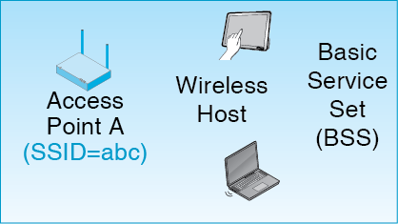
Basic Service Set (BSS)
Basic Service Set (BSS): An access point and its wireless hosts.
Service Set Identifier (SSID) is the name of the network.

Slide 56
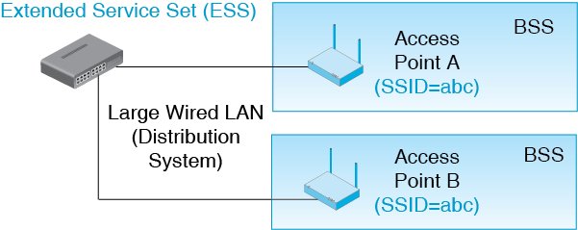
Extended Service Set (ESS)
Collection of access points that all have the same SSID.
Hand Off (Roaming)
Hand Off

Slide 57
6.18: Transmitting in a Single Channel

Slide 58
Media Access Control

Slide 59
CSMA/CA+ACK
Box
Carrier Sense Multiple Access with Collision Avoidance and Acknowledgement
Mandatory for 802.11 Wi-Fi Operation
Carrier Sensing with Multiple Access
Sender listens for traffic (senses the carrier)
If another device is transmitting, it waits
This controls access by multiple devices that must not transmit simultaneously

Slide 60
6.19: CSMA/CA+ACK
Box
Collision Avoidance
When the current sender stops, two or more waiting devices may immediately want to transmit
This will cause a collision
Instead, the devices must wait a randomized amount of time before sending
This usually avoids collision, but it is inefficient

Slide 61
6.19: CSMA/CA+ACK
Box
ACK (Acknowledgement) and Reliability
Receiver immediately sends back an acknowledgement
CA random delay for other devices guarantees there will be enough time for an immediate ACK
If sender does not receive the acknowledgement, it retransmits using CSMA

Slide 62
6.19: CSMA/CA+ACK
Box
ACK (Acknowledgement) and Reliability
CSMA/CA plus ACK is a reliable protocol
Reliable protocols are rare in wired networks
However, radio transmission is unreliable enough to warrant it

Slide 63
6.20: CSMA/CA+ACK
Box
Inefficiency
There is a lot of waiting with CSMA/CA+ACK
This makes it inefficient

Slide 64
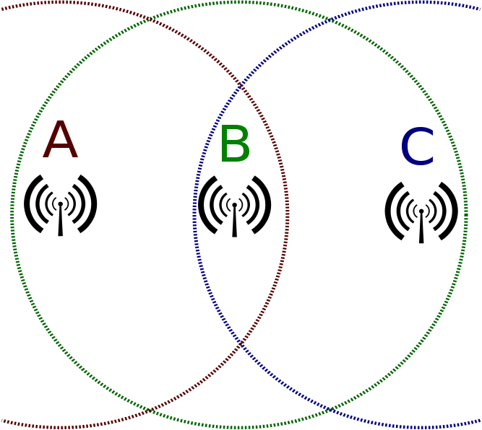
Hidden Node Problem (or Hidden Terminal Problem)
http://en.wikipedia.org/wiki/Hidden_node_problem

Slide 65
6.20: RTS-CTS
Box
Host C
AP B

Slide 66
6.20: RTS-CTS
Box
Host C
AP B

Slide 67
6.20: RTS-CTS
Box
Host C
AP B

Slide 68
6.20: RTS-CTS
Box
0
Host C
AP B

Slide 69
Comparison
Box
CSMA/CA is Mandatory
It is the default MAC method.
It is more efficient than RTS/CTS.
RTS/CTS
Is usually optional.
Is good if two or more client stations cannot hear each other.
Stop them from transmitting at the same time.

Slide 70
Introduction
Radio Signal Propagation
Radio Bands and Bandwidth
Spread Spectrum Transmission
802.11 WLAN Operation
802.11 Transmission Standards
Wireless Mesh Networking

Slide 71
6.21 Major 802.11 Wi-Fi Standards
Standard | Rated Speed
802.11g | 54 Mbps
802.11a | 54 Mbps
802.11n | 100 to 600 Mbps 150 to 300 Mbps common
802.11ac | 433 Mbps to 6.93 Gbps 433 to 1.3 Gbps common

Slide 72
6.21 Major 802.11 Wi-Fi Standards
Standard | Status
802.11g | Obsolescent but still used
802.11a | Obsolescent but still used
802.11n | Dominates the installed base today
802.11ac | Dominates sales today

Slide 73
6.21 Major 802.11 Wi-Fi Standards
Standard | Unlicensed Bands
802.11g | 2.4 GHz
802.11a | 5 GHz
802.11n | 2.4 GHz and 5 GHz
802.11ac | 5 GHz

Slide 74
6.21 Major 802.11 Wi-Fi Standards
Standard | Channel Bandwidth
802.11g | 20 MHz
802.11a | 20 MHz
802.11n | 40 MHz but will drop back to 20 MHz if there is interference from a 802.1g or 802.1a channel
802.11ac | 80 MHz and 160 MHz

Slide 75
6.21 Major 802.11 Wi-Fi Standards
Standard | Channels in 5 GHz Band in the USA
802.11g | NA (2.4 GHz only)
802.11a | 20-25
802.11n | 20-25 at 20 MHz 8-12 at 40 MHz
802.11ac | 4-6 at 80 MHz 1-2 at 160 MHz
Wider channels means fewer channels

Slide 76
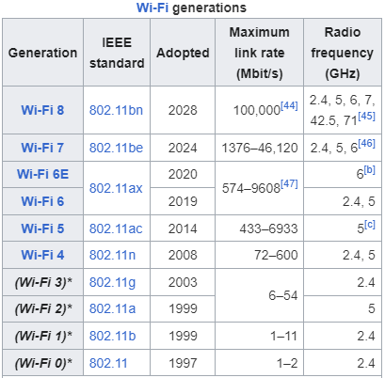
https://en.wikipedia.org/wiki/Wi-Fi

Slide 77
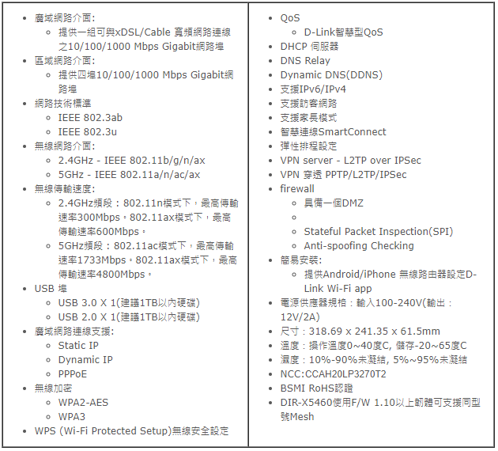
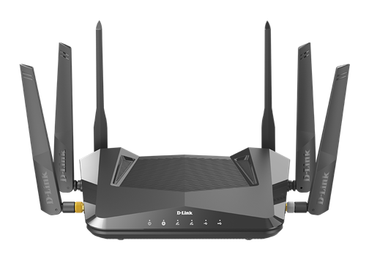
https://www.dlinktw.com.tw/home/product?id=9093&hid=18
AX5400 Wi-Fi 6 雙頻無線路由器

Slide 78
6.22: MIMO
Access point transmits two signals in the same channel—one from Antenna A and
one from Antenna B.
These are called spatial streams.

Slide 79
6.22: MIMO
The two signals arrive at different times at the two receiving antennas. Time differences allow them to be separated and understood.

Slide 80
6.22: MIMO (Multiple Input/Multiple Output)
MIMO Two Benefits
MIMO brings higher speeds because it can send more information in a channel.
MIMO also brings longer propagation distances for technical reasons we will not discuss.

Slide 81
6.23: Beam Forming
Beamforming allows an access point to focus its transmissions and reception

Slide 82
6.23: Beam Forming
Multiuser MIMO (MU-MIMO) allows two wireless hosts to transmit at the same time.

Slide 83
Multiuser MIMO
Defined in 802.11ac, and there is a single standard, so adoption is more likely
However, initial pre-standard 802.11ac products typically do not offer it.

Slide 84
6.21 Major 802.11 Wi-Fi Standards
Standard | MIMO? | Maximum Spatial Streams | MU-MIMO?
802.11g | No | NA | No
802.11a | No | NA | No
802.11n | Yes | 4* | No
802.11ac | Yes | 8 | Yes
* up to 600 Mbps (rated speed)

Slide 85
6.24 Speed, Distance, and Throughput
Rated Speed versus Throughput
Rated speed is the speed the standard specifies
Throughput is the speed that is actually delivered
Total throughput is substantially lower than rated speed—sometimes 50% lower

Slide 86
6.24 Speed, Distance, and Throughput
Aggregate versus Individual Throughput
Access point throughput is aggregate throughput for all devices transmitting and receiving
Its capacity is shared by all stations currently sending or receiving
Individual throughput can be much lower than aggregate throughput

Slide 87
6.24 Speed, Distance, and Throughput
Throughput versus Distance
As distance from the access point increases, signals get weaker
Wireless hosts must use slower but more reliable bit encoding methods—send fewer bits per clock cycle
This reduces individual throughput for these devices

Slide 88
6.25 Backward Compatibility
Devices Built for Newer Standards Still Implement Older Standards
This is called backward compatibility
This Allows Older and Newer Devices to Communicate

Slide 89
6.25 Backward Compatibility
Example of Backward Compatibility
Newer product: 802.11ac in the 5 GHz band
Older product: 802.11n in the 2.4 GHz band
The newer product will drop back to the standard the older product can use
They will communicate using the 802.11n standard in the 2.4 GHz band
They will only get 802.11n speeds

Slide 90
Introduction
Radio Signal Propagation
Radio Bands and Bandwidth
Spread Spectrum Transmission
802.11 WLAN Operation
802.11 Transmission Standards
Wireless Mesh Networking

Slide 91
6.26: Wireless Mesh Network
There is no Ethernet network (distribution system)
Frames are forwarded by access points and wireless hosts

Slide 92
6.26: Wireless Mesh Network
Mesh networks are governed by 802.11s
It is not a mature standard
https://24h.pchome.com.tw/prod/DRAF07-A9009V8PQ

