Slide 1
TCP/IP Internetworking II
Chapter 9
Panko and Panko
Business Data Networks and Security, 10th Edition, Global Edition
Copyright © 2015 Pearson Education, Ltd.

Slide 2
Perspective
Chapter (s) | Coverage | Layers
1–4 | Core concepts and principles | All
5 | Single switched networks | 1–2
6–7 | Single wireless networks | 1–2
8–9 | Internets | 3–4
10 | Wide Area Networks | 1-4
11 | Applications | 5

Slide 3
Perspective
Chapter 8
Major TCP/IP standards
Router operation
Chapter 9
Managing Internets
Securing Internets

Slide 4
IP Subnetting
Network Address Translation (NAT)
Domain Name System (DNS)
IP Security (IPsec)
IPv6 Management
Other TCP/IP Supervisory Standards

Slide 5
9.1: IPv4 Subnetting
Companies are given network parts by their ISP or an Internet number authority.
They divide the remaining bits between a subnet part and a host part.
Larger subnet parts mean more subnets, but this results in smaller host parts, which means fewer hosts per subnet.
The reverse is also true.

Slide 6
9.1: IPv4 Subnetting
If a part has N bits, it can represent 2^{N} - 2 subnets or hosts per subnet.
2^{N} because if you have N bits, you can represent 2^{N} possibilities.
Minus 2 is because you cannot have a part that is all zeros or all ones.
Part Size
(bits)
2^{N}
2^{N}-2
4
2⁴ = 16
16-2 = 14
8
?
?
10
?
?
12
4,096
4,094
16
65,536
65,534
All ones: broadcasting
All zeros: no address assigned initially

Slide 7
9.1: IPv4 Subnetting
Step
Description
1
Total size of IP address
(bits)
32
By definition
2
Size of network part
assigned to firm (bits)
16
Assigned to
the firm
3
Remaining bits for firm
to assign
16
Bits for the
firm to assign
4
Selected subnet/host part
sizes (bits)
8 / 8
The firm’s
decision
Number of possible
subnets (2^{N} - 2)
254
(2⁸ - 2)
Number of possible hosts
per subnet (2^{N} - 2)
254
(2⁸ - 2)

Slide 8
9.1: IPv4 Subnetting
Step
Description
1
Total size of IP address
(bits)
32
By definition
2
Size of network part
assigned to firm (bits)
16
Assigned to
the firm
3
Remaining bits for firm to
assign
16
Bits for the
firm to assign
4
Selected subnet/host part
sizes (bits)
6/10
The firm’s
decision
Number of possible
subnets (2^{N} - 2)
62
(2⁶ - 2)
Number of possible hosts
per subnet (2^{N} - 2)
1,022
(2¹⁰ - 2)

Slide 9
9.1: IPv4 Subnetting
Step
Description
1
Total size of IP address
(bits)
32
By definition
2
Size of network part
assigned to firm (bits)
8
Assigned to
the firm
3
Remaining bits for firm to
assign
24
Bits for the
firm to assign
4
Selected subnet/host part
sizes (bits)
12/12
The firm’s
decision
Number of possible
subnets (2^{N} - 2)
4,094
(2¹² - 2)
Number of possible hosts
per subnet (2^{N} - 2)
4,094
(2¹² - 2)

Slide 10
9.1: IPv4 Subnetting
Step
Description
1
Total size of IP address
(bits)
32
By definition
2
Size of network part
assigned to firm (bits)
8
Assigned to
the firm
3
Remaining bits for firm to
assign
24
Bits for the
firm to assign
4
Selected subnet/host part
sizes (bits)
8/16
The firm’s
decision
Number of possible
subnets (2^{N} - 2)
254
(2⁸ - 2)
Number of possible hosts
per subnet (2^{N} - 2)
65,534
(2¹⁶ - 2)

Slide 11
9.1: IPv4 Subnetting
Exercise
Step
Description
2
Size of IP address
32
2
Size of network part
assigned to firm (bits)
20
3
Remaining bits for firm to
assign
12
Added
Selected subnet part
size (bits)
4
4
Host part size (bits)
?
Number of possible
subnets (2^{N} - 2)
?
Number of possible hosts
per subnet (2^{N} - 2)
?

Slide 12
9.1: IPv4 Subnetting
Exercise
Step
Description
2
Size of IP address
32
2
Size of network part
assigned to firm (bits)
20
3
Remaining bits for firm to
assign
12
Added
Selected subnet part
size (bits)
6
4
Host part size (bits)
?
Number of possible
subnets (2^{N} - 2)
?
Number of possible hosts
per subnet (2^{N} - 2)
?

Slide 13
IP Subnetting
Network Address Translation (NAT)
Domain Name System (DNS)
Simple Network Management Protocol
IP Security (IPsec)
IPv6 Management
Other TCP/IP Supervisory Standards

Slide 14
Private IP Addresses
https://tools.ietf.org/pdf/rfc1918.pdf
The Internet Assigned Numbers Authority (IANA) has reserved the following three blocks of the IP address space for private internets:
10.0.0.0 - 10.255.255.255 (10/8 prefix)
172.16.0.0 - 172.31.255.255 (172.16/12 prefix)
192.168.0.0 - 192.168.255.255 (192.168/16 prefix)

Slide 15
9.2: Network Address Translation (NAT)
NAT
Sends packets with false external source IP addresses and port numbers that are different from internal source IP addresses and port numbers
To expand the number of IP addresses inside the firm
For security purposes

Slide 16
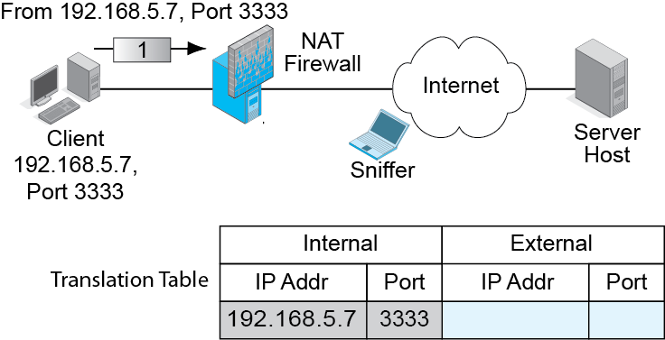
9.3: NAT Operation
NAT Firewall puts the real source IP address and port number in the table.

Slide 17
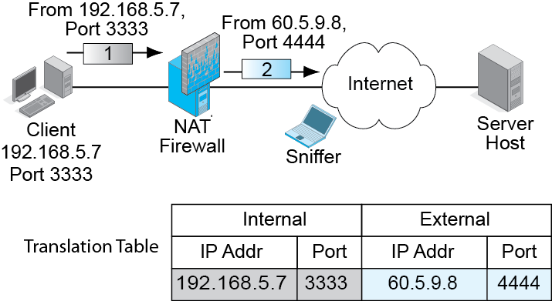
9.3: NAT Operation
NAT Firewall replaces the source IP address and port number of the packet with a false source IP address and port number.
Adds to table.

Slide 18
9.3: NAT Operation
NAT Firewall reverses the process for incoming packets.

Slide 19
9.3: NAT Operation
NAT Firewall reverses the process for incoming packets.

Slide 20
9.2: Network Address Translation
NAT is Transparent to Internal and External Hosts.
The NAT firewall does all the work.
Neither host knows that NAT is taking place.
So there is no need to modify how hosts work.

Slide 21
9.2: Network Address Translation
Security Reasons for Using NAT
External attackers can put sniffers outside the corporation.
Sniffers read IP addresses and port numbers.
Attackers can send attacks to these addresses and port numbers.
With NAT, attackers learn only false external IP addresses. Cannot use this information to attack internal hosts.

Slide 22
9.2: NAT
Expanding the Number of Available IP Addresses
Companies may receive a limited number of IP addresses from their ISPs.
There are roughly 4,000 possible ephemeral port numbers for each client IP address.
So for each IP address, there can be up to about 4,000 external connections.
If a firm is given 248 IP addresses, there can be roughly one million external connections (248 x 4000}

Slide 23
9.2: NAT
Expanding the Number of Available IP Addresses
If each internal device averages several simultaneous external connections, each one will require a different port number.
However, there should not be a problem with this many possible external IP addresses and port numbers.

Slide 24
9.2: NAT
Companies often use private IP addresses internally.
These can be used only within companies—never on the Internet.
There are three Private IP address ranges.
10.x.x.x
172.16.x.x through 172.31.x.x
192.168.x.x (most popular)

Slide 25
9.2: NAT
There Are Protocol Problems Caused by NAT
IPsec, VoIP, and other applications have a difficult time with NAT firewall traversal.
They must know the real IP address and port number of the host on the other side of the NAT firewall.
There are NAT firewall traversal techniques, but they must be managed carefully.

Slide 26
IP Subnetting
Network Address Translation (NAT)
Domain Name System (DNS)
IP Security (IPsec)
IPv6 Management
Other TCP/IP Supervisory Standards

Slide 27
The Domain Name System (DNS)
A domain is any group of resources (routers, single networks, hosts, etc.) under the control of an organization.

Slide 28
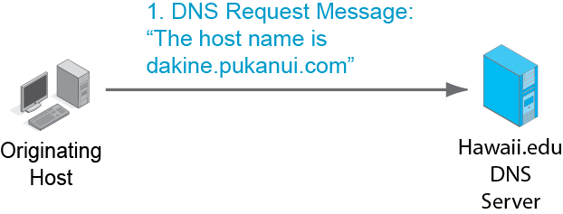
9.4: Domain Name System (DNS) Lookup
Originating host needs the IP address of host dakine.pukanui.com.
Asks its local DNS server at Hawaii.edu.

Slide 29
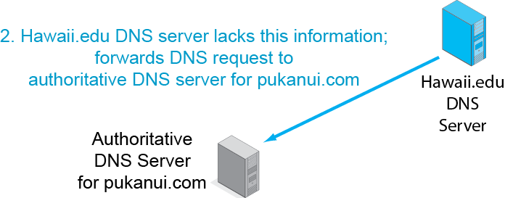
9.4: Domain Name System (DNS) Lookup

Slide 30
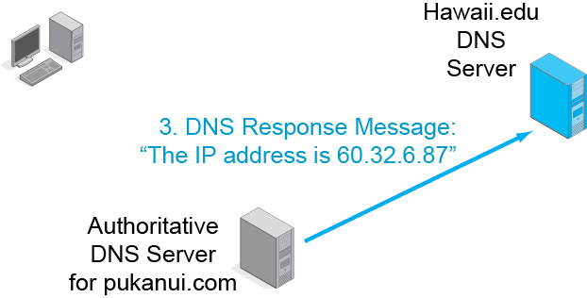
9.4: Domain Name System (DNS) Lookup
Sends response to local DNS server, not the client host.

Slide 31
9.4: Domain Name System (DNS) Lookup
Note that the local DNS server always sends back the response message.

Slide 32
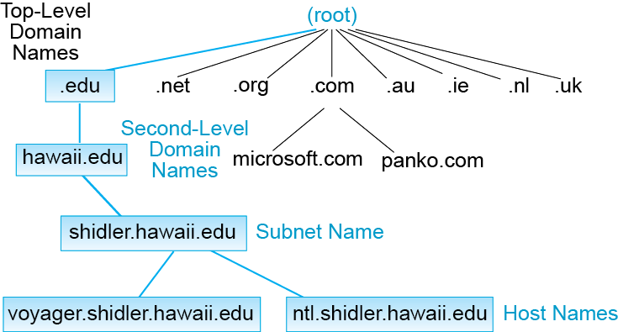
9.5: Domain Name System (DNS) Hierarchy
The DNS really is a general naming system for the Internet.
A domain is a set of resources under the control of an organization.
There is a hierarchy of domains.

Slide 33
9.5: Domain Name System (DNS) Hierarchy
The root is all domains.
There are 13 DNS root servers.
13 DNS root servers :
http://root-servers.org/

Slide 34
9.5: Domain Name System (DNS) Hierarchy
There are two kinds of top-level domains.
Generic top-level domains indicate organization type (.com, .edu, .gov, etc.).
Country top-level domains are specific to a country (.au, .ie, .ch, etc.).

Slide 35
9.5: Domain Name System (DNS) Hierarchy
Traditionally, generic top-level domains were strongly limited in number.
There have been a few additions over the year, such as .museum, .name, and .co.
Since 2012, any individual or company can propose to administer a generic top-level domain.

Slide 36
9.5: Domain Name System (DNS) Hierarchy
Companies want second-level domain names.
(Microsoft.com, apple.com, panko.com, etc.).
Competition for these names is fierce.

Slide 37
9.5: Domain Name System (DNS) Hierarchy
Most companies further divide their organizations into subdomains or subnets.

Slide 38
9.5: Domain Name System (DNS) Hierarchy
At the bottom of the hierarchy are individual hosts.

Slide 39
IP Subnetting
Network Address Translation (NAT)
Domain Name System (DNS)
Simple Network Management Protocol
IP Security (IPsec)
IPv6 Management
Other TCP/IP Supervisory Standards

Slide 40
VPNs
Virtual Private Networks
Really, just cryptographically protected communication over an untrusted network
The Internet
Wireless networks
But it is private in the sense that no one else can see the contents
We saw host-to-host VPNs in Chapters 3 and 7

Slide 41
Two Types of VPNs
Remote access VPN
Site-to-Site VPN
Copyright © 2015 Pearson Education, Ltd.

Slide 42
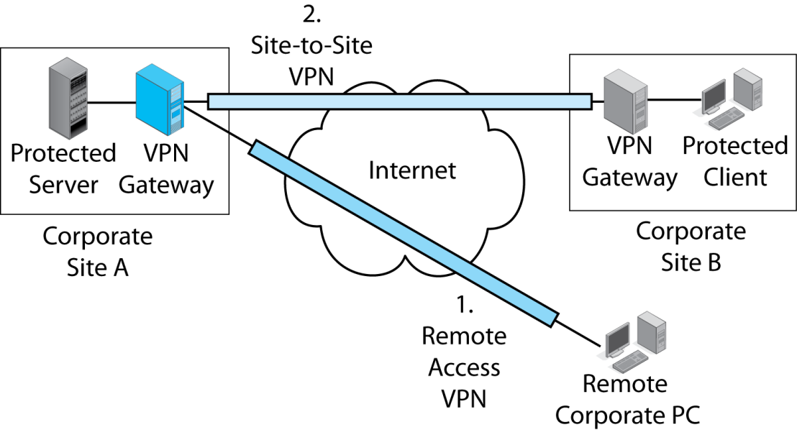
9.8: VPNs
Remote access VPNs connect a remote user to a corporate site.
The user connects to a VPN gateway at the site.
© 2015 Pearsn
9-42
Copyright © 2015 Pearson Education, Ltd.

Slide 43
9.8: VPNs
Site-to-site VPNs protect all traffic
traveling between two sites.
Each site has a gateway to encrypt outgoing traffic and decrypt incoming traffic.
Copyright © 2015 Pearson Education, Ltd.

Slide 44
IPsec VPNs
IPsec: IP Security Standard of IETF
Governed by the IPsec protocols
Operate at the internet layer
Protect transport header, application content, and at least some IP header content.
Protection is transparent. Upper-level content does not even know that it is being protected
Copyright © 2015 Pearson Education, Ltd.

Slide 45
Confidentiality, Authentication, Message Integrity
IP Header
TCP Header
App Content
New IP Header
ESP: Encapsulating Security Payload

Slide 46
9.9: IPsec in Transport and Tunnel Modes
IPsec has two modes (ways) of operating:
Transport mode
Tunnel mode
Both are IPsec
Each mode has strengths and weaknesses
Copyright © 2015 Pearson Education, Ltd.

Slide 47
9.9: IPsec Transport and Tunnel Modes
In transport mode, IPsec provides protection over the Internet and also over site networks between the hosts.
Copyright © 2015 Pearson Education, Ltd.

Slide 48
9.9: IPsec Transport and Tunnel Modes
Transport mode requires a digital certificate and configuration work on each host. This is expensive.
Copyright © 2015 Pearson Education, Ltd.

Slide 49
9.9: IPsec Transport and Tunnel Modes
In tunnel mode, IPsec only provides protection over the Dangerous Internet—not within site networks.
Copyright © 2015 Pearson Education, Ltd.

Slide 50
9.9: IPsec Transport and Tunnel Modes
Only the two IPsec gateways need digital certificates and configuration work.

Slide 51
9.9: IPsec Transport and Tunnel Modes
Criterion | Transport Mode | Tunnel Mode
Security | Better because it provides host-to-host protection. But firewalls cannot read encrypted traffic. | Not as good because it only provides security over the Internet or another trusted network (a wireless network, etc.).
Cost | Higher because of configuration work on each host. | Lower because IPsec operates only on the IPsec gateway .

Slide 52
9.10: IPsec Security Associations and Policy Servers

Slide 53
9.11 IPsec vs. SSL/TLS VPNs
Characteristics of | IPsec | SSL/TLS
Standards Organization | IETF | IETF (created by Netscape as SSL, renamed TLS by the IETF)
Layer | Layer 3 | Layer 4
Built into Browsers, Webservers, and Mail Servers, So Protects These Applications at Little or No Cost | No | Yes

Slide 54
9.11 IPsec vs. SSL/TLS VPNs
Characteristic | IPsec | SSL/TLS
Can protect any application | Yes (also protects transport-layer header and some of the IP header) | No (Only SSL/TLS-aware applications, e.g. web and e-mail)
Type of VPNs Supported in the Standard | Host-to-Host Remote Site Access Site-to-Site | Host-to-Host

Slide 55
9.11 IPsec vs. SSL/TLS VPNs
Characteristic | IPsec | SSL/TLS
Strength of Security | Excellent | Good
Security can be Managed Centrally | Yes | No

Slide 56
IP Subnetting
Network Address Translation (NAT)
Domain Name System (DNS)
Simple Network Management Protocol
IP Security (IPsec)
IPv6 Management
Other TCP/IP Supervisory Standards

Slide 57
9.13 IPv6 Subnetting
Must deal with global IPv6 unicast addresses
Like public IPv6 addresses
Have 3 parts but different names
IPv4 | IPv6 | IPv4 Part Length | IPv6 Part Length
Network Part | Routing Prefix | Variable | Variable
Subnet Part | Subnet ID | Variable | Variable
Host Part | Interface ID | Variable | 64 bits
 |  | 32 bits | 128 bits

Slide 58
9.13: Global Unicast Addresses in IPv6
Global Routing Prefix
(network part in IPv4)
Subnet ID
(subnet part in IPv4)
Interface ID
(host part in IPv4)

Slide 59
9.13: Global Unicast Addresses in IPv6
(Almost)
Always 64 bits
Global Routing Prefix
(network part in IPv4)
Subnet ID
(subnet part in IPv4)
Interface ID
(host part in IPv4)
Interface ID is not of variable length like IPv4 host parts.
“Wastes” 64 bits, but there are plenty of bits to lose.

Slide 60
9.13: Global Unicast Addresses in IPv6
(Almost)
Always 64 bits
Global Routing Prefix
(network part in IPv4)
Subnet ID
(subnet part in IPv4
Interface ID
(host part in IPv4)
m bits
n bits
64 bits
m + n = 64

Slide 61
IP Subnetting
Network Address Translation (NAT)
Domain Name System (DNS)
Simple Network Management Protocol
IP Security (IPsec)
IPv6 Management
Other TCP/IP Supervisory Standards

Slide 62
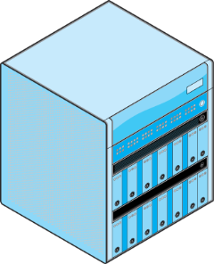
Dynamic Routing Protocols
How do routers get their routing tables?
They constantly exchange information
Communication must be standardized by dynamic routing protocol
There are several dynamic routing Protocols
Routing Table
Information
Router
Router
Dynamic
Routing Protocol

Slide 63
Dynamic Routing Protocols
Note that “Routing” means two things in TCP/IP
The process of forwarding an incoming packet
The process of exchanging routing table information through dynamic routing protocols
This sort of thing is somewhat common due to the IETF’s casual nature

Slide 64
8.15: Dynamic Routing Protocols

Slide 65
8.15: Dynamic Routing Protocols
Interior Dynamic Routing Protocol
Exterior Dynamic Routing Protocol

Slide 66
8.16: Dynamic Routing Protocols
Dynamic Routing Protocol | Interior or Exterior Routing Protocol? | Remarks
OSPF (Open Shortest Path First) | Interior | For large autonomous systems that use only TCP/IP
EIGRP (Enhanced Interior Gateway Routing Protocol) | Interior | Proprietary Cisco Systems protocol. Not limited to TCP/IP routing. Also handles IPX/SPX, SNA, etc.

Slide 67
8.16: Dynamic Routing Protocols
Dynamic Routing Protocol | Interior or Exterior Routing Protocol? | Remarks
BGP (Border Gateway Protocol) | Exterior | Organization cannot choose what exterior routing protocol it will use

Slide 68
Internet Control Message Protocol
ICMP
To handle supervisory communication between internet layer processes on different hosts or routers
Avoids making IP handle this type of message
Standardized by the Internet Control Message Protocol
https://www.iana.org/assignments/icmp-parameters/icmp-parameters.xhtml

Slide 69
9.17: Internet Control Message Protocol
ICMP provides error advisement messages
Helps in the diagnosis of errors
Does not bring reliability

Slide 70
9.17: Internet Control Message Protocol
Ping tells the pinger that the pingee is available.
It also gives round-trip latency

Slide 71
9.17: Internet Control Message Protocol

