Slide 1
Introduction to HTML
Yen-Cheng Chen
National Chi Nan University
ycchen@ncnu.edu.tw

Slide 2
HTML5
<!DOCTYPE html> <html lang="zh-Hant-TW"> <head> <meta charset="UTF-8" /> <meta name="keywords" content=" " /> <meta name="description" content=" " /> <title>網頁標題</title> </head> <body> 網頁內容 </body> </html>
https://ycchen.im.ncnu.edu.tw/www2011/lab/empty.html

Slide 3
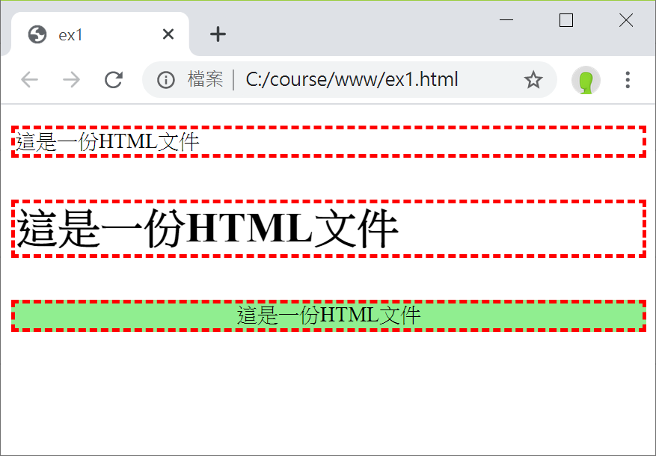
CSS (Cascading Style Sheets)
<!DOCTYPE html>
<html>
<head>
<title>ex1</title>
<meta charset="UTF-8" />
<style type="text/css">
p {border: dashed 2pt red}
.pclass {
text-align: center;
background-color: LightGreen }
</style>
</head>
<body>
<p>這是一份HTML文件</p>
<p style="font-size: 24pt; font-weight:bold;">
這是一份HTML文件</p>
<p class="pclass">這是一份HTML文件</p>
</body>
</html>

Slide 4
3 Layers of Web Page Design
Structural Layer
HTML
Presentation Layer
CSS
Behavior Layer
JavaScript
https://ycchen.im.ncnu.edu.tw/www2011/npm.html
https://www.w3schools.com/js/js_examples.asp

Slide 5
HTML元素與屬性
<element>contents</element>
<p>This is the first paragraph</p>
<element /> (獨立存在的元素)
<br />
<img src=“img1.png" />
<element attribute="value" …>
<div id="banner">…</div>
<a href="https://www.ncnu.edu.tw/" target="new">NCNU</a>
元素與屬性名稱請使用小寫字
元素若有多個屬性設定，屬性設定間需以空白隔開。

Slide 6
HTML網頁結構
<html>
<head>
<title> Page Title</title>
</head>
<body>
<h1>Heading level 1</h1>
<p>The first paragraph is here.</p>
</body>
</html>
~ 巢狀(樹狀)結構 ~

Slide 7
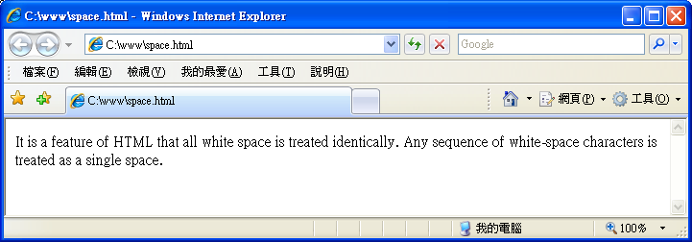
空白與換行
~ 在HTML原始文字檔中的多個空白或換行，瀏覽器只會顯示一個空白。
<p>
It is a feature of HTML that all white space is treated identically.
Any sequence of white-space characters is treated as a single space. </p>

Slide 8
HTML Comments (註解)
<!-- This is a comment. -->
<!-- This is another comment.
2nd line
3rd line
<h1>Heading level 1</h1>
-->

Slide 9
Example (HTML5)
<!DOCTYPE html>
<html>
<head>
<title>Yen-Cheng Chen (陳彥錚)</title>
<meta charset="UTF-8">
<meta http-equiv="Cache-Control" content="no-cache" />
<meta name="keywords" content="Yen-Cheng Chen,陳彥錚, network management, wireless networks" />
<meta name="description" content="Yen-Cheng Chen's web site, including tech and teaching materials." />
<link rel="icon" href="favicon.ico" type="image/x-icon" />
</head>
<body>
<!-- Yen-Cheng Chen's web page goes here… -->
</body>
</html>
<!DOCTYPE html> <html> <head> <meta charset="UTF-8" /> <title>網頁標題</title> </head> <body> 網頁內容 </body> </html>
https://ycchen.im.ncnu.edu.tw/www2011/lab/empty.html

Slide 10
meta and HTTP headers
<meta charset="UTF-8" />
<meta name="viewport" content="width=device-width, initial-scale=1.0" />
<meta http-equiv="Cache-Control" content="no-cache" />
<meta http-equiv="Expires" content ="Fri, 13 Mar 2020 01:47:40 GMT" />
<meta http-equiv="Date" content ="Fri, 06 Mar 2020 01:47:40 GMT" />
<meta http-equiv="refresh" content ="300" />
<meta http-equiv="refresh" content ="5; url=http://www.ncnu.edu.tw/" />
https://en.wikipedia.org/wiki/Meta_element

Slide 11
Setting The Viewport
<meta name="viewport" content="width=device-width, initial-scale=1.0" />
viewport
user's visible area of a web page.
It varies with the device, and will be smaller on a mobile phone than on a computer screen.
width=device-width
the width of the page to follow the screen-width of the device
initial-scale=1.0
the initial zoom level when the page is first loaded by the browser
Without viewport:
https://www.w3schools.com/html/example_withoutviewport.htm
With viewport:
https://www.w3schools.com/html/example_withviewport.htm

Slide 12
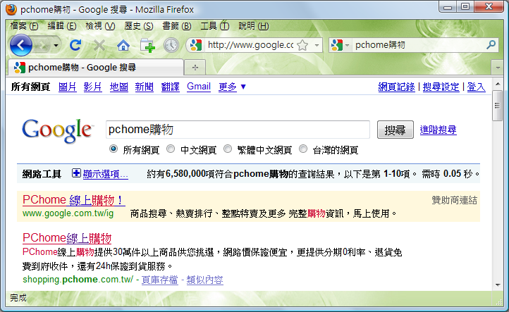
meta and Search Engines
<meta name="keywords" content="購物,NB,筆記型電腦,LV,PC,手機,相機,mp3,Gucci,Coach,psp,Wii,iPod" />
<meta name="description" content="PChome線上購物提供30萬件以上商品供您挑選，網路價保證便宜，更提供分期0利率、退貨免費到府收件，還有24h保證到貨服務。" />
<meta name="robots" content="index, follow" />
http://www.im.ncnu.edu.tw/robots.txt

Slide 13
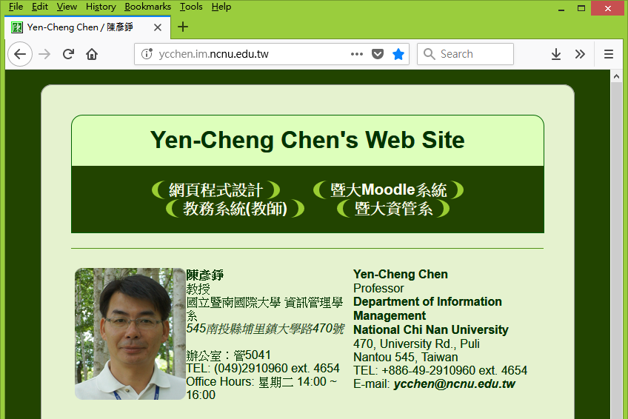
<link rel="icon" href="favicon.ico" type="image/x-icon" />
favicon.ico
➔ https://www.xiconeditor.com/

