Slide 1
CSS選取器 (Selector)

Slide 2
Selector
selector {property: value; …}
  例如: h1 {color: #cc3333; text-align: center;}
選取器種類
  元素選取器 (type/element selector)
  類別選取器 (class selector)
  識別碼選取器 (id selector)
  關聯選取器 (contextual selector)
  屬性選取器 (attribute selector)
  虛擬類別選取器 (pseudoclass selector)
  虛擬元素選取器 (pseudoelement selector)

Slide 3
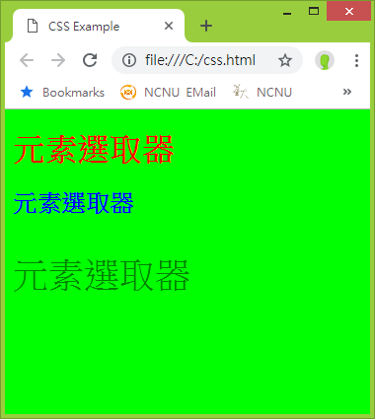
  元素選取器(type selector)
  h1 {text-align: center;}
  p {color: green; font-size: 36px;}
  div {border: 2px solid blue;}
  h2, h3 {font-size: 2.5em}
  h1, p, div {border-bottom: dashed 5px green}
※
※
<style type="text/css">
body {background-color: lime;}
h1 {color: red;}
h2 {color: blue;}
p {color: green; font-size: 36px;}
</style>
…
<h1>元素選取器</h1>
<h2>元素選取器</h2>
<p>元素選取器</p>
練習檔案:
https://ycchen.im.ncnu.edu.tw/www2011/lab/pm.zip

Slide 4
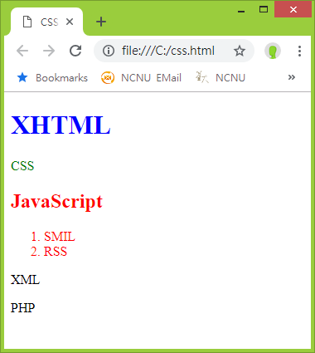
類別選取器(class selector)
.classname {…}
…
<element class="classname" … >
<element class="class1 class2 …" … >
⬅ 多重類別之設定
  <style type="text/css">
  .setcolor {color: red;}
  h1.setcolor {color: blue;}
  p.setcolor {color: green;}
  </style>
  …
  <h1 class="setcolor">XHTML</h1>
  <p class="setcolor">CSS</p>
  <h2 class="setcolor">JavaScript</h2>
  <ol class="setcolor">
  <li>SMIL</li>
  <li>RSS</li>
  </ol>
  <p>XML</p>
  <p>PHP</p>

Slide 5
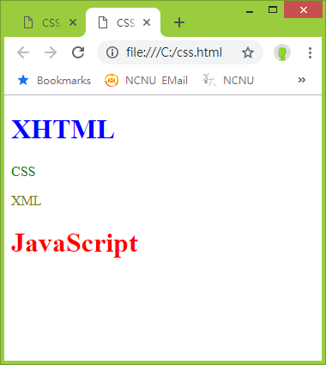
識別碼選取器(id selector)
#idname {…}
…
<element id="idname" … >
<style type="text/css">
#header {color: blue;}
#content {color: green;}
#footer {color: red;}
#sidebar {color: olive;}
</style>
…
<h1 id="header">XHTML</h1>
<p id="content">CSS</p>
<p id="sidebar">XML</p>
<h1 id="footer">JavaScript</h1>

Slide 6
關聯選取器(Contextual Selector)
後代 (Descendant) | E F | Any F element that is a descendant of an E element.
子代 (Child) | E > F | Any F element that is a child of an E element.
相鄰 (Adjacent) | E + F | Any F element immediately preceded by a sibling element E.
ul em
li a
li a em
h2 > em
li > a
h2 > em
h1 + p
h1 + h2
h3 + p
ul a > em
<h1></h1>
<p>Paragraph 1</p>
<ul>
<li>XHTML</li>
<li><em>JavaScript</em></li>
<li><a href="http://www.w3.org/Style/CSS/"><em>CSS</em></a></li>
</ul>
<h1><em>XML</em></h1>
<h2><em>PHP</em></h2>
<h3><em>ASP.NET</em></h3>
<p>Paragraph 2</p>

Slide 7
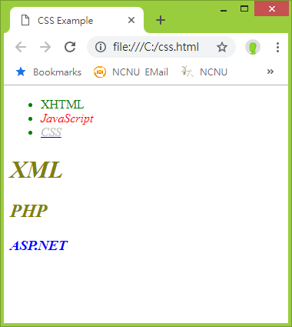
後代選取器(Descendant Selector)
<style type="text/css">
li {color: green;}
li em {color: red;}
li a em {color: silver;}
em {color: blue;}
h1 em, h2 em {color: olive;}
</style>
…
<ul>
<li>XHTML</li>
<li><em>JavaScript</em></li>
<li><a href="http://w3.org/Style/CSS/"><em>CSS</em></a></li>
</ul>
<h1><em>XML</em></h1>
<h2><em>PHP</em></h2>
<h3><em>ASP.NET</em></h3>

Slide 8
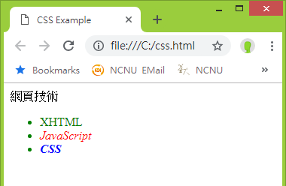
子代選取器(Child Selector)
<style type="text/css">
li {color: green;}
li > em {color: red;}
em {color: blue;}
</style>
</head>
<body>
網頁技術
<ul>
<li>XHTML</li>
<li><em>JavaScript</em></li>
<li><strong><em>CSS</em></strong></li>
</ul>

Slide 9
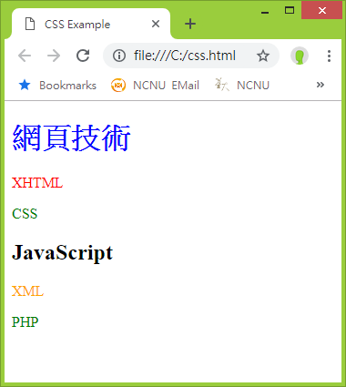
相鄰選取器 (Adjacent Sibling Selector)
<style type="text/css">
h1 {color: blue;}
h1 + p {color: red;}
h2 + p {color: orange;}
p {color: green;}
</style>
…
<h1>網頁技術</h1>
<p>XHTML</p>
<p>CSS</p>
<h2>JavaScript</h2>
<p>XML</p>
<p>PHP</p>

Slide 10
屬性選取器(Attribute Selector)
E[att] | 任何E元素，其att屬性有設定者 Any E element that has an att attribute, regardless of its value.
E[att="val"] | 任何E元素，其att屬性值等於val者 Any E element whose att attribute value is exactly equal to val.
E[att~="val"] | 任何E元素，其att屬性中含有val者 Any E element whose att attribute value is a list of space-separated values, one of which is exactly equal to val.
E[att|="val"] | 任何E元素，其att屬性等於val或以"val-"開頭者 Any E element whose att value is either exactly val or beginning with "val" immediately followed by "-" ex. link[hreflang|="en"] "en", "en-US", "en-cockney"

Slide 11
Attribute Selector (CSS 3)
[attr]
  Ex: [title], [name], [value], …
[attr^=val] “starts with”
  Ex: [id^=Sec], [href^=mailto], [title^=fish]
[attr*=val] “contains”
  Ex: [title*=fish], [href*=ncnu]
[attr$=val] “ends with”
  * Ex: [href$=tw], [title$=fish]
“fish food”
“fish food”, “sword fish”
“sword fish”

Slide 12
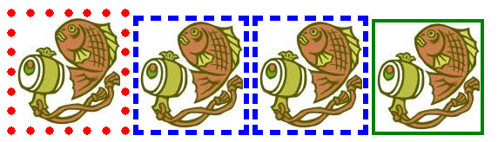
<style type="text/css">
img[title] {border: 4px solid green;}
img[title="first image"] {border: 10px dotted red;}
img[title~="fish"] {border: 6px dashed blue;}
</style>
…
<img src="fish.jpg" alt="大魚" title="first image" />
<img src="fish.jpg" alt="大魚" title="second fish" />
<img src="fish.jpg" alt="大魚" title="third fish" />
<img src="fish.jpg" alt="大魚" title="fourth figure" />

Slide 13
Pseudo-class (虛擬類別)
  A pseudo-class is a selector that selects elements that are in a specific state.
Pseudo-element (虛擬元素)
  Pseudo-elements act as if you had added a whole new HTML element into the markup, rather than applying a class to existing elements.

Slide 14
虛擬類別選取器( pseudoclass selector)
a
  a:link 尚未連結過
  a:visited 已連結過
  a:hover 滑鼠移至連結上時
  a:active 正連結中
:focus 應用到能接受焦點的元素
:first-child 應用到父元素之第一個子元素
:lang( ) 應用到指定語言的元素上

Slide 15
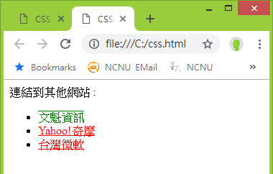
a之虛擬類別
<style type="text/css">
a:link {color: red; text-decoration: underline;}
a:visited {color: blue; text-decoration: blink;}
a:hover {color: green; text-decoration: overline;}
a:active {color: oliver; text-decoration:line-through;}
</style>
…
連結到其他網站 :
<ul>
<li><a href="http://www.kingsinfo.com.tw">文魁資訊</a></li>
<li><a href="http://tw.yahoo.com">Yahoo!奇摩</a></li>
<li><a href="http://www.microsoft.com.tw">台灣微軟</a></li>
</ul>

Slide 16
虛擬元素選取器( pseudoelement selector)
::first-line
::first-letter
::before
::after

Slide 17
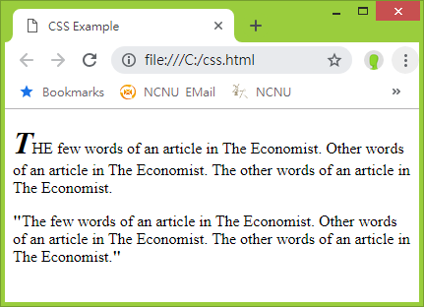
<style type="text/css">
p.pfirst::first-letter { font-size: 200%; font-style: italic; font-weight: bold}
p.pquote::before, p.pquote::after {content: "\""; font-weight:bold}
span {text-transform: uppercase}
p.pquote span {text-transform: lowercase}
</style>
<p class="pfirst">T<span>he</span> few words of an article in The Economist. Other words of an article in The Economist. The other words of an article in The Economist.</p>
<p class="pquote">T<span>he</span> few words of an article in The Economist. Other words of an article in The Economist. The other words of an article in The Economist.</p>

Slide 18
Universal Selector
* {color: purple;}
DIV.danger * {color: red;}
body * UL {color: gray;}
body * * UL {border-right: thin solid green;}

Slide 19
Selector type | Pattern | Description
Universal | * | Matches any element.
Type | E | Matches any E element.
Class | .info | Matches any element whose class attribute contains the value info.
ID | #footer | Matches any element with an id equal to footer.
Descendant | E F | Matches any F element that is a descendant of an E element.
Child | E > F | Matches any F element that is a child of an E element.
Adjacent | E + F | Matches any F element immediately preceded by a sibling element E.
Attribute | E[att] | Matches any E element that has an att attribute, regardless of its value.
Attribute | E[att=val] | Matches any E element whose att attribute value is exactly equal to val.
Attribute | E[att~=val] | Matches any E element whose att attribute value is a list of space-separated values, one of which is exactly equal to val.
Attribute | E[att|=val] | Matches any E element whose att attribute has a hyphen-separated list of values beginning with val.
pseudo-class | E:first-child | Matches element E when E is the first child of its parent.
pseudo-class | E:link E:visited | Matches not yet visited (:link) or already visited (:visited) links.
dynamic pseudo-class | E:active E:hover E:focus | Matches E during certain user actions.
pseudo-class | E:lang(c) | Matches elements of type E that are in language c.
pseudo-element | E::first-line | Matches the contents of the first formatted line of element E.
pseudo-element | E::first-letter | Matches the first letter of element E.
pseudo-element | E::before E::after | Used to insert generated content before or after an element’s content.

Slide 20
CSS Selector Reference
https://www.w3schools.com/cssref/css_selectors.asp
:last-of-type | p:last-of-type | Selects every <p> element that is the last <p> element of its parent
:only-of-type | p:only-of-type | Selects every <p> element that is the only <p> element of its parent
:only-child | p:only-child | Selects every <p> element that is the only child of its parent
:nth-child(n) | p:nth-child(2) | Selects every <p> element that is the second child of its parent
:nth-last-child(n) | p:nth-last-child(2) | Selects every <p> element that is the second child of its parent, counting from the last child
:nth-of-type(n) | p:nth-of-type(2) | Selects every <p> element that is the second <p> element of its parent
:nth-last-of-type(n) | p:nth-last-of-type(2) | Selects every <p> element that is the second <p> element of its parent, counting from the last child
:last-child | p:last-child | Selects every <p> element that is the last child of its parent

Slide 21
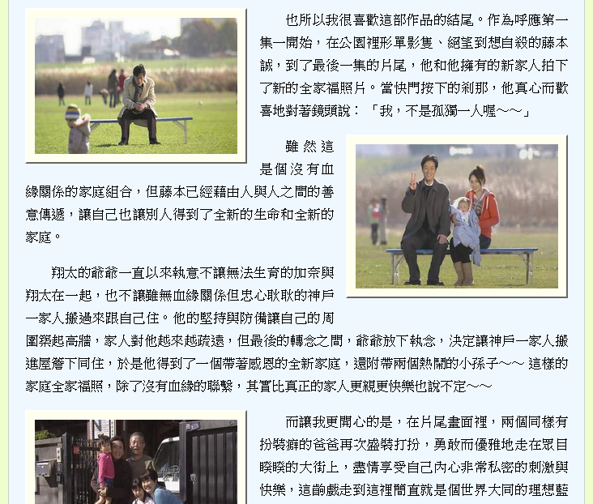
odd & even
img:nth-of-type(odd) {
float: left;
…
}
img:nth-of-type(even) {
float: right;
…
}

