Slide 1
JavaScript Events

Slide 2
Old-style Event Handlers
<body onload="welcome()">
<form>
<input type="text" id="uid" onchange="check()" />
<button id="ok" onclick="okay();return false;">
Click me</button>
</form>
</body>
<script type="text/javascript">
function welcome() {
alert("Welcome to My Blog!");
}
function check() {
var uid = document.getElementById("uid");
if (uid.value == "") {
alert("不可空白!");
uid.value="user id";
}
}
function okay() {
var btn = document.getElementById("ok");
btn.style.color = "green";
return false;
}
</script>

Slide 3
Event handlers using DOM
<body>
<form>
<input type="text" id="uid" />
<button id="ok">Click me</button>
</form>
</body>
window.onload = function( ) {
alert("Welcome to My Blog!");
var uid = document.getElementById("uid");
uid.onchange=check;
document.getElementById("ok").onclick = okay;
};
function check( ) {
if (this.value == "") {
alert("不可空白!");
this.value="user id";
}
}
function okay( ) {
this.style.color = "green";
return false;
}

Slide 4
Event handlers using DOM
<script type="text/javascript">
window.onload = function() {
document.getElementById("uid").onchange = function() {
//…
};
document.getElementById("ok").onclick = function() {
//…
};
// …
};

Slide 5
What We Learned
定義初始化函數
    window.onload = function() {
    //初始化函數
    }
在初始化函數中，設定各元素事件處理函數名稱
  使用document.getElementById("element id")選取元素
  element.oneventname = eventHandlingFunction;
定義各事件處理函數
  在事件處理函數中，可使用this指至發生事件之元素

Slide 6

JavaScript HTML DOM EventListener (1/2)
addEventListener()
  attaches an event handler to the specified element.
  attaches an event handler to an element without overwriting existing event handlers.
  You can
    add many event handlers to one element.
    add many event handlers of the same type to one element.
    add event listeners to any DOM object not only HTML elements
<button id="chkBtn">Check<button>
var chk=document.getElementById("chkBtn");
chk.addEventListener("click", function(){
alert("Checking!");
});
chk.addEventListener("click", dblChk);
function dblChk() {
…
}

Slide 7
JavaScript HTML DOM EventListener (2/2)
removeEventListener()
  removes event handlers that have been attached with the addEventListener() method
var chk=document.getElementById("chkBtn");
chk.addEventListener("click", dblChk);
…
chk.removeEventListener("click", dblChk);

Slide 8
HTML DOM Events
➔ https://www.w3schools.com/jsref/dom_obj_event.asp
Mouse Events
Keyboard Events
Frame/Object Events
Form Events
Drag Events
Clipboard Events
Print Events
Media Events
Animation Events (CSS)
Transition Events (CSS)
Server-Sent Events
Misc Events (其他)
Touch Events

Slide 9
Event | Description
onclick | the user clicks on an element
oncontextmenu | the user right-clicks on an element to open a context menu
ondblclick | the user double-clicks on an element
onmousedown | the user presses a mouse button over an element
onmouseenter | the pointer is moved onto an element
onmouseleave | the pointer is moved out of an element
onmousemove | the pointer is moving while it is over an element
onmouseover | the pointer is moved onto an element, or onto one of its children
onmouseout | a user moves the mouse pointer out of an element, or out of one of its children
onmouseup | a user releases a mouse button over an element
onkeydown | the user is pressing a key
onkeypress | the user presses a key
onkeyup | the user releases a key
onabort | the loading of a resource has been aborted
onbeforeunload | before the document is about to be unloaded
onerror | an error occurs while loading an external file
onhashchange | there has been changes to the anchor part of a URL
onload | an object has loaded
onpageshow | the user navigates to a webpage
onpagehide | the user navigates away from a webpage
onresize | the document view is resized
onscroll | an element's scrollbar is being scrolled
onunload | once a page has unloaded (for <body>)
Mouse Events
Keyboard Events
Frame/Object Events

Slide 10
Getting more event information
https://www.w3.org/TR/DOM-Level-2-Events/events.html#Events-MouseEvent
事件處理函數，加入參數
    function onclickHandling(e) {
    //e.type
    // e.screenX, e.screenY, e.clientX, e.clientY
    // e.button,
    }

Slide 11
Properties of Event
target
type
button
clientX, clientY
screenX, screenY
altKey, ctrlKey, shiftKey
keyCode
cancelBubble

Slide 12
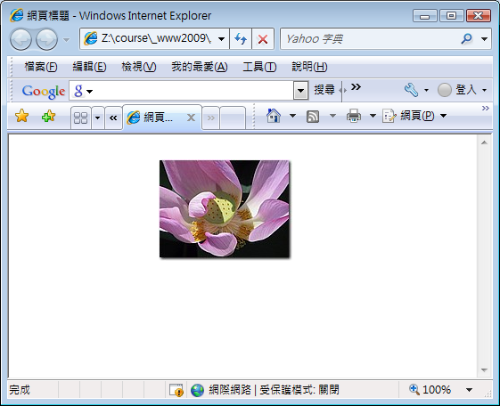
<style type="text/css">
img {
position: absolute;
}
</style>
…
<body>
<div id="content">
<img id="lily" src="lily.jpg" alt="" />
</div>
</body>
window.onload=function() {
document.onclick=mvImg;
}
function mvImg(e) {
if (window.event)
e=window.event;
var img=document.getElementById("lily");
img.style.top=(e.clientY-0.5*img.height)+"px";
img.style.left=(e.clientX-0.5*img.width)+"px";
}
https://ycchen.im.ncnu.edu.tw/www2011/lab/ImgEventJS.html

Slide 13
Mouse Event Example
https://ycchen.im.ncnu.edu.tw/www2011/lab/jslab/mvEventJS.html
window.onload = function() {
img1 = document.getElementById("lily");
img1.style.position="absolute";
img1.style.top="300px";
img1.style.left="300px";
img1.onclick = clickStart;
}
function clickStart(e) {
document.onmousemove = imgMove;
mtop = parseInt(img1.style.top);
mleft = parseInt(img1.style.left);
x1 = e.clientX;
y1 = e.clientY;
}
function imgMove(e) {
img1.onclick=clickStop;
x2 = e.clientX;
y2 = e.clientY;
mtop = mtop+y2-y1;
mleft = mleft +x2-x1;
x1=x2;
y1=y2;
img1.style.top=mtop+"px";
img1.style.left=mleft+"px";
}
function clickStop(e) {
document.onmousemove = null;
img1.onclick = clickStart;
}

Slide 14
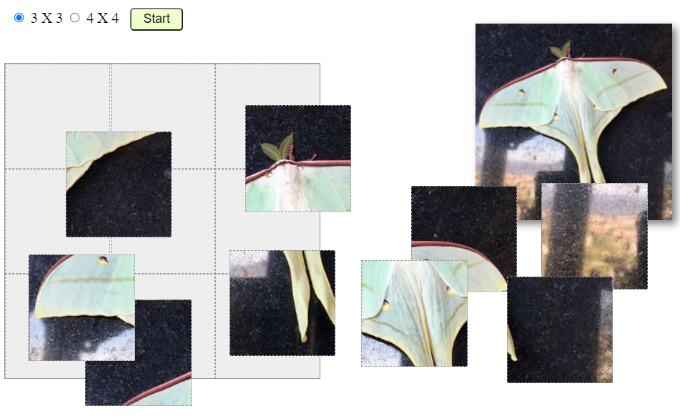
Drag and Drop
https://ycchen.im.ncnu.edu.tw/moth/puzz.html?11

Slide 15
Keyboard Events
<script type="text/javascript">
window.onload = function () {
document.getElementById("keyp").onkeypress=getKey;
document.getElementById("keyd").onkeydown=getKey;
}
…
function getKey(e) {
keynum = e.keyCode;
alert(keynum);
// return false;
}
</script>
…
<form>
keypress: <input type="text" id="keyp" /><br />
keydown: <input type="text" id="keyd" /><br />
</form>
- 主要有兩種keyboard events:
* keypress ➔ 文數字鍵, 例如a, A
* keydown ➔ 鍵盤上的任何鍵, 例如shift, 方向鍵
- 利用event的keyCode屬性來判斷
⬅ 取消此事件
https://ycchen.im.ncnu.edu.tw/www2011/lab/jslab/keyEventJS.html

Slide 16
取消事件
html:
<input type="text" id="keypc" />
<script type="text/javascript">
window.onload = function () {
…
document.getElementById("keypc").onkeypress=getKeyCancel;
};
function getKeyCancel(e) {
keynum = e.keyCode;
if ((keynum>=65 && keynum <=90) || (keynum>=97 && keynum<=122))
return true; // 事件正常發生!
else
return false; // 取消事件，視同按鍵無作用！
}
</script>
A~Z: 65~90, a~z: 97~122
https://zh.wikipedia.org/wiki/ASCII
https://ycchen.im.ncnu.edu.tw/www2011/lab/jslab/keyEventJS.html

Slide 17
表單檢查與取消事件
html:
<form id="join" …>
…
<input type="submit" />
</form>
<script type="text/javascript">
window.onload=function() {
document.getElementById("join").onsubmit=frmCheck;
};
…
function frmCheck() {
var isOK=true;
// check form elements.
// if any input is not ok, set isOK=false;
…
return isOK;
}
</script>

Slide 18
window.onload = function() {
document.onkeydown= getKey;
var img1 = document.getElementById("lily");
img1.style.top="300px"; img1.style.left="300px";
}
function getKey(e) {
var keynum;
if (window.event) e=window.event;
keynum=e.keyCode;
var img1 = document.getElementById("lily");
var mtop = parseInt(img1.style.top);
var mleft = parseInt(img1.style.left);
switch (keynum) {
case 37:
img1.style.left = Math.max(0, (mleft-10)) +"px";
break;
case 38:
img1.style.top =Math.max(0, (mtop-10)) +"px";
break;
case 39:
img1.style.left = Math.min(document.documentElement.clientWidth-img1.width, mleft+10)+"px";
break;
case 40:
img1.style.top = Math.min(document.documentElement.clientHeight-img1.height, mtop+10)+"px";
break;
}
}
▲
▲
▲
▼
https://ycchen.im.ncnu.edu.tw/www2011/lab/keydownEventJS.html
<style type="text/css">
img {
position: absolute;
}
</style
關於螢幕及瀏覽器大小，請參考：
https://ycchen.im.ncnu.edu.tw/www2011/lab/jslab/screenJS.htm

Slide 19
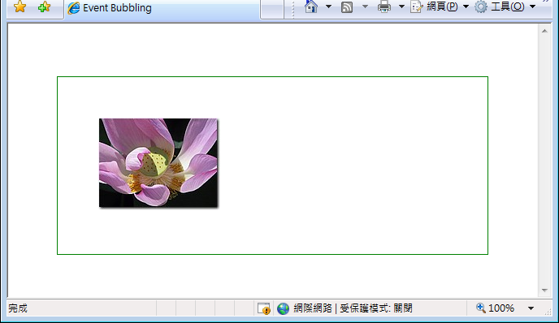
Event Bubbling
<body>
<div id="content">
<img id="lily" src="lily.jpg" />
</div>
</body>
window.onload = function () {
document.onclick=docClick;
document.getElementById("content").onclick=divClick;
document.getElementById("lily").onclick=imgClick;
}
function docClick() {
alert("document clicked!");
}
function divClick() {
alert("div clicked!");
}
function imgClick() {
alert("img clicked!");
}

Slide 20
event.cancelBubble
function imgClick(e) {
if (window.event)
e=window.event;
e.cancelBubble = true;
// e.stopPropagation();
alert("img clicked!");
}
https://ycchen.im.ncnu.edu.tw/www2011/lab/EventBubbleJS.html

Slide 21
Other Event Objects
Event Object | Description
AnimationEvent | For CSS animations
ClipboardEvent | For modification of the clipboard
DragEvent | For drag and drop interaction
FocusEvent | For focus-related events
HashChangeEvent | For changes in the anchor part of the URL
InputEvent | For user input
KeyboardEvent | For keyboard interaction
MouseEvent | For mouse interaction
PageTransitionEvent | For navigating to, and away from, web pages
PopStateEvent | For changes in the history entry
ProgressEvent | For the progress of loading external resources
StorageEvent | For changes in the window's storage area.
TouchEvent | For touch interaction
TransitionEvent | For CSS transitions
UiEvent | For user interface interaction
WheelEvent | For mousewheel interaction

