Slide 1
文字CSS樣式

Slide 2
文字的屬性
text-decoration none | underline | overline | line-through | blink
text-transform none | capitalize | uppercase | lowercase
line-height
text-indent
text-align left | right | center | justify
vertical-align baseline | sub | super | top | text-top | middle |
bottom | text-bottom | <percentage> | <length>
letter-spacing
word-spacing
white-space
direction ltr | rtl

Slide 3
文字裝飾線(text-decoration)
<p style="text-decoration: none;">Text Decoration - none</p>
<p style="text-decoration: underline;">Text Decoration - underline</p>
<p style="text-decoration: overline;">Text Decoration - overline</p>
<p style="text-decoration: line-through;">Text Decoration - line-through</p>

Slide 4
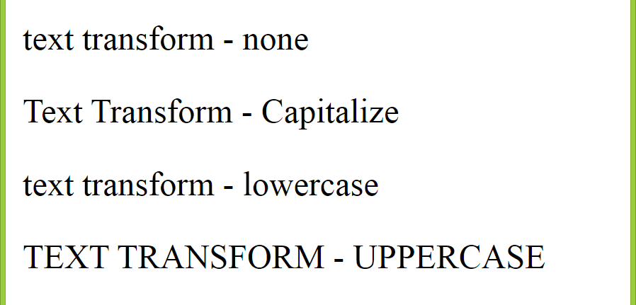
英文字母大小轉換(text-transform)
<p style="text-transform: none;">text transform - none </p>
<p style="text-transform: capitalize;">text transform - capitalize</p>
<p style="text-transform: lowercase;">text transform - lowercase</p>
<p style="text-transform: uppercase;">text transform - uppercase</p>

Slide 5
文字行高(line-height)
<p style="line-height: normal;">
Line height of paragraph is normal. <br />
Line height of paragraph is normal. </p>
<p style="line-height: 2.5;">
Line height of paragraph is 2.5. <br />
Line height of paragraph is 2.5. </p>
<p style="line-height: 2em;">
Line height of paragraph is 2em. <br />
Line height of paragraph is 2em. </p>
<p style="line-height: 220%;">
Line height of paragraph is 300%. <br />
Line height of paragraph is 300%. </p>

Slide 6
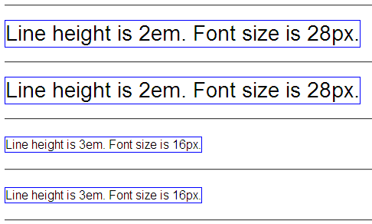
span {line-height: 2em; font-size: 28px; border: 1px solid blue;}
#em3 {line-height: 3em; font-size: 16px; border: 1px solid blue;}
...
<hr /><span>Line height is 2em. Font size is 28px.</span><hr />
<span>Line height is 2em. Font size is 28px.</span><hr />
<span id="em3">Line height is 3em. Font size is 16px.</span><hr />
<span id="em3">Line height is 3em. Font size is 16px.</span><hr />

Slide 7
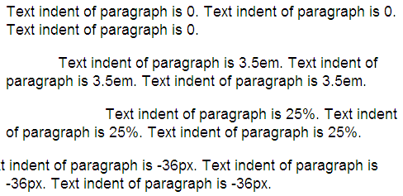
第一行文字縮排(text-indent)
<p style="text-indent: 0;">
<p style="text-indent: 3.5em;">
<p style="text-indent: 25%;">
<p style="text-indent: -36px;">

Slide 8
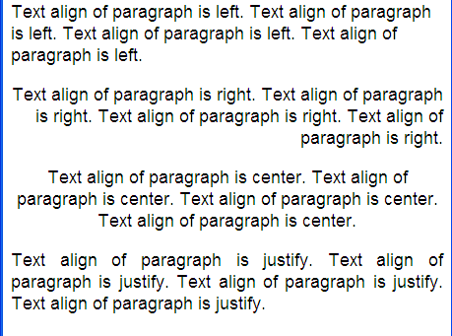
文字水平對齊(text-align)
<p style="text-align: left;">
<p style="text-align: right;">
<p style="text-align: center;">
<p style="text-align: justify;">

Slide 9
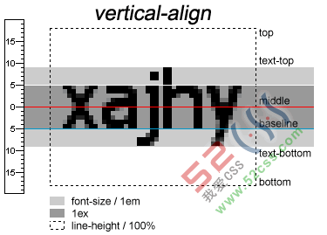
垂直對齊(vertical-align)
依據基準線
baseline | sub | super
依據文字高度
text-top | middle | text-bottom
依據行高
top | bottom
https://www.jb51.net/css/10337.html

Slide 10
vertical-align Example
<style type="text/css">
#preface {background-color:#cfc;
line-height:2;
font-size:18pt;
}
#fb1 {vertical-align: middle}
#fb2 {vertical-align: text-bottom}
</style>
<div id="preface">
上一季倉本聰編劇的「風之花園」<img src="fb.png" id="fb1" />後，同樣為紀念富士電視台(Fuji TV)<img src="fb.png" id="fb2" />開台五十…</div>

Slide 11
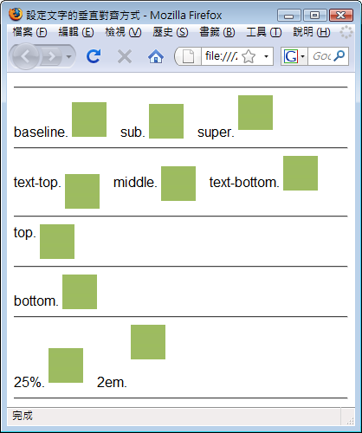
p {line-height: 60px;}
img {width: 40px; height: 40px;}
baseline.<img src="fish.jpg" alt="" style="vertical-align: baseline;" />
…

Slide 12
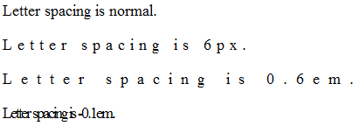
字元間距(letter-spacing)
<p style="letter-spacing: normal;">Letter spacing is normal.</p>
<p style="letter-spacing: 6px;">Letter spacing is 6px.</p>
<p style="letter-spacing: 0.6em;">Letter spacing is 0.6em.</p>
<p style="letter-spacing: -0.1em;">Letter spacing is -0.1em.</p>

Slide 13
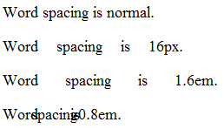
單字間距(word-spacing)
<p style="word-spacing: normal;">Word spacing is normal.</p>
<p style="word-spacing: 16px;">Word spacing is 16px.</p>
<p style="word-spacing: 1.6em;">Word spacing is 1.6em.</p>
<p style="word-spacing: -0.8em;">Word spacing is -0.8em.</p>

Slide 14
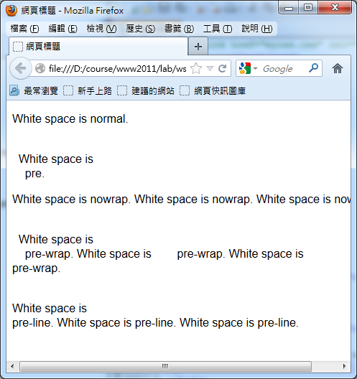
<p style="white-space: normal;">
White space is
normal.
</p>
<p style="white-space: pre;">
White space is
pre.
</p>
<p style="white-space: nowrap;">
White space is
nowrap. White space is nowrap. White space is nowrap.
</p>
<p style="white-space: pre-wrap;">
White space is
pre-wrap. White space is pre-wrap. White space is pre-wrap.
</p>
<p style="white-space: pre-line;">
White space is
pre-line. White space is pre-line. White space is pre-line.
</p>
空白字元 (white-space)

