Slide 1
JavaScript DOM Objects (1)
https://ycchen.im.ncnu.edu.tw/www2011/lab/DomObjsJS.html

Slide 2
JavaScript DOM Objects
DOM: Document Object Model
Browser Object Model (BOM)
window, screen, navigator, history, location
DHTML DOM
document, form, anchor, link, image, …
W3C DOM
element, node, …

Slide 3
screen
navigator
window
history
location
document
anchors[]
links[]
images[]
event
forms[]
…
input
…
select
…
textarea
option
button

Slide 4
screen
Property | Description
availHeight | Returns the height of the display screen (excluding the Windows Taskbar)
availWidth | Returns the width of the display screen (excluding the Windows Taskbar)
colorDepth | Returns the bit depth of the color palette on the destination device or buffer
height | The height of the display screen
width | Returns width of the display screen
https://ycchen.im.ncnu.edu.tw/www2011/lab/DomObjsJS.html#screen

Slide 5
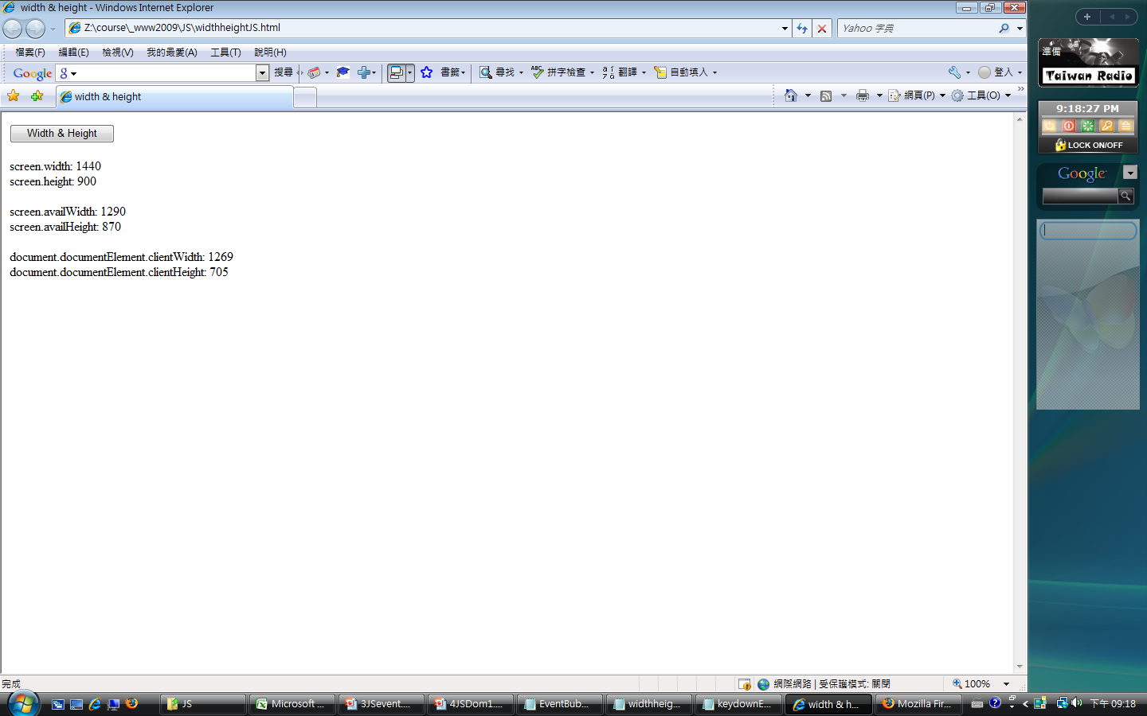
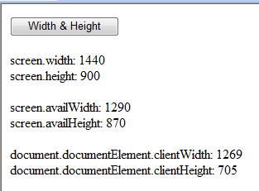
https://ycchen.im.ncnu.edu.tw/www2011/lab/jslab/screenJS.htm
1440
1290
1269
705
870
900

Slide 6
navigator
Property | Description
appCodeName | Returns the code name of the browser
appName | Returns the name of the browser
appVersion | Returns the platform and version of the browser
cookieEnabled | Returns a Boolean value that specifies whether cookies are enabled in the browser
platform | Returns the operating system platform
userAgent | Returns the value of the user-agent header sent by the client to the server
Method | Description
javaEnabled() | Specifies whether or not the browser has Java enabled
taintEnabled() | Specifies whether or not the browser has data tainting enabled
https://ycchen.im.ncnu.edu.tw/www2011/lab/DomObjsJS.html#navigator

Slide 7
window
http://w3schools.com/jsref/obj_window.asp
Property | Description
closed | Returns whether or not a window has been closed
document | See Document object
history | See History object
length | Sets or returns the number of frames in the window
location | See Location object
name | Sets or returns the name of the window
opener | Returns a reference to the window that created the window
parent | Returns the parent window
personalbar | Sets whether or not the personal bar (or directories bar) should be visible
scrollbars | Sets whether or not the scrollbars should be visible
self | Returns a reference to the current window
statusbar | Sets whether or not the statusbar should be visible
toolbar | Sets whether or not the tool bar is visible or not
top | Returns the topmost ancestor window

Slide 8
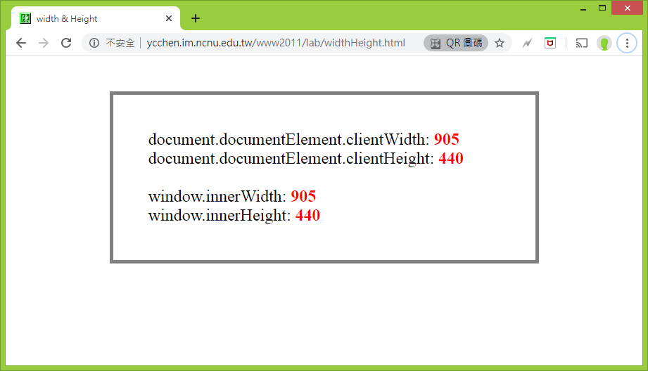
https://ycchen.im.ncnu.edu.tw/www2011/lab/widthHeight.html
var ww2 = window.innerWidth;
var hh2 = window.innerHeight;

Slide 9
window's methods (1/2)
https://w3schools.com/jsref/obj_window.asp
Method | Description
alert() | Displays an alert box with a message and an OK button
confirm() | Displays a dialog box with a message and an OK and a Cancel button
prompt() | Displays a dialog box that prompts the user for input
open() | Opens a new browser window
close() | Closes the current window
print() | Prints the contents of the current window
focus() | Sets focus to the current window
blur() | Removes focus from the current window
setInterval() | Evaluates an expression at specified intervals
setTimeout() | Evaluates an expression after a specified number of milliseconds
clearInterval() | Cancels a timeout set with setInterval()
clearTimeout() | Cancels a timeout set with setTimeout()

Slide 10
window's methods (2/2)
Method | Description
moveBy() | Moves a window relative to its current position
moveTo() | Moves a window to the specified position
resizeBy() | Resizes a window by the specified pixels
resizeTo() | Resizes a window to the specified width and height
scrollBy() | Scrolls the content by the specified number of pixels
scrollTo() | Scrolls the content to the specified coordinates
https://w3schools.com/jsref/obj_window.asp

Slide 11
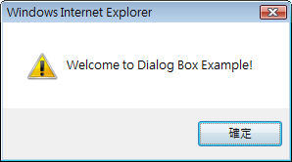
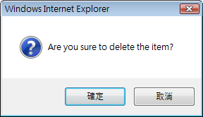
Dialog Boxes
alert("Welcome to …!");
if (confirm("Are you sure to …?")) {
// Yes, do something
} else {
// No, do nothing, or other things
}
var nname = prompt("Welcome!\nPlease give a nick name:", "fred");
https://ycchen.im.ncnu.edu.tw/www2011/lab/js-dialog.html

Slide 12
window.open( )
window.open(URL, name, specs, replace);
var w=window.open(URL, name, specs, replace);
// w.close();
URL: 字串，網址
name: 字串，window名字
specs: 以逗號分開多個項目的字串(逗號後不要有空白), 例如:
"width=300,height=200,scrollbars=1,location=no"
* 設定是否出現: scrollbars, status, toolbar, menubar, resizable
* 設定大小: width, height, top, left
replace: true 或false
URL是否取代history list目前文件記錄
https://www.w3schools.com/jsref/met_win_open.asp
注意不同瀏覽器支援情形:
menubar=yes|no|1|0
top=100

Slide 13
channelmode=yes|no|1|0 | Whether or not to display the window in theater mode. Default is no. IE only
fullscreen=yes|no|1|0 | Whether or not to display the browser in full-screen mode. Default is no. A window in full-screen mode must also be in theater mode. IE only
height=pixels | The height of the window. Min. value is 100
left=pixels | The left position of the window. Negative values not allowed
location=yes|no|1|0 | Whether or not to display the address field. Opera only
menubar=yes|no|1|0 | Whether or not to display the menu bar
resizable=yes|no|1|0 | Whether or not the window is resizable. IE only
scrollbars=yes|no|1|0 | Whether or not to display scroll bars. IE, Firefox & Opera only
status=yes|no|1|0 | Whether or not to add a status bar
titlebar=yes|no|1|0 | Whether or not to display the title bar. Ignored unless the calling application is an HTML Application or a trusted dialog box
toolbar=yes|no|1|0 | Whether or not to display the browser toolbar. IE and Firefox only
top=pixels | The top position of the window. Negative values not allowed
width=pixels | The width of the window. Min. value is 100

Slide 14
var strf = "width=600,height=400,menubar=0,scrollbars=no";
window.open("http://www.im.ncnu.edu.tw/", "NCNU", strf);

Slide 15
https://tw.stock.yahoo.com/
Yahoo!奇摩股市
<a href="javascript:open_win('/h/kimosel.php','menu','stock_id','stock_name')" …> <img name="button01" src="…" … /></a>
<form name="menu" …>
<input value="輸入台股代號/名稱" id="stock_id" name="stock_id" />
…
/form>
function open_win(loc, form, id , name, error)
{
var ldata = "" + loc;
loc = loc+"?form="+form+"&form_id="+id+"&form_name="+name;
if ( error ) {
loc = loc + "&error=1";
}
self.win_child=open(loc,"getcode", \ "directories=no,location=no,menubar=no,toolbar=no,scrollbars=yes,height=400,width=630");
self.win_child.rtn_id=id;
self.win_child.rtn_name=name;
self.win_child.win_parent=self;
}
https://s.yimg.com/f/i/tw/stock/img06/stock22.js

Slide 16
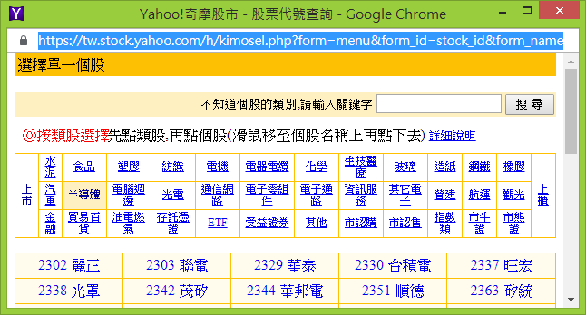
https://tw.stock.yahoo.com/h/kimosel.php?form=menu&form_id=stock_id&form_name=stock_name
<a class=none href="javascript:setid('2330','台積電');">2330 台積電</a></TD>
function setid(id, name) {
if (opener.document.menu.stock_id != null) {
opener.document.menu.stock_id.value=id;
}
if (opener.document.menu.s != null) {
opener.document.menu.s.value=id;
}
if (opener.document.menu.stock_name != null) {
opener.document.menu.stock_name.value=name;
}
self.close();
}

Slide 17
setInterval(), clearInterval()
https://ycchen.im.ncnu.edu.tw/www2011/lab/winTimeJS.html
var int;
window.onload = function() {
int=window.setInterval("clock()", 1000);
}
function clock( ) {
var t=new Date();
var hh = t.getHours( ); var mm = t.getMinutes( ); var ss = t.getSeconds( );
hh = (hh<10) ? "0"+hh : hh;
mm = (mm<10) ? "0"+mm : mm;
ss= (ss<10) ? "0"+ss : ss;
document.getElementById("clock").innerHTML=hh+":"+mm+":"+ss;
}
…
window.clearInterval(int);
http://ycchen.im.ncnu.edu.tw/AlarmClock/

Slide 18
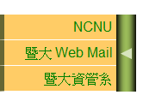
setTimeOut()
function hideMenu() {
var pos=parseInt(sMenu.style.left);
pos -=2;
sMenu.style.left=pos+"px";
if (pos>-136)
window.setTimeout("hideMenu()", 5);
…
}
pos
136
https://ycchen.im.ncnu.edu.tw/www2011/lab/smenu.html

Slide 19
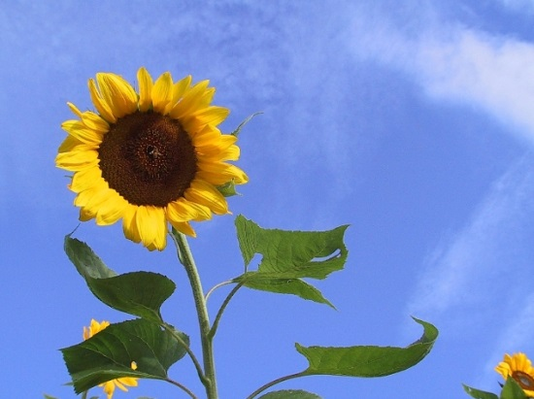
window.setTimeOut() Example
function imgShow() {
o1 = parseFloat(img1.style.opacity);
o2 = parseFloat(img2.style.opacity);
o1 -= 0.02;
o2 += 0.02;
img1.style.opacity = o1;
img2.style.opacity = o2;
if (o1>0)
window.setTimeout("imgShow()", 200);
}
https://ycchen.im.ncnu.edu.tw/www2011/lab/opacity.zip

Slide 20
window.setTimeOut() Example
<script type="text/javascript">
var deg=45;
window.onload=function() {
document.getElementById("disc").style.transform="rotate(45deg)";
document.getElementById("disc").onclick=showDeg;
rot();
};
function rot() {
deg = (deg+1) % 360;
document.getElementById("disc").style.transform="rotate("+deg+"deg)";
window.setTimeout("rot()", 20);
}
function showDeg() {
alert(deg);
}
</script>
<img src="music-disk.png" id="disc" />
https://ycchen.im.ncnu.edu.tw/www2011/lab/rotate.html

Slide 21
history
Properties
length
Methods
back()
forward()
go(number)
window.history.back();
window.history.forward();
window.history.go(-1);
https://ycchen.im.ncnu.edu.tw/www2011/lab/DomObjsJS.html#history

Slide 22
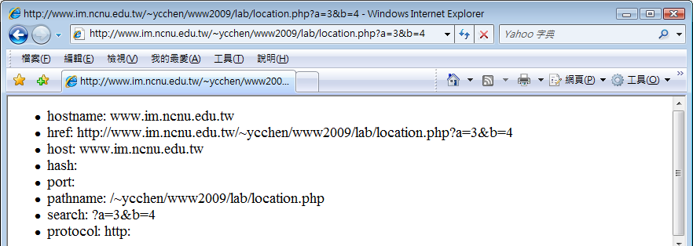
location
Property | Description
hash | Sets or returns the URL from the hash sign (#)
host | Sets or returns the hostname and port number of the current URL
hostname | Sets or returns the hostname of the current URL
href | Sets or returns the entire URL
pathname | Sets or returns the path of the current URL
port | Sets or returns the port number of the current URL
protocol | Sets or returns the protocol of the current URL
search | Sets or returns the URL from the question mark (?)
https://ycchen.im.ncnu.edu.tw/www2011/lab/DomObjsJS.html#location

Slide 23
https://ycchen.im.ncnu.edu.tw/www2011/lab/location.php?a=1&b=5#Part1
href: https://ycchen.im.ncnu.edu.tw/www2011/lab/location.php?a=1&b=5#Part1
protocol: https:
host: ycchen.im.ncnu.edu.tw
hostname: ycchen.im.ncnu.edu.tw
port:
pathname: /www2011/lab/location.php
search: ?a=1&b=5
hash: #Part1

Slide 24
window.location.search
https://ycchen.im.ncnu.edu.tw/moth/puzz.html?1
https://ycchen.im.ncnu.edu.tw/moth/puzz.html?2
https://ycchen.im.ncnu.edu.tw/moth/puzz.html?3
var picNum = window.location.search;
picNum=picNum.substring(1, picNum.length);

Slide 25
location's methods
Method | Description
assign() | Loads a new document
reload() | Reloads the current document
replace() | Replaces the current document with a new one
window.location.assign("http://www.php.net/");
window.location.reload();
window.location.replace("http://www.php.net/");

