Slide 1
顏色與背景CSS樣式

Slide 2
顏色與背景的屬性
color 文字顏色
background-color 設定元素之背景顏色
background-image 背景影像
background-repeat 背景影像重複方式
background-position 背景影像位置
background-attachment 固定背景影像位置
background-size 背景影像大小
background-origin 背景影像起始點
background-clip 背景範圍
background-blend-mode 多重背景混和模式
background 設定背景之所有屬性

Slide 3
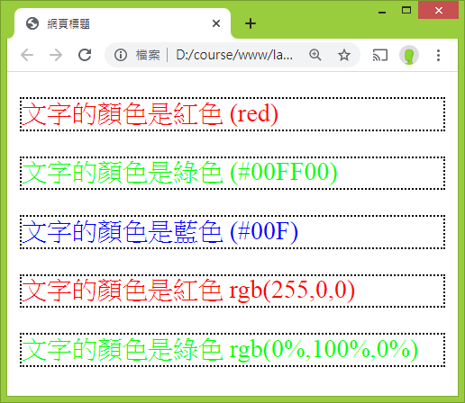
文字顏色(color)
<p style="color: red;">文字的顏色是紅色 (red)</p>
<p style="color: #00FF00;">文字的顏色是綠色 (#00FF00)</p>
<p style="color: #00F;">文字的顏色是藍色 (#00F)</p>
<p style="color: rgb(255,0,0);">文字的顏色是紅色 rgb(255,0,0)</p>
<p style="color: rgb(0%,100%,0%);">文字的顏色是綠色
rgb(0%,100%,0%)</p>

Slide 4
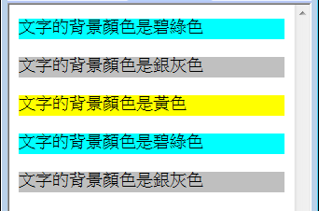
背景顏色(background-color)
<p style="background-color: aqua;">背景顏色是碧綠色</p>
<p style="background-color: #C0C0C0;">背景顏色是銀灰色</p>
<p style="background-color: #FF0;">背景顏色是黃色</p>
<p style="background-color: rgb(0,255,255);">背景顏色是碧綠色</p>
<p style="background-color: rgb(75%,75%,75%);">背景顏色是銀灰色</p>

Slide 5
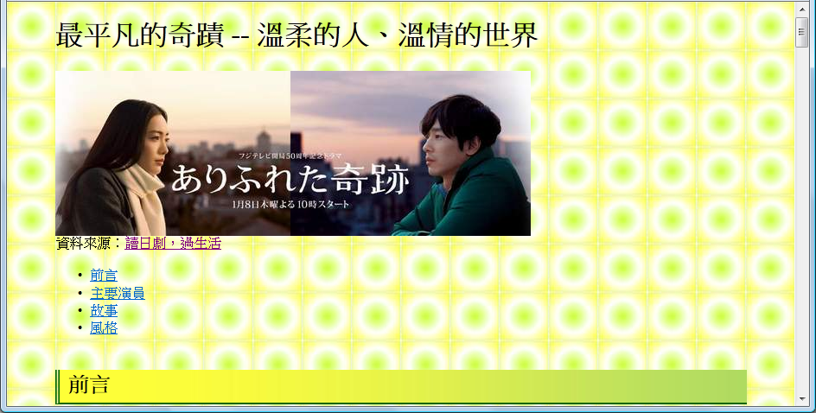

背景影像(background-image)
body {background-image: url(bg1.jpg);
…}
bg1.jpg

Slide 6
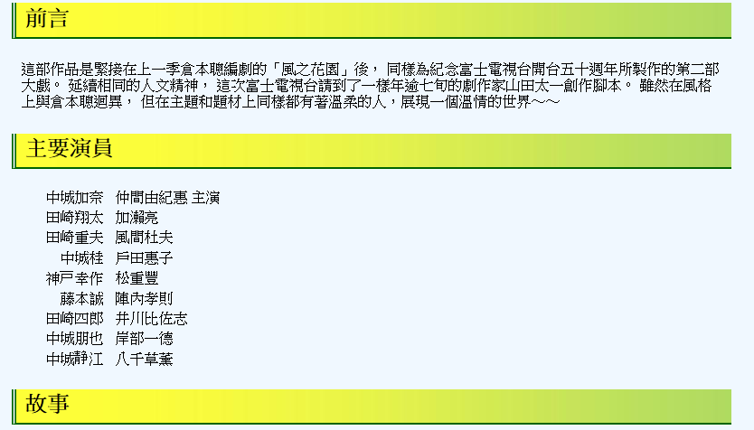
背景影像重複方式(background-repeat)
h2 {
background-image: url(h-bg.jpg);
background-repeat: repeat-y;
… }
h-bg.jpg

Slide 7
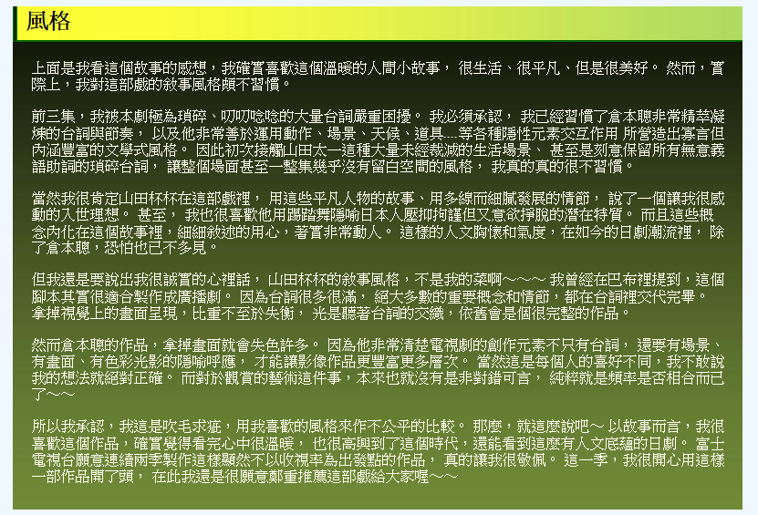
div {
background-image: url(v-bg.jpg);
background-repeat: repeat-x;"
… }
v-bg.jpg

Slide 8
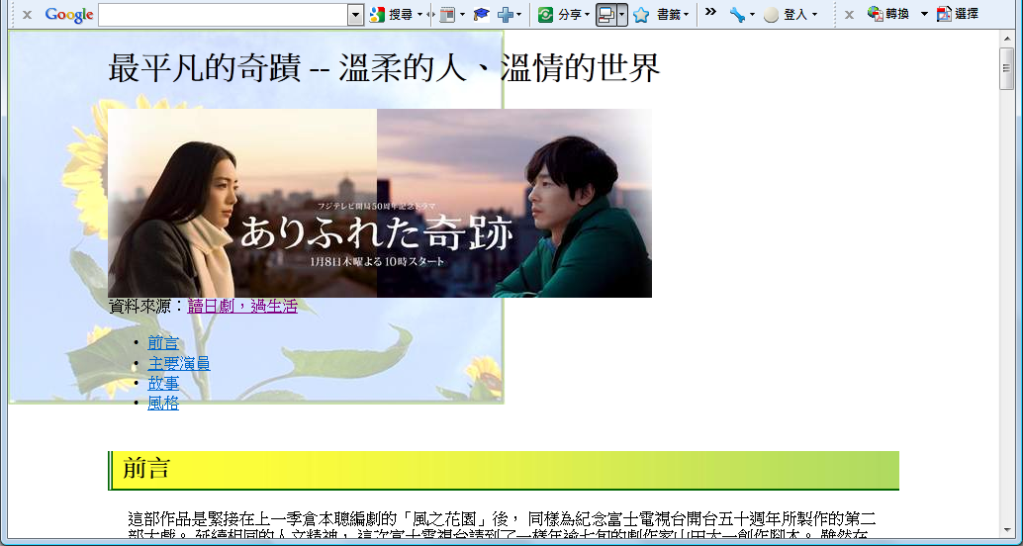
body {background-image: url(sunFlower.jpg);
background-repeat: no-repeat;
… }

Slide 9
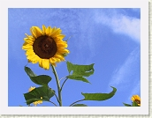
背景影像位置(background-position)
left
center
right
top
center
bottom

Slide 10

body {background-image: url(sunFlower.jpg);
background-repeat: no-repeat;
background-position: top right;
… }

Slide 11
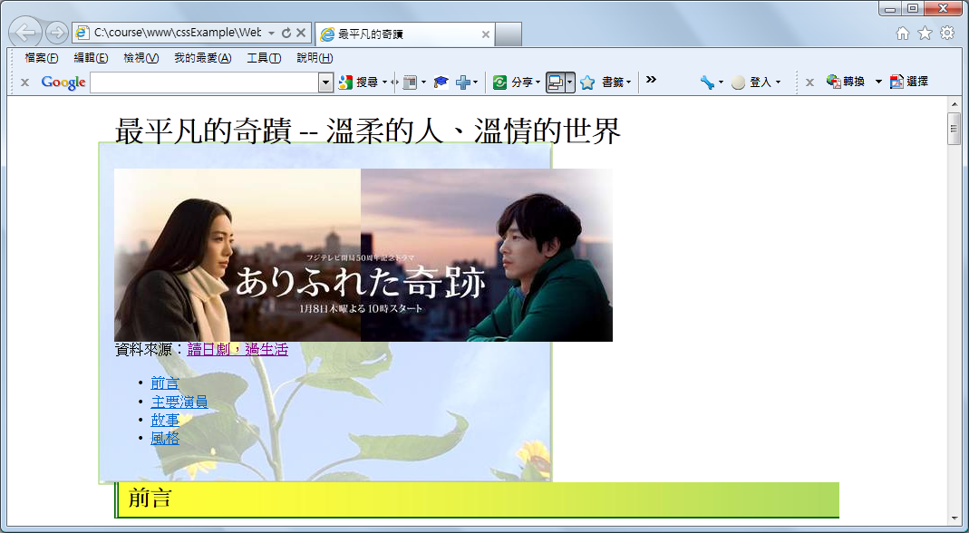
body {background-image: url(sunFlower.jpg);
background-repeat: no-repeat;
background-position: 100px 50px;
… }
100px
50px

Slide 12
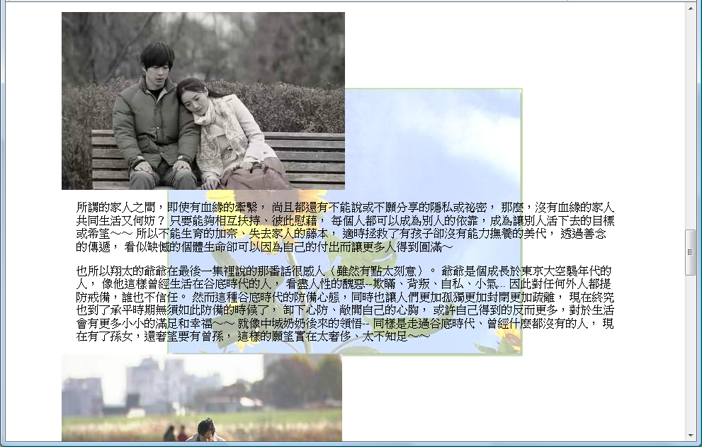
固定背景影像位置(background-attachment)
  body {
  background-image: url(sunFlower.jpg);
  background-position: center;
  background-repeat: no-repeat;
  background-attachment: fixed;
}
fixed | scroll

Slide 13
Multiple Backgrounds
tbg.png
bg.png
bbg.png
#intro {
padding: 35px;
width: 595px;
background-image: url(tbg.png), url(bbg.png), url(bg.png);
background-position: top left, bottom left, top left;
background-repeat: no-repeat, no-repeat, repeat-y ;
}
Note:
Width of background image: 665px
width = (665 – 35*2) px
https://ycchen.im.ncnu.edu.tw/www2011/lab/mbg.zip

Slide 14
background
background: bg-color bg-image position/bg-size bg-repeat bg-origin bg-clip bg-attachment initial|inherit;
body {background: url(flower.jpg) no-repeat fixed center;}

Slide 15
background properties
background-color
background-image
background-position
background-size
background-repeat
background-origin
background-clip
background-attachment
background-blend-mode

Slide 16
background-origin, background-clip
border-box
padding-box
content-box
故事的一開始，源於一個中年男子藤本誠的自殺未遂事件。這名男子四年前因為一場火災，頓時失去妻女，原本一個再平凡不過的幸福家庭一夕之間化為烏有。太過傷心的他又因為精神恍惚而丟掉工作，日子越過越孤獨、越活越失意，孤家寡人的他四年來嚐盡寂寞絕望的滋味，生命失去目標，終於決定從電車月台一躍而下了結此生。但就在他準備縱身跳下月台的剎那，突然有一男一女分別用力拉住他，阻止他尋死。這個故事於是就從這三個素不相識的陌生人互動過程中逐漸開展......

Slide 17
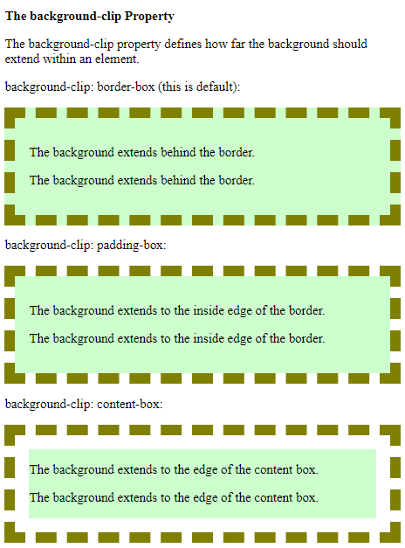
https://www.w3schools.com/cssref/tryit.asp?filename=trycss3_background-clip
border-box
padding-box
content-box

Slide 18

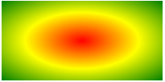
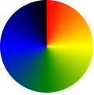
CSS3 Gradients
https://www.w3schools.com/css/css3_gradients.asp
Three types of gradients:
  Linear Gradients (goes down/up/left/right/diagonally)
  Radial Gradients (defined by their center)
  Conic Gradients (rotated around a center point)
background-image: linear-gradient(direction, color1, color2, ...);
background: linear-gradient(direction, color1, color2, ...);
direction: to top, to bottom, to right, to left, to bottom right, to top left
0deg, 180deg, 90deg, -90deg, 135deg, -45deg,

Slide 19




background: linear-gradient(to right, orange, yellow, green);
background: linear-gradient(to top left, black, green, #3f3);
background: linear-gradient(black, #66f);
background: linear-gradient(135deg, cyan, purple);
background: linear-gradient(to right, rgba(0,255,0,0), rgba(0,255,0,1));

Slide 20
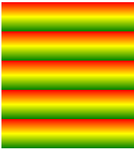

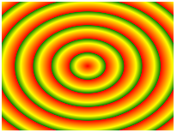
CSS3 Gradients
Stop at 10%
Repeating a linear-gradient
Radial Gradient
Repeating a radial-gradient
background: repeating-linear-gradient(red, yellow 10%, green 20%);
background: radial-gradient(red, yellow, green);
background: radial-gradient(circle, red, yellow, green);
repeating-radial-gradient(red, yellow 10%, green 15%);

Slide 21

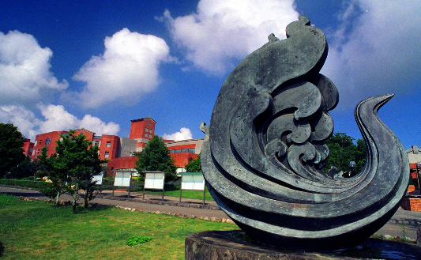
Transparency + Background Image
#banner {
background-image:
linear-gradient(to right, rgba(16,64,0,1), rgba(16,64,0,1) 65%, rgba(0,0,0,0)), url(ncnu.png);
background-repeat: no-repeat;
background-color: darkOliveGreen;
background-position: right center;
…
}
Stop at 65%
<div id="banner"> </div>
ncnu.png

Slide 22
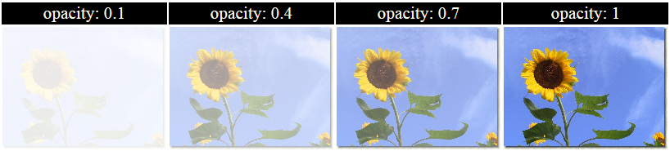
不透明度 opacity

Slide 23
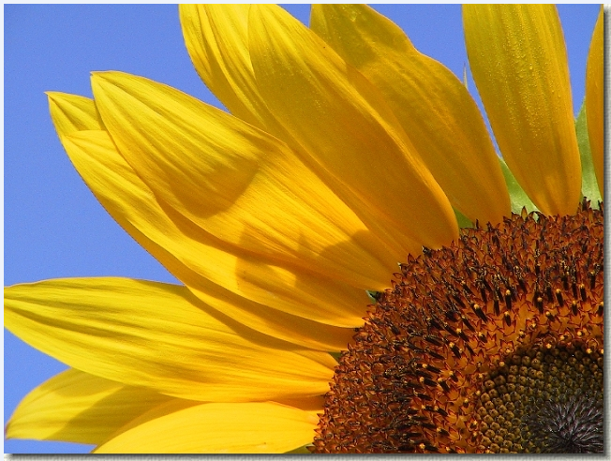
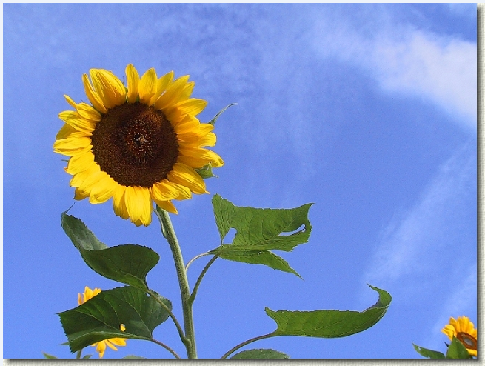
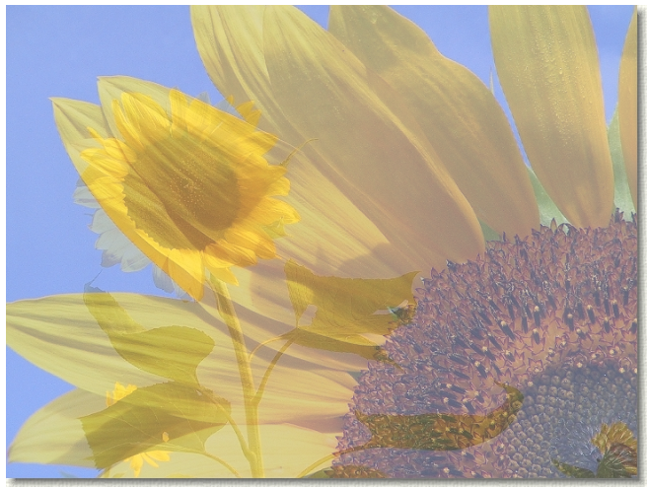
https://ycchen.im.ncnu.edu.tw/www2011/lab/opacity.zip

