Slide 1
表單 (Form)
https://www.w3schools.com/html/html_forms.asp
https://ycchen.im.ncnu.edu.tw/www2011/lab/form.html

Slide 2
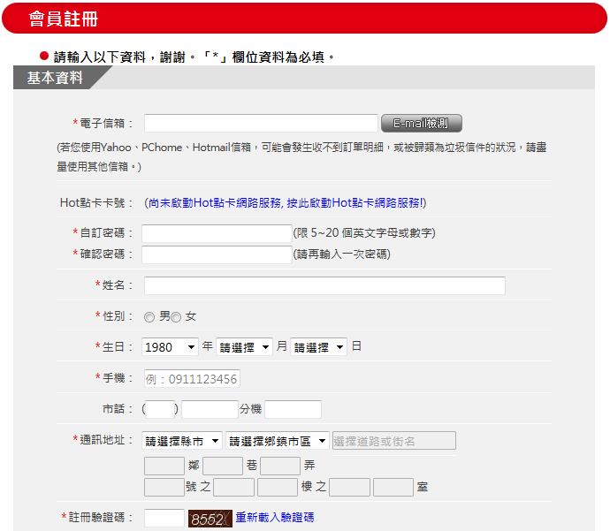
圖形驗證碼(Captcha)
https://en.wikipedia.org/wiki/CAPTCHA

Slide 3
<form>
<form id="…" action="…" method="…" enctype="…">
…
</form>
Ex.
<form id="joinForm" action="join.php" method="post">
…
</form>

Slide 4
method
method="get"
  URL: http://www.abc.com/join.php?uid=ycc&pwd=mypwd
  HTTP message entity: none
  表單的所有內容都顯示於網址。
  不可超過256個字元
  form若沒設method屬性，預設為get。
method="post"
  URL: http://www.abc.com/join.php
  HTTP message entity: uid=ycc&pwd=mypwd
  表單的所有內容存於HTTP Request Message之資料欄位內
，

Slide 5
action屬性
<form action="join.php" />…</form>
action="join.php"
  表單送出至server端的join.php程式
  與原表單網頁存放於同一資料夾的join.php
練習用的:
  action="https://ycchen.im.ncnu.edu.tw/join.php"

Slide 6
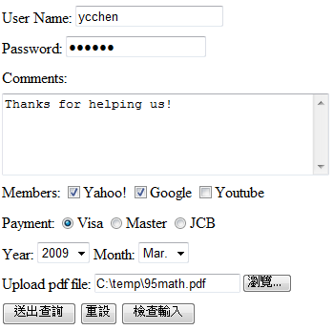
Form Example
text
password
textarea
checkbox
radio
select
file
submit reset button

Slide 7

<input type="text" … />
<input id="…" type="text" name="…" size="…" maxlength="…" value="…" />
Ex.
User Name:
<input id="uid" type="text" name="uid" size="8" maxlength="20" placeholder="Your id" /><br />

Slide 8

表單元素中的id與name屬性
User Name:
<input type="text" id="uid" name="userId" />
name屬性為必要屬性(按鈕除外)，name的值會與使用者輸入的值一起送至伺服器端。
設定id屬性，只是方便讓瀏覽器端的JavaScript程式進行檢查與控制。
userId=FredChen

Slide 9

<input type="password" … />
<input type="password" id="…" name="…" size="…" maxlength="…" value="…" />
Ex.
Password:
<input type="password" id="pwd" name="pwd" size="10" maxlength="20" /><br />

Slide 10
size="…" maxlength="…"
size="20"
  在網頁上顯示20個字的空間，實際可以輸入字元數目則由maxlength值決定。
maxlength="20"
  至多只能輸入20個字元。
  注意駭客！
  (駭客可以偽造另一個表單，拿掉此限制！)

Slide 11
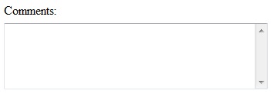
<textarea …>…</textarea>
<textarea id="…" name="…" cols="…" rows="…">
…</textarea>
ex.
Comments: <br />
<textarea id="cmts" name="cmts" cols="40" rows="5"> </textarea><br />
cols="40"
rows="5"

Slide 12
<input type="checkbox" … />
<input type="checkbox" id="…" name="…" value="…" checked />
ex.
Members:
<input type="checkbox" id="yahoo" name="yahoo" value="yahoo" /> Yahoo!
<input type="checkbox" id="google" name="google" value="google" checked /> Google
<input type="checkbox" id="youtube" name="youtube" value="youtube" /> Youtube<br/>

Slide 13
<input type="radio" … />
<input type="radio" id="…" name="…"
value="…" checked />
ex.
Payment:
<input type="radio" id="pay" name="pay" value="Visa" checked />Visa
<input type="radio" id="pay" name="pay" value="Master" />Master
<input type="radio" id="pay" name="pay" value="JCB" />JCB

Slide 14

<select …><option …>…</option></select>
<select id="…" name="…">
<option value="…" selected >…</option>
…
</select>
Ex.
Year:
<select id="year" name="year">
<option>2009</option>
<option value="2010">2010</option>
<option>2011</option>
<option selected>2012</option>
</select>

Slide 15
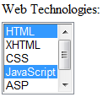
<select …><option …>…</option></select>
<select id="…" name="…" size="…" multiple >
<option value="…" selected >…</option>
</select>
Ex.
Web Technologies:<br />
<select id="wts" name="wts" size="5" multiple >
<option selected >HTML</option>
<option>XHTML</option>
<option>CSS</option>
<option selected >JavaScript</option>
<option>ASP</option>
<option selected >PHP</option>
</select>
多選，不建議採用！
* 你的家人會操作多選?

Slide 16
option的value及text
<option value="4">April</option>
此option的text值為April，value值為4
<option>April</option>
此option的text值為April，value值也為April
* 表單送出時，只有value會被送至伺服器。
* 設定原則：
text方便使用者選擇，value方便伺服器端處理

Slide 17
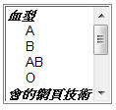
<optgroup label="…">…</optgroup>
不常使用！
<select name="個人資料" size="6" multiple >
<optgroup label="血型">
<option>A</option>
<option>B</option>
<option>AB</option>
<option>O</option>
</optgroup>
<optgroup label="會的網頁技術">
<option>JavaScript</option>
<option>VBScript</option>
<option>PHP</option>
<option>ASP.NET</option>
</optgroup>
</select>

Slide 18
<input type="file" … />
<form id="…" action="…" method="post"
enctype="multipart/form-data">
…
<input type="file" id="…" name="…" />
…
</form>
ex.
<form id="join" action="join.php" method="post"
enctype="multipart/form-data">
Upload pdf file: <input type="file" id="pdf" name="pdf" />
</form>

Slide 19
POST /ycchen/www2011/ex/join.php HTTP/1.1
Accept: image/gif, image/x-xbitmap, image/jpeg, image/pjpeg, application/x-shockwave-flash, application/vnd.ms-excel, application/vnd.ms-powerpoint, application/msword, */*
Referer: http://www.im.ncnu.edu.tw/~ycchen/www2009/ex/form.html
Accept-Language: zh-tw,zh-cn;q=0.5
Content-Type: multipart/form-data; boundary=---------------------------7d934db290122
UA-CPU: x86
Accept-Encoding: gzip, deflate
User-Agent: Mozilla/4.0 (compatible; MSIE 7.0; Windows NT 5.1; GTB5; .NET CLR 1.1.4322; .NET CLR 2.0.50727; InfoPath.1)
Host: www.im.ncnu.edu.tw
Content-Length: 1720496
Connection: Keep-Alive
Cache-Control: no-cache
-----------------------------7d934db290122
Content-Disposition: form-data; name="uid"
Your id
-----------------------------7d934db290122
Content-Disposition: form-data; name="pwd"
mypwd
-----------------------------7d934db290122
Content-Disposition: form-data; name="google"
google
enctype="multipart/form-data"
"multipart/form-data"
1/2

Slide 20
-----------------------------7d934db290122
Content-Disposition: form-data; name="wts"
HTML
-----------------------------7d934db290122
Content-Disposition: form-data; name="wts"
XHTML
-----------------------------7d934db290122
Content-Disposition: form-data; name="pdf"; filename="C:\paper\IEEEMembershipApp.pdf"
Content-Type: application/pdf
%PDF-1.3
%....
35 0 obj
<<
/Linearized 1
/O 37
/H [ 1122 330 ]
/L 1719209
/E 701707
/N 3
/T 1718391
上傳的檔案
放在這裡！
2/2

Slide 21
<input type="hidden" … />
<input type="hidden" id="…" name="…" value="…" />
ex.
<input type="hidden" id="isM" name="isM" value="true" />
使用isM偷偷記錄是不是會員。 方便後端處理，但不安全！
<input type="hidden" id="page" name="page" value="17" />
使用page記載目前所在頁次！
注意: Parameter tempering attack
Price manipulation tempering

Slide 22
1 2 3 4 5
submit按鈕
  1. <input type="submit" />
  2. <input type="submit" value="OK" />
reset按鈕
  3. <input type="reset" />
  4. <input type="reset" value="Clear" />
一般性按鈕 (無作用，配合JavaScript程式使用)
  5. <input type="button" value="Press this button" />

Slide 23

<input type="image" … />
<input type="image" src="…" alt="…" />
ex.
<input type="image" src="ok.jpg" alt="OK" />
* 等同submit功能(送出)
* 會送出使用者在圖片上所按位置之x, y座標值
(e.g. x=4, y=15)

Slide 24


<button><img …>…</button>
<button type="…" ><img …>…</button>
ex.
<button type="reset">
<img src="r1.gif" alt="reset" width="34" /><br />
Reset
</button>
<button type="submit">
…
</button>

Slide 25
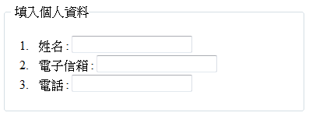
<fieldset><legend>…</legend></fieldset>
<fieldset>
<legend>填入個人資料</legend>
<ol>
<li>姓名 : <input type="text" id="name" name="name" /></li>
<li>電子信箱 : <input type="text" id="email" name="email" /></li>
<li>電話 : <input type="text" id="state" name="state" /></li>
</ol>
</fieldset>
填入個人資料

Slide 26

<label>
兩種表示方法：
<label for="male">Male</label>
<input type="radio" name="sex" id="male" /><br />
<label for="female">Female</label>
<input type="radio" name="sex" id="female" />
<label>Male<input type="radio" name="sex" /></label><br />
<label>Female<input type="radio" name="sex" /></label>

Slide 27
What's New in HTML5 Forms
Elements
  <datalist>, <keygen>, <output>
  https://www.w3schools.com/html/html_form_elements.asp
Input Types
  color, date, datetime, datetime-local, email, month, number, range, search, tel, time, url, week
  https://www.w3schools.com/html/html_form_input_types.asp
Input Attributes
  autocomplete, autofocus, form, formaction, formenctype, formmethod, formnovalidate, formtarget, height, width, list, min, max, multiple, pattern(regexp), placeholder, required, step
  https://www.w3schools.com/html/html_form_attributes.asp
https://ycchen.im.ncnu.edu.tw/www2011/lab/form.html

Slide 28
Data List: <input list="browList" name="browser" />
<datalist id="browList">
<option value="Internet Explorer">
<option value="Firefox">
<option value="Chrome">
<option value="Opera">
<option value="Safari">
</datalist>
ID Card Number:(pattern) <input type="text" name="cid" pattern="[A-Z][1-2][0-9]{8}" />
E-mail: <input type="email" name="email">
Number: <input type="number" name="points" step="5">
Date: <input type="date" id="dte" name="dte" />
Range: <input type="range" name="range1" min="0" max="100" value="30" />
Color: <input type="color" name="clr" value="#00ffff" />

Slide 29

placeholder="First name"
善意提示的文字
required 必要輸入的欄位
<input type="text" name="usrname" required>
https://www.w3schools.com/html/tryit.asp?filename=tryhtml5_input_placeholder
https://www.w3schools.com/html/tryit.asp?filename=tryhtml5_input_required

