Slide 1
JavaScript DOM Objects (2)

Slide 2
Document
Collection | Description
anchors[] | Returns a reference to all Anchor objects in the document
forms[] | Returns a reference to all Form objects in the document
images[] | Returns a reference to all Image objects in the document
links[] | Returns a reference to all Area and Link objects in the document
Property | Description
body | Gives direct access to the <body> element
cookie | Sets or returns all cookies associated with the current document
domain | Returns the domain name for the current document
lastModified | Returns the date and time a document was last modified
referrer | Returns the URL of the document that loaded the current document
title | Returns the title of the current document
URL | Returns the URL of the current document

Slide 3
Document (methods)
Method | Description
open() | Opens a stream to collect the output from any document.write() or document.writeln() methods
write() | Writes HTML expressions or JavaScript code to a document
writeln() | Identical to the write() method, with the addition of writing a new line character after each expression
close() | Closes an output stream opened with the document.open() method, and displays the collected data
getElementById() | Returns a reference to the first object with the specified id
getElementsByName() | Returns a NodeList containing all elements with the specified name
getElementsByTagName() | Returns a NodeList containing all elements with the specified tagname
getElementsByClassName() | Returns a NodeList containing all elements with the specified class name
querySelector() | Returns the first element that matches a specified CSS selector(s)
querySelectorAll() | returns a NodeList containing all elements that matches a specified CSS selector(s)

Slide 4
Finding HTML Elements
Finding HTML elements by id
Finding HTML elements by tag name
Finding HTML elements by class name
Finding HTML elements by CSS selectors
Finding HTML elements by HTML object collections

Slide 5
getElementById("id")
<span id="id1"></span>
var eleS = document.getElementById("id1");
eleS.style.color = "red";
eleS.innerHTML = "…";
…
* body內的html文件load後，才能呼叫document.getElementById("…")

Slide 6
getElementsByTagName("tag")
<h1>Heading 1.1</h1>
<h1>Heading 1.2</h1>
<h1>Heading 1.3</h1>
var arrH1 = document.getElementsByTagName("h1");
var strH11 = arrH1[0].innerText;
arrH1[1].innerHTML = "…";
* body內的html文件load後，才能呼叫document.getElementsByTagName("…")

Slide 7
getElementsByName("name")
<a name="a1">a1 Here!</a> <br />
<input name="a1" type="text" value="input here!" />
var arrA1 = document.getElementsByName("a1");
arrA1[1].value = "…";
* body內的html文件load後，才能呼叫document.getElementsByName("…")

Slide 8
getElementsByClassName("classname")
<p class="intro">The DOM is very useful.</p>
<p class="intro">This example demonstrates getElementsByClassName. </p>
<p id="demo"></p>
<script type="text/javascript">
var x = document.getElementsByClassName("intro");
document.getElementById("demo").innerHTML =
'The first paragraph (index 0) with class="intro": ' + x[0].innerHTML;
</script>

Slide 9
Finding HTML Elements by CSS Selectors
document.querySelectorAll(selector)
var x = document.querySelectorAll(".example");
for (let i=0; i<x.length; i++) {
x[i].style.backgroundColor = "red";
}
document.querySelector(selector)
-- get the first element with class=selector
var x = document.querySelector("#foot p");
x.style.backgroundColor = "red";

Slide 10
HTML DOM Objects
anchor
link
image
form
input
select, option
textarea
button
table
row
cell

Slide 11
Common Properties
Property | Description
id | Sets or returns the id of an element
innerHTML | Sets or returns the HTML between the start and end tags of an element
className | Sets or returns the class attribute of an element
title | Sets or returns an element's advisory title

Slide 12
Multiple classes in className
html:
<h1 id="hh1" >Heading 1</h1>
css:
.red {color: red;}
.uline {text-decoration: underline;}
Welcome
JavaScript:
window.onload=function() {
var hh=document.getElementById("hh1");
hh.className = "red";
hh.className += " uline";
};
Welcome
注意類別名稱之間要有空白
document.getElementById("hh1").className ➔ "red uline"

Slide 13
Add/Remove/Toggle a class
<div id="menu" class="vmenu vip bg" >…</div>
Use element.className
document.getElementById("menu").className="";
document.getElementById("menu").className += " anotherClass";
Use element.classList
document.getElementById("menu").classList.add("anotherClass");
document.getElementById("menu").classList.remove("vip");
document.getElementById("menu").classList.toggle("bg");

Slide 14
HTML data-* Attribute
data-* 自定義屬性
不能包含大寫字母，屬性值可以是任何的字串。
可由element.dataset讀取自定義屬性值
element.dataset.category element.dataset.animalType
<ul data-category="animal">
<li data-animal-type="bird">Owl</li>
<li data-animal-type="fish">Salmon</li>
<li data-animal-type="spider">Tarantula</li>
<li data-animal-type="moth"> Attacus atlas</li>
</ul>

Slide 15
window.onload=function() {
var listItems=document.querySelectorAll("ul li");
listItems.forEach((item) => {
item.addEventListener("click", showType);
});
}
function showType(e) {
let animalType = e.target.dataset.animalType;
$("show").innerHTML="The " + e.target.innerHTML + " is a " + animalType + ".";
}
function $(id) {
return document.getElementById(id);
}
https://ycchen.im.ncnu.edu.tw/www2011/lab/dataset.html

Slide 16
Form Objects
form
input
text, password, hidden, checkbox, radio, file, button, submit, reset
textarea
select
option
button

Slide 17
form
<form id="f1" method="post" action="join.php" target="newWin">
Property | Description
elements[] | Returns an array containing each element in the form
action | Sets or returns the action attribute of a form
enctype | Sets or returns the MIME type used to encode the content of a form
id | Sets or returns the id of a form
length | Returns the number of elements in a form
method | Sets or returns the HTTP method for sending data to the server
name | Sets or returns the name of a form
target | Sets or returns where to open the action-URL in a form
Method | Description
reset() | Resets the values of all elements in a form
submit() | Submits a form

Slide 18
Properties
input
textarea | text, password | file | hidden | checkbox, radio | submit, reset, button | select | option
id | id | id | id | id | id | id | id
name | name | name | name | name | name | name
type | type | type | type | type | type | type
value | value | value | value | value | value | selectedIndex | value
form | form | form | form | form | form | form | form
accessKey | accessKey | accessKey |  | accessKey | accessKey
tabIndex | tabIndex | tabIndex |  | tabIndex | tabIndex | tabIndex
 | alt | alt | alt | alt | alt
disabled | disabled | disabled |  | disabled | disabled | disabled | disabled
defaultValue | defaultValue | defaultValue |  | defaultChecked |  | multiple | defaultSelected
readOnly | readOnly | accept |  | checked |  | length | text
rows | size |  |  |  |  | size | selected
cols | maxLength |  |  |  |  | options[]

Slide 19
<form name="join" …>
Country: <input type="text" id="ctry" name="ctry" value="Taiwan" /> <br />
User Name: <input type="text" id="uid" name="uid" value="Your id" /><br />
Password: <input type="password" id="pwd" name="pwd" value="mypwd" /><br />
…
</form>
value
var f1=document.getElementById("join");
f1.ctry.value = "Taiwan";
document.getElementById("ctry").value = "Taiwan";
disabled
f1.ctry.disabled = true;
readOnly
f1.pwd.readOnly = true;
accessKey
document.getElementById("pwd").accessKey = 'p'; //Alt+p or Alt+Shift+p
http://ycchen.im.ncnu.edu.tw/www2011/lab/DomFormJS.html

Slide 20
Members:
<input type="checkbox" id="yahoo" name="yahoo" value="yahoo" />Yahoo!
<input type="checkbox" id="google" name="google" value="google" />Google
<input type="checkbox" id="youtube" name="youtube" value="youtube" />Youtube
Payment:
<input type="radio" id="payV" name="pay" value="Visa" checked="checked" />Visa
<input type="radio" id="payM" name="pay" value="Master" />Master
<input type="radio" id="payJ" name="pay" value="JCB" />JCB
*checked
var yahoo=document.getElementById("yahoo");
if (yahoo.checked) alert("You select Yahoo!");
document.getElementById("google").checked = false;
var payV = document.getElementById("payV");
if (payV.checked) alert("Your payment via: "+payV.value);
document.getElementById("payJ").checked = true;
// Use getElementsByName("…")
var arrPay = document.getElementsByName("pay");
if (arrPay[0].checked) alert("Your payment via: "+arrPay[0].value);
arrPay[2].checked = true;

Slide 21
Month: <select id="month" name="month">
<option>Jan.</option>
<option value="February">Feb.</option>
<option>Mar.</option>
<option value="April">Apr.</option>
</select>
*selectedIndex
var month = document.getElementById("month");
alert(month.selectedIndex);
month.selectedIndex = 2;
* options[]
var opt = month.options[month.selectedIndex];
alert(opt.text+" / "+ opt.value);
* selected
opt.selected = true;
document.getElementById("month").options[2].selected = true;

Slide 22
multiple select
Web Technologies: <br />
<select id="wts" name="wts[]" size="5" multiple="multiple">
<option selected="selected">HTML</option>
<option>XHTML</option>
<option>CSS</option>
<option selected="selected">JavaScript</option>
<option>ASP</option>
<option selected="selected">PHP</option>
</select>
var wts = document.getElementById("wts");
var str1="";
for (var i=0; i<wts.length;i++) {
if (wts.options[i].selected)
str1 += wts.options[i].text+", ";
}
alert("You select : "+str1);

Slide 23
methods
text, textarea, password, file | checkbox, radio, button, submit, reset | select
blur() | blur() | blur()
focus() | focus() | focus()
select() | click() | add()
 |  | remove()

Slide 24
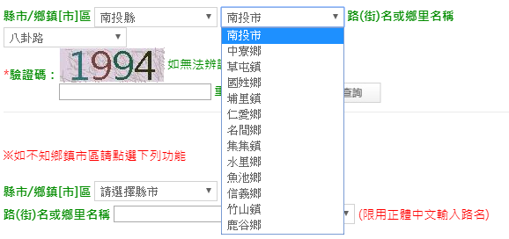
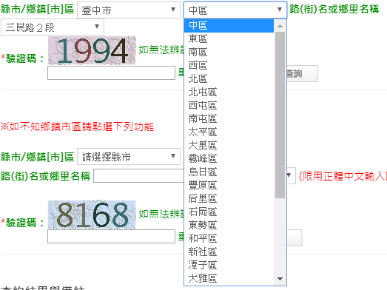
3+2郵遞區號查詢
https://www.post.gov.tw/post/internet/SearchZone/index.jsp?ID=130107

Slide 25
<select name="city" ID="city" onChange="citychange_23()" class="select">
<option value="%" >請選擇縣市</option>
<option value="基隆市" >基隆市</option>
<option value="臺北市" >臺北市</option>
<option value="新北市" >新北市</option>
<option value="桃園市" >桃園市</option>
<option value="新竹市" >新竹市</option>
…
</select>
…
<INPUT type="text" value="" name="cityareatext"
ID="cityarea" size="6" maxlength="4">
cityarea = new Array();
cityarea_account = new Array();
cityarea_account[0] = 0;
cityarea[1] = "仁愛區";
cityarea[2] = "信義區";
…
cityarea[6] = "暖暖區";
cityarea[7] = "七堵區";
cityarea_account[1] = 7;
cityarea[8] = "中正區";
cityarea[9] = "大同區";
cityarea[10] = "中山區";
…
cityarea[17] = "內湖區";
cityarea[18] = "南港區";
cityarea[19] = "文山區";
cityarea_account[2] = 19;
cityarea[20] = "萬里區";
cityarea[21] = "金山區";
cityarea[22] = "板橋區";
…
function citychange_23() {
i = window.document.form1.city.selectedIndex;
window.document.form1.cityarea.length = \
cityarea_account[i] - cityarea_account[i-1];
index = cityarea_account[i-1] + 1;
…
for (j = 0; j < window.document.form1.cityarea.length; j ++) {
if (j!=0) {
window.document.form1.cityarea.options[j].value = cityarea[index + j-1];
window.document.form1.cityarea.options[j].text = cityarea[index + j-1];
}
}
…
}

Slide 26
add(), remove() of Select
Month: <select id="month" name="month">
<option>Jan.</option>
<option value="February">Feb.</option>
<option>Mar.</option>
<option value="April">Apr.</option>
</select>
var month = document.getElementById("month")
* add()
var opt1 = new Option();
opt1.text = "五月天";
opt1.value="May"
month.add(opt1);
// month.add(opt1, 4)
* remove()
month.remove(2);
month.remove(month.selectedIndex);
before the 4-th option

Slide 27
Table
Collection | Description
cells[] | Returns an array containing each cell in a table
rows[] | Returns an array containing each row in a table
Property | Description
border | Sets or returns the width of the table border
caption | Sets or returns the caption of a table
cellPadding | Sets or returns the amount of space between the cell border and cell content
cellSpacing | Sets or returns the amount of space between the cells in a table
frame | Sets or returns the outer-borders of a table
id | Sets or returns the id of a table
rules | Sets or returns the inner-borders of a table
summary | Sets or returns a description of a table
tFoot | Returns the TFoot object of a table
tHead | Returns the THead object of a table
width | Sets or returns the width of a table

Slide 28
Table's methods
Method | Description
createCaption() | Creates a caption element for a table
createTFoot() | Creates an empty tFoot element in a table
createTHead() | Creates an empty tHead element in a table
deleteCaption() | Deletes the caption element and its content from a table
deleteRow() | Deletes a row from a table
deleteTFoot() | Deletes the tFoot element and its content from a table
deleteTHead() | Deletes the tHead element and its content from a table
insertRow() | Inserts a new row in a table

Slide 29
var tbl = document.createElement("table");
tbl.id="tid";
var cap = tbl.createCaption();
cap.innerHTML="9x9 乘法表";
tbl.insertRow(0);
for (var i=0;i<8;i++) {
tbl.rows[0].insertCell(i);
tbl.rows[0].cells[i].className="cTh";
tbl.rows[0].cells[i].innerHTML=i+2;
}
tbl.insertRow(1);
for (var i=0;i<8;i++) {
var k=i+2;
tbl.rows[1].insertCell(i);
var str="";
for (var j=1;j<10;j++)
str += k+" * "+j+" = "+k*j+"<br />";
tbl.rows[1].cells[i].innerHTML=str;
}
document.body.appendChild(tbl);
https://ycchen.im.ncnu.edu.tw/www2011/lab/DomTableJS.html
#tid {width:900px; border: 8px outset green; border-collapse: collapse;}
#tid .cTh {text-align:center; font-size: 20pt; font-weight: bolder; color:red;}
#tid td {padding:5px 10px; border: 3px inset green;}

Slide 30
What We learned
使用document.createElement("tagName")產生一個元素節點。
使用table.insertRow(i)產生第i列，使用table.rows[i]存取第i列。
使用row.insertCell(j)產生該列第j個cell(行)，使用table.rows[i].cells[j]存取第i列之第j行。
使用element.appendChild(node)將節點node附加至元素element之下。

Slide 31
Row
Collection | Description
cells[] | Returns an array containing each cell in the table row
Property | Description
align | Sets or returns the horizontal alignment of data within a table row
id | Sets or returns the id of a table row
innerHTML | Sets or returns the HTML between the start and end tags of a table row
rowIndex | Returns the position of a row in the table's rows collection
vAlign | Sets or returns the vertically alignment of data within a table row
Method | Description
deleteCell() | Deletes a cell in a table row
insertCell() | Inserts a cell in a table row

Slide 32
Cell
Property | Description
abbr | Sets or returns an abbreviated version of the content in a cell
align | Sets or returns the horizontal alignment of data within a cell
axis | Sets or returns a comma-delimited list of related cells
cellIndex | Returns the position of a cell in the cells collection of a row
colSpan | Sets or returns the number of columns a cell should span
id | Sets or returns the id of a cell
innerHTML | Sets or returns the HTML between the start and end tags of a cell
rowSpan | Sets or returns the number of rows a cell should span
vAlign | Sets or returns the vertical alignment of data within a cell
width | Sets or returns the width of a cell

Slide 33
Image
Property | Description
align | Sets or returns how to align an image according to surrounding text
alt | Sets or returns an alternate text to be displayed
border | Sets or returns the border around an image
complete | Returns whether or not the browser has finished loading the image
height | Sets or returns the height of an image
hspace | Sets or returns the white space on the left & right side of the image
id | Sets or returns the id of the image
isMap | Returns whether or not an image is a server-side image map
longDesc | Sets or returns a URL containing a description of the image
lowsrc | Sets or returns a URL to a low-resolution version of an image
name | Sets or returns the name of an image
src | Sets or returns the URL of an image
useMap | Sets or returns the value of the usemap attribute of an client-side image map
vspace | Sets or returns the white space on the top & bottom of the image
width | Sets or returns the width of an image
*
*
*
*

Slide 34
Creating an Image
var img = new Image();
img.src="lily.png";
img.alt="A lily picture";
…
var img = document.createElement("img");
img.setAttribute("src", "lily.png");
img.setAttribute("alt", "A lily picture");
…

Slide 35
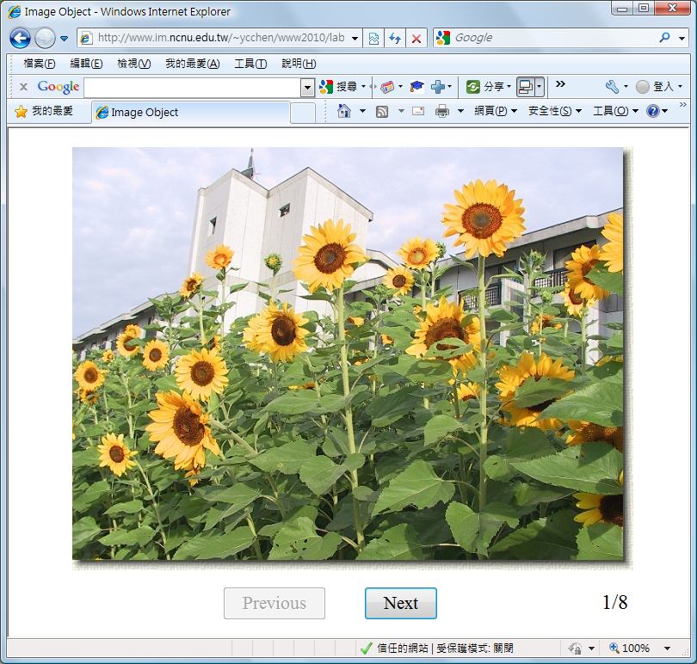
Two Image Examples

Slide 36
Example 1
https://ycchen.im.ncnu.edu.tw/www2011/lab/image/imageObj.html
var ind=0;
var imgFiles= ["sf003.jpg", "sf027.jpg", "sf029.jpg", "sf032.jpg", "sf033.jpg", "sf038.jpg"];
var imgArr=new Array();
…
for (var i=0;i<imgFiles.length;i++) {
imgArr[i]=new Image();
imgArr[i].src = imgFiles[i];
}
…
document.getElementById("img1").src = imgArr[++ind].src;
…
<body>
…<img id="img1" src="sf003.jpg" />…
</body>

Slide 37
Example 2
https://ycchen.im.ncnu.edu.tw/www2011/lab/image/imageObjx.html
var ind=0;
var imgFiles= ["sf003.jpg", "sf027.jpg", "sf029.jpg", "sf032.jpg", "sf033.jpg", "sf038.jpg"];
…
document.getElementById("img1").src = imgFiles[++ind];
…
<body>
…<img id="img1" src="sf003.jpg" />…
</body>

Slide 38
Web Storage
document.cookie
Client
Web Server
Set-Cookie
Cookie
Cookie
localStorage
Session
sessionStorage
https://ycchen.im.ncnu.edu.tw/www2011/lab/adopt/adopt_ans.html

Slide 39
Cookie
"cookieName=cokieValue; Max-Age=seconds; Path=pathName; Domain=domainName"
" cookieName=cokieValue; Expires=date; Path=pathName; Domain=domainName "
舉例:
"count=1; Expires=Mon, 27 Apr 2009 11:43:24 UTC; Domain=www.im.ncnu.edu.tw"
"nickName=fred; Max-Age=600"
"isVisit=1"

Slide 40
Set Cookie
var eday = new Date();
eday.setDate(eday.getDate()+7);
//cookie's life: 瀏覽器開啟時間, i.e., Session Cookie
document.cookie="count=1";
//cookie's life: cookie設定起7天
document.cookie="count=1; Max-Age="+60*60*24*7;
// cookie's life: 到期日
document.cookie="count=1; Expires="+eday.toUTCString();
document.cookie="userName="+escape("小明");

Slide 41
Get Cookie
document.cookie="count=1";
document.cookie="userName=fred; Expires= Mon, 30 Apr 2012 11:43:24 UTC";
var cookieStr=document.cookie; //"count=1; userName=fred"
var cookieArr=document.cookie.split("; ")
// cookieArr[0]: "count=1" cookieArr[1]: "username=fred"
var cookie1Arr = cookieArr[1].split["="];
// cookie1Arr[1]: username cookie1Arr[1]: fred
var user= unescape(cookie1Arr[1]); //fred

Slide 42
var cookieArr=new Array();
getCookies();
var visitCount = parseInt(cookieArr['count']);
var userName = cookieArr['userName'];
…
function getCookies() {
var cookies = document.cookie.split("; ");
for (var i=0;i<cookies.length;i++) {
var cnv = cookies[i].split("=");
cookieArr[cnv[0]] = unescape(cnv[1]);
}
}

Slide 43
var cookieArr= getCookies();
var visitCount = parseInt(cookieArr['count']);
var userName = cookieArr['userName'];
…
function getCookies() {
var cookies = document.cookie.split("; ");
var cookieArr=new Array();
for (var i=0;i<cookies.length;i++) {
cnv = cookies[i].split("=");
cookieArr[cnv[0]] = unescape(cnv[1]);
}
return cookieArr;
}

Slide 44
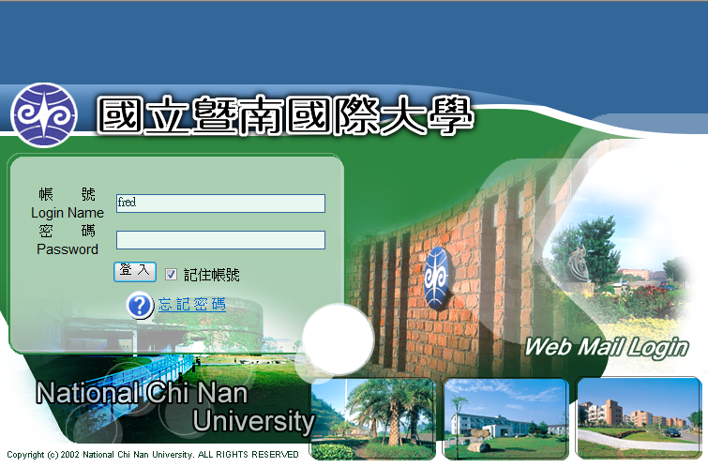
https://webmail.ncnu.edu.tw/
function fl() {
var key=document.cookie;
var form=document.lf;
if ( key.match(/uid=([^;]+)[;]*/) ){
form.USERID.value = RegExp.$1;
form.remember.checked = true;
}
}
// uid是cookie名稱，改成你的cookie名稱
<body onLoad="fl();document.lf.USERID.focus()">

Slide 45
Delete Cookie
document.cookie="count=";
document.cookie="count=; Max-Age=0";
document.cookie="userName=; Expires=Mon, 01 Jan 1990 00:00:00 UTC";

Slide 46
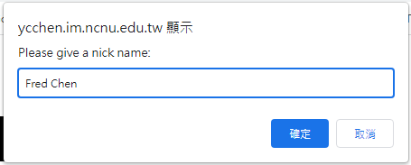
var cookieArr=getCookie();
if (!cookieArr['count']) {
document.cookie = "count=1; max-age=600";
reqNickName();
}
else {
cookieArr['count'] = parseInt(cookieArr['count'])+1;
document.cookie = "count="+cookieArr['count']+"; max-age=600";
alert("Hi! "+cookieArr['nickName']+"\nThis is your "+cookieArr['count']+"-th visit.");
}
function reqNickName() {
var nn = prompt("Please give a nick name:", "");
if (nn !="") document.cookie = "nickName="+escape(nn)+"; max-age=600";
}
function getCookie() {
var cookieArr=[];
var cookies = document.cookie.split("; ");
for (var i=0;i<cookies.length;i++) {
cnv = cookies[i].split("=");
cookieArr[cnv[0]] = unescape(cnv[1]);
}
return cookieArr;
}
https://ycchen.im.ncnu.edu.tw/www2011/lab/setCookiesJS.html

Slide 47
HTML5: localStorage
if (!localStorage.cnt)
localStorage.cnt=1;
else
localStorage.cnt++;
…
document.getElementById("no").innerHTML = localStorage.cnt;
…
<p>You have visited this page
<span id="no">0</span>times.</p>

Slide 48
HTML5: localStorage
localStorgae.cnt=1;
localStorage.setItem("cnt", 1);
localStorage.clear();
localStorage.removeItem("cnt");
https://ycchen.im.ncnu.edu.tw/www2011/lab/localStorage.html

Slide 49
HTML5: sessionStorage
Similar to localStorage
Life Cycle:
Data stored in sessionStorage will disappear after the browser is closed.
http://www.w3schools.com/html/html5_webstorage.asp

