Slide 1
XML DOM
XML: Extensible Markup Language

Slide 2
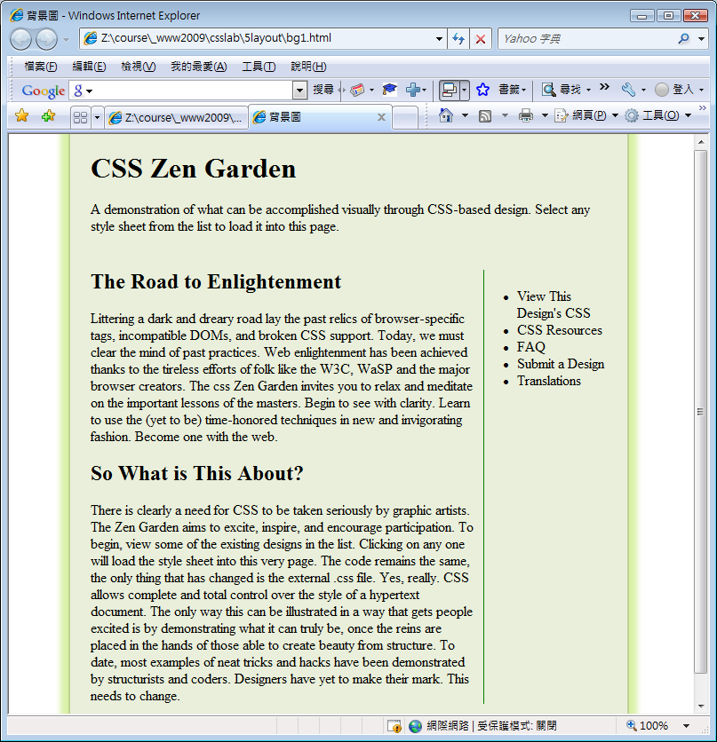
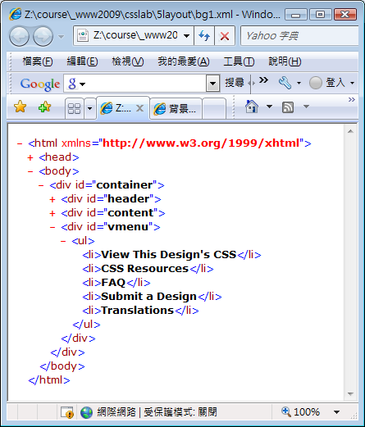
https://ycchen.im.ncnu.edu.tw/www2011/lab/xmlDomEx1.zip

Slide 3
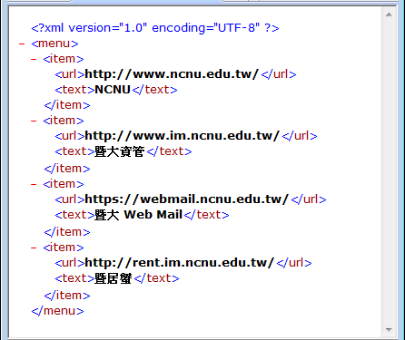
menu.xml
<?xml version="1.0" encoding="UTF-8" ?>
<menu>
<item>
<url>http://www.ncnu.edu.tw/</url>
<text>NCNU</text>
</item>
<item>
<url>http://www.im.ncnu.edu.tw/</url>
<text>暨大資管</text>
</item>
<item>
<url>https://webmail.ncnu.edu.tw/</url>
<text>暨大 Web Mail</text>
</item>
<item>
<url>http://rent.im.ncnu.edu.tw/</url>
<text>暨居蟹</text>
</item>
</menu>

Slide 4
文件結構
整份文件: document
文件之root元素:
document.documentElement
文件為一個由節點組成的樹狀結構
節點(node)
元素節點(element)
屬性節點(attribute)
文字節點(text)

Slide 5
Node (節點)
Property | Description
childNodes | Returns a NodeList of child nodes for a node
parentNode | Returns the parent node of a node
firstChild | Returns the first child of a node
lastChild | Returns the last child of a node
nextSibling | Returns the node immediately following a node
previousSibling | Returns the node immediately before a node
nodeName | Returns the name of a node, depending on its type
nodeType | Returns the type of a node
nodeValue | Sets or returns the value of a node, depending on its type
ownerDocument | Returns the root element (document object) for a node

Slide 6
Node Types
Node type | Description | Children
Document | the entire document (the root-node of the DOM tree) | Element (max. one),
Element | an element | Element, Text, CDATASection
Attr | an attribute | Text
Text | textual content in an element or attribute | None
CDATASection | a CDATA section in a document (text that will NOT be parsed) | None
Other node types:
DocumentFragment, ProcessingInstruction, EntityReference,
Comment, Entity, Notation

Slide 7
nodeType
NodeType | Named Constant
1 | ELEMENT_NODE
2 | ATTRIBUTE_NODE
3 | TEXT_NODE
4 | CDATA_SECTION_NODE
5 | ENTITY_REFERENCE_NODE
6 | ENTITY_NODE
7 | PROCESSING_INSTRUCTION_NODE
8 | COMMENT_NODE
9 | DOCUMENT_NODE
10 | DOCUMENT_TYPE_NODE
11 | DOCUMENT_FRAGMENT_NODE
12 | NOTATION_NODE

Slide 8
<script type="text/javascript">
<!--
var str="";
window.onload=function() {
var ele=document.documentElement;
showTree(ele);
var w=window.open("", "tree", "width=500,height=800, scrollbars");
w.document.write(str);
w.document.close();
}
function showTree(node) {
str += "<ul><li>"+node.nodeName+": "+node.nodeType;
if (node.hasChildNodes()) {
for (var i=0; i<node.childNodes.length;i++)
showTree(node.childNodes[i]);
}
else
str +="<br />"+node.nodeValue;
str +="</li></ul>";
}
//-->
</script>

Slide 9
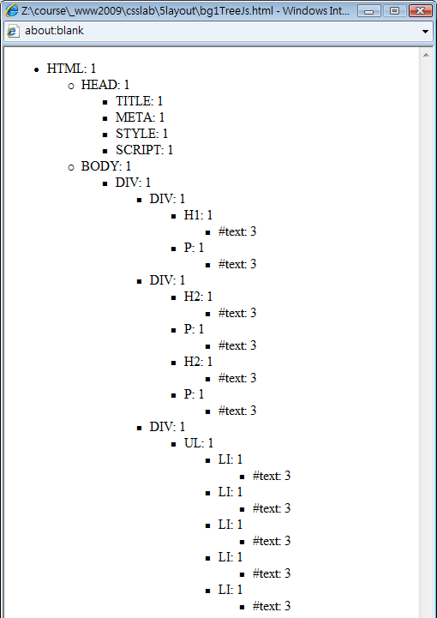

Slide 10
Node's methods
Method | Description
appendChild() | Adds a new child node to the end of the list of children of a node
cloneNode() | Clones a node
hasChildNodes() | Returns true if a node has any child nodes, otherwise it returns false
insertBefore() | Inserts a new child node before an existing child node
removeChild() | Removes a child node
replaceChild() | Replaces a child node

Slide 11
appendChild(), insertBefore()
var img = new Image();
img.src="lily.jpg";
img.id ="lily1";
img.className="imgC1";
var div2=document.getElementById("div2");
div2.appendChild(img);
div2.insertBefore(img, div2.firstChild);

Slide 12
Element Object
Property | Description
attributes | Returns a NamedNodeMap of attributes for the element
tagName | Returns the name of the element
Other properties: (the same as node)
childNodes, firstChild, lastChild, nextSibling, nodeName, nodeType, nodeValue, ownerDocument, parentNode, previousSibling

Slide 13
element's methods
Method | Description
getAttribute() | Returns the value of an attribute
getAttributeNode() | Returns an attribute node as an Attribute object
getElementsByTagName() | Returns a NodeList of matching element nodes, and their children
hasAttribute() | Returns whether an element has any attributes matching a specified name
hasAttributes() | Returns whether the element has any attributes
removeAttribute() | Removes a specified attribute
removeAttributeNode() | Removes a specified attribute node
setAttribute() | Adds a new attribute
setAttributeNode() | Adds a new attribute node
Other methods: (the same as node)
appendChild(), cloneNode(), hasChildNodes(), insertBefore(), removeChild(), replaceChild()

Slide 14
var img = document.createElement("img");
img.setAttribute("src", "lily.png");
img.setAttribute("id", "img2");
document.getElementById("div2").appendChild(img);

Slide 15
Attribute Object
Property | Description
name | Returns the name of the attribute
nodeName | Returns the name of the node, depending on its type
nodeType | Returns the type of the node
nodeValue | Sets or returns the value of the node, depending on its type
ownerDocument | Returns the root element (document object) for an attribute
specified | Returns true if the attribute value is set in the document, and false if it's a default value in a DTD/Schema.
value | Sets or returns the value of the attribute

Slide 16
(XML) Document
Property | Description
async | Specifies whether downloading of an XML file should be handled asynchronously or not
childNodes | Returns a NodeList of child nodes for the document
doctype | Returns the Document Type Declaration associated with the document
documentElement | Returns the root node of the document
firstChild | Returns the first child node of the document
lastChild | Returns the last child node of the document
nodeName | Returns the name of a node (depending on its type)
nodeType | Returns the node type of a node
nodeValue | Sets or returns the value of a node (depending on its type)

Slide 17
Document's methods
Method | Description
createAttribute(name) | Creates an attribute node with the specified name, and returns the new Attr object
createCDATASection() | Creates a CDATA section node
createComment() | Creates a comment node
createElement() | Creates an element node
createTextNode() | Creates a text node
getElementById(id) | Returns the element that has an ID attribute with the given value. If no such element exists, it returns null
getElementsByTagName() | Returns a NodeList of all elements with a specified name

Slide 18
var img = document.createElement("img");
var attrSrc = document.createAttribute("src");
attrSrc.nodeValue="lily1.jpg";
img.setAttributeNode(attrSrc);
document.getElementById("content").appendChild(img);
https://ycchen.im.ncnu.edu.tw/www2011/lab/xmlDomJS.html
https://ycchen.im.ncnu.edu.tw/www2011/lab/digit.zip

Slide 19
getElementsByTagName()
getElementById()只能用於XHTML/HTML
在一般XML document，應使用getElementsByTagName("tagName")
getElementsByTagName("tagName")傳回一個由element組成的陣列(or collection)

