Slide 1
清單的CSS樣式

Slide 2
unordered list / ordered list
<ul>
<li>XHTML 1.0</li>
<li>XHTML 1.1</li>
<li>XHTML 2.0</li>
</ul>
<ol>
<li>XHTML 1.0</li>
<li>XHTML 1.1</li>
<li>XHTML 2.0</li>
</ol>

Slide 3
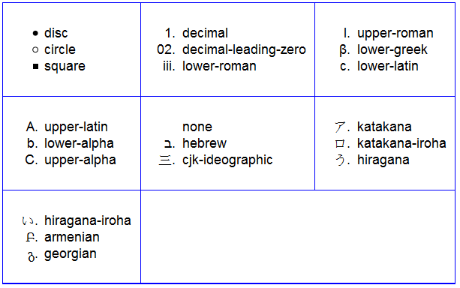
清單類型
list-style-type: disc;
disc circle square
decimal decimal-leading-zero
lower-alpha upper-alpha
lower-roman upper-roman
none cjk-ideographic

Slide 4
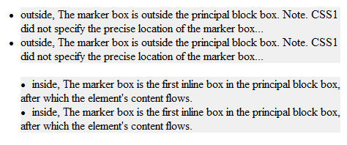
清單位置
list-style-position: outside;
list-style-position: inside;
outside
inside

Slide 5
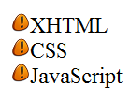
清單影像
list-style-image: url(icon.png);
ul.iconc {
list-style-image: url(icon.png);
font-size: 18pt;
}
icon.png
<ul class="iconc">
<li>XHTML</li>
<li>CSS</li>
<li>JavaScript</li>
</ul>

Slide 6
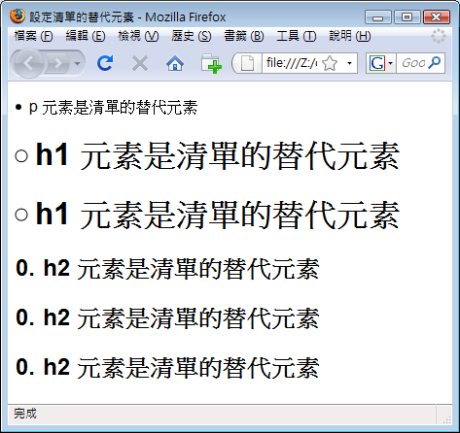
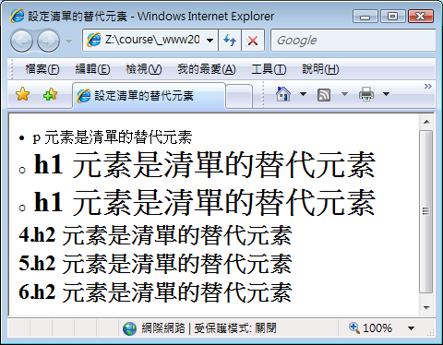
顯示成清單項目
display: list-item;
可指定任何元素，以清單方式顯示
p {display: list-item; … }
h1 {display: list-item; … }
h2 {
display: list-item;
list-style-type: decimal;
list-style-position: inside;
}
…
<h2>h2 元素是清單的替代元素</h2>
<h2>h2 元素是清單的替代元素</h2>
<h2>h2 元素是清單的替代元素</h2>

Slide 7
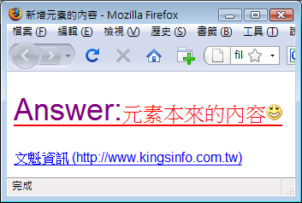
元素之內容屬性 (content)
content: 屬性值;
屬性值
[normal | <string> | <uri> | <counter> | attr(<identifier>)
|open-quote | close-quote | no-open-quote | no-close-quote ]+
p:before {content: "Answer:";
font-size: 36px;
color: purple;}
p:after {content: url(smile.gif);}
a[href]:after {content: " (" attr(href) ")";}
…
<p>元素本來的內容</p>
<a href="http://www.kingsinfo.com.tw">文魁資訊</a>

Slide 8
設定清單編號號碼
設定起始號碼(重新開始編號)
使用counter-reset屬性
屬性值 [<identifier> <integer>?]+ | none
<identifier>為自訂的counter name
<integer> 為counter起始值
設定編號增加量
使用counter-increment屬性
屬性值 [<identifier> <integer>?]+ | none
<identifier>為自訂的counter name
<integer> 為每次增加量

Slide 9
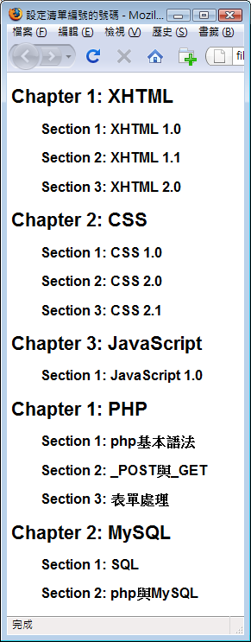
div {counter-reset : chapter;}
h1:before { counter-increment : chapter;
content : "Chapter " counter(chapter) ": "
}
h2:before { counter-increment : section;
content : "Section " counter(section) ": "
}
h1 {counter-reset : section;}
<div >
<h1>XHTML</h1>
<h2>XHTML 1.0</h2>
<h2>XHTML 1.1</h2>
<h2>XHTML 2.0</h2>
<h1>CSS</h1>
<h2>CSS 1.0</h2>
<h2>CSS 2.0</h2>
<h2>CSS 2.1</h2>
<h1>JavaScript</h1>
<h2>JavaScript 1.0</h2>
</div>
<div>
<h1>PHP</h1>
<h2>php基本語法</h2>
<h2>_POST與_GET</h2>
<h2>表單處理</h2>
<h1>MySQL</h1>
<h2>SQL</h2>
<h2>php與MySQL</h2>
</div>

