Slide 1
定位的CSS樣式

Slide 2
CSS之正常排版
文字與Inline元素由上而下、由左而右依序排列
區塊元素由上而下排列，左右空間被區塊元素整個佔住
每個元素位置變動，將影響周遭元素位置
以上可使用CSS定位相關屬性加以控制改變

Slide 3
float屬性
float屬性用來設定元素浮動的位置
left | right | none

Slide 4
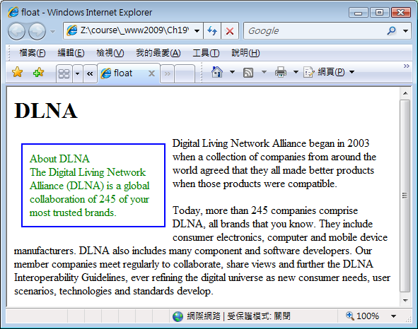
p#about {float:left;
width:180px;
padding: 10px;
margin: 10px;
color: green;
border: 2px solid blue;
}
<p id="about">
About DLNA<br />
The Digital Living Network Alliance (DLNA) …
</p>
<p id="intro">
Digital Living Network Alliance began in 2003 when a collection of companies from around the world agreed that they all made better products when those products were compatible.
</p>
<p id="overview">
Today, more than 245 companies comprise DLNA, all brands that you know. They include consumer electronics, computer …
</p>

Slide 5
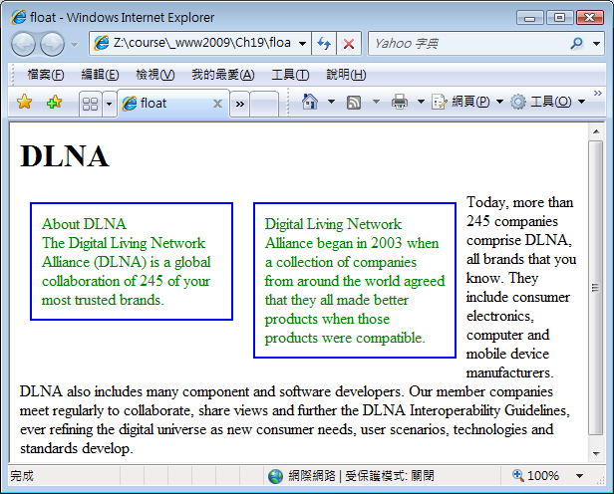
p#about, p#intro {
float:left;
width:180px;
padding: 10px;
margin: 10px;
color: green;
border: 2px solid blue;
}

Slide 6
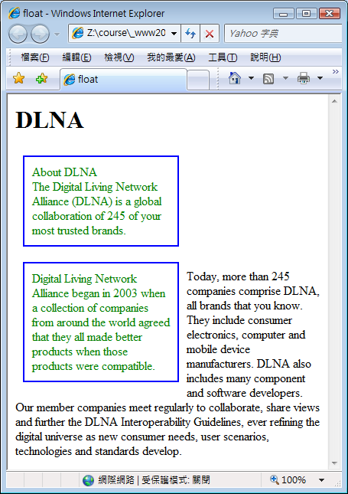

Slide 7
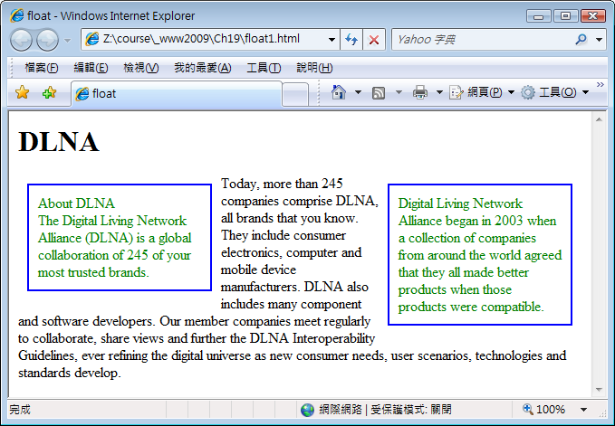
p#about {
float:left;
width:180px;
padding: 10px;
margin: 10px;
color: green;
border: 2px solid blue;
}
p#intro {
float:right;
width:180px;
padding: 10px;
margin: 10px;
color: green;
border: 2px solid blue;
}

Slide 8
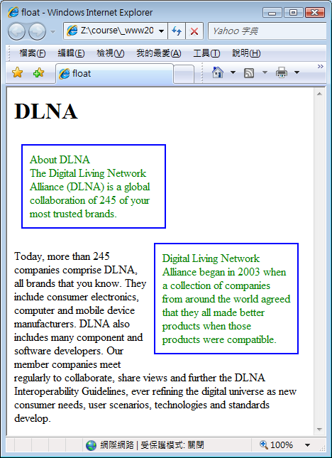

Slide 9
清除浮動元素
使用clear屬性
屬性值 left | right | both | none
浮動在(left | right | both)邊之浮動元素，在其後面使用clear屬性之區塊元素，恢復正常排版。
只適用於區塊元素

Slide 10
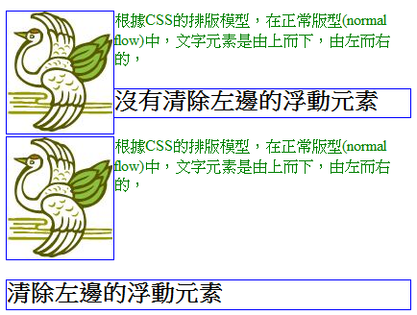
<p>
<img src="bird.jpg" alt="" style="float: left;" />
根據CSS的排版模型，在正常版型(normal flow)中，文字元素是由上而下，由左而右的，
</p>
<h2>沒有清除左邊的浮動元素</h2>
<p>
<img src="bird.jpg" alt="" style="float: left;" />
根據CSS的排版模型，在正常版型(normal flow)中，文字元素是由上而下，由左而右的，
</p>
<h2 style="clear: left;">清除左邊的浮動元素</h2>

Slide 11
設定定位類型
position屬性
static | relative | absolute | fixed
static (靜態): 依照出現順序排列(預設)
relative (相對):
新位置相對於原來排版之位置，移動一個相對位置
但原始空間仍保留。
absolute (絕對):
新位置相對於其包容區塊(該包容區塊亦需定位，即包容區塊也需設定position屬性)
元素從原排版抽離
fixed (固定):
新位置相對於瀏覽器視窗
元素從原排版抽離

Slide 12
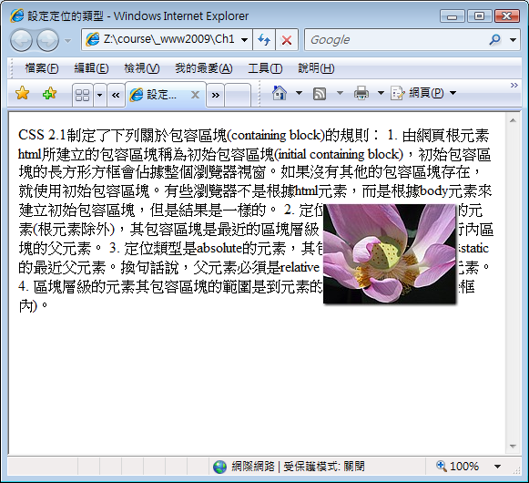
設定元素位置
top
right
bottom
left
<img src="lily.jpg" alt="" style="position: fixed; right: 50px; top: 100px;" />

Slide 13
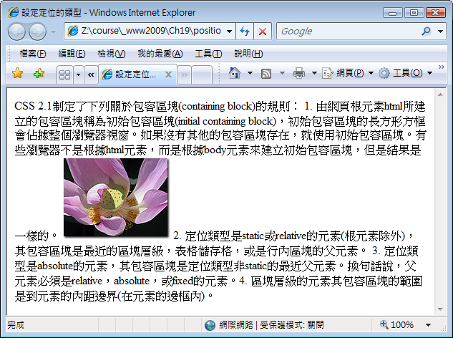
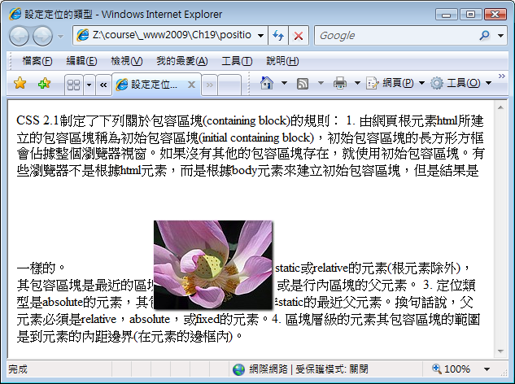
relative
<img … style="position: relative; left: 100px; top: 50px;"/>

Slide 14
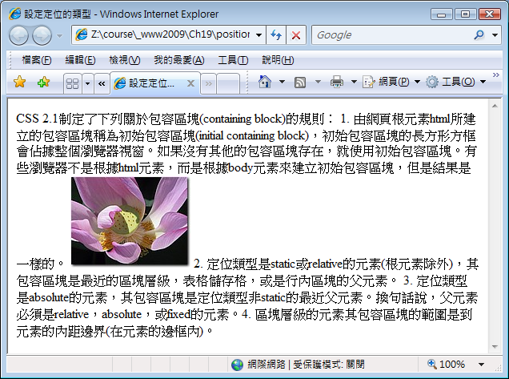
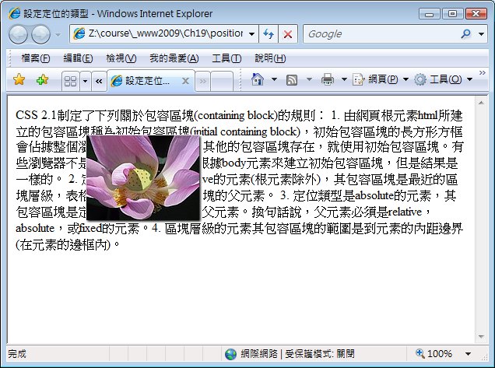
absolute
<img … style="position: absolute; left: 100px; top: 50px;" />

Slide 15
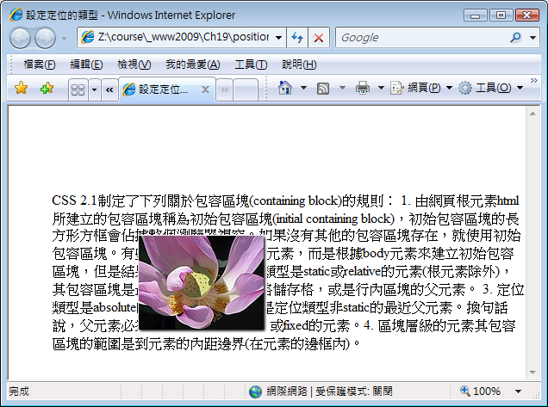
<div style="position: absolute; left: 50px; top: 100px;">
…
<img … style="position: absolute; left: 100px; top: 50px;" />
…
</div>

Slide 16
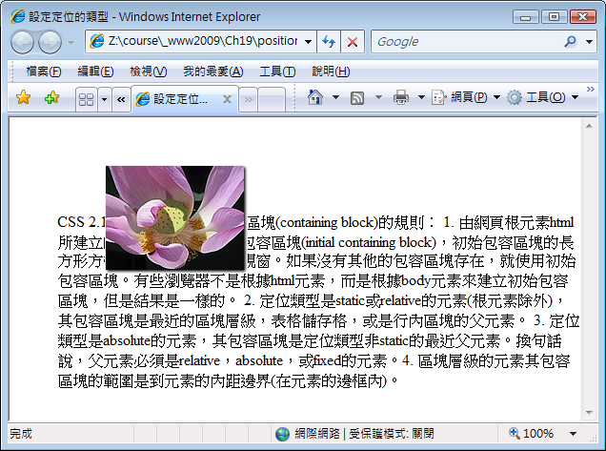
fixed
<div style="position: absolute; left: 50px; top: 100px;">
…
<img … style="position: fixed; left: 100px; top: 50px;" />
…
</div>

Slide 17
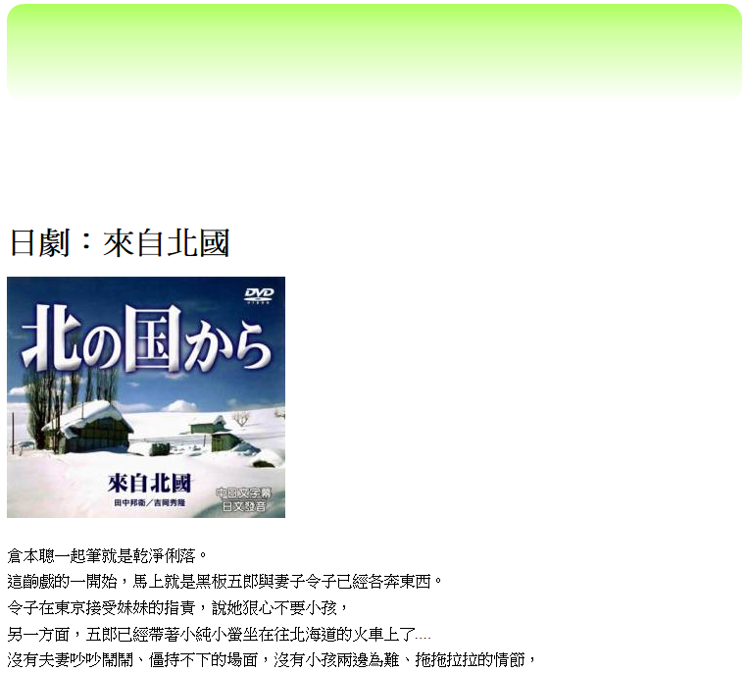
https://ycchen.im.ncnu.edu.tw/www2011/lab/position.zip
#tbg {
position: absolute;
top: 0px;
left: 0px;
z-index:-1;
}
#north {
width: 150px;
position: absolute;
bottom: 20px;
right: 20px;
}
<div id="content">
<img id="tbg" src="tbg.png" />
<h1>日劇：來自北國</h1>
<img id="north" src="north.jpg" />
<p>
倉本聰一起筆就是乾淨俐落。<br/>
…
</div>

Slide 18
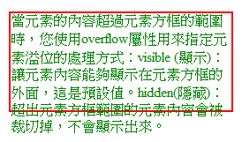
元素溢位處理方式
<div style="height: 110px; width: 250px;">
當元素的內容超過元素方框的範圍時，您使用overflow屬性用來指定元素溢位的處理方式：…
</div>
overflow
overflow屬性
visible | hidden | scroll | auto

Slide 19
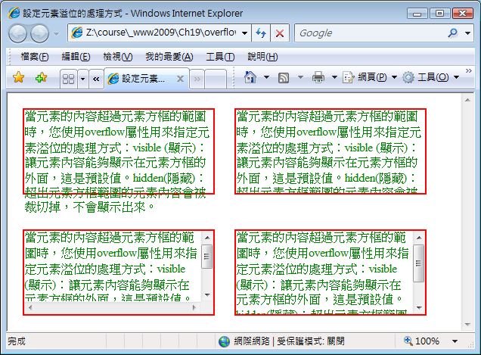
overflow: visible;
overflow: hidden;
overflow: scroll;
overflow: auto;

Slide 20
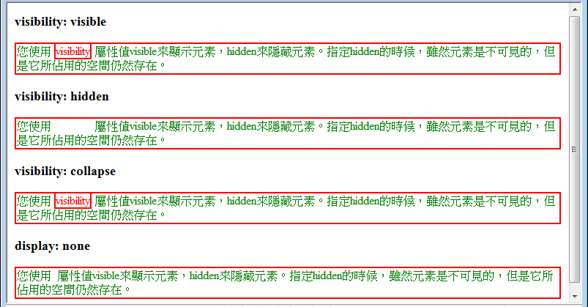
顯示與隱藏元素
visibility:
visible | hidden | collapse
<span style="visibility: hidden;">visibility</span>
➔ 適用於表格

Slide 21
display屬性
display:
inline | block | inline-block | list-item | none | contents | flex | grid | inline-flex | inline-grid | inline-table | run-in | compact | marker | table | table-row-group | table-header-group | table-footer-group | table-row | table-column-group | table-column | table-cell | table-caption
RWD: Responsive Web Design
https://www.w3schools.com/html/html_responsive.asp

Slide 22
Value | Description
inline | Displays an element as an inline element (like <span>). Any height and width properties will have no effect
block | Displays an element as a block element (like <p>). It starts on a new line, and takes up the whole width
contents | Makes the container disappear, making the child elements children of the element the next level up in the DOM
flex | Displays an element as a block-level flex container
grid | Displays an element as a block-level grid container
inline-block | Displays an element as an inline-level block container. The element itself is formatted as an inline element, but you can apply height and width values
inline-flex | Displays an element as an inline-level flex container
inline-grid | Displays an element as an inline-level grid container
inline-table | The element is displayed as an inline-level table
list-item | Let the element behave like a <li> element
run-in | Displays an element as either block or inline, depending on context
table | Let the element behave like a <table> element
table-caption | Let the element behave like a <caption> element
table-column-group | Let the element behave like a <colgroup> element
table-header-group | Let the element behave like a <thead> element
table-footer-group | Let the element behave like a <tfoot> element
table-row-group | Let the element behave like a <tbody> element
table-cell | Let the element behave like a <td> element
table-column | Let the element behave like a <col> element
table-row | Let the element behave like a <tr> element
none | The element is completely removed
initial | Sets this property to its default value.
inherit | Inherits this property from its parent element.

Slide 23
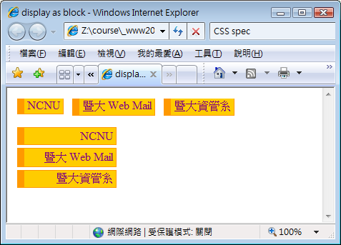
a {width:120px;
text-align:right;
margin:4px;
padding: 2px 4px 2px;
text-decoration: none;
border: #f90 solid 1px;
border-left-width: 10px;
background-color: #fc0;
}
.menu a {
display: block;
}
<p>
<a href="http://www.ncnu.edu.tw/">NCNU</a>
<a href="https://webmail.ncnu.edu.tw/">暨大 Web Mail</a>
<a href="http://www.im.ncnu.edu.tw/">暨大資管系</a>
</p>
<div class="menu">
<a href="http://www.ncnu.edu.tw/">NCNU</a>
<a href="https://webmail.ncnu.edu.tw/">暨大 Web Mail</a>
<a href="http://www.im.ncnu.edu.tw/">暨大資管系</a>
</div>

Slide 24
inline, block, inline-block
inline
寬度(width)由內容決定，無法設定width屬性
Block
預設寬度為由左而右佔滿的空間寬度
可以設定寬度(width)，但仍維持區塊特性
inline-block
預設寬度由內容決定
可以設定寬度(width)，但仍維持行內特性

Slide 25
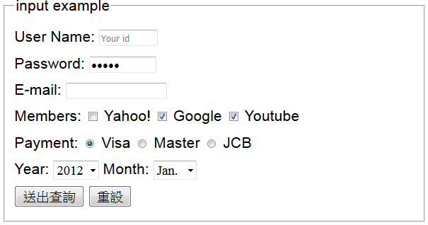
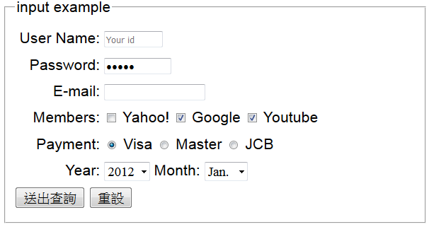
User Name:
<input type="text" id="uid" name="uid" size="10" maxlength="20" placeholder="Your id" /><br />
Password:
<input type="password" id="pwd" name="pwd" size="12" maxlength="20" /><br />
<span class="frmTxt">User Name:</span>
<input type="text" id="uid" name="uid" size="10" maxlength="20" placeholder="Your id" /><br />
<span class="frmTxt">Password:</span>
<input type="password" id="pwd" name="pwd" size="12" maxlength="20" /><br />
.frmTxt {
display: inline-block;
width:120px;
text-align: right;
}
display: inline-block;

Slide 26
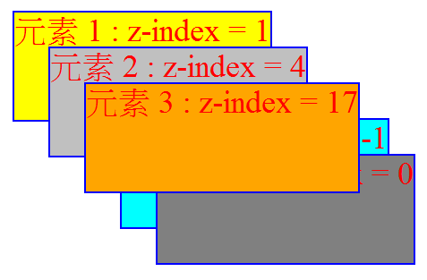
設定元素堆疊順序
z-index屬性
z-index值越高者，堆疊越上面
p { border: 2px solid blue;
color: red;
font-size: 36px;
position: absolute;
height: 120px;
}
<p style="z-index: 1; top: 20px; left: 20px; background-color: yellow;">元素 1 : z-index = 1
</p>

Slide 27
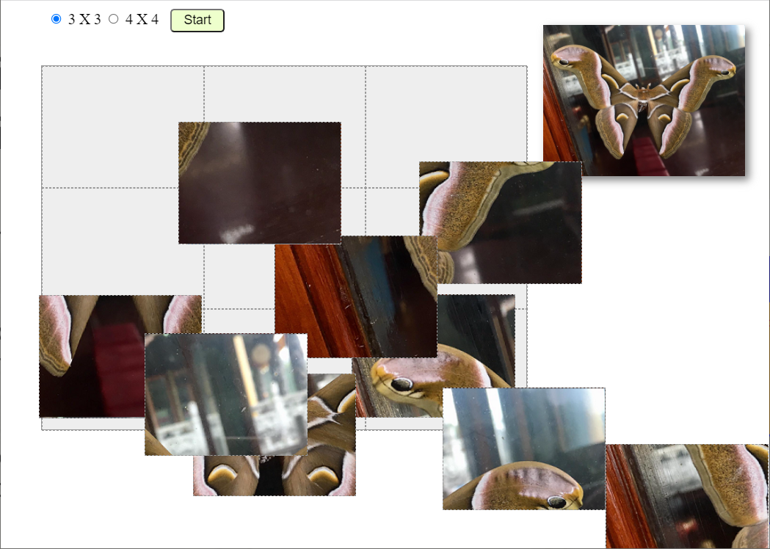
https://ycchen.im.ncnu.edu.tw/moth/puzz.html?2

