Slide 1
HTML 5 & JavaScript
canvas
Audio/Video
What's New in ECMAScript 6
HTML Geolocation API

Slide 2
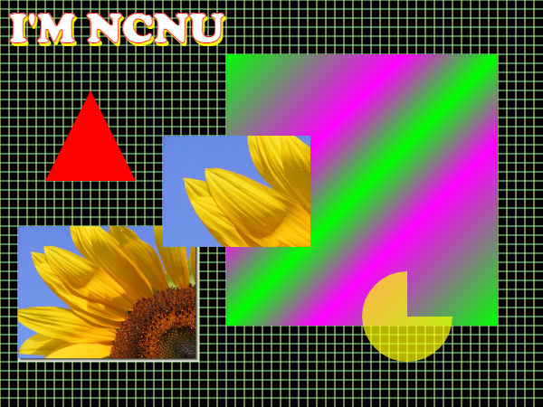
canvas
https://www.w3schools.com/tags/ref_canvas.asp
<canvas id="cv" width="600" height="450"> </canvas>
cv=document.getElementById("cv");
var ct = cv.getContext("2d");
ct.fillStyle="black";
ct.fillRect(0, 0, 600, 450);
…
ct.beginPath();
ct.moveTo(100,100);
ct.lineTo(150,200);
ct.lineTo(50,200);
ct.lineTo(100,100);
ct.fillStyle="red";
ct.fill();
img = new Image();
img.src="sf033.jpg";
ct.drawImage(img, 20,250, 200,150);

Slide 3
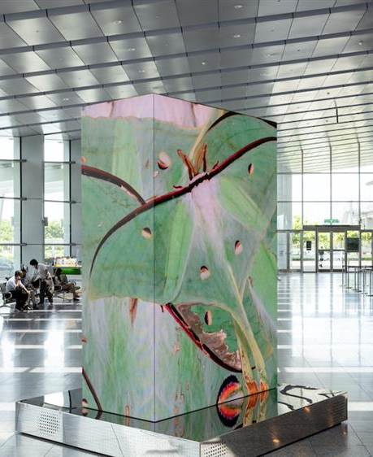
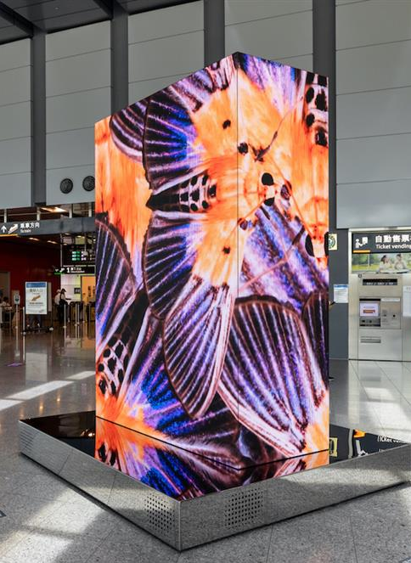
https://www.wowlavie.com/article/ae2200969
高鐵「寶島隨身聽」光體藝術展演

Slide 4

https://ycchen.im.ncnu.edu.tw/moth/canvas.html?CC6 https://ycchen.im.ncnu.edu.tw/moth/canvas.html?c9
cv=document.getElementById("cv");
ctx=cv.getContext("2d");
…
ctx.fillStyle="black";
ctx.fillRect(0,0,w-1,h-1);
ctx.shadowColor = "black";
ctx.shadowBlur = 5;
ctx.shadowOffsetX = 5;
ctx.shadowOffsetY = 5;
for (let i=0;i<num;i++) {
  var x=intRandom(-iw, w-1);
  var y=intRandom(-ih, h-1);
  var d=intRandom(0, 360);
  ctx.save();
  ctx.rotate(d * Math.PI / 90);
  ctx.drawImage(img,0,0,iw,ih,x,y,iw*rate,ih*rate);
  ctx.restore();
}

Slide 5
<audio> (HTML 5)
<audio src="Dreams.ogg" controls autoplay loop preload> Audio
</audio>
<audio id="song" preload="auto" >
<source src="Dreams.ogg" type="audio/ogg" />
<source src="Dreams.mp3" type="audio/mpeg" />
</audio>

Slide 6
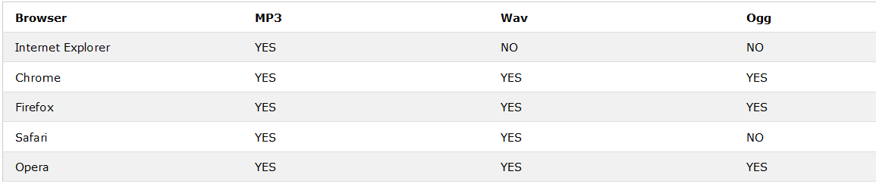
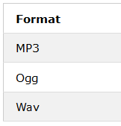
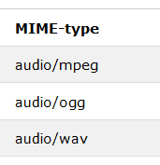
Audio Formats
https://www.w3schools.com/html/html5_audio.asp

Slide 7
Properties
src
volume 0 ~ 1
duration seconds
currentTime seconds
controls true | false
autoplay true | false
seeking true | false
paused true | false
muted true | false
ended true | false

Slide 8
Methods
load()
play()
pause()
canPlayType("audio/subtype")
Reference:
http://www.w3schools.com/tags/ref_av_dom.asp

Slide 9
<head>
<script type="text/javascript">
var s1;
window.onload = function() {
s1 = document.getElementById("song1");
...
}
s1.play();
s1.pause();
s1.controls = true;
s1.currentTime= 17.5;
s1.volume = 0.5;
</script>
</head>
<body>
...
<audio id="song1" src="dreams.ogg"></audio>
...
</body>
</html>

Slide 10
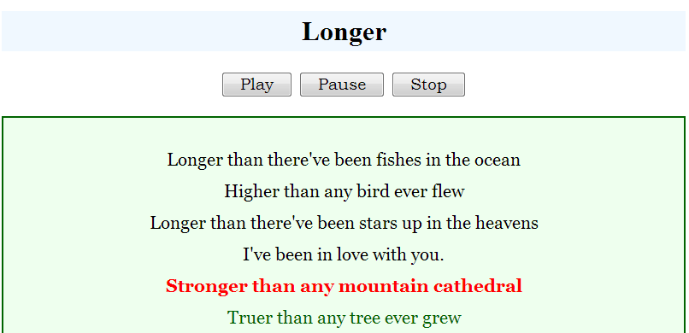
Example
http://ycchen.im.ncnu.edu.tw/www2011/lab/audio/TimeRec.html
http://ycchen.im.ncnu.edu.tw/www2011/lab/audio/ans/Longer.html
http://ycchen.im.ncnu.edu.tw/www2011/lab/audio/ans/SoS.html

Slide 11
<video> (HTML 5)
<video id="video1" width="420">
<source src="mov_bbb.mp4" type="video/mp4">
<source src="mov_bbb.ogg" type="video/ogg">
Your browser does not support HTML5 video.
</video>
<video id="video1" width="420" controls loop autoplay preload>
…
</video>
https://www.w3schools.com/html/tryit.asp?filename=tryhtml5_video_js_prop

Slide 12
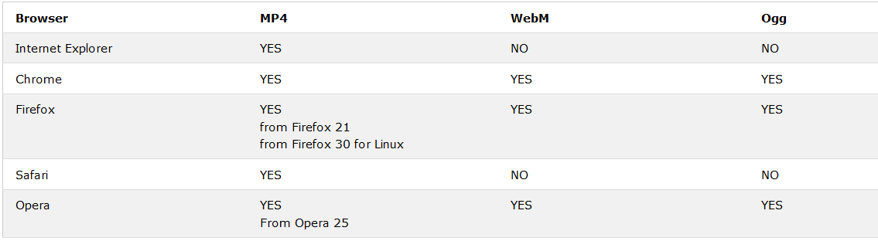
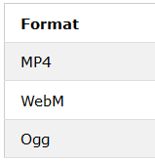
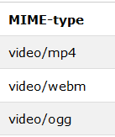
Video Formats
https://www.w3schools.com/tags/tag_video.asp

Slide 13
References
HTML5 Audio
    http://w3schools.com/html/html5_audio.asp
HTML5 Video
  http://w3schools.com/html/html5_video.asp
格式工廠
  http://www.pcfreetime.com/CN/download.html

Slide 14
HTML Geolocation API
https://www.w3schools.com/html/html5_geolocation.asp
var x = document.getElementById("demo");
function getLocation() {
if (navigator.geolocation) {
navigator.geolocation.getCurrentPosition(showPosition);
} else {
x.innerHTML = "Geolocation is not supported by this browser.";
}
}
function showPosition(position) {
x.innerHTML = "Latitude: " + position.coords.latitude +
"<br>Longitude: " + position.coords.longitude;
}

Slide 15
navigator.geolocation.getCurrentPosition(success, error, options)
function success(pos) {
//get position from pos
…
}
function error(err) {
//get error from err
…
}
var options = {
enableHighAccuracy: true,
timeout: 5000,
maximumAge: 0
};

Slide 16
Displaying the Result in a Map
function showPosition(position) {
var latlon = position.coords.latitude + "," + position.coords.longitude;
var img_url =
"https://maps.googleapis.com/maps/api/staticmap?center=" +
latlon+"&zoom=14&size=400x300&sensor=false&key=YOUR_KEY";
document.getElementById("mapholder").innerHTML =
"<img src='"+img_url+"'>";
}
…
<div id="mapholder"></div>
Get an API Key:
https://developers.google.com/maps/documentation/javascript/get-api-key?hl=zh_TW

