Slide 1
XAMPP Installation
Yen-Cheng Chen
IM, NCNU

Slide 2
XAMPP
https://www.apachefriends.org/zh_tw/index.html
XAMPP Download
https://www.apachefriends.org/zh_tw/download.html
XAMPP Windows版本 Download
https://sourceforge.net/projects/xampp/files/XAMPP%20Windows/8.2.12/xampp-windows-x64-8.2.12-0-VS16-installer.exe
https://ycchen.im.ncnu.edu.tw/xampp-windows-x64-8.2.12-0-VS16-installer.exe

Slide 3
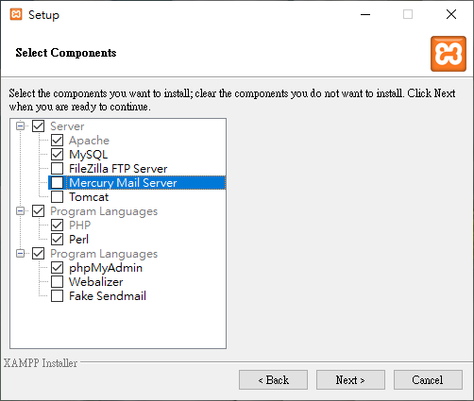

Slide 4
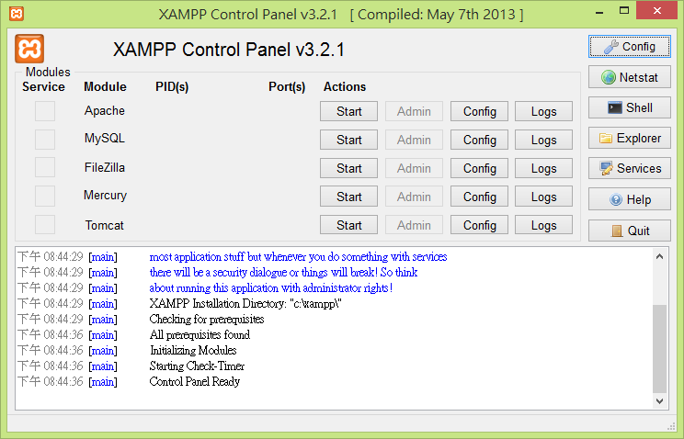
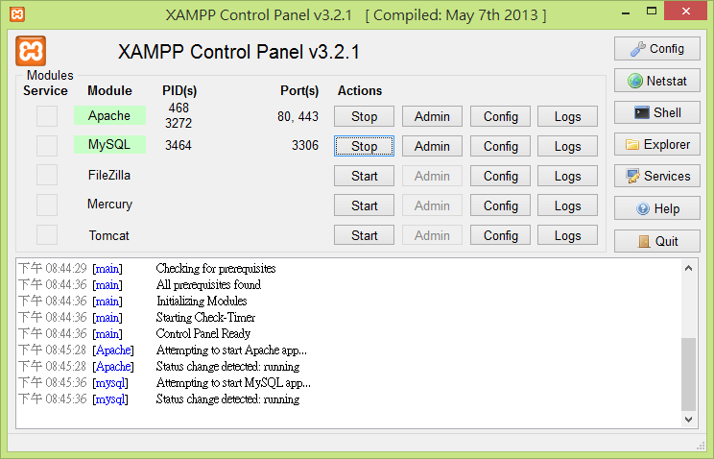
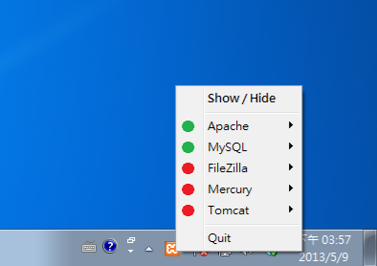
1
2
3

Slide 5
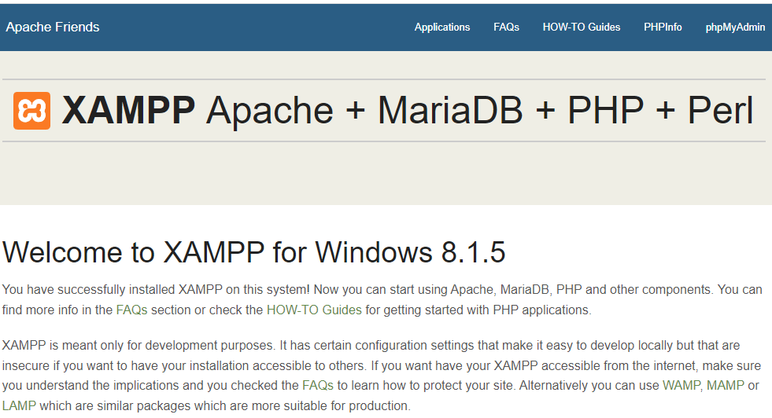
XAMPP
http://localhost/ or http://localhost/dashboard/

Slide 6
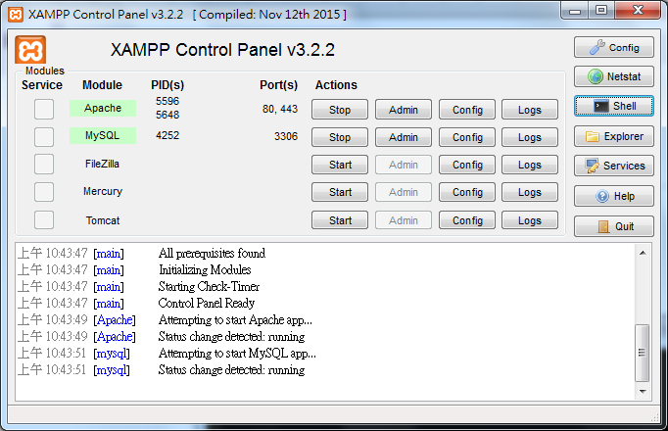
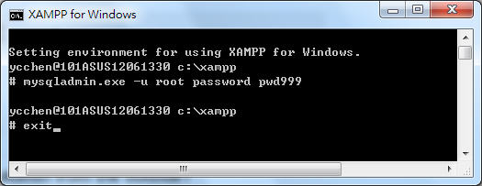
設定MySQL root密碼
mysqladmin.exe -u root password yourpassword

Slide 7
手動設定MySQL root密碼
如果沒有設定root密碼畫面
cd C:\xampp\mysql\bin
mysqladmin -u root password rootpwd
變更密碼:
mysqladmin -u root -p password newpwd
Enter password: oldpwd

Slide 8
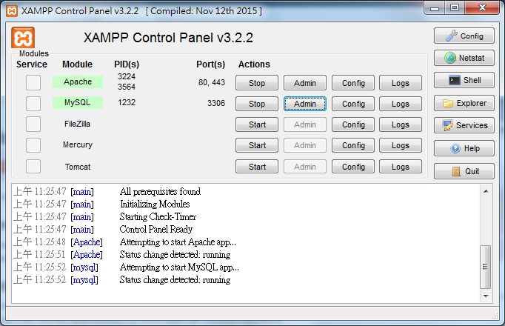
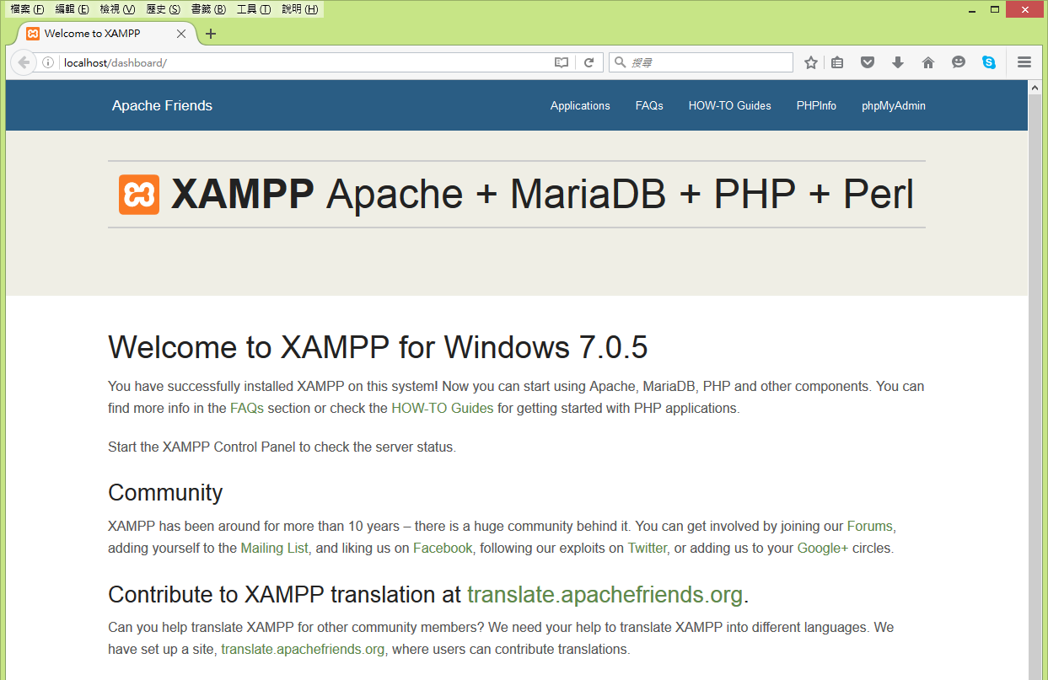
phpMyAdmin
未設定登入MySQL帳密！

Slide 9
設定phpMyAdmin 登入MySQL帳密
修改phpMyAdmin之config.inc.php
檔案位置 C:\xampp\phpMyAdmin
在config.inc.php找到以下指令進行修改
$cfg['Servers'][$i]['auth_type'] = 'config';
$cfg['Servers'][$i]['user'] = 'root';
$cfg['Servers'][$i]['password'] = 'yourpassword';

Slide 10
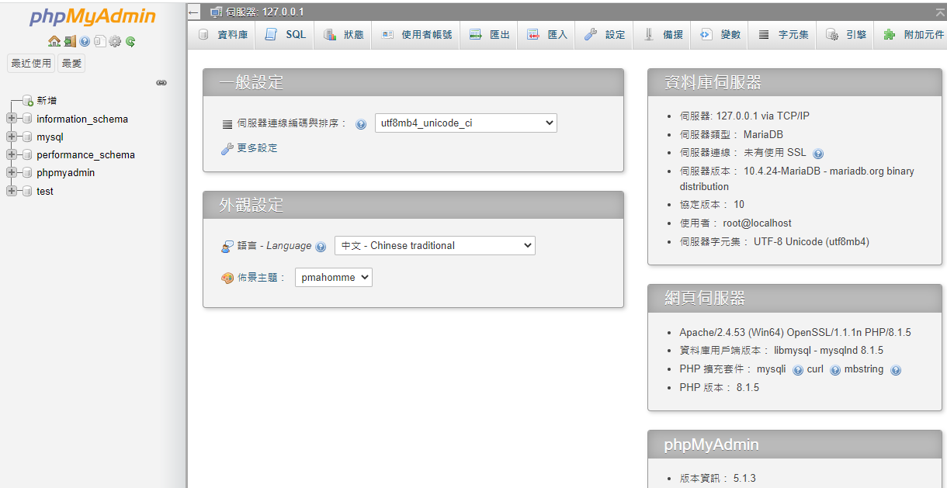

Slide 11
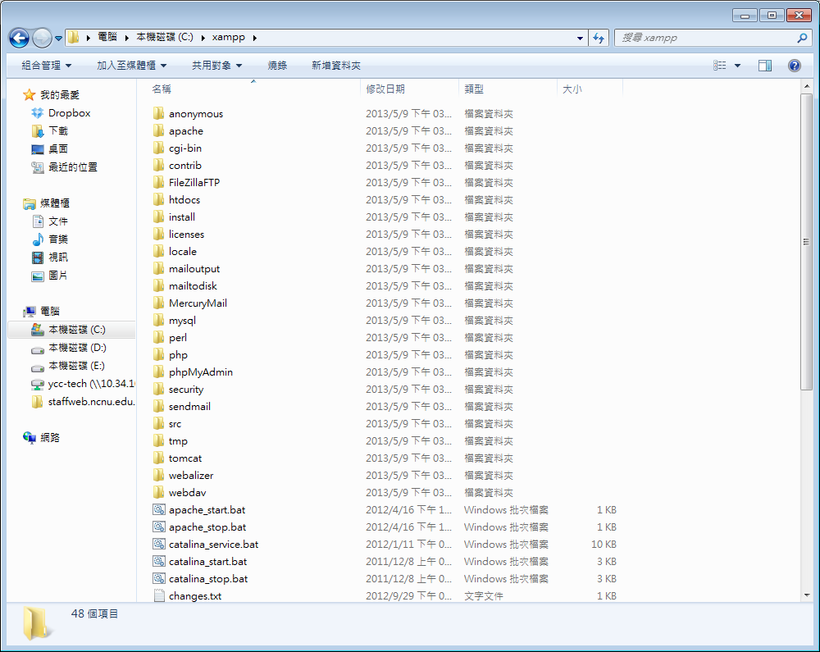
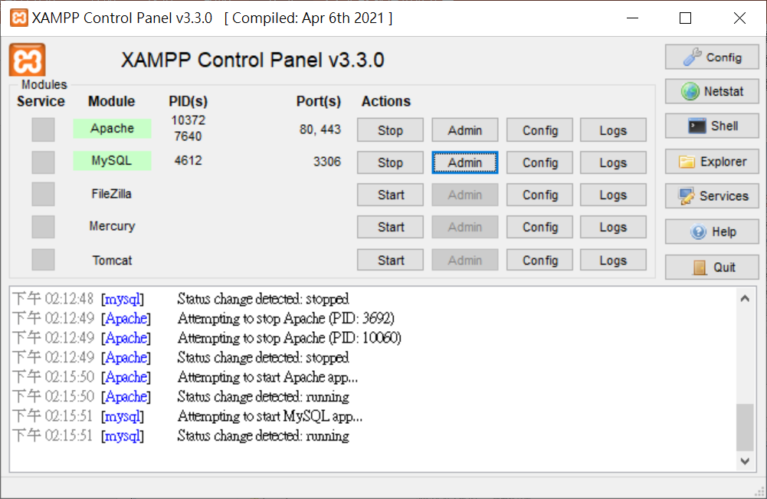

Slide 12
XAMPP目錄
C:\xampp
網站主目錄
C:\xampp\htdocs
Apache組態檔
C:\xampp\apache\conf\httpd.conf
php組態檔
C:\xampp\php\php.ini
phpMyAdmin
C:\xampp\phpMyAdmin\config.inc.php
MySQL
C:\xampp\mysql

Slide 13
PHPInfo

Slide 14
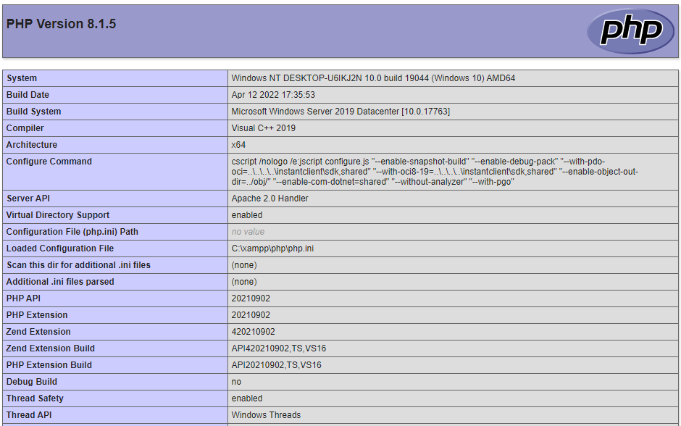

Slide 15
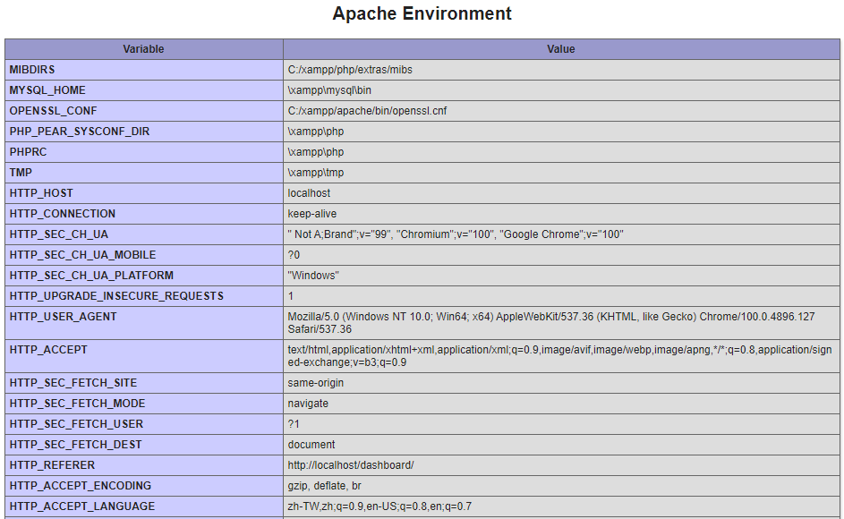

Slide 16
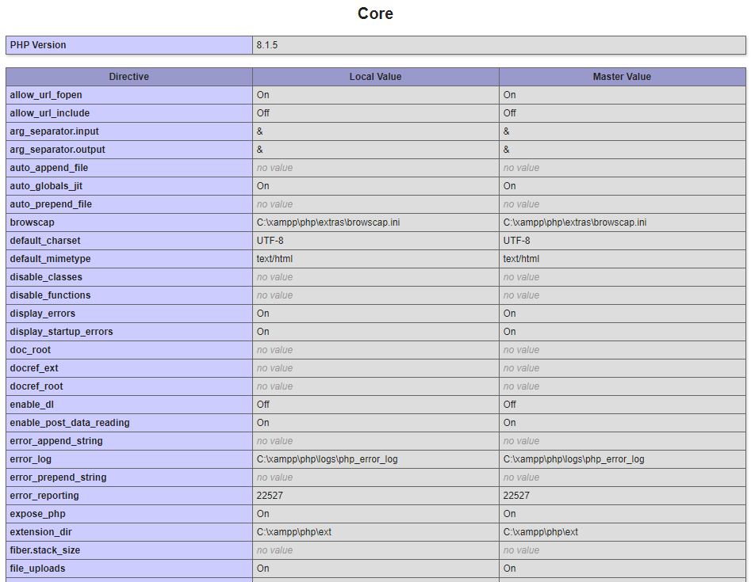

Slide 17
